Slide 1
Grid connections for
Energy Security in ASEAN
Dr Nuki Agya Utama, ACE Executive Director
2020 APERC Online Energy Security Workshop, 10 September 2020

Slide 2

Energy Landscape
With a continuously growing demand, ensuring the availability of energy sources will be a key in sustaining ASEAN’s collective growth as a region.
The historical energy supply is still fossil-fuel based, dominated by oil with a growing proportion of coal.
While ASEAN is showing growing reliance on fossil fuels, the ability to supply this energy domestically depends on its local reserves, and production.
The lower of local fossil fuel resources, comparing to other regions, continues to put pressure on regional energy security, with the total energy import dependency of ASEAN at 40% in 2017.
CAGR 2.5%,
From 2005 to 2017, 35%
CAGR 4.7%
From 2005 to 2017, 73%
Imported Oil
Imported Coal
Imported NG
One Community for Sustainable Energy
2

Slide 3
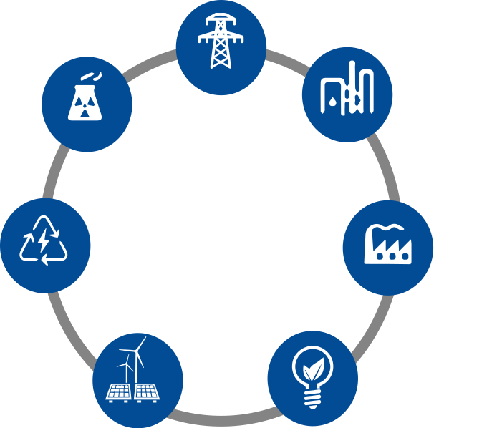


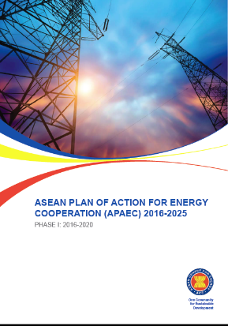
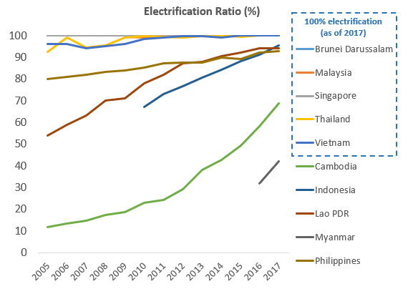

ASEAN Plan of Action for Energy Cooperation (APAEC ) 2016-2025: Phase I 2016 – 2020 and Phase II 2021 – 2025
“Enhancing Energy Connectivity and Market Integration in ASEAN to Achieve Energy Security, Accessibility, Affordability and Sustainability for All”
ASEAN Power
Grid (APG)
Development of APAEC Phase II: 2021-2025
ASEAN has engaged the ASEAN DPs and IOs during the 37th SOME last year.
80% of generation from fossil fuel
Civilian Nuclear Energy
(CNE)
Trans-ASEAN Gas Pipeline (TAGP)
Identified new areas of collaboration including:
  Multilateral power trade with greater integration of RE sources;
  Future of cooling and establishing green buildings codes;
  Capacity building in investments and financing in energy infrastructure;
  Deployment of LNG; and
  Emerging trends such as hydrogen and CCUS
Clean Coal Technology
(CCT)
Regional Energy Policy and Planning
(REPP)
Electricity Accessibility
5 AMS are still not reach 100% Electrification.
Energy Efficiency
& Conservation
(EE&C)
Final report is currently being finalised and will seek endorsement at the 38th AMEM in November 2020.
Renewable Energy (RE)
One Community for Sustainable Energy
3
Notes:
Increased power system connectivity through the APG offers several potential benefits for AMS. It can enable more efficient use of resources, enhance grid stability and service in remote areas, and improve the region’s energy security as electricity demands and end uses grow. The APG can also support better utilization of renewable energy resources, furthering clean energy and climate protection goals.

Slide 4
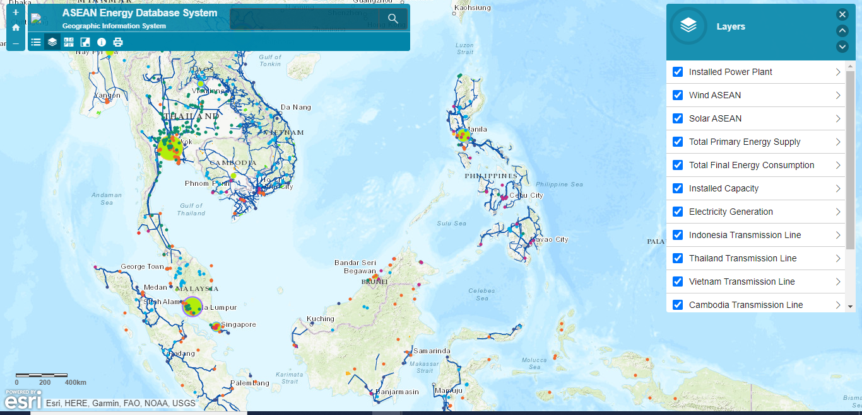
ASEAN Energy Database System
Geographical Information System
Source: http://aseanenergy.maps.arcgis.com/apps/View/index.html

Slide 5
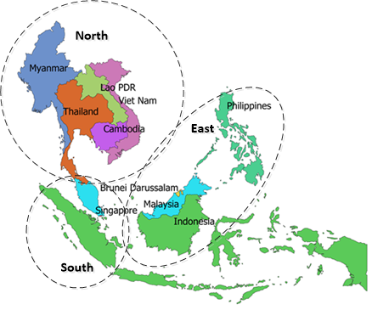
APG Subregions
The Heads of ASEAN Power Utilities/Authorities (HAPUA) and ACE have investigated these possibilities in a series of ASEAN Interconnection Masterplan Studies (AIMS).
The AIMS projects have evaluated the potential for cross-border electricity trade, regional costs and benefits, and exploring the link between the APG and more ambitious renewable energy targets.
Leveraging the improved connectivity, power trade among AMS has grown substantially. Over the last 15 years, trade has increased more than five-fold. Power exports from Lao PDR to Thailand (APG-North) have made up an important and growing share of this amount (AEO6).
At present, most electricity trade within the APG occurs through bilateral agreements. But there isa pilot multilateral trading in Lao PDR-Thailand-Malaysia-Singapore Power Integration Project (LTMS-PIP).
Notes:
At present, most electricity trade within the APG occurs through bilateral agreements. However, since 2018 there has been a small demonstration of multilateral trading in the Lao PDR-Thailand-Malaysia-Singapore Power Integration Project (LTMS-PIP). Conceived as a pilot and an opportunity to address technical, legal, and financial issues raised by multilateral trade, LTMS-PIP is premised on wheeling up to 100 MW of supply from Lao PDR through Thailand (Lao PDR Ministry of Energy and Mines et al. 2014). Currently the power is delivered to Malaysia, although the intention is ultimately to connect to the market in Singapore. Through March 2019, 25 gigawatt-hours of electricity had been traded under the project (IEA 2019).

Slide 6
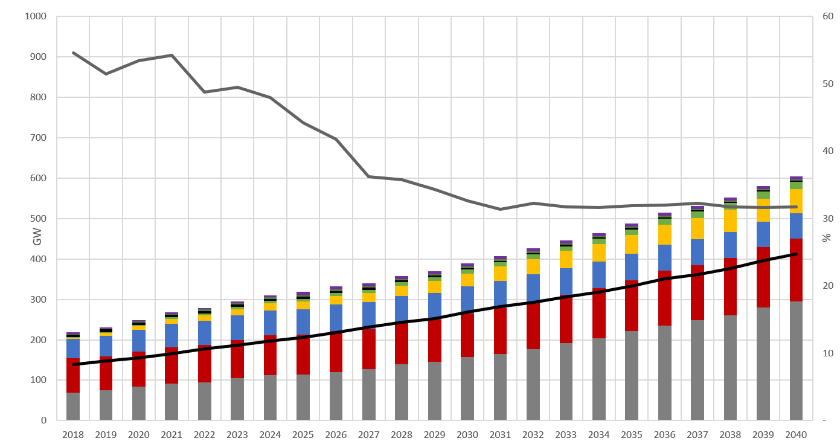
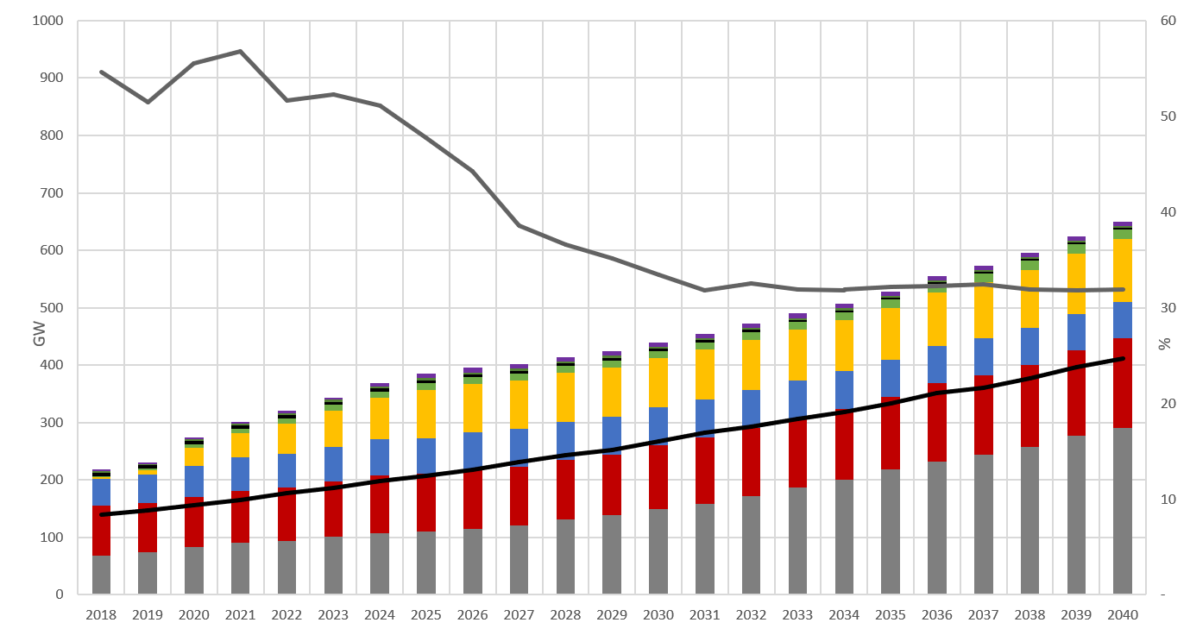
High potential RE to be installed, increasing regional energy security
Base Case: PDPs of all 10 AMS
APAEC RE Target: 23% RE in Energy Mix by 2025
Note: Significant additional amount of RE should be installed to achieve APAEC RE Target, but it’s possible based on the technical potential and also utilising the possible interconnections.

Slide 7




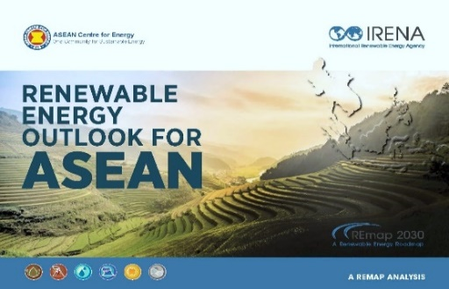
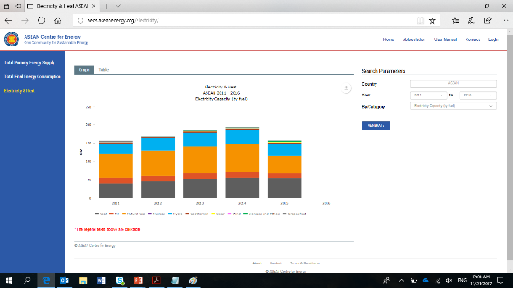
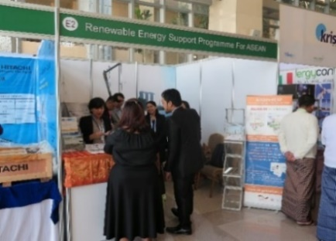
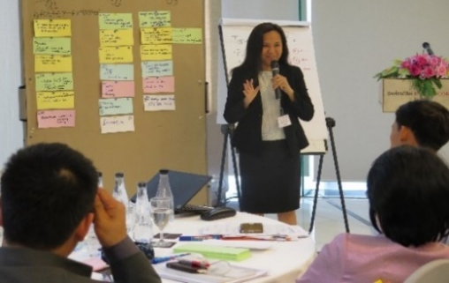
Introduction: ASEAN Centre for Energy (ACE)
Think Tank
Energy Data and Knowledge Hub
Catalyst
Identifying and surfacing innovative solutions
Unify and strengthen ASEAN Energy Cooperation and Integration
Provide a knowledge depository for AMS
Policies, Legal & Regulatory Frameworks and Technologies
Policy and Research Analytics
Energy Database
APAEC Activities, including with DPs/IOs
Secretariat
Research, publication, training, capacity building, workshop, policy exchange and recommendations, etc.
One Community for Sustainable Energy
7

Slide 8
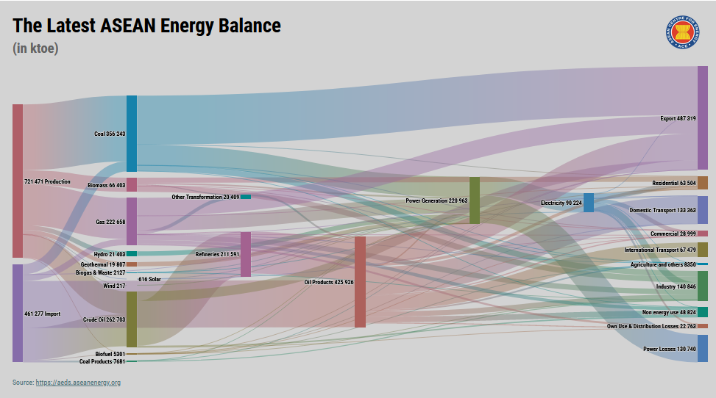
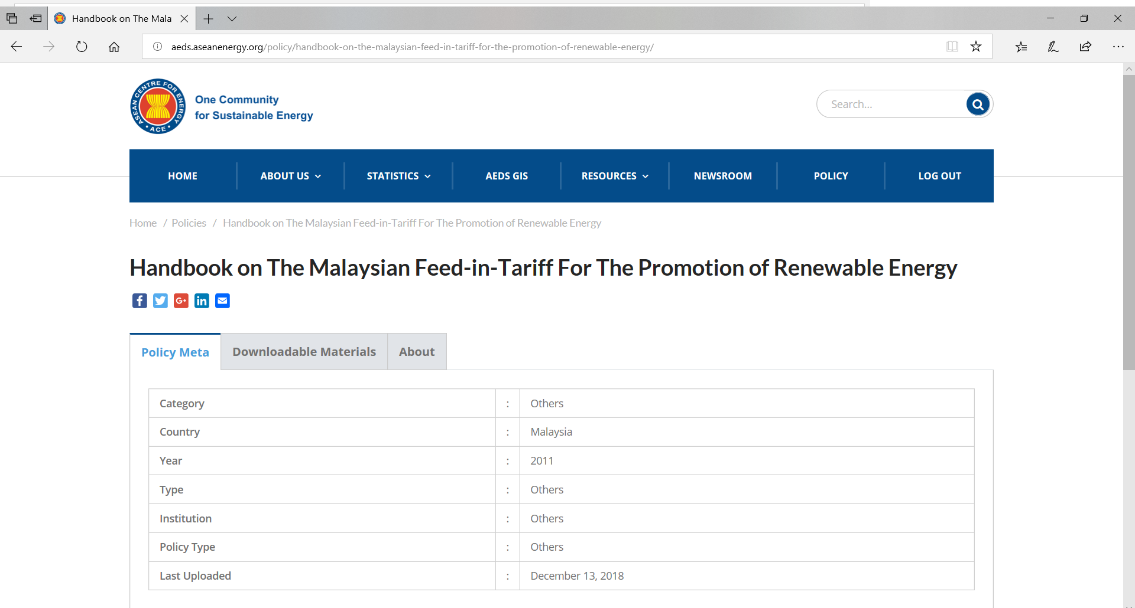
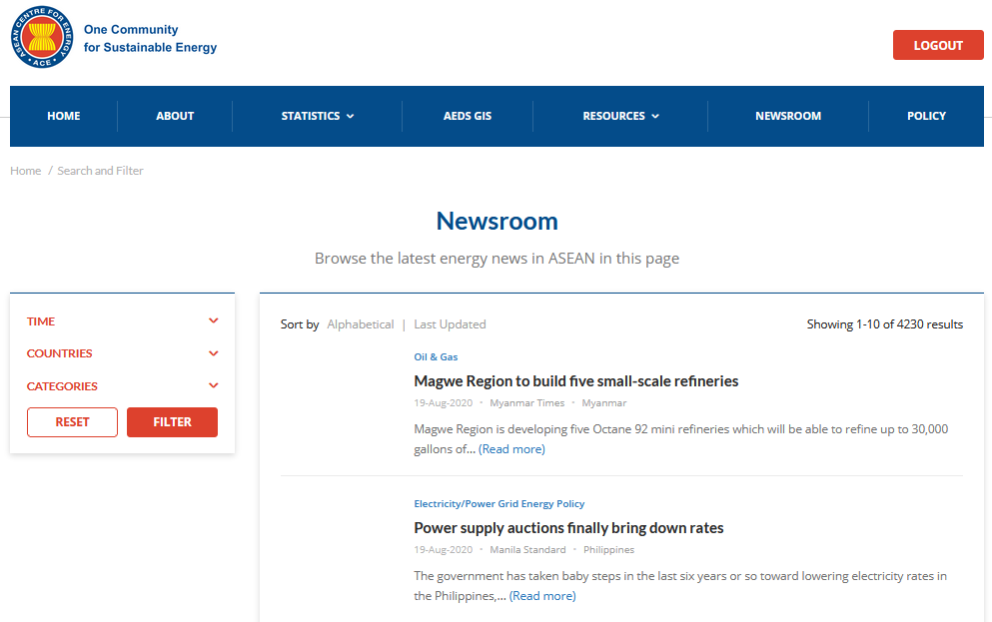
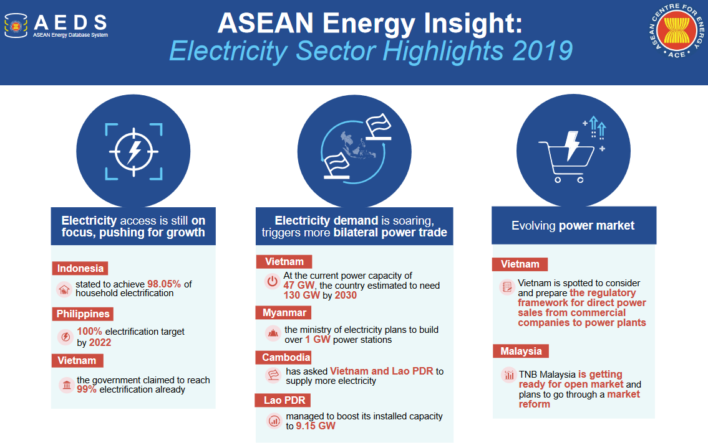
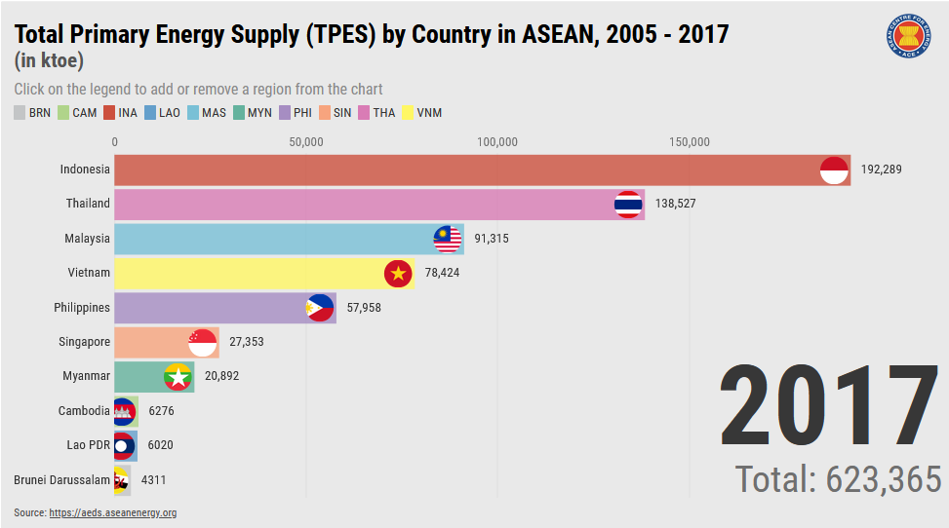
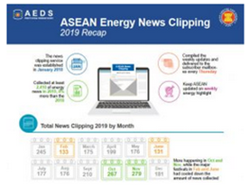
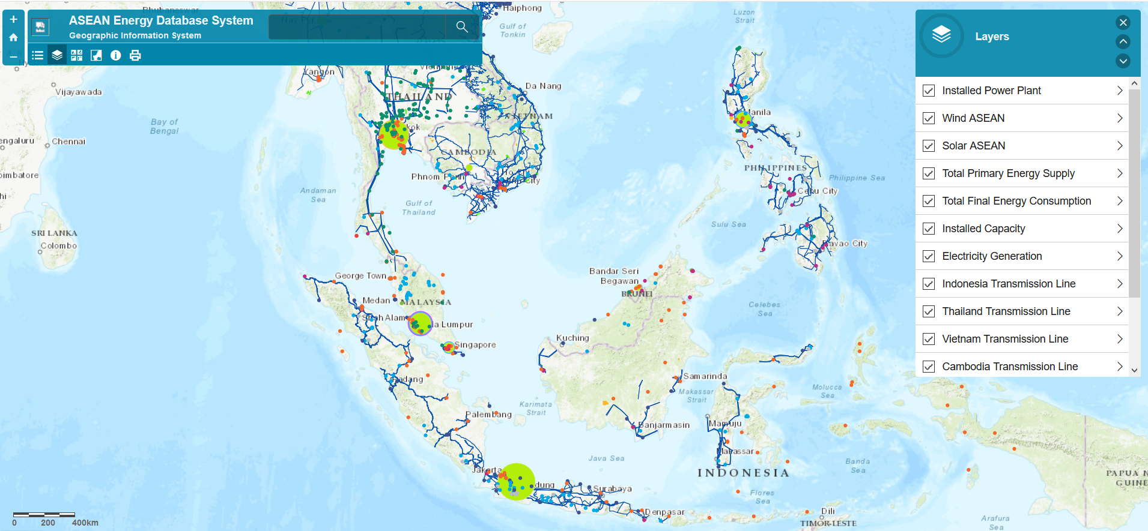
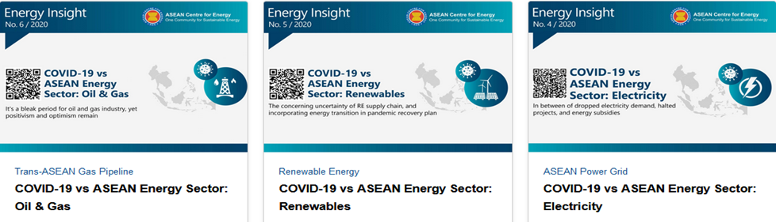

Regional Energy Policy and Planning
ACE develop the ASEAN Energy Data and Information that used as a web-based system of integrated and comprehensive ASEAN energy data and information that cover both regional and national levels.
Energy Data
Policies Database
Newsroom & Clipping
Energy Insight
GIS/Map
One Community for Sustainable Energy
8

Slide 9
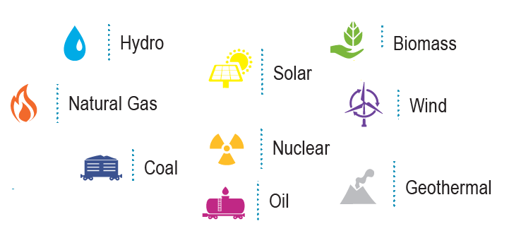
ASEAN Energy Goals
ASEAN - 10 Member States:
→ different economic level, different energy resources but has a collaborative goal as guided by APAEC.
All Fuel Options Policy
ASEAN Plan of Action for Energy Cooperation (APAEC) 2016-2025
“Enhancing Energy Connectivity and Market Integration in ASEAN to Achieve Energy Security, Accessibility, Affordability and Sustainability for All”.

Slide 10
Wrap Up Points
  The on-going AIMS III study will set out the interconnection infrastructure needed to enable expanded power trade as well as integrate higher shares of renewables into the APG. Results of AIMS III will be the foundation to advance Energy Security and Market Integration in ASEAN.
  Regional model presents various key benefits: utilizing and sharing unused reserved margin as one system, shift of peak demand of the entire region, flatten load profile and variety of VRE available in different time zones, and identify a pilot projects of promoting multilateral traded → enhance the regional energy security.

