Slide 1
APEC Expert Group on Clean Fossil Energy (EGCFE)
Oil and Gas Meeting
APEC Gas Market Report 2019
apec
Diego RIVERA RIVOTA
Sendai, Japan
11 April 2019

Slide 2
About the Report and its Structure
Second edition of these APERC fossil fuels annual reports.
Structure:
  Executive summary
  Section 1: Gas Demand
  Section 2: Gas Production
  Section 3: Gas Trade
  Section 4: Outlook for natural gas in APEC
  Section 5: Gas Prices
  Section 6: Case study on China
Notes:
According to the BP Statistical Review of World Energy 2017, nearly 75% of global coal consumption occurred in APEC member economies, a huge jump from 59% in 1985.
Developing economies, such as China and Southeast Asia economies, were overwhelmingly responsible for the largest increases particularly compared to developed APEC members.
This is because of strong economic growth over the period 2005-2015, averaging 3.1% a year compared to 2.8% for world growth over the same period.
China recorded the highest economic growth, reaching 14.2% in 2007 before sliding down to 6.9% in 2015, followed by APEC-South East Asia region with average annual growth of 5.1% from 2005-2015.
APEC-Northeast Asia recorded an average growth of 1.4% yearly for 2005-2015 period.
The USA and APEC-Other Americas members also showed similar growth trends to APEC-Northeast Asia economies.
Russia, which relies on energy trade, got the hardest hit during world financial crisis 2007-08, partly because of lower oil and gas demand around the world as well as low oil prices in 2008.
Prior to 2008, Russia recorded an average economic growth of 7.1% per year (2005-2007).

Slide 3
1- Gas Demand: World and APEC, 2007-2017
World gas demand has grown by 2.0% on average in the past 10 years
APEC gas has grown by 2.6% in the past decade (64 Mtoe).
In 2017, about 57% of global gas consumption took place in APEC (54% in 2007).
In 2017, gas accounted for at least 10% of TPES in all APEC economies, except three.
Sources: International Energy Agency (IEA), World Energy Balances 2018; Asia Pacific Energy Research Centre, Energy Balance Table

Slide 4
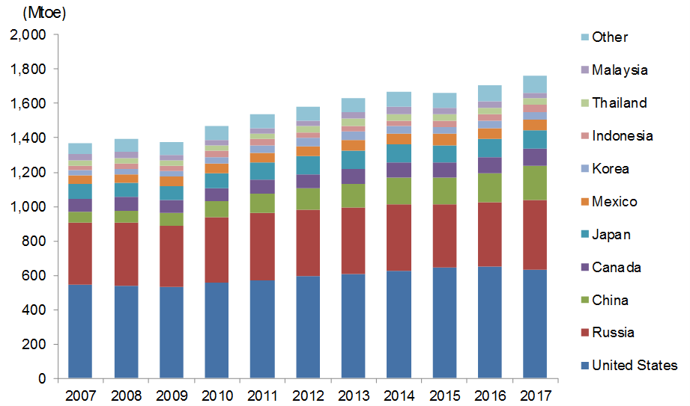
1- Gas Demand: APEC gas demand by economy, 2007-2017
The US remains the main gas consumer in the world.
Russia has had an overall sluggish growth over the past decade.
Electricity remains the main growth driver but industry also increased rapidly.
Sources: IEA, World Energy Balances 2018

Slide 5
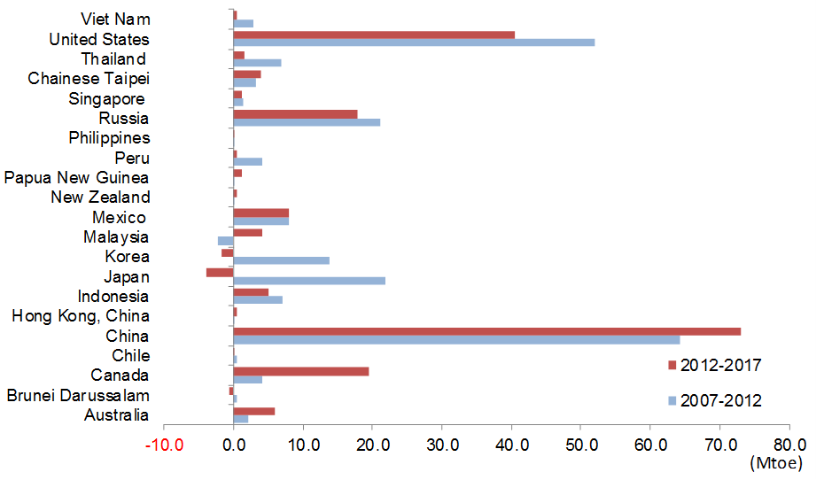
1- Gas Demand: Changes in demand by economy, 2007-2017
Demand growth driven by the China (363%) and the US (17%) in the past decade.
Australia, Russia and Canada have also increased domestic demand.
Korea and Japan had an overall decrease of its gas demand in the past 5 years.
Sources: IEA, World Energy Balances 2018

Slide 6
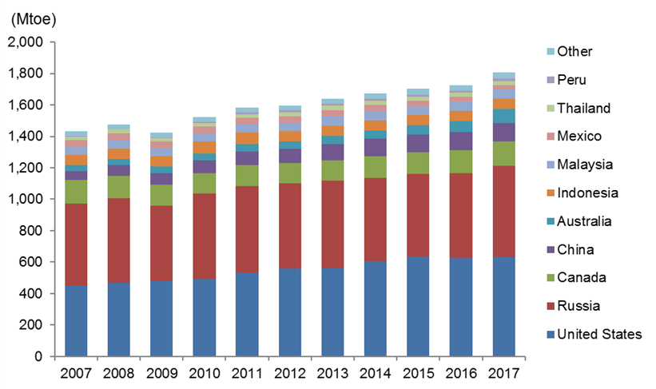
2- Gas production: APEC production by economy, 2007-2017
APEC gas production increased 26% in the last decade, while it’s share remained stable at around 57% of world’s production.
The US surpassed Russia in 2012 as the world’s largest producer (shale revolution).
3 of the world’s 4 largest gas producers are APEC members (US, Russia and Canada).
Sources: IEA, World Energy Balances 2018

Slide 7
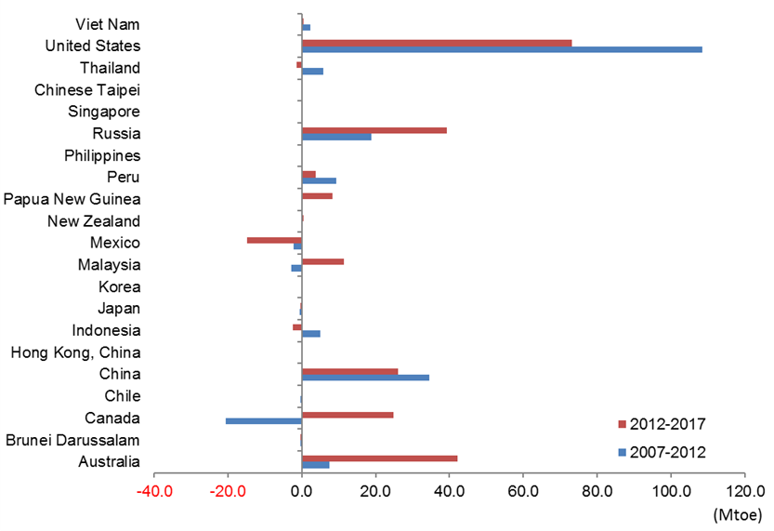
2- Gas production: Changes in production by economy, 2007-2017
The US, Russia, China and Australia are the largest contributors to APEC production growth.
Conversely, Mexico’s production shrank by 40% (17 Mtoe) in the last decade.
Sources: IEA, World Energy Balances 2018

Slide 8
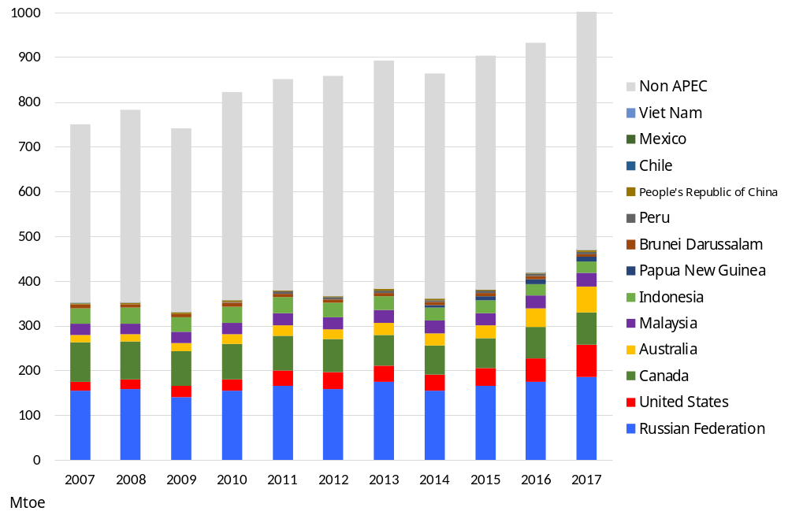
3- Trade: World and APEC gas exports, 2007-2017
APEC remains a net exporter region, 25% of gas production being exported.
Russia remains the world’s largest gas exporter.
The US more than tripled natural gas exports including pipeline deliveries and LNG exports.
Canada exported 88 bcm to the US in 2017, 20% lower than in 2007.
Sources: IEA, World Energy Balances 2018

Slide 9
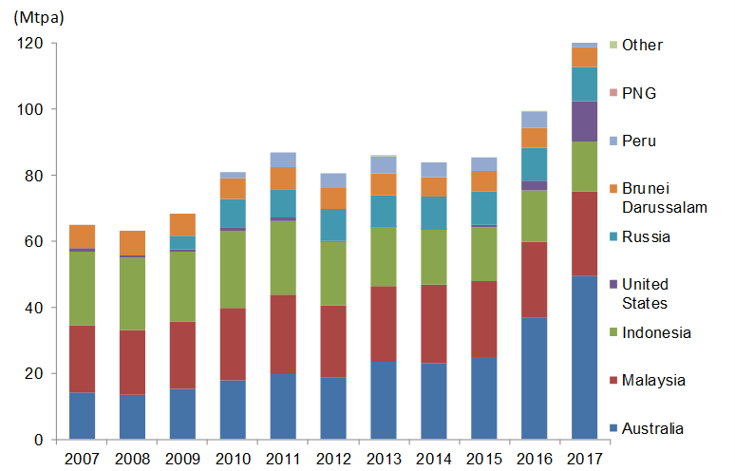
3- Trade: APEC LNG exports, 2007-2017
From 2007-17, APEC LNG production grew annually by 6.7% (world’s LNG by 6.0%).
Australian LNG exports more than tripled in 10 years, leading growth.
US LNG exports more than quadrupled compared with 2016.
In 2017, Malaysian LNG exports were stagnant while Indonesia’s have been decreasing.
Sources: IEA, World Energy Balances 2018

Slide 10
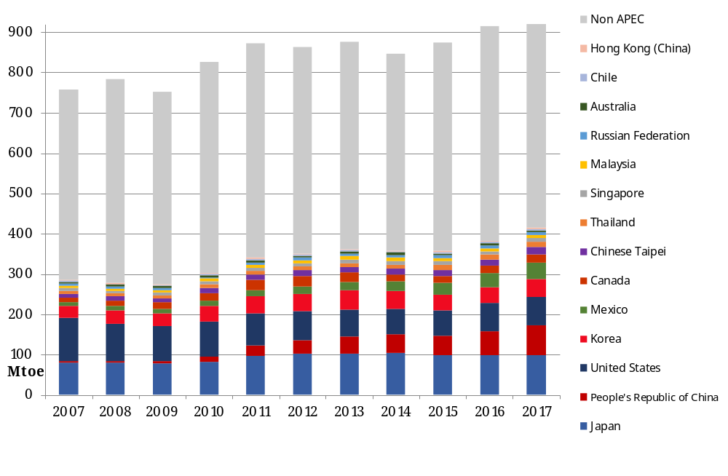
3- Trade: World and APEC gas imports, 2007-2017
APEC imports represent 42% of world imports.
Japan was the largest natural gas and LNG importer in the world in 2017.
China is the fastest growing importer in the world, with LNG accounting for 57% of imports.
While US imports decreased, still the third largest gas importer in APEC.
Sources: IEA, World Energy Balances 2018

Slide 11
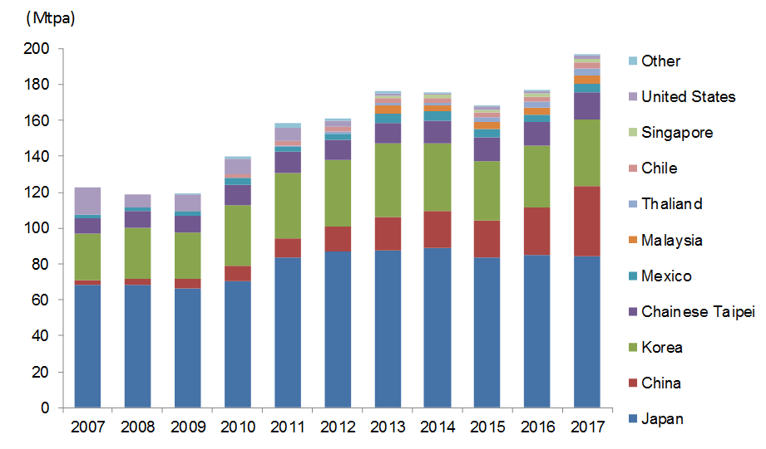
3- Trade: APEC LNG imports by economy, 2007-2017
World LNG demand has grown by 5.7% on average in the past 10 years.
However, APEC LNG imports grew by 4.8% per year on average (116 Mtpa increase, 2007-17).
APEC LNG demand represented 72% of world imports, with 14 members being LNG importers.
Sources: IEA, World Energy Balances 2018

Slide 12
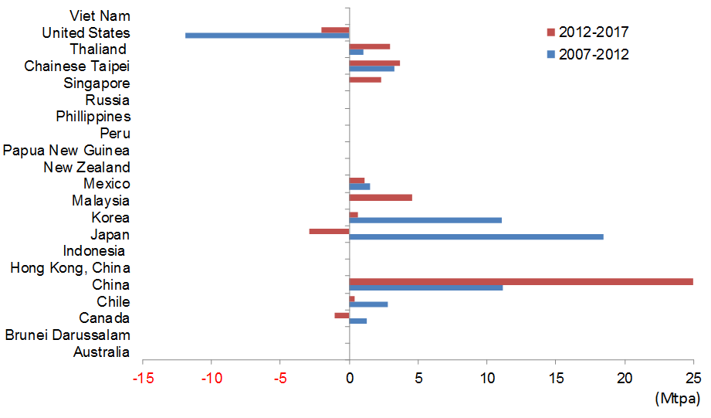
3- Trade: Change in APEC LNG imports (2007-2017)
Japan remains the largest LNG importer, despite its demand falling since 2014.
China became the second world’s largest importer in 2017 (35 Mtpa growth 2007-17).
US imports shrank by 13 Mtpa since 2007, following increased production.
Korean LNG demand grew for the first time since 2013, but uncertainty remains.
Sources: IEA, World Energy Balances 2018

Slide 13
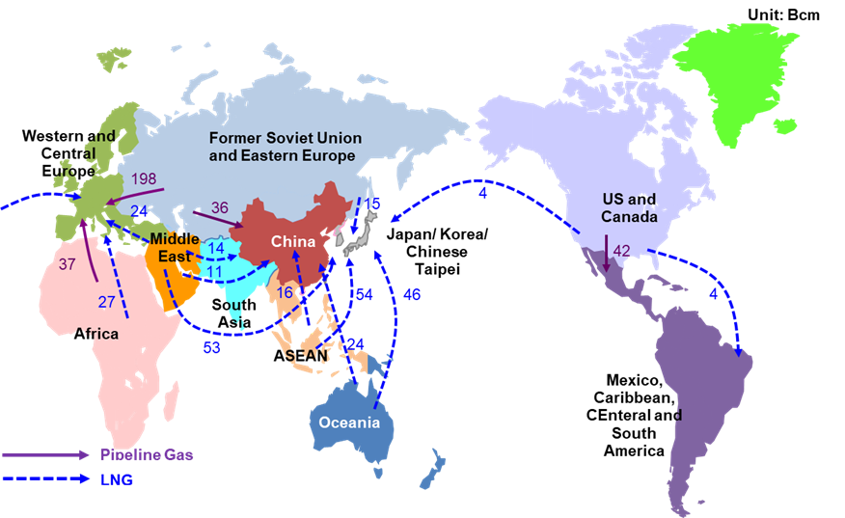
3- Trade: Major natural gas trade flows, 2017
International gas trade grew by 2.8% per year from 2007 to 2017.
LNG trade has grown at 5.7%, increasing its share from 23% to 33% in the same period.
Only 3 out of 21 APEC members do not trade gas: NZ, Viet Nam and the Philippines.
Sources: IEEJ Outlook 2018
Notes:
This slides shows the coal demand around the world.
Besides developing APEC members, India, another fast growing Asian economy, has recorded rapid increases in coal demand over the past decade.
The economy doubled its coal consumption from 211 Mtoe in 2005 to 412 Mtoe in 2017
On the other hand, European economies, which used to be major coal producers and consumers, have declined in recent years.
Other major coal consumers, such as South Africa and Brazil, recorded almost flat demand for the past decade.
Despite that, coal production in South Africa and Colombia, another major coal producer, increased as a result of export growth.

Slide 14
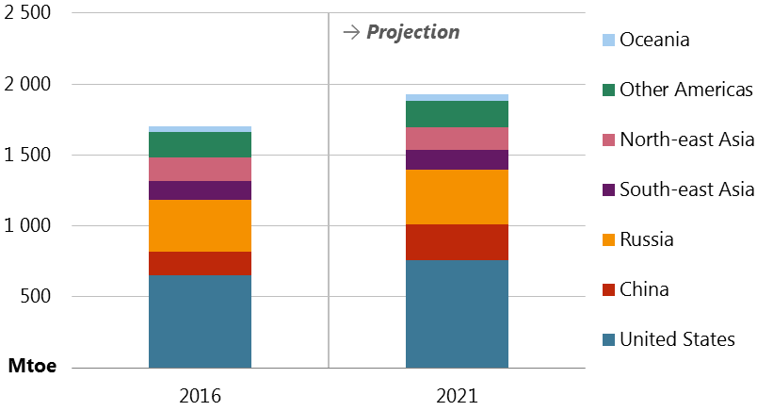
4- Outlook: Natural gas demand in APEC, 2016 and 2021
APEC gas demand increases by an average 1.8% to 1 900 by 2021.
All APEC economies grow, except New Zealand and Japan.
Demand growth continues to be driven mainly by the US and China.
Sources: APERC, APEC Energy Demand and Supply Outlook 7th Edition
Notes:
This slides shows the coal demand around the world.
Besides developing APEC members, India, another fast growing Asian economy, has recorded rapid increases in coal demand over the past decade.
The economy doubled its coal consumption from 211 Mtoe in 2005 to 412 Mtoe in 2017
On the other hand, European economies, which used to be major coal producers and consumers, have declined in recent years.
Other major coal consumers, such as South Africa and Brazil, recorded almost flat demand for the past decade.
Despite that, coal production in South Africa and Colombia, another major coal producer, increased as a result of export growth.

Slide 15

4- Outlook: Natural gas production in APEC, 2016 and 2021
APEC gas production increases to almost 2 000 Mtoe by 2021.
Combined production in United States, Russia, China and Australia increases by more than 230 Mtoe by 2021.
Production in Mexico, Indonesia and Thailand decreases steadily towards 2021.
Sources: APERC, APEC Energy Demand and Supply Outlook 7th Edition
Notes:
This slides shows the coal demand around the world.
Besides developing APEC members, India, another fast growing Asian economy, has recorded rapid increases in coal demand over the past decade.
The economy doubled its coal consumption from 211 Mtoe in 2005 to 412 Mtoe in 2017
On the other hand, European economies, which used to be major coal producers and consumers, have declined in recent years.
Other major coal consumers, such as South Africa and Brazil, recorded almost flat demand for the past decade.
Despite that, coal production in South Africa and Colombia, another major coal producer, increased as a result of export growth.

Slide 16
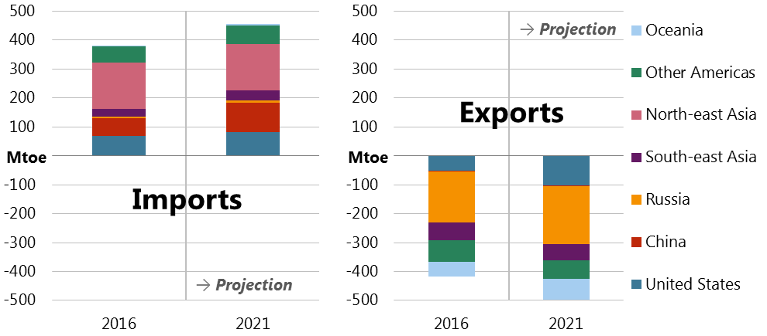
4- Outlook: Natural gas trade in APEC, 2016 and 2021
Piped and LNG imports to China almost double towards 2021, while North-east Asia and South-east Asia also grow.
US exports more than double, most to the APEC region but some to Europe.
Russian gas exports also increase, mainly to China.
Sources: APERC, APEC Energy Demand and Supply Outlook 7th Edition
Notes:
This slides shows the coal demand around the world.
Besides developing APEC members, India, another fast growing Asian economy, has recorded rapid increases in coal demand over the past decade.
The economy doubled its coal consumption from 211 Mtoe in 2005 to 412 Mtoe in 2017
On the other hand, European economies, which used to be major coal producers and consumers, have declined in recent years.
Other major coal consumers, such as South Africa and Brazil, recorded almost flat demand for the past decade.
Despite that, coal production in South Africa and Colombia, another major coal producer, increased as a result of export growth.

Slide 17
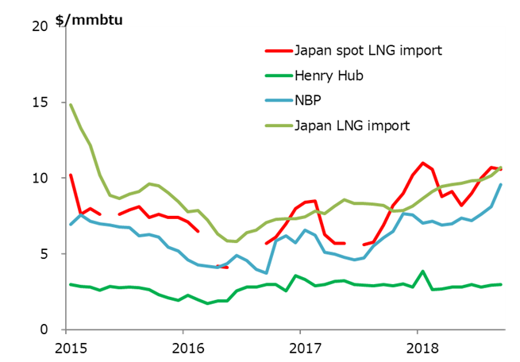
5- International gas prices
The Japan LNG import price rose to $10/Mmbtu, following crude oil prices until mid 2018.
NBP increased to almost $10/Mmbtu; increased demand and declining production in the Netherlands.
Henry Hub remained around $3/Mmbtu
Sources: Ministry of Finance of Japan, Agency of Natural Resources of Energy of Japan, U.S. Energy Information Administration, Intercontinental Exchange
Notes:
This slides shows the coal demand around the world.
Besides developing APEC members, India, another fast growing Asian economy, has recorded rapid increases in coal demand over the past decade.
The economy doubled its coal consumption from 211 Mtoe in 2005 to 412 Mtoe in 2017
On the other hand, European economies, which used to be major coal producers and consumers, have declined in recent years.
Other major coal consumers, such as South Africa and Brazil, recorded almost flat demand for the past decade.
Despite that, coal production in South Africa and Colombia, another major coal producer, increased as a result of export growth.

Slide 18
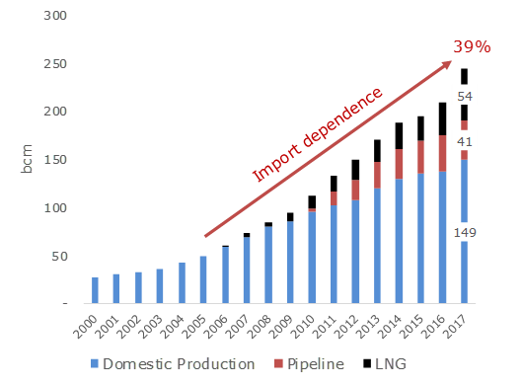
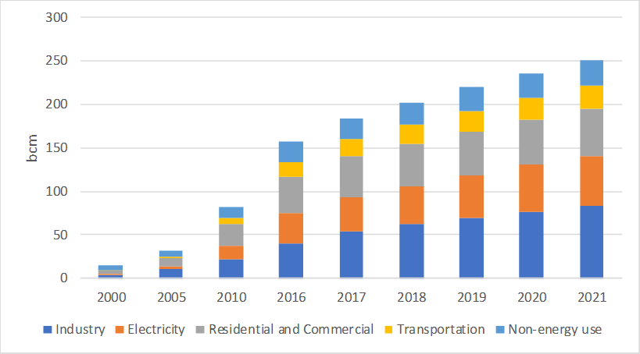
6- Case study: China, growing demand and import dependence
LNG has filled supply shortfalls to become the fastest growing source of gas supply for China in 2017.
Pollution reduction policies that mandate coal to gas switching in residential and industrial sectors have driven growth.
The policy-led surge in demand was so strong between 2017/2018 that it outpaced natural gas supply, resulting in widespread fuel shortages in several regions.
Source: CNPC Economics & Technology Research Institute

Slide 19
6- Case study: China, growing demand and import dependence
Supply security measures
Gas storage, obstacle to market development and shortage.
Transmission and distribution measures
LNG regasification capacity (currently 20 construction projects, up to 190 bcm)
Key policies
13th Five-Year Plan and General Guidelines
Winter Clean Heating in northern China
The Battle for Blue Sky Policy
Transport
Fuel competition
    Price competitiveness and expansion of clean coal
    Clean coal policies
Impact on international markets
Source: CNPC Economics & Technology Research Institute

Slide 20
Conclusions
With 57% of global gas consumption and production, APEC members are at the centre of the global natural gas dynamics.
China and the US are driving gas demand growth.
While the shale revolution has substantially changed gas demand in the US, the impact of US LNG exports is still relatively limited.
China gas demand will keep growing to become the main gas importer and later the main LNG importer, as well.
After sluggish developments of new LNG projects in recent years, linked to low LNG prices in Asia, supply and demand balance could become tight in the early 2020s as demand in China and Southeast Asia continues to grow.
Three dynamics to follow:
  Russian piped and LNG exports to China and their impact.
  China’s actions on increasing domestic pipeline infrastructure, further regasification and storage capacity as well as pricing mechanisms.
  US LNG exports and their competitiveness in global markets, particularly in Asia.
Source: CNPC Economics & Technology Research Institute

Slide 21
Thank you for your attention! diego.rivera@aperc.ieej.or.jp

