Slide 1
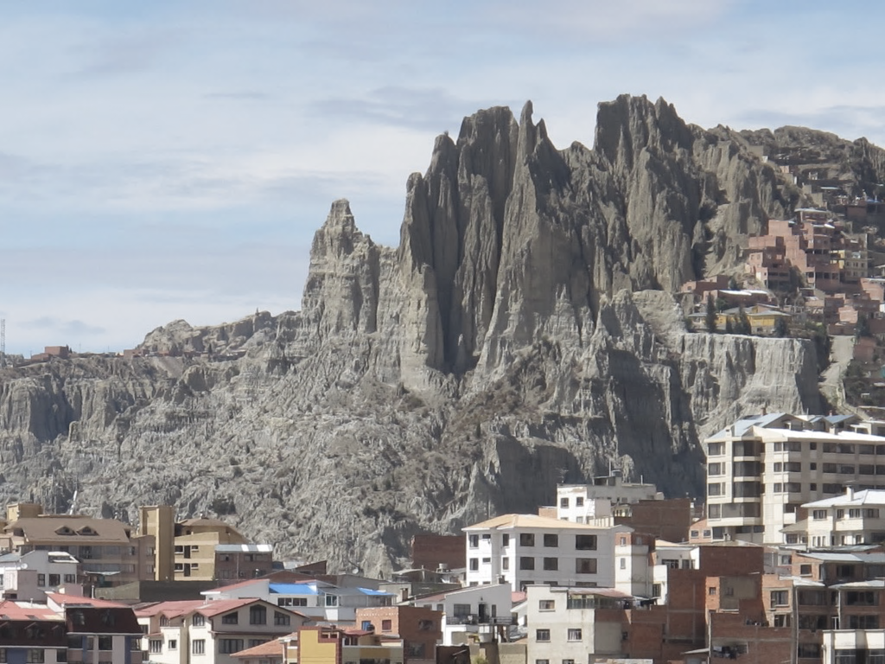

APEC LOW CARBON MODEL TOWN SYMPOSIUM
LIMA, PERU, OCTOBER 21, 2019

Slide 2
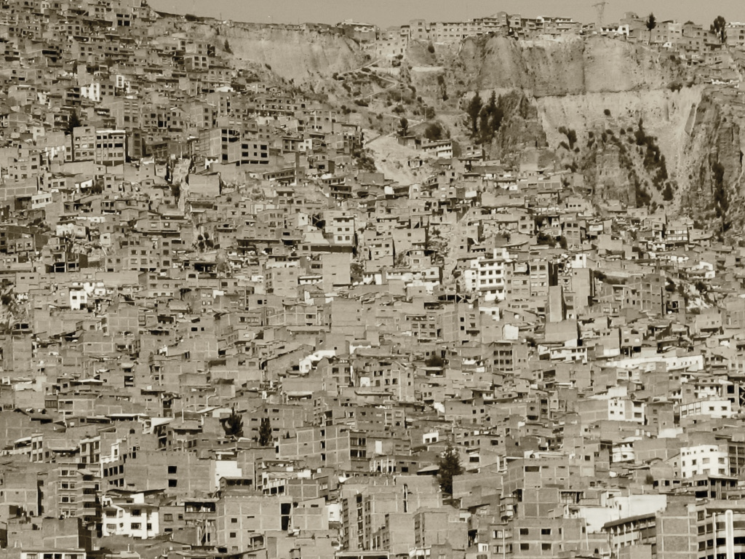
Latin America is the most urbanized continent in the world
Home to 600 million people, 85% of which live in urban areas. Today, there are more than 55 cities with a population of one million or more, including some of the largest metropolitan areas on the planet.
Resilient Cities LAC
Proposal
Urbanization in Latin America has had mixed results
while it has brought economic growth and innovation at local level, it has also increased poverty, insecurity and social exclusion. 25% or urban dwellers live in slums and 77% lack proper sanitation
$180 billion a year
Estimated needs for investment in urban infrastructure in Latin America for the next decade
2

Slide 3
Urban Resilience is the capacity of individuals, communities, institutions, businesses, and systems within a city to survive, adapt, and grow no matter what kinds of chronic stresses and acute shocks they experience.
Notes:
SPEAKER: We have a technical definition of resilience here on the screen, but I’d like to tell you how that definition applies to real life.
Building resilience is about recognizing that shocks and stresses are interconnected, and solutions should be as well. We can go around trying to solve single challenges with single solutions, but at the pace of growth, and pace of challenges, cities will bankrupt themselves. Instead, what resilience aims to do is focus on developing responses that have multiple benefits. It also requires comprehensive input from people outside of government – everything from technical experts to community leaders to the business community.
In short, resilience requires that cities gain a better understanding of their challenges, recognize those challenges are connected, and seek to solve them holistically.
If a city does this, it will be better able to serve its citizens in both good times and bad, and will be better prepared to face a wide range of future challenges, both known and unknown.

Slide 4

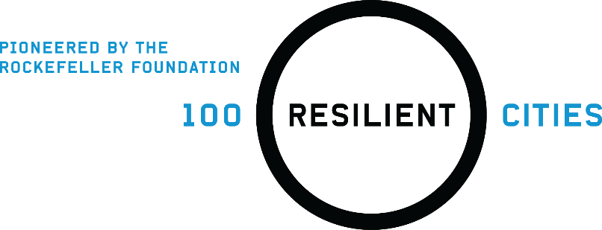
From 2014 to 2019, The Rockefeller Foundation invested over $200 million to stand the 100 Resilient Cities program

Slide 5


Partnering with cities for a better today
and a stronger tomorrow
CHIEF RESILIENCE OFFICER
RESILIENCE STRATEGY
Urban Transformation
GLOBAL NETWORK
GLOBAL PARTNERSHIPS
Notes:
SPEAKER: So here is how we partner with cities to create change.

Slide 6
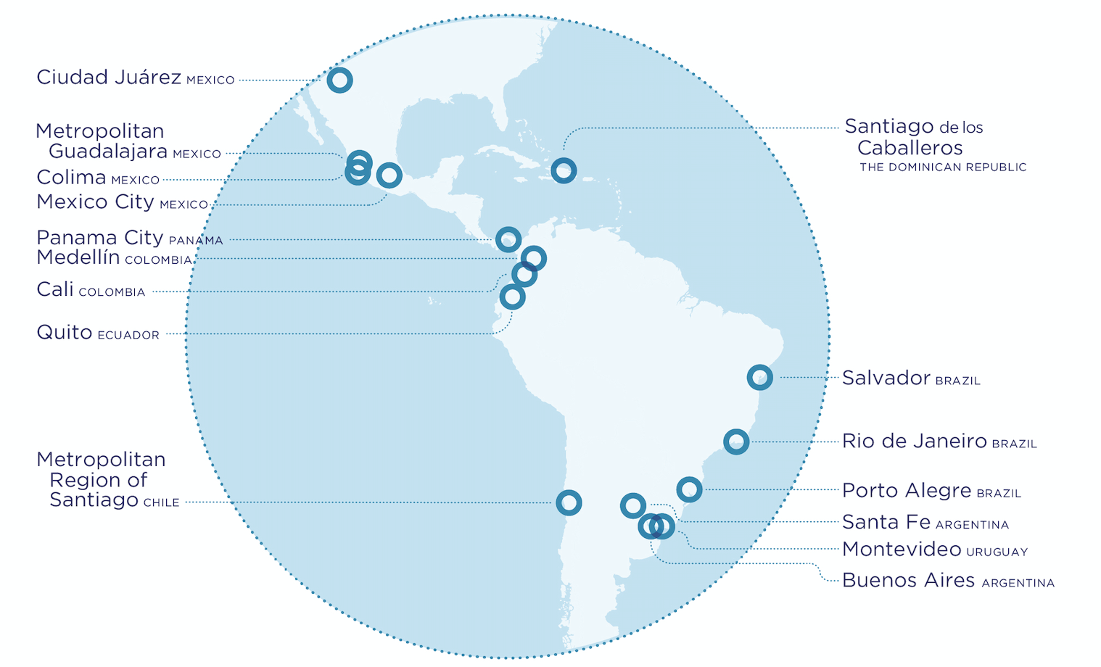
Resilient Cities LAC
San Juan
PUERTO RICO

Slide 7
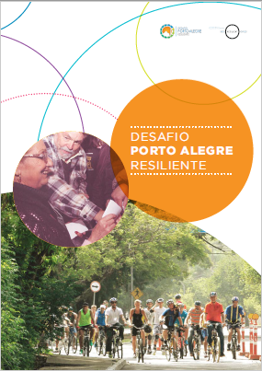
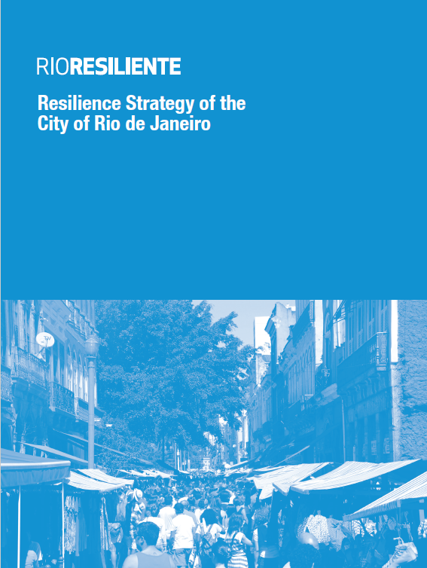
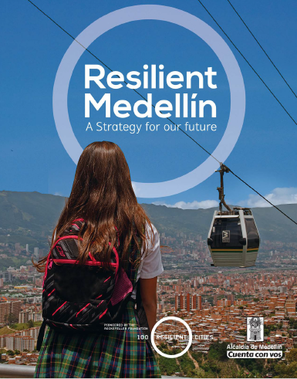
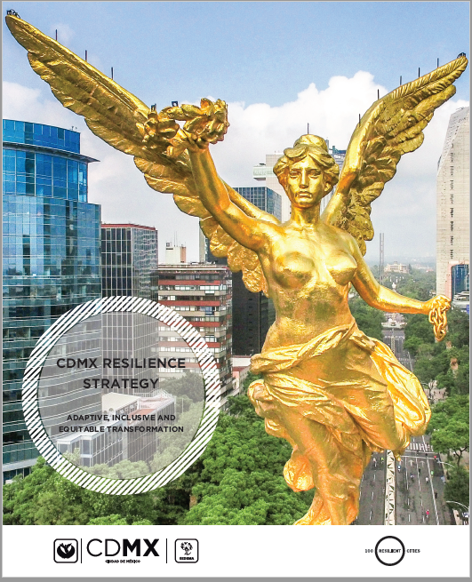
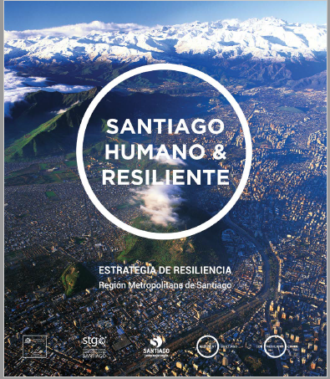
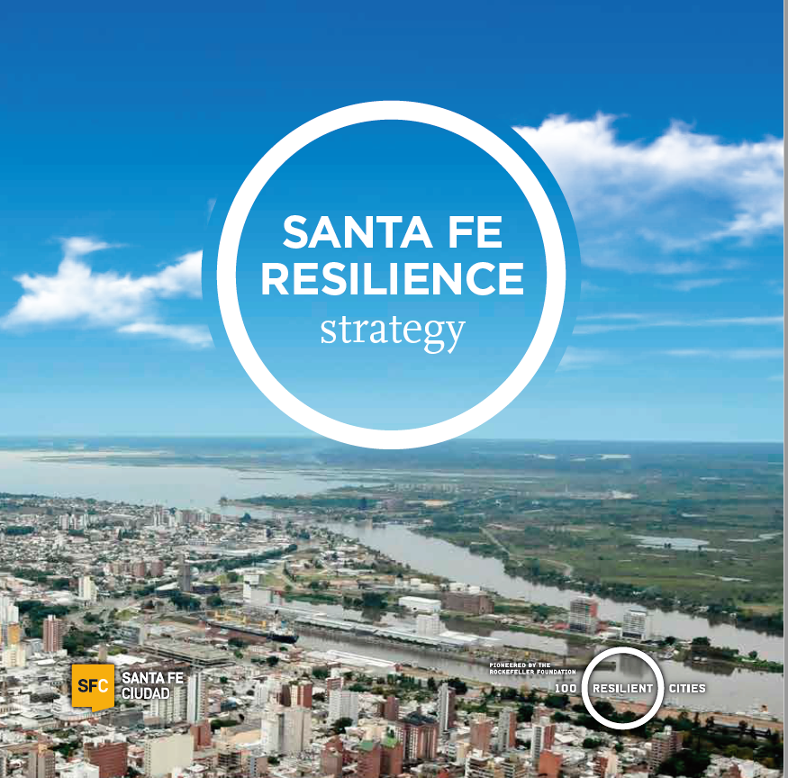
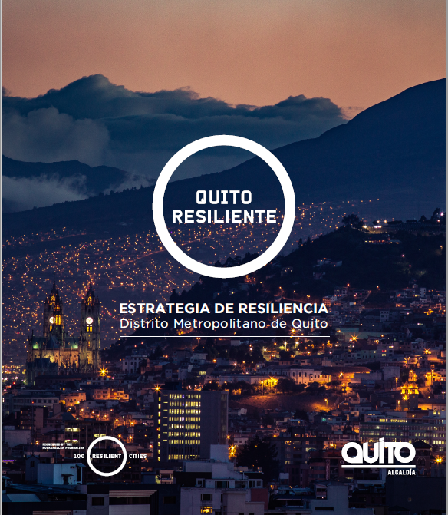
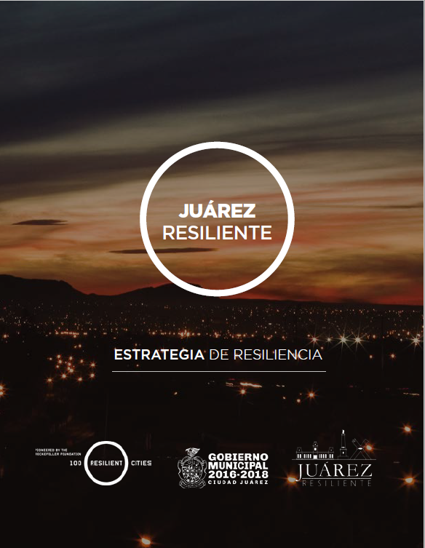
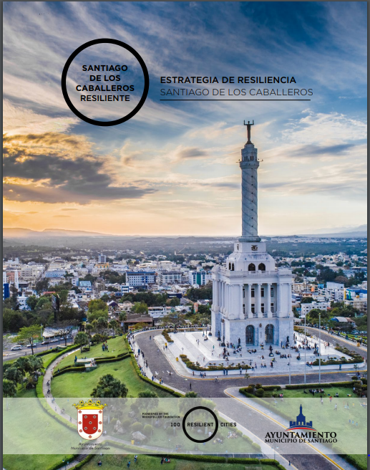
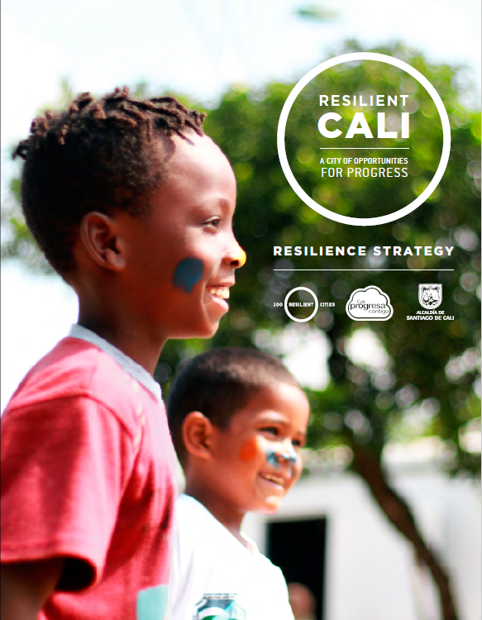
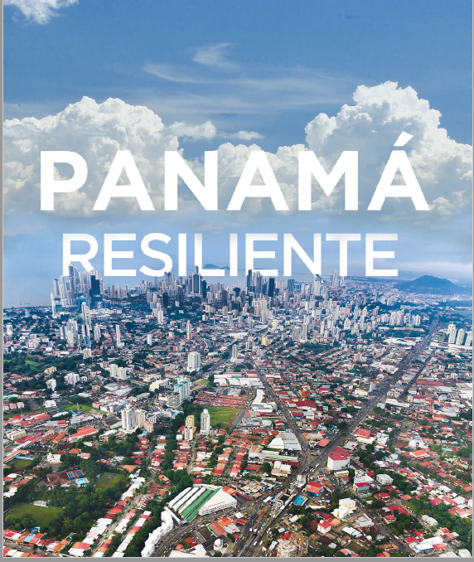
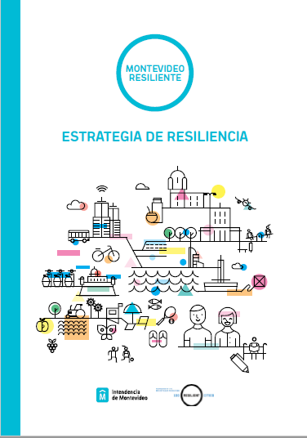
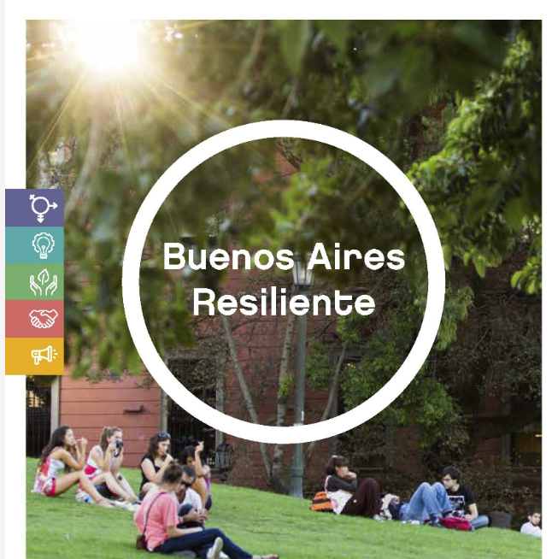
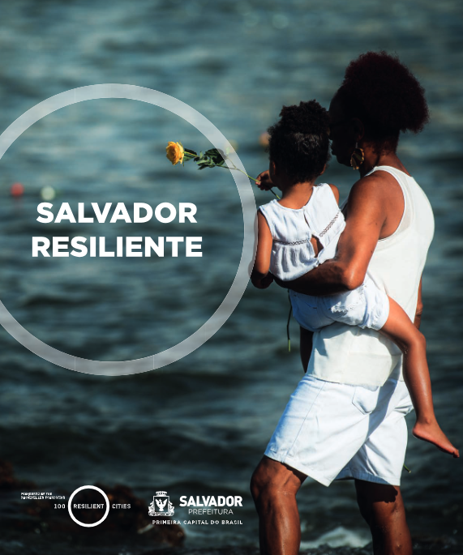
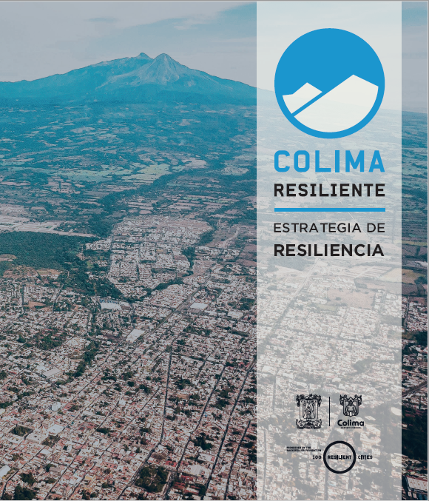
Resilient Cities LAC
has finalized its strategies and is now focusing on implementing impactful projects and initiatives

Slide 8
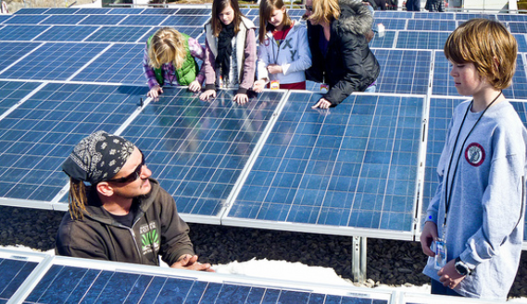
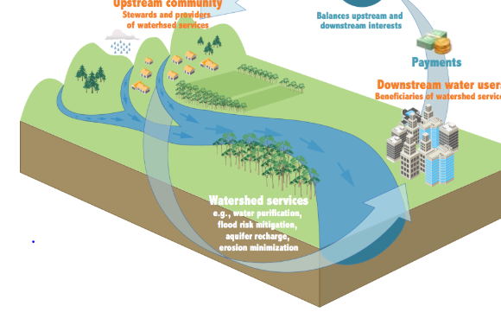
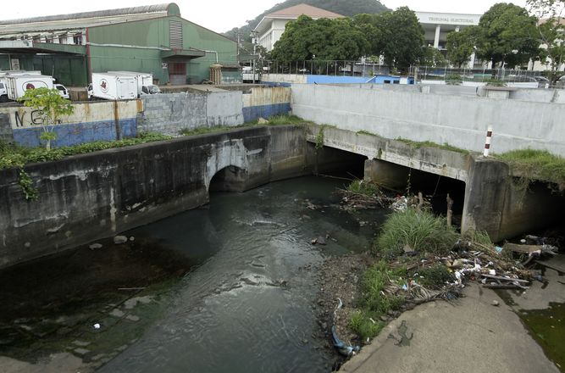
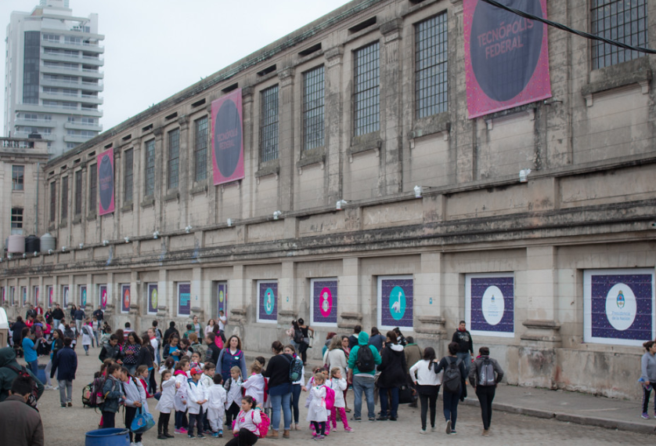
Implementing resilient projects for low carbon towns:
LAC cities have been actively working to implement the projects and initiatives identified in their Resilience Strategies. These projects range from small activities like community workshops, to large scale infrastructure works in mobility, waste, education, health or water management. Some examples below:
2
Estacion Belgrano
Santa Fe
Green building and energy efficient recovery of an iconic abandoned railway station, urban renewal for regional logistics, creative economies and job creation. Estimated investment: +$40M
4
Juan Diaz wetlands and coastal recovery
Panama City
Complex upgrading of water management and flood protection systems in a high-risk coastal strip, focusing on new mobility schemes and wetland recovery. Estimated investment: $100M
1
Solar panels in public schools
Porto Alegre
Retrofitting of 93 schools with solar panels, supported by Felicity Project with GIZ financing (energy savings)
3
Water Fund
Metropolitan Santiago
Financial and governance mechanism engaging public, private, and civil society to contribute to water security, nature-based infrastructure and sustainable management of water sheds

Slide 9
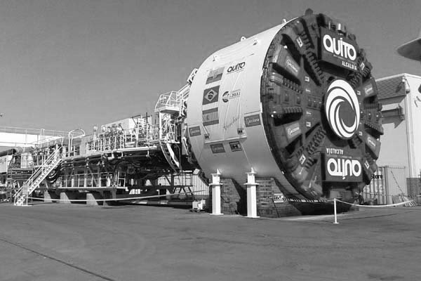
+$650 million
Dollars leveraged from 2014-2019 to implement initiatives and projects from LAC City Resilience Strategies
Photo: Metro in Quito
9

Slide 10
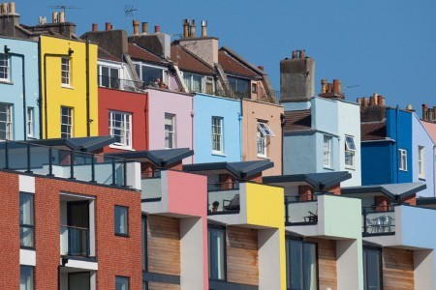
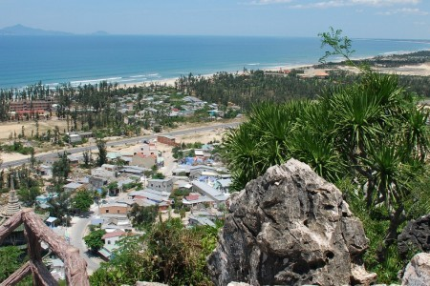
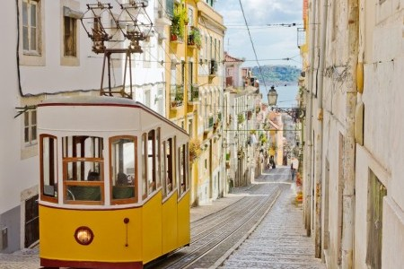
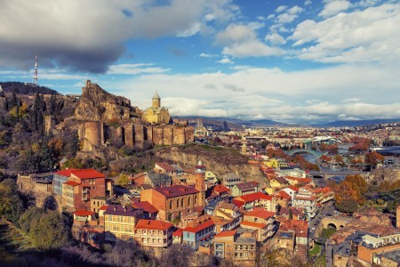
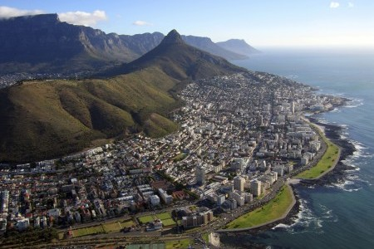
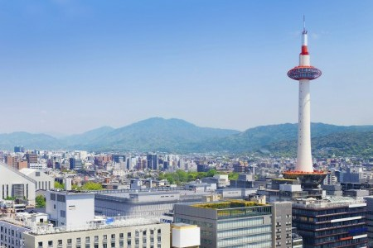
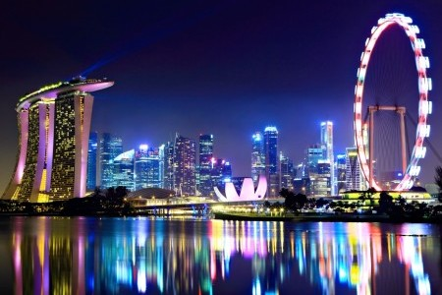
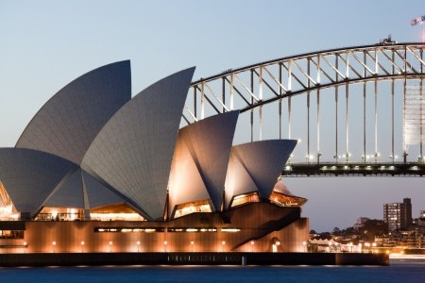
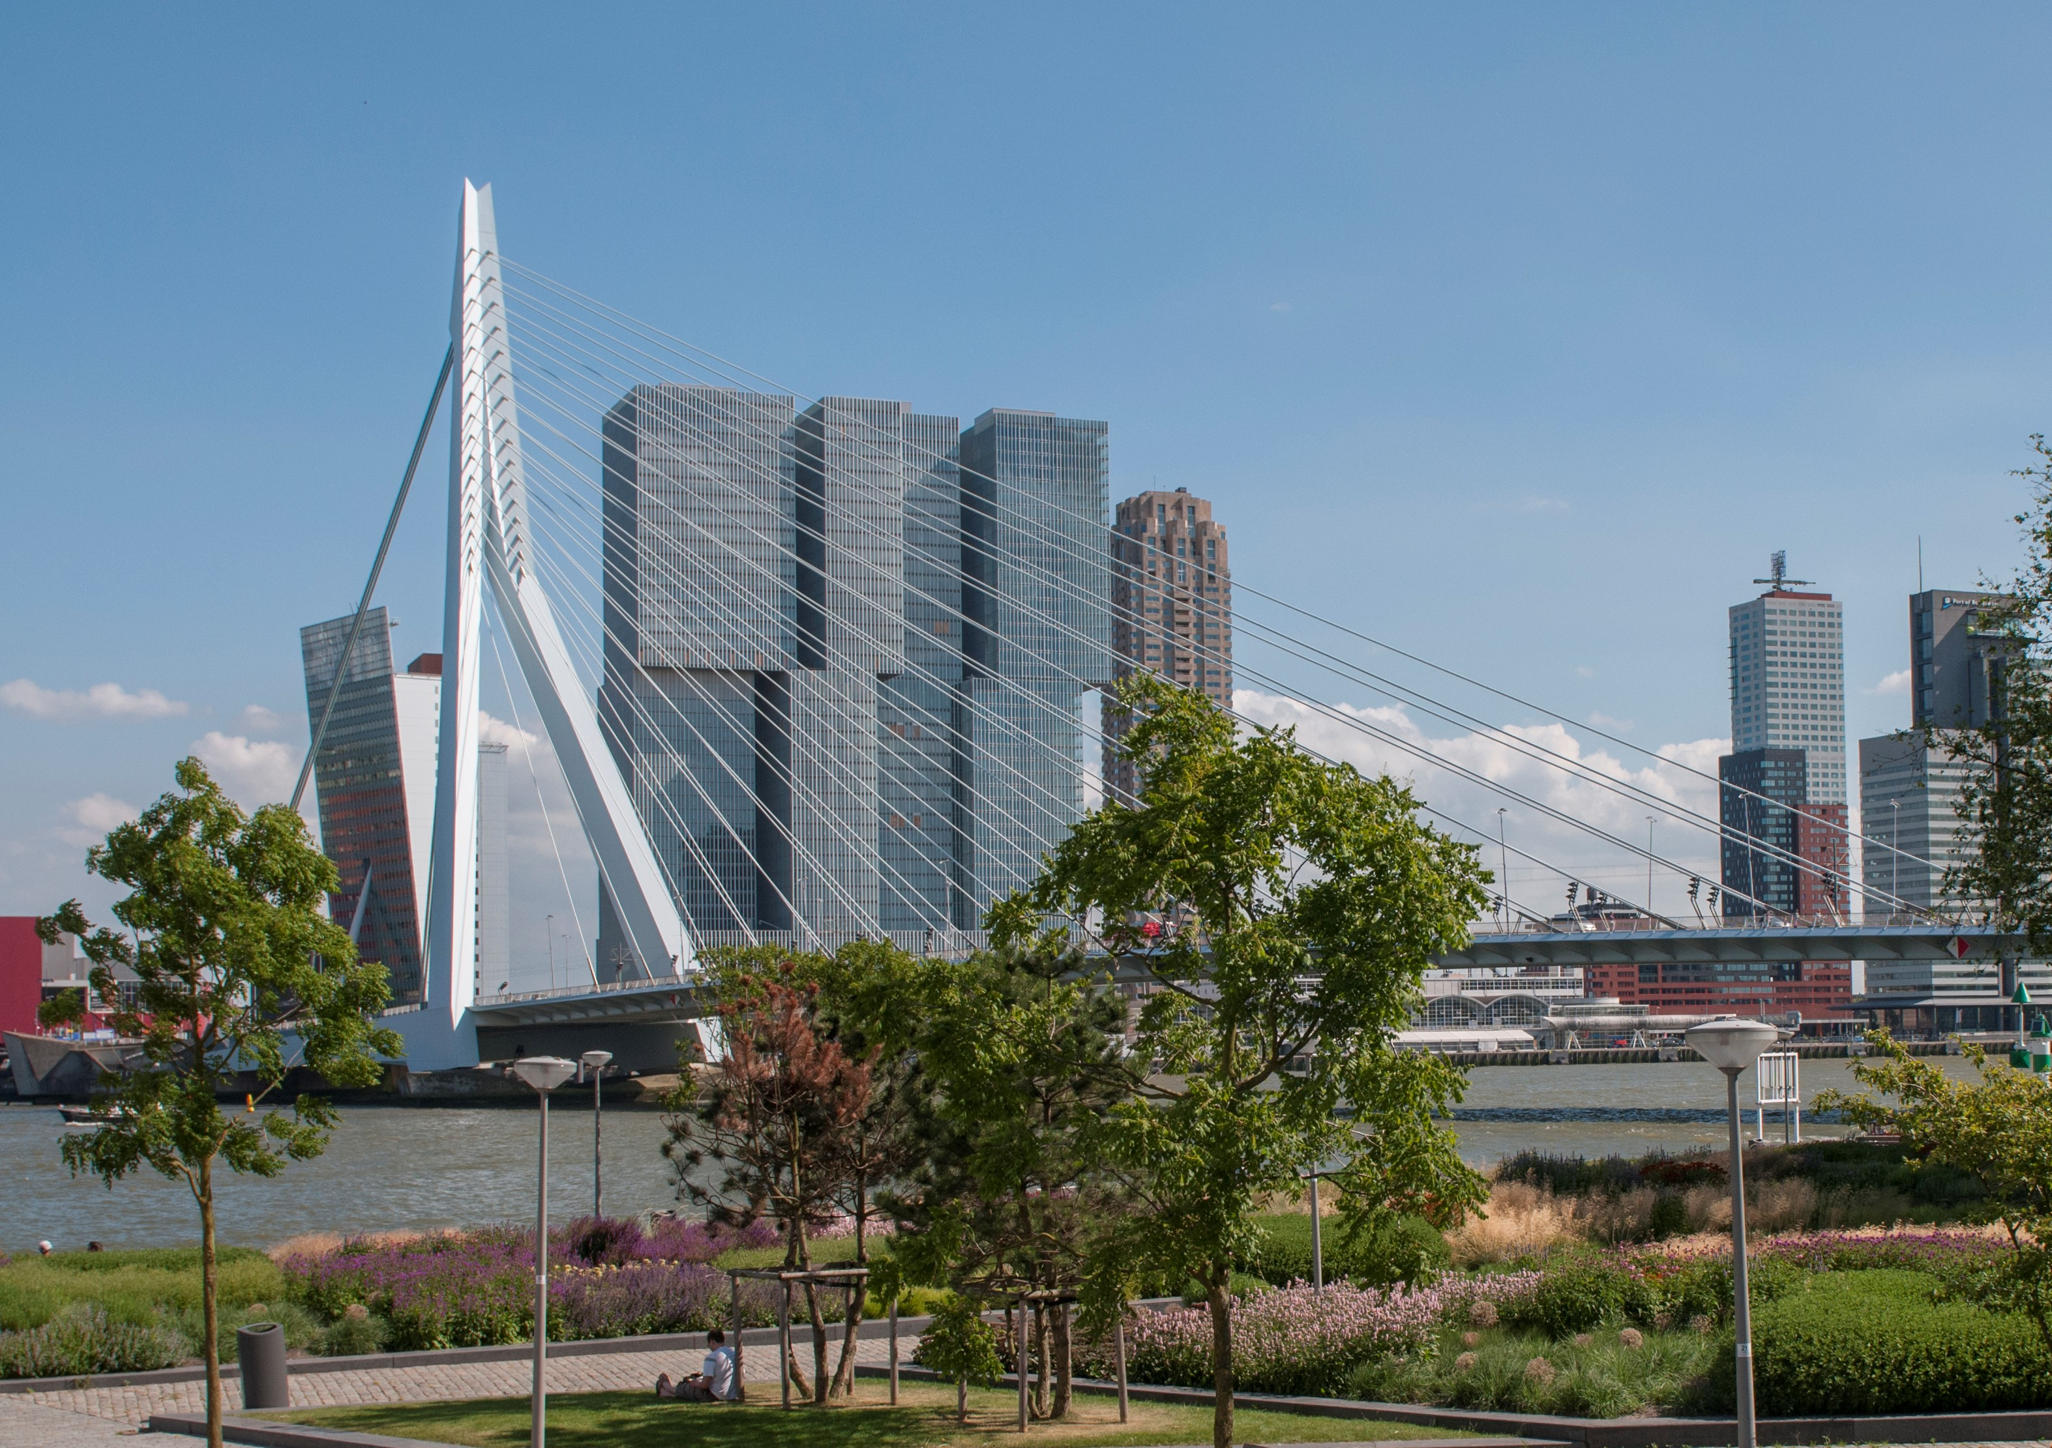
100RC lessons learned so far:
Strengths:
The value of the network
The need to adapt more closely to regional and local contexts
Institutionalization of resilience in city government as crucial
Challenges:
Continuity after mayoral changes
Retaining local expertise
Change of mindset, from sectoral siloed policy making to holistic resilience
Access to international capital markets from municipal govts

Slide 11
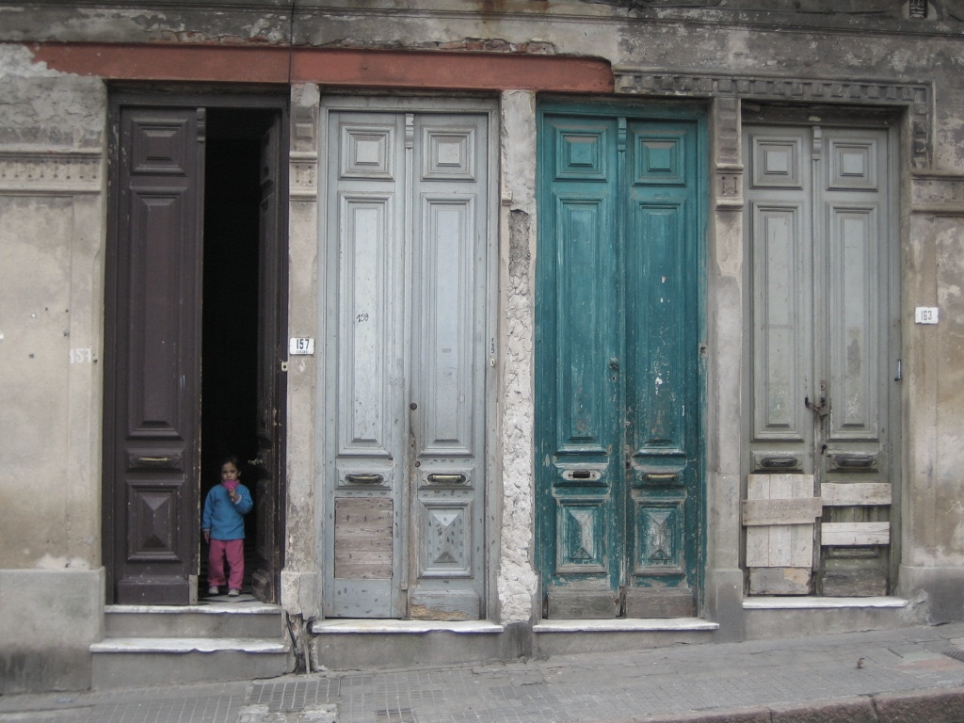
Resilient Cities
VISION
Photo: Downtown Montevideo
11

Slide 12
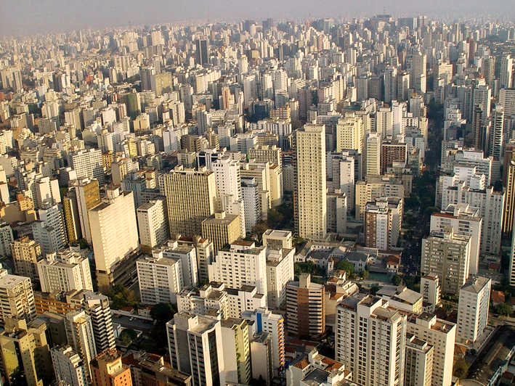
An engaged network of city resilience practitioners and decision makers implementing projects that support excluded and vulnerable populations, to better anticipate and overcome the risks and vulnerabilities related to urbanization and climate change

Slide 13
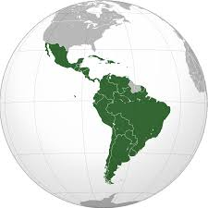
Resilient Cities
LAC
Our value proposition:
1. Established LAC Network. Regional chapter of a global Resilient Cities network working with CROs in 17 cities in 10 countries to share experience with the international ecosystem of urban resilience practitioners
2. Training and convening. Escuela de Resiliencia (Resilience School) to train and build capacity for municipalities on urban resilience, reducing the impact of climate change and disasters on vulnerable populations
3. Urban Resilience Advisory Hub. Provides technical support, consulting, tools and project preparation services to deliver resilience value to city initiatives
4. Project pipeline development and support. Sourcing of innovative finance opportunities for resilience-screened projects
5. Strategic partnerships. Alliances with key regional development institutions, national governments, academia, corporate allies and philanthropy
6. New cities with sponsored membership. Inclusion of new cities in the network, CRO onboarding and support to develop Resilience Strategies
13

Slide 14
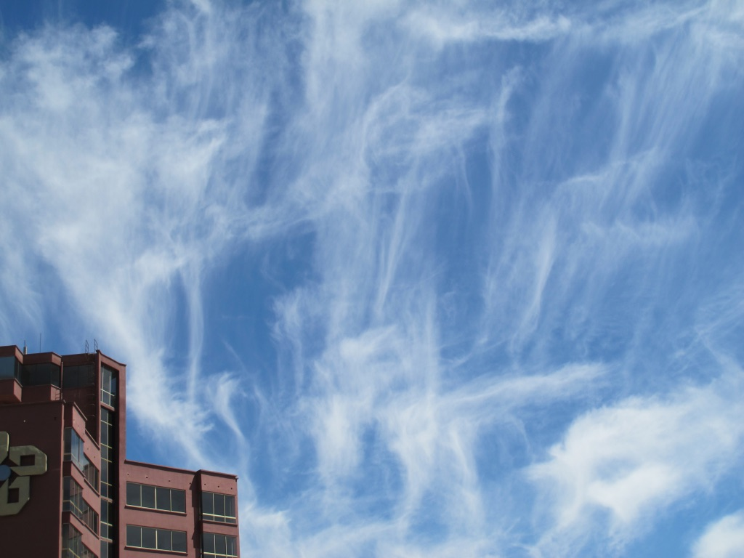
The time to build
resilience is now.
thank you
14

