Slide 1

Davao City
Ivan c. cortez, EnP
Officer-in-charge
Office on the city planning and development coordinator
The 2nd APEC Low-Carbon Model Town Symposium
20 September 2018

Slide 2
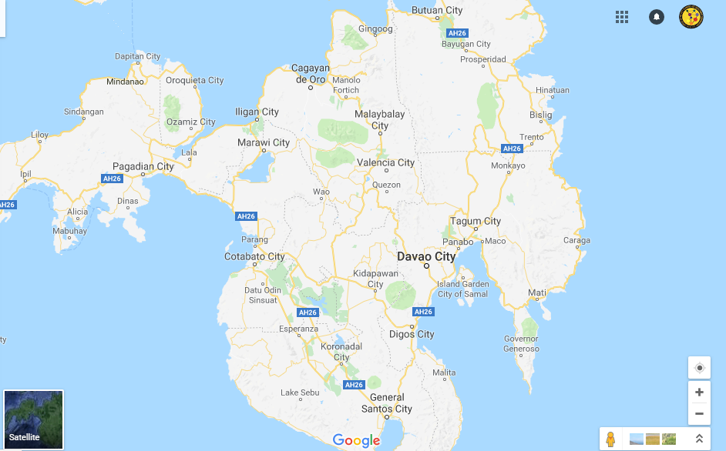
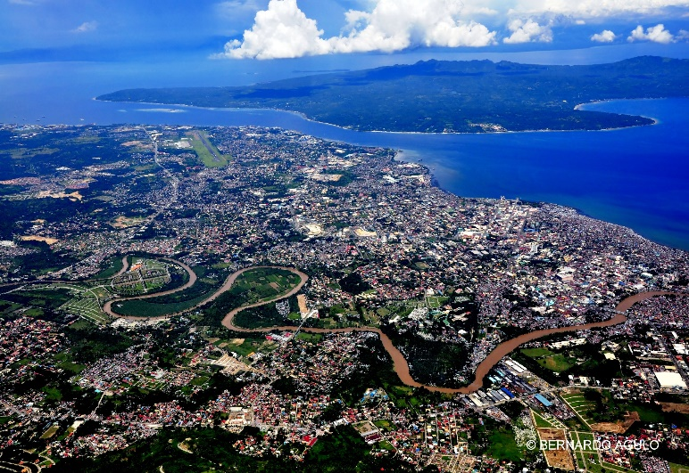
Davao City Location
Located at the South-eastern portion of the island of Mindanao and the Southern part of the Philippine Archipelago, Located in the West Central area of Region XI,

Slide 3
Land and Water Uses
LAND USE IN HECTARES
Urban Use | 13,150
Agriculture | 91,386
Water Use | 1,890
Forest | 26,454
Grassland/Pasture | 111,120
Total | 244,000

Slide 4
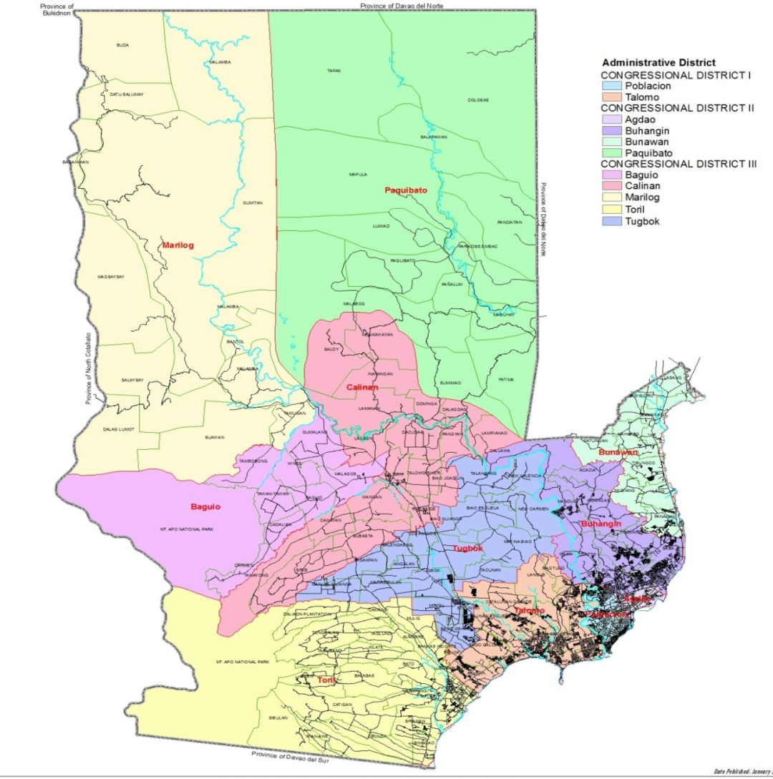
The city’s land area is 244,000 hectares or 2,440 sq. km.
Divided in to 3 Congressional Districts and further subdivided to 11 Administrative Districts
Population Density:
7 persons/ ha or
669 persons/ sq. km.

Slide 5
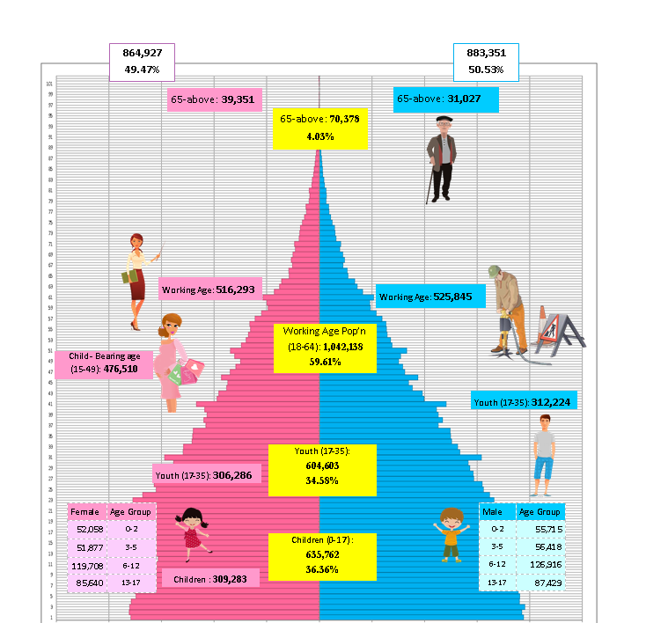
2018 Projected Population Pyramid
Population
2018 Total Projected
Population 1,748,279
Doubling Time - 30.4
(in years)
2015, Overall Dependency Ratio (per 100 persons) | 64
Young (0 to 17 years old. | 57
Old ( 65 years old and over) | 7

Slide 6
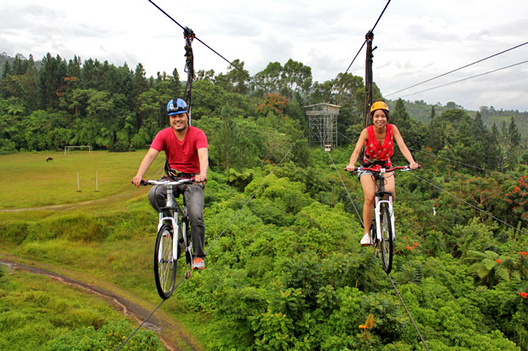
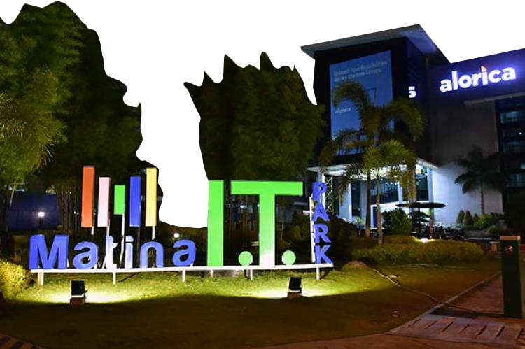
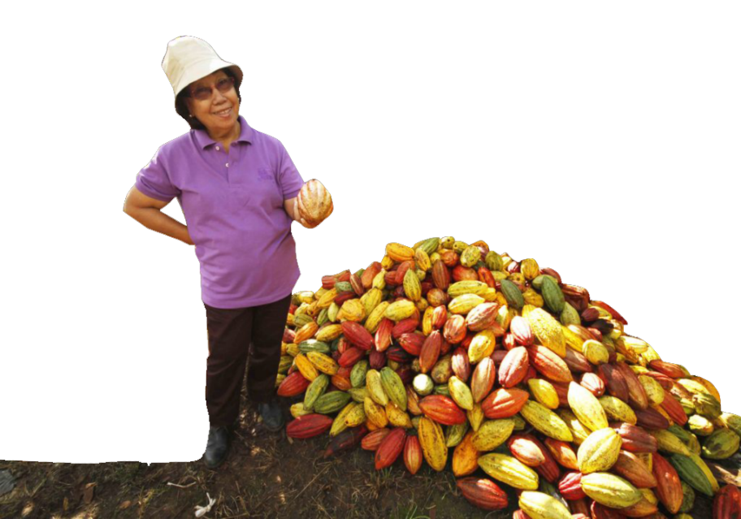
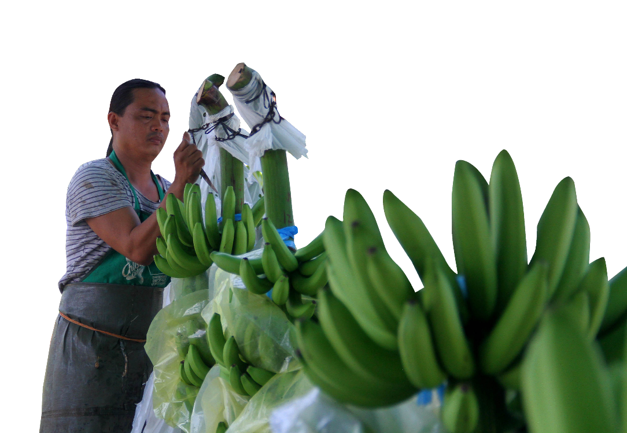
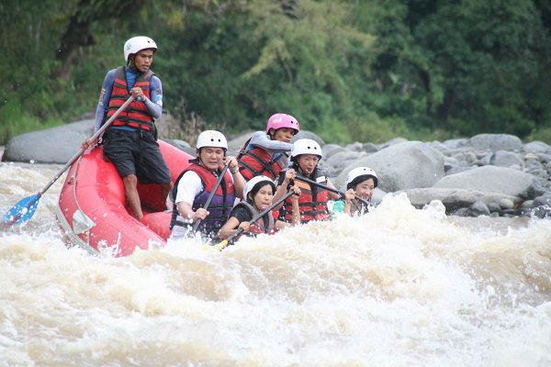

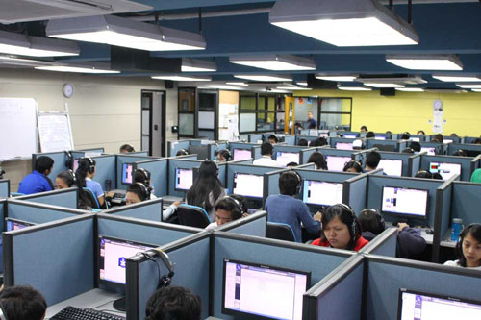
Major Economic Drivers
AGRICULTURE / AGRO-PROCESSING
INFORMATION & COMMUNICATION TECHNOLOGY
-Increase Farmer’s Productivity and Profitability
-Expand Production Areas
ECO and AGRI TOURISM

Slide 7
Tourism Industry
Tourist Arrivals | 2016 | 2017 | % Change
Foreign | 124,863 | 126,294 | 1.14
Balikbayan/Overseas Filipinos | 23,256 | 48,020 | 106.48
Local/Domestic | 1,716,224 | 1,838,311 | 7.11
Total | 1,864,343 | 2,012,625 | 7.95
Average Length of Stay (no. of days) | 4.0 | 3.6
Average Daily Expenditures (Php/day) | 3,964 | 4,270 | 7.72
Estimated Tourist Receipts (Php Billion) | 29.56 | 30.94 | 4.66
Estimated Economic Benefits (Php Billion) | 65.03 | 68.06 | 4.65
Recent Awards
Award Title | Year | Award Giving Body
ASEAN Clean Tourist City Standard | 2018 | ASEAN/Dept. of Tourism

Slide 8
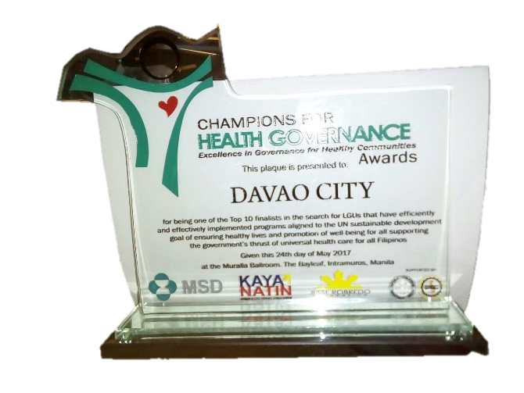
Vital Health Statistics
Indicator | 2016 | 2017 | % Change
% Deliveries by Skilled Births Attendance | 90 | 92.09 | 2.09
% Fully Immunized Mothers (FIM) | 53 | 56 | 3.0
% Contraceptive Prevalence Rate | 50.70 | 61.2 | 10.5
Prevalence Rate of Malnourished Children (0-5years old) | 3.30 | 3.06 | 0.24
% Households with access to potable water | 98.80 | 98.80 | -
% Households with sanitary toilets | 91.60 | 92.34 | 0.74
Recent Awards
Award Title | Year | Award Giving Body
Champion for Health Governance, Excellence in Government for Healthy Communities Awards | 2017 | Department of Health (DOH)

Slide 9
Peace and Order
Recent Awards
Indicator | 2016 | 2017 | % Change
Crimes reported | 10,269 | 7,576 | -26.22
% Crime Solution Efficiency | 79.64 | 87.54 | 9.91
Monthly Crime Rate / 100,000 pop’n | 52.74 | 39.00 | -26.05
Award Title | Year | Award Giving Body
Special Recognition as Most Peaceful & Safest City in Southeast Asia | 2018 | Philippine Chamber of Commerce & Industry (PCCI)/ Numbeo
Best City Police Office | 2018 | Philippine National Police (PNP) Camp Crame
Philippine Top Model City - Safe Haven Award | 2018 | The Manila Times

Slide 10


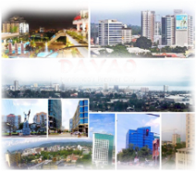
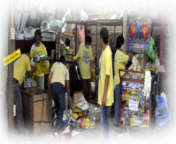
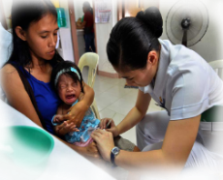
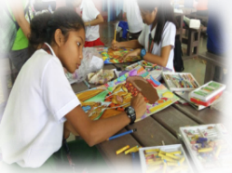


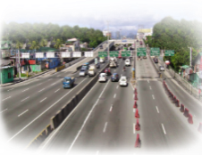
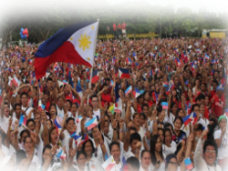

10 Key Priority Areas,
30 Doable Projects in 3 years
Poverty Alleviation | Infrastructure Development | Solid Waste Management| Health | Education | Agriculture | Tourism | Transportation Planning and Traffic Management | Peace and Order | Disaster Risk Reduction and Mitigation

Slide 11

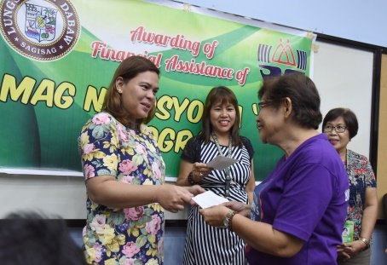
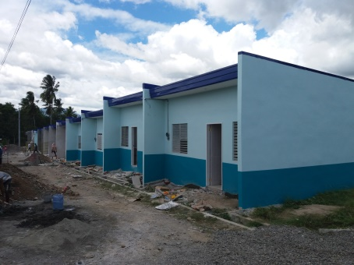
1. POVERTY ALLEVIATION
Sustainable Livelihood Development Program
Shelter Programs (Relocation Projects/Medium Size Socialized Housing)
Standardization of Social Services and Residential Care Facilities
Sustainable Reforestation Program for Upland Tribes

Slide 12
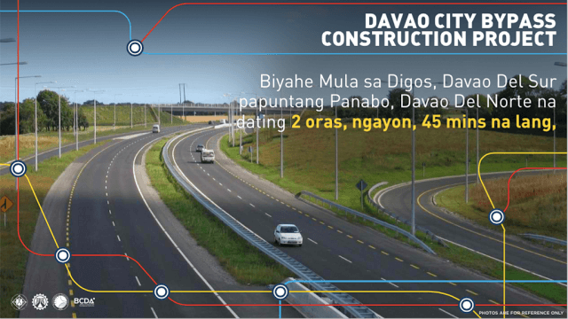
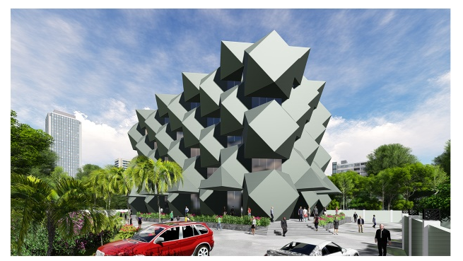
2. INFRASTRUCTURE DEVELOPMENT
Construction of Major Road, Highways and Farm to Market roads
Clean Surface Water as means of potable water supply
Renewal Energy Development and Usage of Energy Saving Lighting Technology
Underground Cabling and Piping of Utilities
Drainage, Sewerage and Water Treatment System Development
Modernization of Government Buildings and Facilities

Slide 13
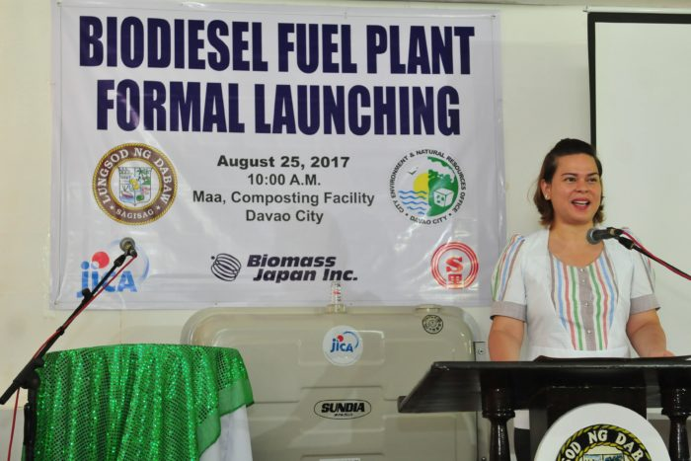
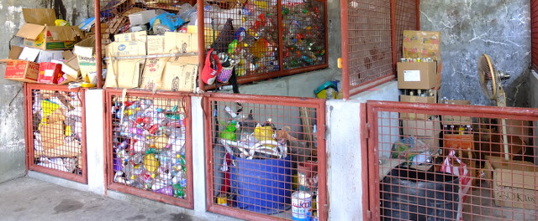
3. SOLID WASTE MANAGEMENT
Establishment of Waste to Energy facility
Development of New Sanitary Landfill Sites and Solid Wastes Segregation

Slide 14
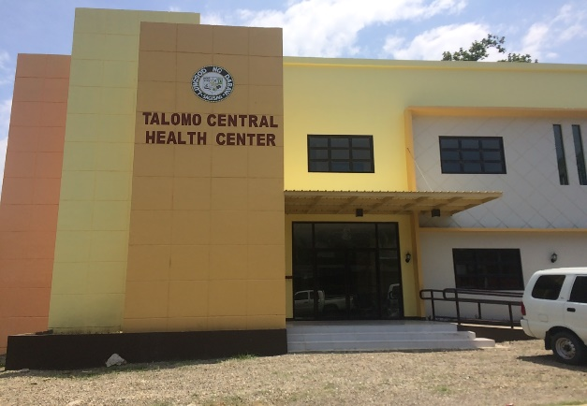
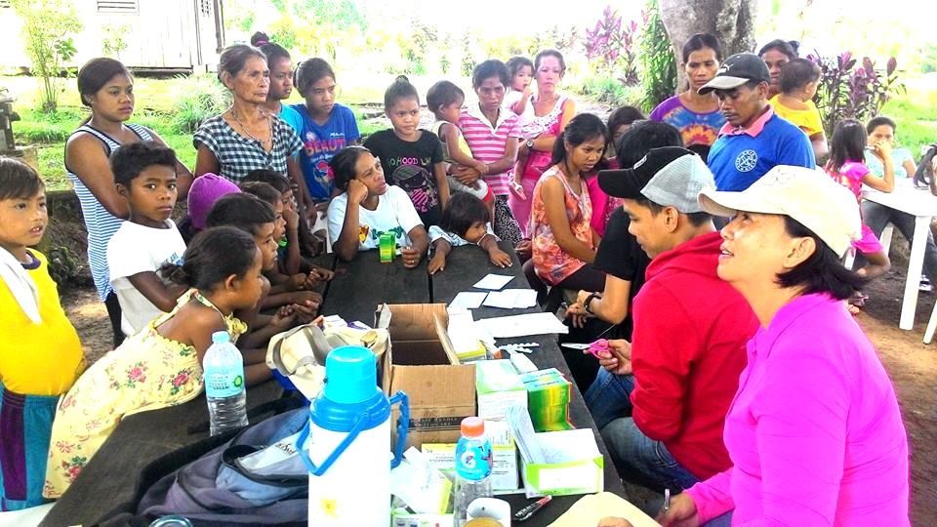
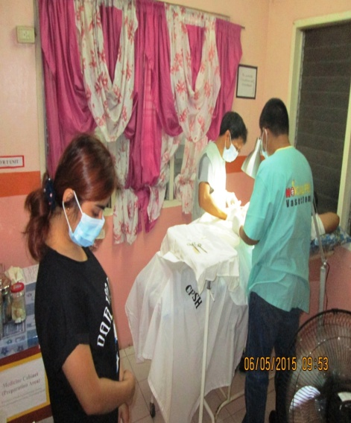
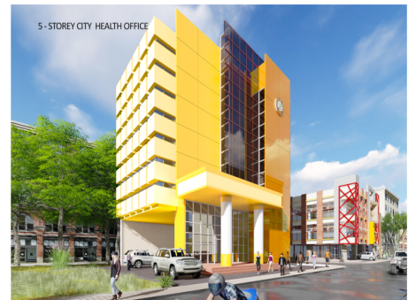
4. HEALTH
Clean Air Davao Program
Health Facility Enhancement Program
Inclusive Health Programs/Projects/
Activities thru “Life-Cycle Approach”
Promotion of Healthy Lifestyle
Reproductive Health Care Program

Slide 15
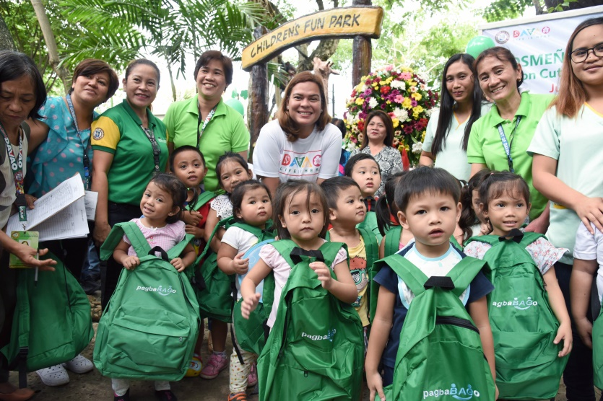
5. EDUCATION
Improvement of Industry-based competencies
Sufficiency in Education Facilities and
Learning Materials
Education Scholarship Program

Slide 16
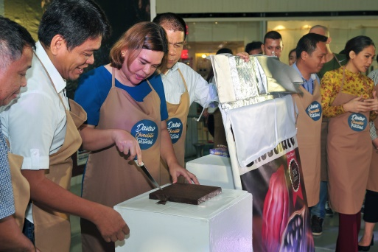
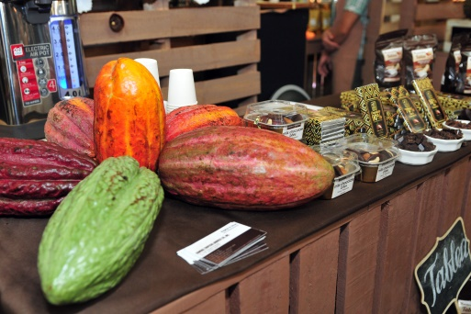
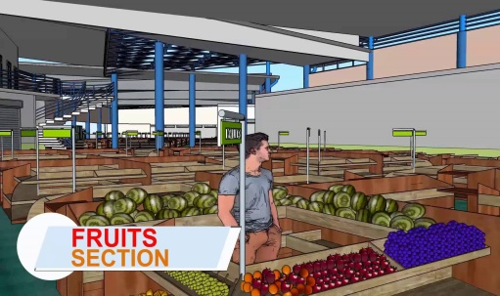
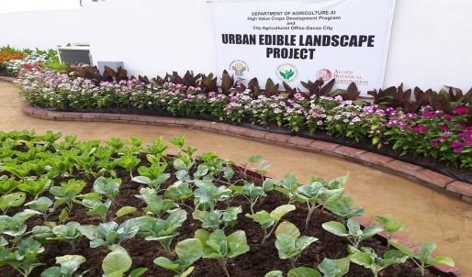
6. AGRICULTURE
Development of Davao City as the “ Chocolate Capital of the Philippines”
Completion of the Agri-Pinoy Trading Center at Daliao
Organic Farming and Containerized Gardening

Slide 17
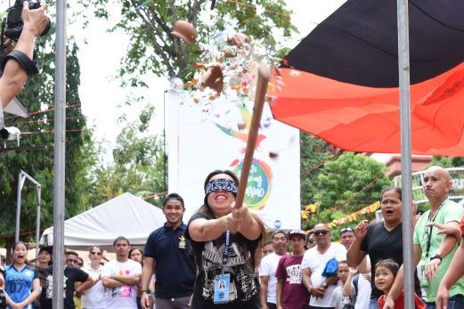
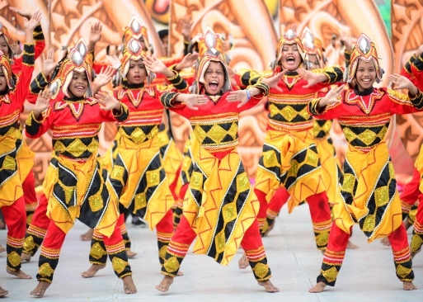

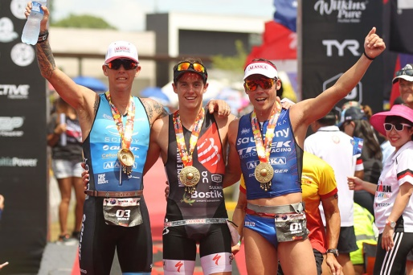
7. TOURISM
Tourism Promotion in the South East Asia Region
Tourism Development Program
Community Based Tourism Village
Riverside Development
Tourism Information Center
Tourism Development within the context of environmental regulations

Slide 18

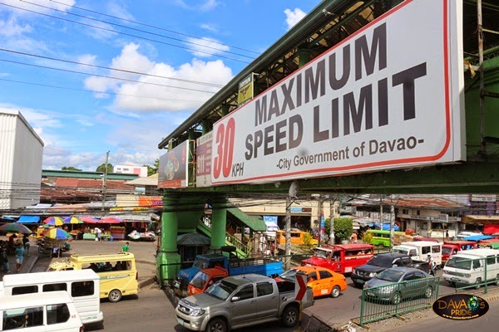
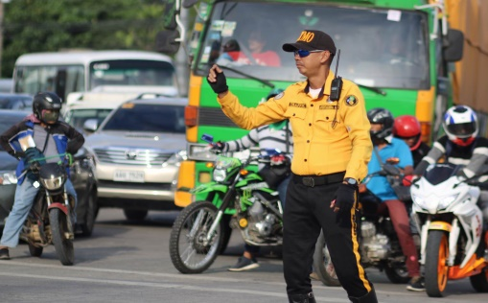
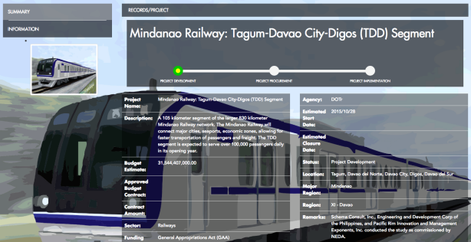
8. TRANSPORTATION PLANNING AND TRAFFIC MANAGEMENT
Creation of the City Transportation and Traffic Management Office
Develop Efficient Public Transportation System

Slide 19
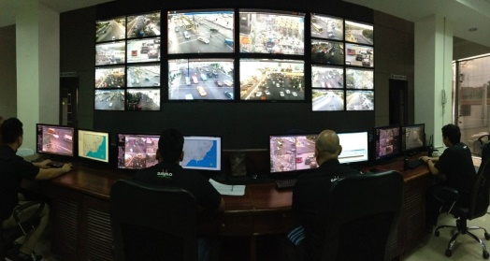
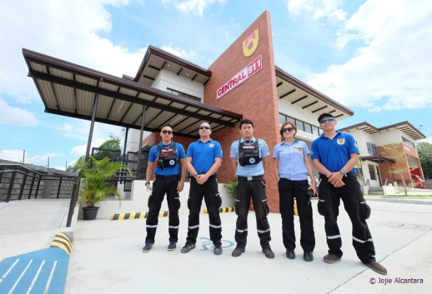
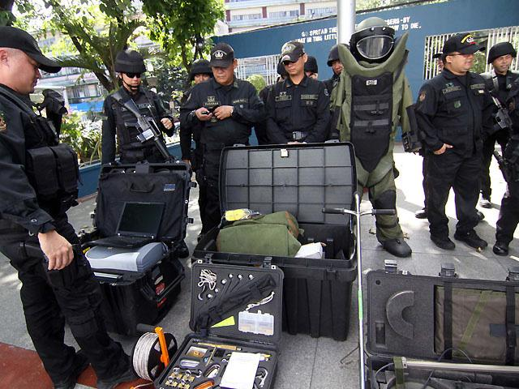
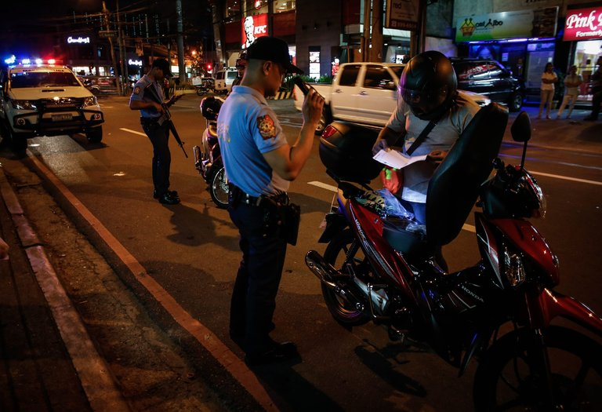
9. PEACE AND ORDER
Expansion of Central 911 Main Headquarter and Construction of Satellite Stations
Intensify Campaign Against Illegal Drugs

Slide 20
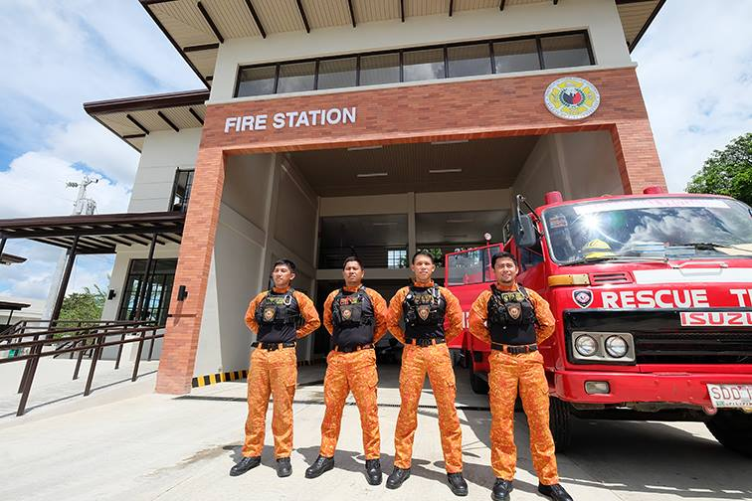
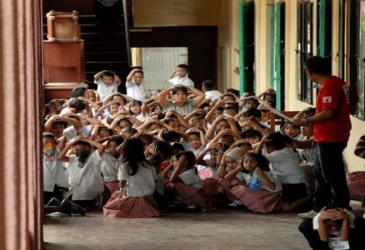
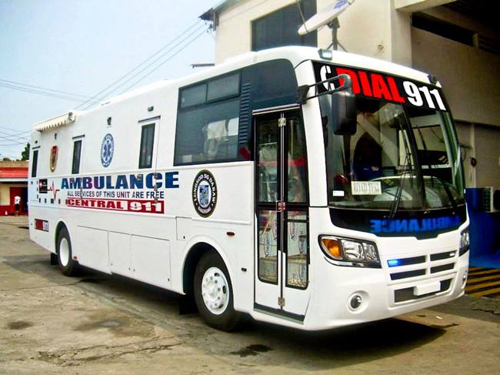
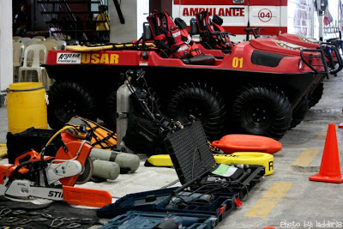
10. DISASTER RISK REDUCTION
AND MITIGATION
Local Climate Change Action Plan
Disaster Risk Reduction Management Plan
Construction of Disaster Resilient Evacuation Centers
Evacuation Management Plan

Slide 21
Low-Carbon Measures in Davao City
Demand | 1. Town Structure | IM4 Davao Formulation Transit-Oriented Development Planning 10% Additional Greening/Greenspace UEE Implementation Rules & Regulations More Open Spaces Proposed Coastal Road
 | 2. Buildings | Green Building Ordinance Rain Water Harvesting Law
 | 3. Transportation | HPBS (High Priority Bus System) Railway System/Monorail Expressways (Bypass Road) Coastal Road Road Network Rationalizing Program

Slide 22
Low-Carbon Measures in Davao City
Supply | 4. Area Energy System | None
 | 5. Untapped Energy | (Waste To Energy (WTE)
 | 6. Renewable Energy | Hydro Electric Power Plants, Talomo Hydro 1, Talomo Hydro 2, Talomo Hydro 3, HEDCOR Agus Iligan
 | 7. Multi Energy System | Hydro Electric Power Plants, Talomo Hydro 1, Talomo Hydro 2, Talomo Hydro 3, HEDCOR Agus Iligan, Therma South
Demand & Supply | 8.1.1 Energy Management System | None; Present in Source Industry Facilities but Interested
 | 8.1.2
 | 8.1.3 Micro Grid | None but interested

Slide 23
Low-Carbon Measures in Davao City
Environment & Resources | 9. Greenery | Park Maintenance (Botanical, Peoples Park, Islands, Quezon Park, Sta. Ana Park)/ Park Development (Brgy. 10) Tree Growing/Forest Rehabilitation Mangrove Rehabilitation Adopt-a-Watershed Program Riverbank Rehabilitation
 | 10. Water Management | Rainwater Harvesting Law Surface Water Development Project Community Water System Development Septage/Sewerage Treatment Plant

Slide 24
Low-Carbon Measures in Davao City
Environment & Resources | 11. Waste Management | Updating of Solid Waste Management (SWM) Plan Biodiesel Waste to Energy (WTE) Project Establishment of Material Recovery facilities (MRF) Operation of Sanitary Land Fill (SLF)
 | 12. Pollution | Green House Gas (GHG) Inventory Study with KITAKYUSHU Operationalization of Water Quality Management Areas Water Quality Monitoring Program Smoking Regulation Ordinance Anti-Smoke Belching Ordinance Establishment of Watershed Multipartite Monitoring Team Coastal Clean-up Organic Farming Ordinance

Slide 25
Low-Carbon Measures in Davao City
Governance | 13. Policy Framework | Ordinance Number | Ordinance Title
 |  | Ord. No. 999, s. 1974 | Prohibiting the construction of Houses/or buildings within the 50-meter distance from the highest tide level along the seashore of Talomo beach
 |  | Ord. No. 117-01, s. 2001 | Water Resource Management and Protection Code of Davao City
 |  | Ord. No. 0280-06, s. 2006 | The Anti-Smoke Belching Ordinance-Protection of the Air Quality of Davao City

Slide 26
Low-Carbon Measures in Davao City
Governance | 13. Policy Framework | Ordinance Number | Ordinance Title
 |  | Ord. No. 0310-07, s. 2007 | Watershed Protection, Conservation and Management Ordinance hereinafter referred to as the Watershed Code
 |  | Ord. No. 0375, s. 2009 | Establishment and Management of Davao City Maritime Protected Areas
 |  | Ord. No. 0289-09, s. 2009 | Davao City Rainwater Ordinance of 2009
 |  | Ord. No. 0361, s. 2010 | An ordinance providing for an Ecological Solid Waste Management prohibiting certain acts and providing penalties for violations, and for other purposes

Slide 27
Low-Carbon Measures in Davao City
Governance | 13. Policy Framework | Ordinance Number | Ordinance Title
 |  | Ord. No. 0363-10/2849-10, s. 2010 | Septage and Sewerage Management Ordinance of Davao City
 |  | Ord. No. 0367-12, s. 2012 | The New Comprehensive Anti-Smoking Ordinance of Davao City
 |  | Ord. No. 0546-13, s. 2013 | The Zoning Ordinance of Davao City
 |  | Ord. No. 0325-15, s. 2015 | An Ordinance Closing off the City Davao to Mining
 |  | Ord. No. 044-02 | Creation of the Solid Waste Management Board
 |  | Resolution Number | Resolution Title
 |  | Res. No. 01163-08 | Adopting the 10-year Integrated Solid Waste Management Plan 2008-20017 of Davao City

Slide 28
Low-Carbon Measures in Davao City
Governance | 14. Education & Management | IEC Program on Solidwaste Management Waste Disposal Management System Monitoring Biodegradable Waste of Public Market Processed for Greening Program of the City Issuance of Solid Waste Management Certificates relative to the issuance of business permits

Slide 29
Self-evaluation Results of Davao City
Please paste the radar chart evaluation results and explain the current status of the low-carbon town development.

Slide 30
Future Plan of Davao City
Take initial steps in terms of measures, interventions and policy to achieve low-carbon levels in the city of Davao
Scientific data collection
Green House Gas Inventory
Capacity building on Low Carbon
Formulation of Local Climate Change Action Plan (LCCAP)
Information and Education Campaign (IEC)/Popularization of Low Carbon Targets

Slide 31
Feedback for LCT-I System
Please describe any comments on the LCT-I System.
What were the difficulties in the evaluation process?
How are you going to utilize the evaluation results?
How do you think the LCT-I System can be improved?
Any expectations for the LCMT Secretariat to further develop the LCT-I System?

