Slide 1
2nd APEC Low-Carbon Model Town Symposium
Da Nang, 20 September, 2018
APEC LOW-CARBON TOWN INDICATOR (LCT-I) SYSTEM
Munehisa Yamashiro, Vice President, APERC

Slide 2
Key Activities of LCMT Project (Phase 1-6)
Development and refinement of the “Concept of the Low-Carbon Town in the APEC Region (Concept)”
The Concept shows a basic idea/principle of a low-carbon town and provide guidance.
The APEC Low-Carbon Town Indicator (LCT-I) System has been developed based on the Concept.
2. Feasibility Study for a Case Town
3. Policy Review for a Case Town

Slide 3
Preliminary Research for the LCT-I System
Concept
Feasibility
Study
Policy Review
Cities Surveyed in Phase 1- 6
Case Towns in Phase 1- 6
Phase 1
Yujiapu, Tianjin, China
Greenfield development of central business districts (CBD) of a large city
Da Nang, Viet Nam; Surabaya, Indonesia; Cebu,
The Philippines; Putrajaya, Malaysia; and Tianjin, China
Phase 2
Samui Island, Thailand
Development on an island resort
Samui Island, Thailand; Penghu Island, Chinese Taipei;
and Da Nang, Viet Nam
Phase 3
Da Nang, Viet Nam
Redevelopment of an existing city
Portland, The US and San Borja, Peru
Vancouver, Calgary, and Toronto in Canada;
and Philadelphia, The US
San Borja, Peru
Residential area in a city
Phase 4
Adelaide and Melbourne in Australia; Auckland and Palmerston North in New Zealand; and Santiago, Chile
Bitung, Indonesia
Industrial area in a city
Phase 5
Phase 6
Mandaue, The Philippines
Low-carbon development plans in cooperation with neighbouring cities
Yongin and Jincheon in Korea; Krasnoyarsk, Russia; and Yokohama and Kashiwa in Japan
Development of LCT-I System

Slide 4
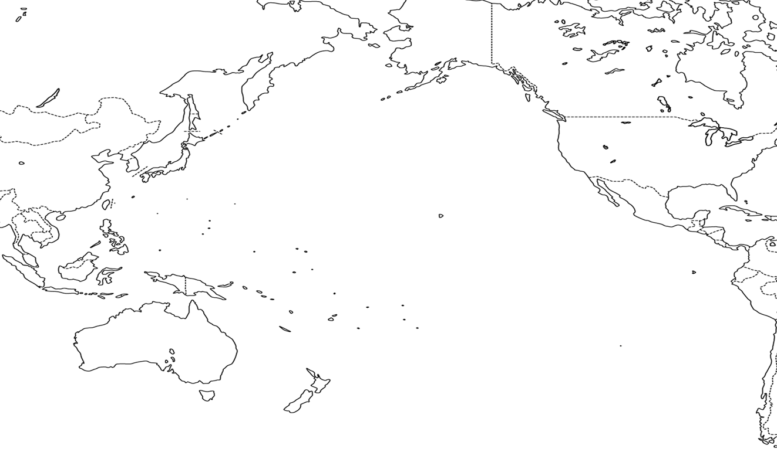
Case Towns of Feasibility Study and Policy Review
Phase 7
Krasnoyarsk
Russia
Phase 1
Tianjin
China
Inland region with high demand for heating and cooling
Central
Business
District(CBD)
Phase 3
Da Nang
Viet Nam
Phase 6
Mandaue
Philippine
Redeveloping
mixed-use
urban district
Cooperation with neighboring cities
Phase 4
San Borja
Peru
Phase 2
Samui
Thailand
Phase 5
Bitung
Indonesia
Residential areas
Island
resort area
Industrial area

Slide 5
Sixth Edition of the Concept
The Concept aims to promote the development of LCT in the APEC region by providing a basic principle that can assist the central and local government officials in planning effective low-carbon policies and in formulating an appropriate combination of low-carbon measures while taking socio-economic conditions and city-specific characteristics into consideration.
The Sixth Edition of the Concept* consists of:
Executive Summary (3 pages)
Volume I: Main Chapter (72 pages)
Volume II: Low-Carbon Measures (81 pages)
The 1st-6th Editions of the Concept are available at:
http://aperc.ieej.or.jp/publications/reports/lcmt.html
The Sixth Edition is the final.

Slide 6
Volume I: Main Chapter
Chapters in Volume I
1 | Background and Achievement to Date
2 | APEC Low-Carbon Town and its Concept
3 | Basic Approach to Develop the Low-Carbon Town
4 | Characterisation of Towns and Low-Carbon Measures
5 | Measures Applicable to the Development of Low-Carbon Town
6 | Evaluating the Effect of Low-Carbon Measures

Slide 7
Volume II: Low-Carbon Measures
Volume II includes:
  Low-Carbon Measures and Their Applicability
  Low-Carbon Measures with Case Examples
Cogeneration System/Combined Heat and Power/Trigeneration | (11) Hydroelectric Power Generation | (21) Electrically Driven Vehicle
(2) Using Sea/River Water | (12) Waste Heat from Incineration Plants | (22) Infrastructure for Electrically Driven Vehicle
(3) District Heating and Cooling (DHC) | (13) Solar Power Generation | (23) Community Cycle Sharing
(4) Sunlight Reflection, Shading and Thermal Insulation | (14) Solar Heating & Cooling | (24) Smart Grid
(5) Façade Engineering | (15) Biomass Power Generation | (25) Community Energy Management System
(6) Natural Ventilation | (16) Geothermal Power Generation | (26) Home Energy Management System
(7) Daylight Use plus Lighting System | (17) Wind Power Generation | (27) Factory Energy Management System
(8) Hybrid of Natural Ventilation plus Air Conditioning | (18) Fuel Cell | (28) EV Charging Management Solution
(9) High-efficient Heat or Cooling Source plus Thermal Storage | (19) Transportation (Establishment of Public Transportation Network) | (29) Demand Side Management
(10) Waste Heat from Sewage Treatment Plant | (20) Local Transportation System (Bus, LRT, etc.) | (30) Simulation Results for CO2 Emission Reduction (Central TOKYO 7 Wards Area)

Slide 8
Characteristics of LCT-I System
A self-assessment tool to assess and monitor the progress of each LCT development project (not for comparison).
It is supposed to be used by central and local government officials.
Designed to be as simple as possible with user-friendliness in mind.
Users can carry out an assessment with the attached LCT-I evaluation sheet.
The assessment areas of the LCT-I System are comprehensive and uses a five point scale evaluation in principle.
APEC’s liaison officer had attended meetings of ISO/TC268 on Sustainable Cities and Communities since February 2015 to maintain the LCT-I System relevant to global standards developed by ISO.

Slide 9
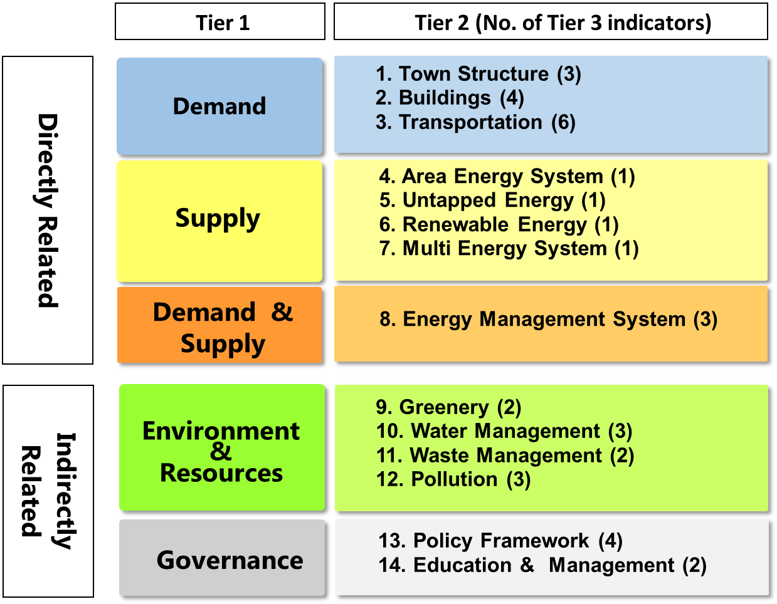
Assessment Framework of LCT-I System
Notes:
As the low-carbon measures addressed in the Concept were originally designed from the energy perspective, they were first categorized into two main categories: measures directly related energy usage; and measures indirectly related to energy usage.

Slide 10
Indicators of LCT-I System: Demand
Demand
Tier 1
Tier 2
Tier 3
Town Structure
Adjacent Workplace and Residence
Land use
Transit Oriented Development (TOD)
Energy Saving Construction
Green Construction
Buildings
Transportation
Promotion of Public Transportation
  Easy-to-Use Public Transportation
  Comprehensive Transportation Measures
Improvement in Traffic Flow
  Transportation Demand Management (TDM)
  Transportation Infrastructure Planning
Introduction of low carbon vehicles
Promotion of Efficient Use
  Support for Eco-driving

Slide 11
Indicators of LCT-I System: Supply, Demand & Supply
Supply
Tier 1
Tier 2
Tier 3
Area Energy
System
Area Energy System
Untapped
Energy
Untapped Energy
Renewable
Energy
Renewable Energy
Multi-Energy
System
Multi-Energy System
Demand & Supply
Tier 1
Tier 2
Tier 3
Energy
Management
System
Energy Management of Buildings/Area
  Energy Management System (EMS)
  Area Energy Management System (AEMS)
  Smart Micro-Grid

Slide 12
Indicators of LCT-I System: Environment & Resources
Environ-ment & Resources
Tier 1
Tier 2
Tier 3
Greenery
Securing Green Space
  Formation of Green Shade
  Formation of Greening
Water Management
Water Resources
  Water Usage
  Water Reuse
    Rainwater Use
    Recycled Wastewater Use
Waste Management
Waste Products
  Reduction of Waste Products
  Reuse of Waste Products
Pollution
Air Pollution
Water Pollution
Soil Pollution

Slide 13
Indicators of LCT-I System: Governance
Gover-nance
Tier 1
Tier 2
Tier 3
Policy Framework
Efforts toward a Low-Carbon Town
  Policies/Business Plans to Create Low-Carbon Town
  Budget for Policies/Business Plans to Create Low-Carbon Town
Efforts toward sustainability
  Business Continuity Plan (BCP)/Life Continuity Plan (LCP)
  Developments with Less Impact on Natural Environment
Education &
Management
Life Cycle Management
Area Management toward Energy-Saving and Low-Carbon Town

Slide 14
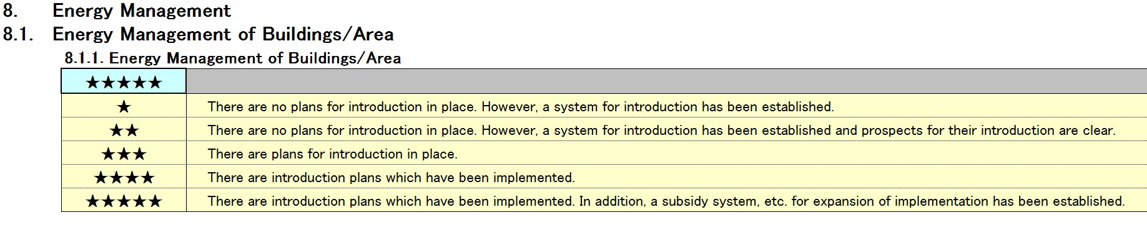

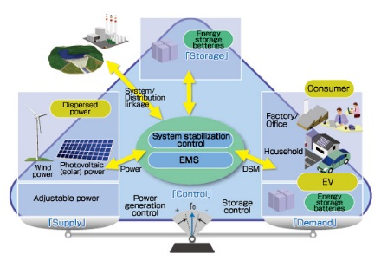
Sample of Qualitative Indicator
Assess the presence or absence of EMS introduction plans.
EMS refers to systems or technologies that enable energy conservation through visualising energy consumption, controlling and monitoring of building and equipment operations, as well as optimising the use of renewable energy.
Notes:
You can choose one to five stars in the blue box in each indicator based on your city’s current situation.

Slide 15
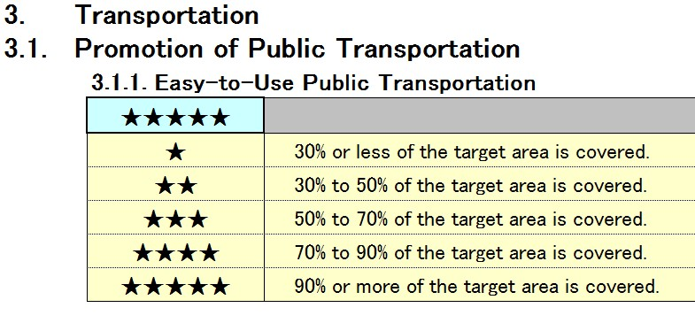
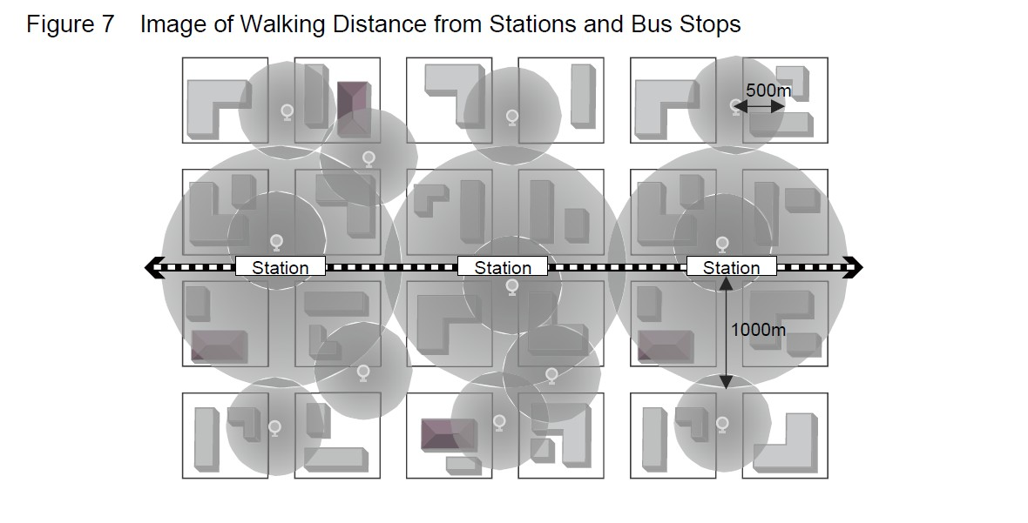
Sample of Quantitative Indicators
Assess the coverage ratio of the areas of walking distance from the train stations and bus stops to the target area.
Coverage ratio refers to the proportion of range (area of a circle) with a radius of 500m-1000m, centering on train stations and bus stops, to the entire range (assessment target area).
Train station: radius of 1000m
Bus stop: radius of 500m
The range of walking distances (500m or1000m) were referenced from CASBEE(CASBEE for Urban Development –3.1.1.1 Development of traffic facilities)

Slide 16
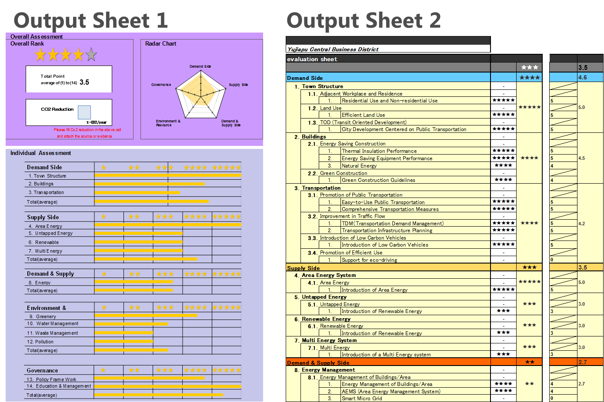
Image of Evaluation Results
Notes:
Once you choose number of stars (★ to ★★★★★) in each indicator, the results will automatically appear on the output sheet 1 and 2.
The assessment results will appear as “overall rank”, ”radar chart”, and ”Individual assessment” in the output sheet 1.
These results will help identify the achievement level of the low-carbon development projects and where to be improved for the realization of a low-carbon town.
On the output sheet 2, you can see the assessment result of each indicator at one sight.

Slide 17
Resources for CO2 emissions calculation
The calculation method is according to the calculation criteria of each economy, but for economies that do not have a regulated calculation method, the following guideline can be used as an example.
Intergovernmental Panel on Climate Change (IPCC)
http://www.ipcc-nggip.iges.or.jp/public/2006gl/index.html
‘ISO14064’ regulated by International Organization for Standardization (ISO) about estimate, report and verification of greenhouse gas (GHG) emissions and reductions.
http://www.iso.org/iso/catalogue_detail?csnumber=38381
*no need to do verification process (ISO 14064-3)
Simplified method is also explained with a quote from CASBEE for Cities in the LCT-I System Guideline.

Slide 18
Thank you for your kind attention
      The LCT-I System Guideline:
      http://aperc.ieej.or.jp/publications/reports/lcmt/LCT-I_System_Guideline.pdf
      Evaluation Sheet:
      http://aperc.ieej.or.jp/publications/reports/lcmt/LCT-I_Evaluation_sheet_first_edition_rev2.xls

