Slide 1
ADB Low Carbon Development Projects
At 2nd APEC LCMT Symposium
Xuedu Lu
Asian Development Bank
Da Nang, Viet Nam
20-21 September 2018

Slide 2
Outline
  ADB’s Climate Change Program
  Cases of ADB Low Carbon Development Projects
  Procedures of seeking ADB support

Slide 3
1. ADB’s Climate Change Program

Slide 4
ADB Climate Strategy
ADB Climate Change Operational Framework 2017-2030:
Support to ambitious climate objectives (NDCs) and climate plans by developing members
Accelerating low GHG emissions development
Promoting climate change adaptation
Integrating climate change adaptation and disaster risk management
Linking climate actions to the wider sustainable development agenda.

Slide 5
ADB Climate Strategy
ADB climate change actions:
Supporting institutional development and appropriate policy frameworks
Access to finance
Promoting use of climate technology
Developing knowledge solutions and capacity development
Strengthening partnerships and networks.

Slide 6
ADB Climate Finance
In 2015 ADB made a commitment to double its climate financing from its own resources to $ 6 billion by 2020.
2016：ADB climate investments: $3.7 billion ($2.6 b in mitigation and $1.1 b in adaptation）
2017： ADB climate investments: $5.15 billion ($4.2 b in mitigation and $0.95 b in adaptation）
From 2019 – 2030, ADB cumulative climate finance of own source reaches $80 billion

Slide 7
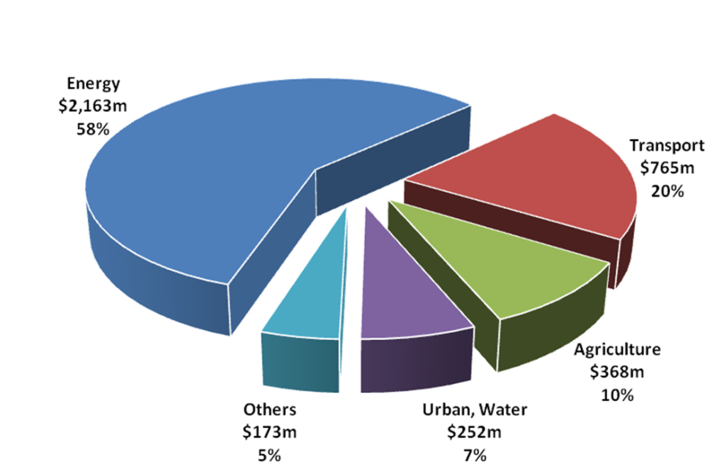
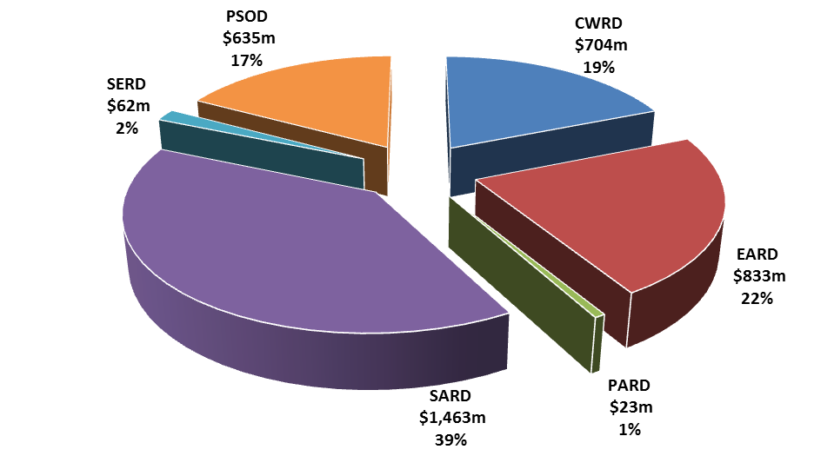
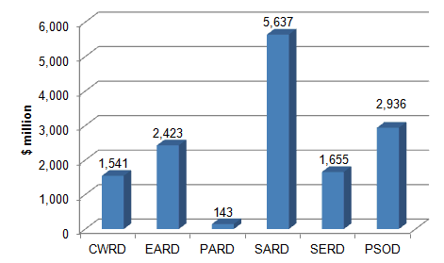
ADB Climate finance in 2016
By Sector
By region
Regional Department climate finance (2012-2016)
Total climate finance: $3.7 B
Mitigation
$2.6 B
Adaptation
$1.1 B
External resources $701 million for climate support.

Slide 8
Total Annual GHG Emission Reductions by ADB Supported Loan projects (tCO2e/yr)
Region/Year | 2013 | 2014 | 2015 | 2016 | 2017
PRC | 897,916 | 3,765,728 | 1,975,694 | 1,054,350 | 2,052,960
CWRD | 600,000 | - | 60,000 | - | 7,989
EARD | 897,916 | 3,765,728 | 343,991 | - | 1,444,222
PARD | - | - | - | - | -
PSOD |  | 830,150 | 1,787,276 | 1,571,215 | 674,133
SARD | 91,000 | - | - | 383,000 | 508,790
SERD | - | 258,550 | 173,789 | - | 1,497,794
ADB | 1,588,916 | 4,854,428 | 2,365,056 | 1,954,215 | 4,132,928

Slide 10
ADB Approaches to Climate Finance Mobilization
Deploying concessional resources
Maximizing
market mechanisms
Catalyzing
private capital
Internally-managed funds
Clean Energy Financing Partnership Facility (CEFPF)
Climate Change Fund (CCF)
Others with bilaterals
Externally-managed funds
Climate Investment Funds (CIFs)
Global Environment Facility (GEF)
Green Climate Fund (GCF)
Carbon finance
  Asia Pacific Carbon Fund (closed in 2014)
  Future Carbon Fund
Carbon Market Technical Support Facility
  CDM support
  domestic emissions trading
  Supporting other market mechanisms
    Japan Fund for the Joint Crediting Mechanism
    Renewable energy credits; feed in tariffs
    Green and climate bonds
Direct project finance (lending, guarantees, syndications), and equity investment
Public private partnerships: (PPPs) working with client DMCs across stages of PPPs

Slide 11
ADB Climate Funds
ADB has established more than 20 funds related to climate change. In 2017, three new climate related Funds were established:
Asia-Pacific Climate Finance Fund (ACliFF), aiming to support the development of climate-relevant financial risk management products.
High-Level Technology Fund (HLTF), providing support to promote the integration of high-level technology and innovative solutions throughout the project cycle.
Canadian Climate Fund for the Private Sector in Asia II, providing cofinancing for ADB private sector projects focused on climate change mitigation and adaption.

Slide 12
ADB Green/Climate bonds
$500 M green bonds issued in March 2015 for mitigation and adaptation
$225 M climate bonds issued in Feb 2016 to support a geothermal power project in The Philippines
$1.3 B Climate Bonds issued in August 2016 for mitigation and adaptation
$46 M green bonds issued in May 2017 to help fund more than 700 megawatts of solar and wind energy capacity in India.
$1.25 B green bonds issued in August 2017 to help finance climate change mitigation and adaptation projects
In July 2018, €600 million climate bonds issued to finance ADB climate change mitigation and adaptation projects

Slide 13
Mitigation Initiatives
Clean Energy
  > $2b investments
  Hub for SE4All Initiative/ E4All Partnership
  Sustainable Transport
  urban transport
  railway
  Climate proofing of road infrastructure
Land Use and Forest Management
  Piloting REDD in Indonesia and Lao PDR

Slide 14
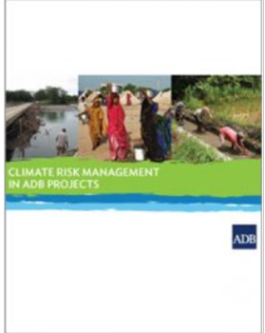
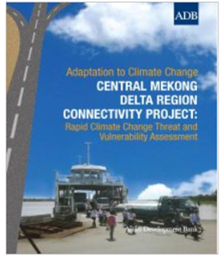
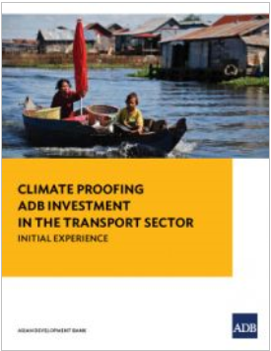
Adaptation Initiatives
Mainstreaming climate resilience in core development planning
  Pilot Program on Climate Resilience for Bangladesh, Cambodia, Nepal, Papua New Guinea, Samoa, Tajikistan and the Pacific
Climate proofing vulnerable projects: roads and bridges, ports, water supply and drainage
Knowledge support: regional climate projections consortium data facility , and tools

Slide 15
ADB Climate Knowledge Products
Catalyzing Green Finance: A Concept for Leveraging Blended Finance for Green Development: an innovative financing solution for enhancing both financially bankable and environmentally sustainable infrastructure projects.
Emissions Trading Schemes and Their Linking: Challenges and Opportunities in Asia and the Pacific
Roadmap for Carbon Capture and Storage Demonstration and Deployment in the People’s Republic of China
……

Slide 16
ADB's Pilot Asia-Pacific
Climate Technology Finance Center (CTFC)
ADB-UNEP Collaboration
Pilot A-P Climate Technology Network and Finance Center
Technology Network (UNEP)
Technology Finance Center(CTFC) (ADB)
1
2
3
4
5
6
Facilitating Technology Network
Building Technology Centers
Enabling Policies
Technology Main-streaming
Catalyzing Project & Venture Capital Investments
Pilot Marketplace for Low-Carbon Technologies
Network Facilitation and Development
Enhancing Enabling Environment
Investment Facilitation
Capacity Building

Slide 17
2. Cases of ADB Low Carbon Development Projects

Slide 18
New Approach: Low carbon and resilient city
ADB is supporting developing member countries to develop low carbon and resilient city to address climate change and pollution while maintaining economy development.
TA: Promoting Low-Carbon Development in Central Asia Regional Economic Cooperation Program Cities
Loan: Xiangtan Low Carbon City Development

Slide 19
TA: Promoting Low-Carbon City Development
The project will strengthen the city government capacity to plan and implement climate actions in city investment plans to further enhance sustainable, inclusive, and low carbon development.

Slide 20
TA: Promoting Low-Carbon City Development
Project budget: $2.8 million, covering four components:
GHG data management systems
Investment roadmaps for low-carbon growth
Collection of successful cases driving low-carbon development
Capacity building for city governments

Slide 21
Xiangtan Low-Carbon City Transformation
The project will address complex development issues and support to cities for its integrated, inclusive, low carbon and green development.

Slide 22
Xiangtan Low-Carbon City Transformation
The project cost is estimated about $400 million, covering four components.
Intelligent, integrated, low-carbon urban transport system
Green city infrastructure for increasing carbon sink and enhancing climate adaptation
Enabling ICT-based systems for informed decision-making
Green Procurement Policy and action plans

Slide 23
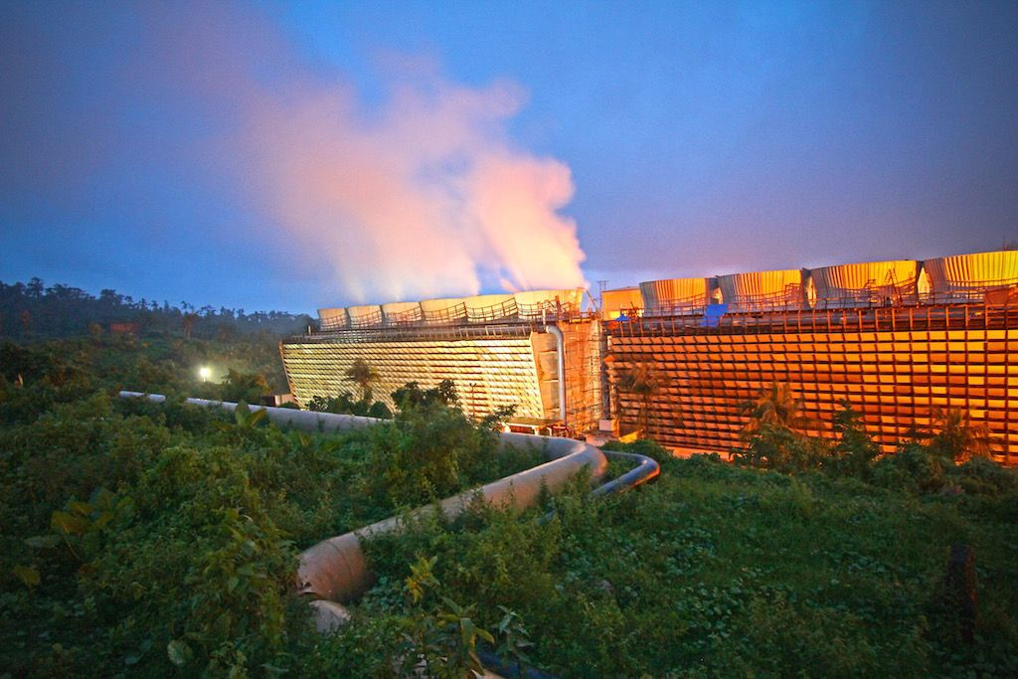
ADB first climate bonds project
ADB first climate bonds project
ADB first climate bonds project:
Tiwi and MakBan Geothermal Power, operated by AP Renewables, Inc. (APRI), The Philippine

Slide 24
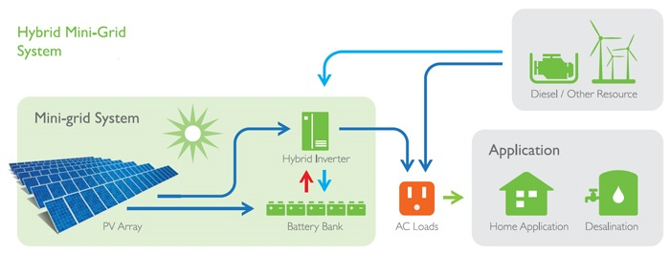
Maldives Solar/Diesel Project
Maldives Outer Islands for Sustainable Energy Development Project:
Transform the existing energy grids of outer islands into a hybrid renewable energy system, by installing energy management and control systems; energy storage; and improvements in distribution networks to reduce the need for diesel to generate electricity.

Slide 25
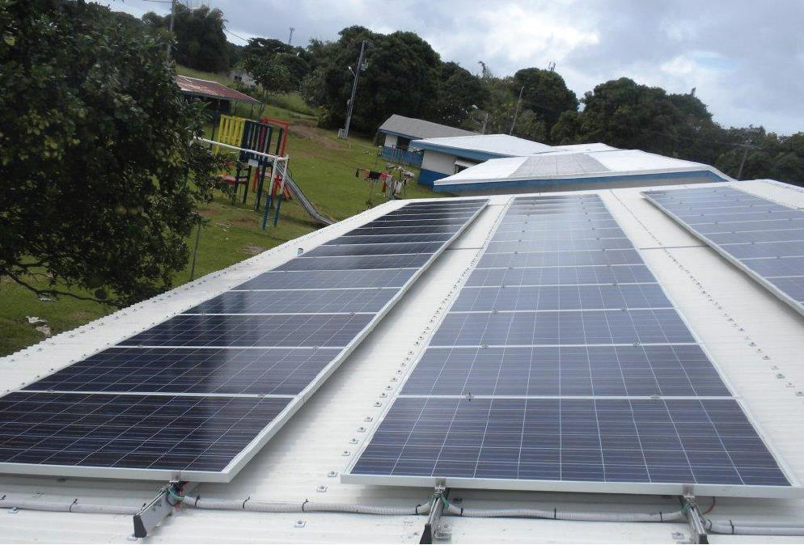
Solomon Islands
Solar Power Development Project
  The Project will develop a solar PV Power with capacity of 1.8MW to provide reliable, cleaner electricity supply from renewable sources

Slide 26
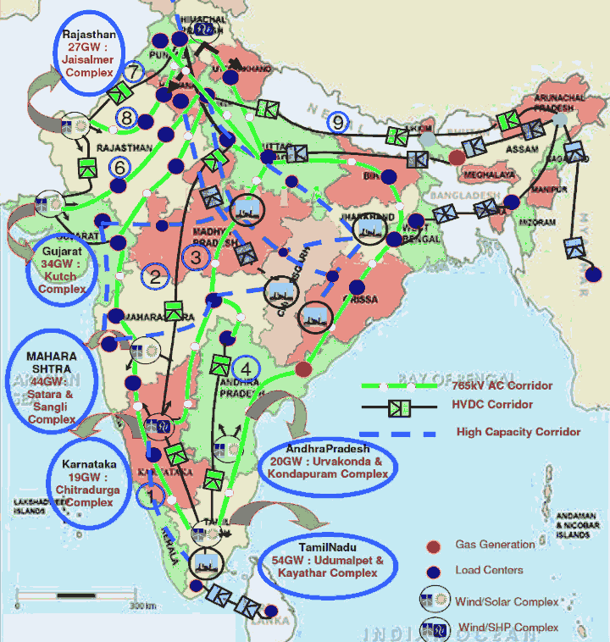
India Green Corridor Project
India’s “Green Energy Corridor” facilitates the transfer of RE from RE rich states to other states
Absorption and smoothing out of the RE intermittency
Static compensators (STATCOMs) to enhance grid stability
$500 million sovereign + $300 million non-sovereign loans

Slide 27
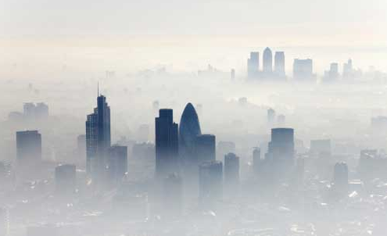
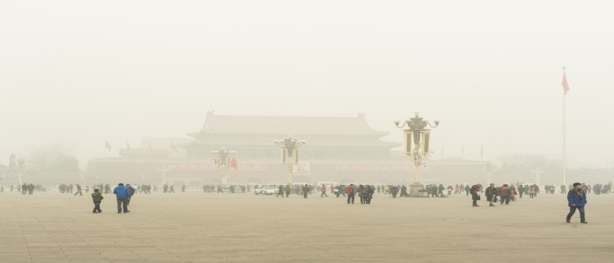
BTH Air Quality Improvement and CO2 reduction
Promote high technology in major polluting sources in BTH
  Targets large industrial, urban and rural emitters to demonstrate advanced technologies – e.g. coke-oven flue gas to LNG, renewable energy-based heating, distributed renewable + smart micro grid etc.
  Partners with city governments, technology institutes, financial institutions to de-risks high technology investments and leverage co-financing
  Large co-benefits of CO₂ mitigation

Slide 28
3. Procedures of seeking ADB support

Slide 29
ADB first climate bonds project
Ways of ADB support
ADB support its developing members through following:
Financing (loan) – sovereign and non-sovereign loan
Technical assistance (TA) – sovereign TA, regional TA, knowledge and policy TA, and transaction TA
Knowledge partnership/support
Others: human resources, ---

Slide 30
ADB first climate bonds project
Procedures of seeking ADB support
For sovereign loan and TA: consultation with counterpart of governments - governments proposed projects to be supported
For non-sovereign loan and TA: ADB to work with clients/partners directly while keeping governments informed
Knowledge partnership: work with knowledge institutes while keeping government informed

Slide 31
Asia-Pacific Forum on Low Carbon Technology
24-26 October 2018
Changsha, Hunan, China
Promotion of Climate Technology Transfer and Investment

Slide 32
Thank you!
Xuedu Lu xlu@adb.org

