Slide 1
Update on OIL AND GAS SECURITY
Chile
María Valenzuela
Engineer of Energy Security and Market Division
Ministry of Energy / Government of Chile
4th Oil and Gas Security Network Forum, 7-8 March 2018, Tokyo, Japan

Slide 2
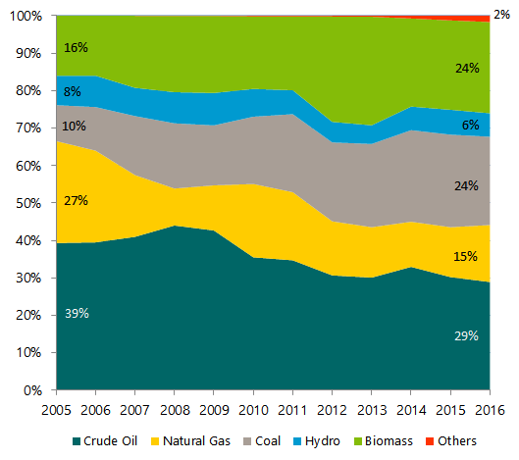
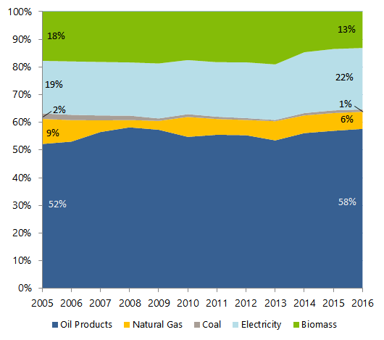
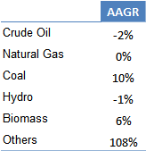
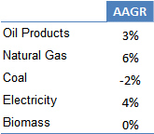
CHILE
Oil and Gas Supply and Demand Situation
Primary Energy Supply, 2005 - 2016
Final Energy Demand, 2005 - 2016
29 Mtoe
32 Mtoe
23 Mtoe
29 Mtoe
Source: Balance Nacional de Energía 2016
Source: Balance Nacional de Energía.
Others: Wind Energy, Solar Energy and Biogas.
AAGR: Average Annual Growth Rate
4th Oil and Gas Security Network Forum, 7-8 March 2018, Tokyo, Japan
Notes:
- Renewable energy has been an important energy source for many decades, at 25-30% of the TPES. In 2016, it accounted for 26.8% of the TPES. This category comprises biofuels and waste (21.2%), hydropower (4.5%), wind (0.5%) and solar energy (0.7%).
Traditional use of firewood for heating and cooking in the residential sector represents the main share of biofuels and waste consumption.
- From 2006 to 2016, the renewable energy supply in the TPES grew by 35%, or 2.6 Mtoe. This growth mainly resulted from a nearly 50% increase in biofuels supply. Wind and solar energy have begun to increase in recent years, but from a very low level.
- Hydropower supply varies significantly year-on-year, depending on the hydrological conditions.

Slide 3
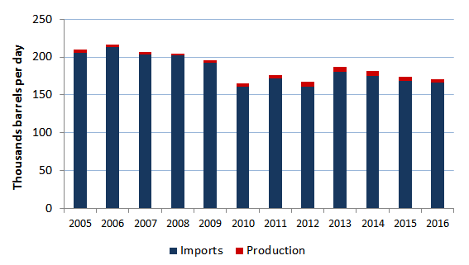
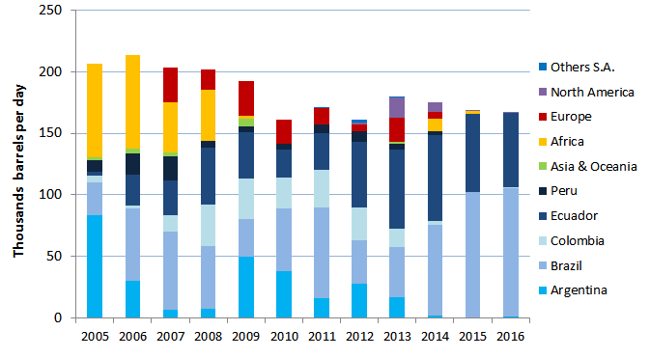
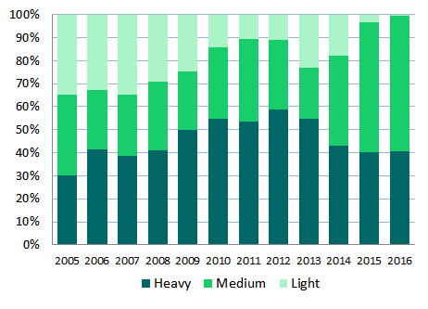
CHILE
Oil and Gas Supply and Demand Situation
Crude Oil Production and Imports, 2005 - 2016
Despite the existence of domestic production, the country is in essence a net importer.
Chile does not export crude oil.
The total share of South American countries in crude oil imports has grown from 62% in 2005 to 98% in 2016.
2%
98%
Source: Balance Nacional de Energía
Crude Oil Imports by Origin
Types of Crude Oil Imported
Source: Cámara de Comercio de Santiago.
Source: Memorias ENAP.
Others South America: Bolivia and Trinidad & Tobago.
4th Oil and Gas Security Network Forum, 7-8 March 2018, Tokyo, Japan
Notes:
- Brazil is the single-largest exporter of crude oil to Chile, providing 63% of the total in 2016, followed by Ecuador at 36%.
- The total share of South American countries in crude oil imports has grown from 65% in 2006 to 97% in 2016, because of lower transportation costs and a tariff agreement, and made possible by adapting the National Petroleum Company (ENAP) refineries to process heavy crude oil from Brazil or Ecuador.

Slide 4
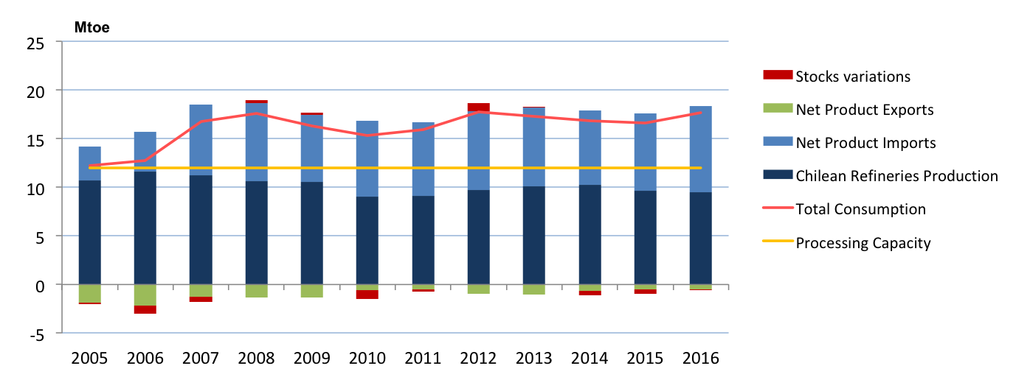

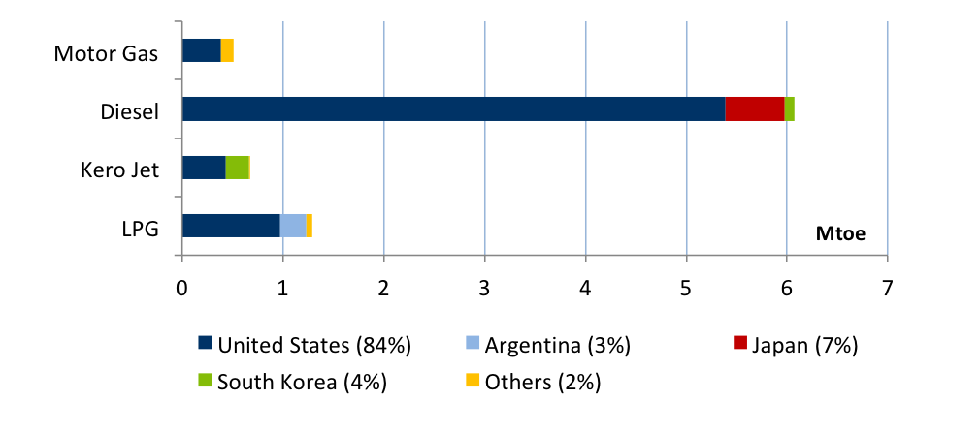
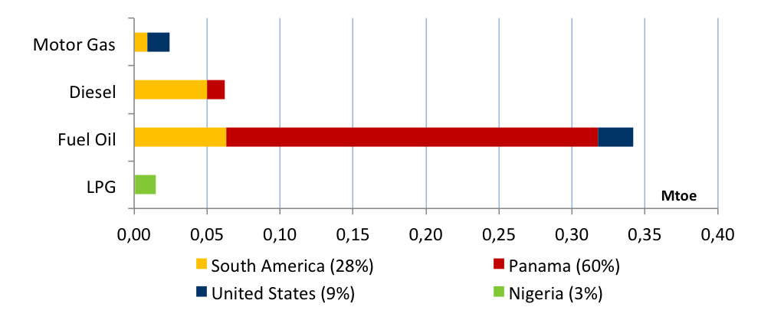
CHILE
Oil and Gas Supply and Demand Situation
Refinery Production, 2005 - 2016
Refinerías Aconcagua
Refinerías BioBío
Refinería Gregorio
Source: Balance Nacional de Energía
Oil Products Imports by Origin, 2016
Oil Products Exports by Destination, 2016
Source: Cámara de Comercio de Santiago.
Source: Cámara de Comercio de Santiago.
Others: Peru, Norway, Germany, Netherlands and Spain.
4th Oil and Gas Security Network Forum, 7-8 March 2018, Tokyo, Japan
Notes:
- In 2016, Chile imported 8.56 Mt of crude oil and 7.29 Mt of oil products. Although imports of crude oil decreased by 23% from 2006 to 2016, imports of oil products increased by 86%, and drove up the total oil imports.
- The main product consumed in Chile is diesel.
- In terms of oil products, the United States is the largest exporter to Chile, accounting for 87% of the total imports in 2016.

Slide 5
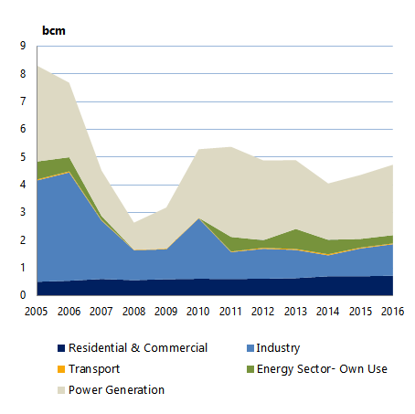
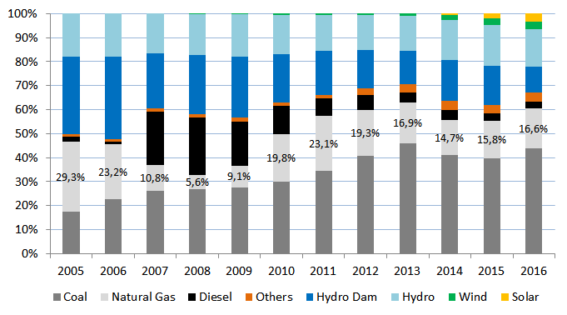
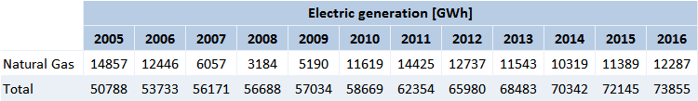
CHILE
Oil and Gas Supply and Demand Situation
Natural Gas Demand by Sector, 2005 - 2015
Share of Natural Gas in Power Generation Mix, 2005 - 2015
Source: Generación Bruta SIC-SING – CNE.
Source: Balance Nacional de Energía.
Others: Includes Petcoke, Cogeneration, Biomass
During 2007-2008 Chile experienced extreme drought, and the almost complete interruption of natural gas supply from Argentina (imports continued for residential and commercial sector)
As a result of that situation, power generators switched to diesel. Then the electric system set to coal and recently to renewable energy, whereas industry switched to oil.
As a countermeasure, two onshore liquefied natural gas (LNG) regasification terminals were developed in a public–private partnership and since 2010 has Chile depended on imported LNG for its gas supply.
4th Oil and Gas Security Network Forum, 7-8 March 2018, Tokyo, Japan

Slide 6
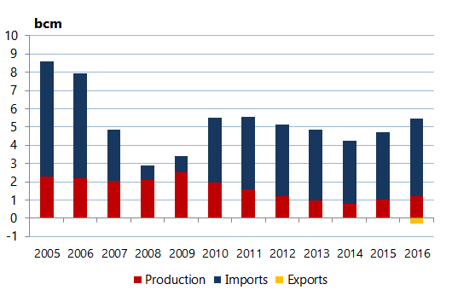
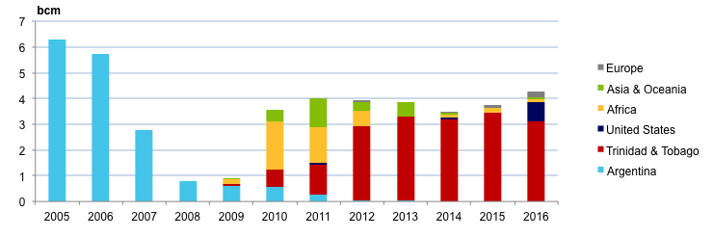
CHILE
Oil and Gas Supply and Demand Situation
Natural Gas Production and Imports, 2005 - 2015
Domestic natural gas is produced in the Magallanes Region, the southernmost region of Chile, and is also used to meet local electricity and heating demand.
EXPORTS:
In 2016, 7% of the imported LNG was exported to Argentina via gas pipelines. This was the first time that Chile exported natural gas.
Source: Balance Nacional de Energía 2015
78%
22%
Natural Gas Imports by Origin
LNG
SOURCES
Piped Gas: Argentina
LNG:
Other countries
Source: Cámara de Comercio de Santiago.
4th Oil and Gas Security Network Forum, 7-8 March 2018, Tokyo, Japan
Notes:
LNG has mostly been imported from Trinidad and Tobago (92% of total imported natural gas in 2014-15). However, thanks to the expansion of the Panama Canal, the transit time from the Atlantic is shorter and import sources became more diversified in 2016: next to Trinidad and Tobago (72%) are also the United States (East Coast) (17%), France reloads (4%), Norway (3%), Qatar (2%) and Equatorial Guinea (2%). Since 2015, no gas has been imported from Argentina, according to Enargas, Argentina’s gas regulator.

Slide 7
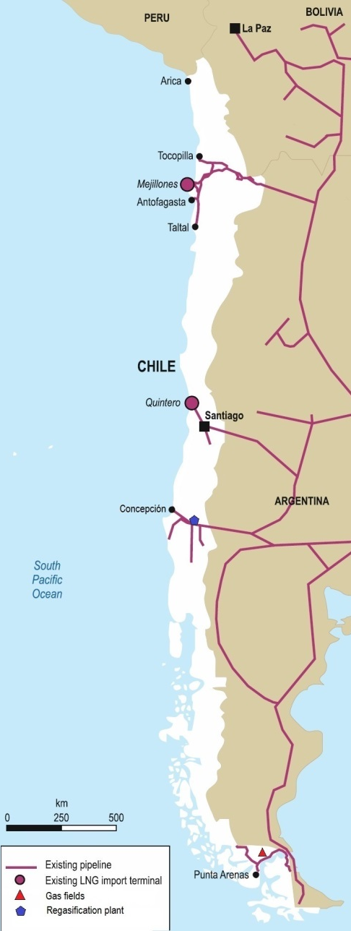
CHILE
Oil and Gas Supply and Demand Situation
Transnational Gas Pipeline | Capacity [mcm/d] | Length [km] | Operation Status for Gas Imports/Exports
Norandino | 7.8 | 1056 | Operational since 2016 solely for exports to Argentina
GasAndes | 10.8 | 541 | Operational as at 2017 exclusively for exports to Argentina
Gas Pacífico | 6.0 | 674 | Sporadic operation for minimum quantities imported from Argentina and for the last swap
Cóndor-Posesión | 2.0 | 9 | Sporadic operation for imports from Argentina
Cóndor-Posesión 2 | 2.5 | 9 | Sporadic operation for imports from Argentina
NORANDINO
GASATACAMA
To date there are no transnational pipeline projects.
GASANDES
PACÍFICO
Status | Terminal | Regasification Capacity [mcm/d] | Date of Operation
Existent | Mejillones LNG | 5.5 | July 2009
 | Quintero LNG | 15 | June 2010
Projected | Andes LNG | 10 | 2020
 | LNG Penco-Lirquén | 15 | (estimated)
 | Talcahuano LNG | 8.5 | 2019
Source: Energy Policies Beyond IEA countries – Chile 2018 review.
CÓNDOR-POSESIÓN
4th Oil and Gas Security Network Forum, 7-8 March 2018, Tokyo, Japan

Slide 8
CHILE
Oil and Gas Security Policy
Oil Stockpiling
Indicators to Gauge Supply Security
Product | Storage [Thounsands m³] | Days of Stocks 2017
Crude Oil | 518 | 19
Motor Gas | 242 | 19
Kerosene | 110 | 24
Diesel | 404 | 15
Fuel Oil | 71 | 23
LPG | 242 | 38
Supply/Demand Monitoring by weekly reports on projections:
- Oil Products: Imports, refinery production, stocks and demand.
- Gas Imported: Imports, regasification, stocks and demand.
- Gas Production: Production, demand and line-pack.
Monitoring of Gas & Oil Production by monthly reports.
The stock level is monitored to accomplish the following:
- Oil products: 25 days
- Gas: 10 days
Oil industry participants currently have the obligation to hold stocks.
Article 7 of Decree with Force of Law N° 1 of 1978 of the Ministry of Mining states the following:
“Every producer or importer of liquid, petroleum-based fuels is required to maintain an average stock of each product which is equal to 25 days of average sales during the previous six months or average imports for the same period of time, if it is for own consumption.”
Chile’s acknowledges that the current 25-day stockholding obligation needs to be updated.
4th Oil and Gas Security Network Forum, 7-8 March 2018, Tokyo, Japan

Slide 9
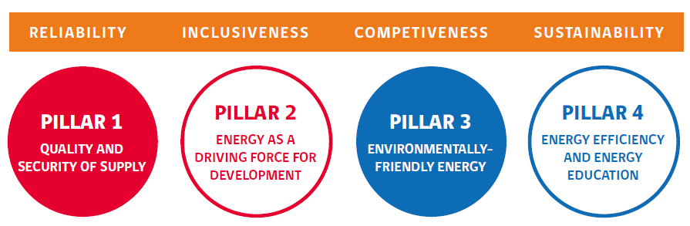
CHILE
Oil and Gas Security Policy
Oil & Gas Supply Security Framework: National Energy Policy for 2050
The National Energy Policy is sustained by four pillars:
Guidelines set forth in the National Energy Policy:
Develop national, regional and municipal plans for managing risks and emergencies affecting the energy sector that are aligned with other sectorial and national plans.
Increase the security of supply, storage, transport and distributions of fuels.
Promote research into and exploration and exploitation of Chiles’s hydrocarbon resources.
4th Oil and Gas Security Network Forum, 7-8 March 2018, Tokyo, Japan

Slide 10
CHILE
Oil and Gas Security Policy Gaps
Strengthen regional oil and gas security
It is in Chile’s interest to maintain regional collaboration with the APEC member economies, with the aim of contributing to keep a bridge of cooperation in technical and emergency response matters. This collaboration will allow economies to provide public value to emergency management in the different phases of the risk cycle, with relevance in the preventive phase. Chile's experience could greatly contribute to strengthening APEC’s regional work in this area, as well as to the exchange of best practices among individual economies.
4th Oil and Gas Security Network Forum, 7-8 March 2018, Tokyo, Japan

Slide 11
Thank you
Update on OIL AND GAS SECURITY
Chile
Email Address: mvalenzuela@minenergia.cl
Contact Number: +56 2 22367 75 79
4th Oil and Gas Security Network Forum, 7-8 March 2018, Tokyo, Japan

