Slide 1
Update on OIL AND GAS SECURITY
Australia
Ms Alison Dell
Director, International Energy Security Engagement
Department of the Environment and Energy
4th Oil and Gas Security Network Forum, 7-8 March 2018, Tokyo, Japan

Slide 2
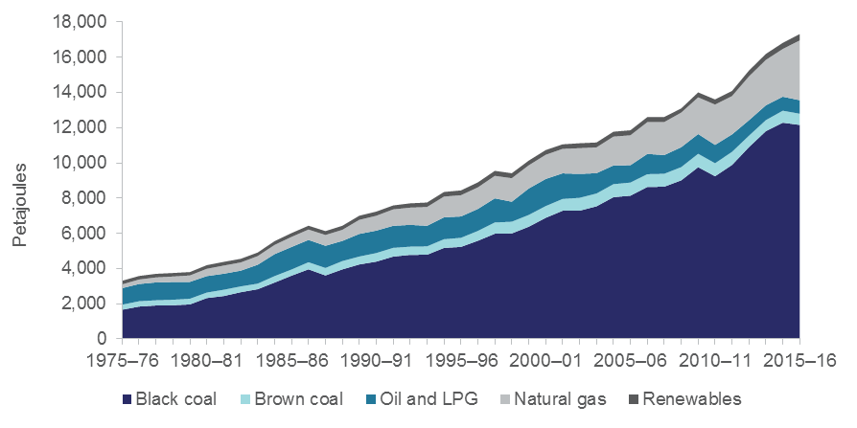
Australia
Oil and Gas Supply and Demand Situation
4th Oil and Gas Security Network Forum, 7-8 March 2018, Tokyo, Japan
Notes:
Slide 1 – Information requested:
Historical (2005-2015/2016) oil and gas demand and supply situation (annual growth rate, average shares to total primary supply and final energy demand, and oil and gas self-sufficiency levels)
Slide 2 – Information requested:
Historical (2005-2016/2017) crude oil production, exports and imports (import dependency level)
Types of crude oil produced and imported
Share of each type of crude oil to total imports (e.g., heavy, medium and light).
Export destination (percent share by economy.
Import sources (percent share by economy)
18,000 PJ = 342 million homes per year.

Slide 3
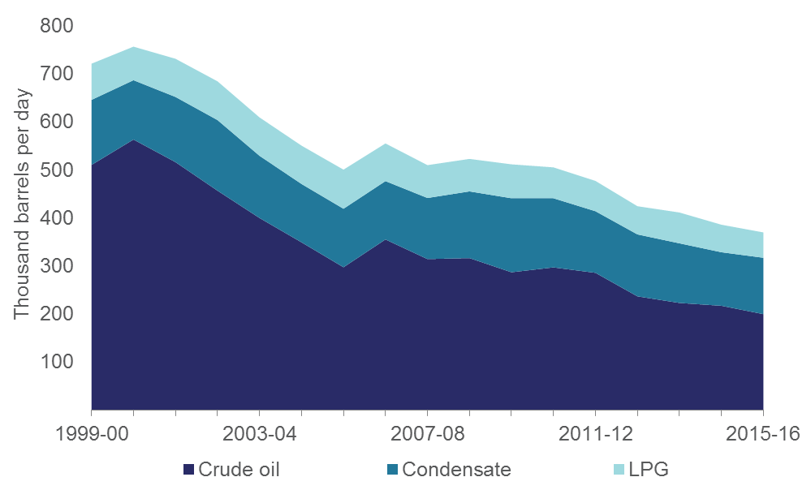
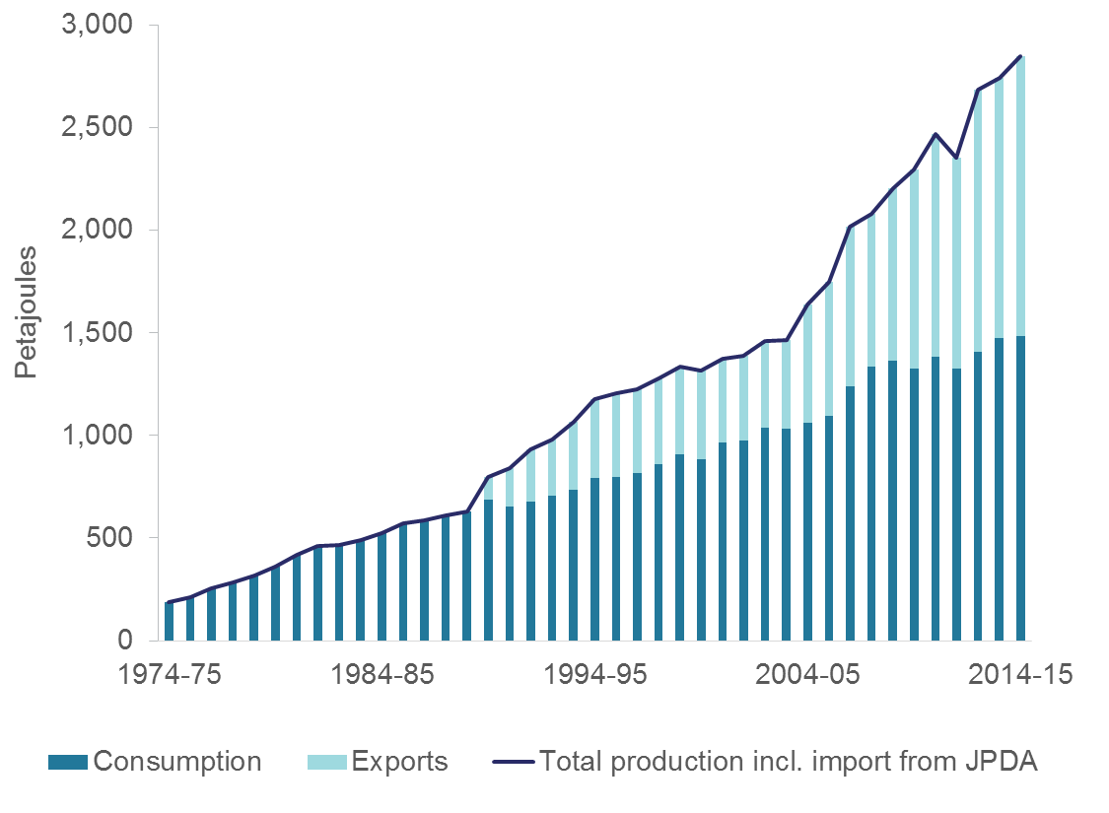
Australia
Oil and Gas Supply and Demand Situation
Oil Production Gas Production
Source: Department of the Environment and Energy (2016)
Australian Petroleum Statistics – December 2016
Source: Department of Industry, Innovation and Science (2016)
Australian Energy Statistics
4th Oil and Gas Security Network Forum, 7-8 March 2018, Tokyo, Japan
Notes:
Slide 1 – Information requested:
Historical (2005-2015/2016) oil and gas demand and supply situation (annual growth rate, average shares to total primary supply and final energy demand, and oil and gas self-sufficiency levels)
Slide 2 – Information requested:
Historical (2005-2016/2017) crude oil production, exports and imports (import dependency level)
Types of crude oil produced and imported
Share of each type of crude oil to total imports (e.g., heavy, medium and light).
Export destination (percent share by economy.
Import sources (percent share by economy)

Slide 4
Australia
Oil and Gas Supply and Demand Situation
Australian primary energy consumption, by fuel
Source: Department of the Environment and Energy (2017), Australian Energy Statistics, Table C
4th Oil and Gas Security Network Forum, 7-8 March 2018, Tokyo, Japan
Notes:
Slide 1 (Information Requested)
Historical (2005-2016/2017) oil and gas demand and supply situation (annual growth rate, average shares to total primary supply and final energy demand, and oil and gas self-sufficiency levels)

Slide 5
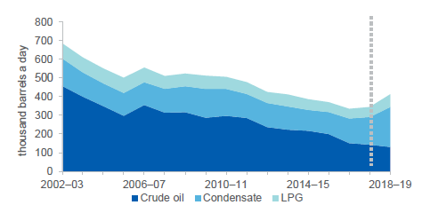
Australia
Oil and Gas Supply and Demand Situation
Recent declines in oil production outweighed by higher condensate and LPG output
Refined product imports have been growing following refinery closures
Source: Dept of Environment and Energy ,Australian Petroleum Statistics (2017); EnergyQuest (2017); Department of Industry, Innovation and Science (2017); Dept of the Environment and Energy (2017), Australian Energy Statistics, Tables D and J
4th Oil and Gas Security Network Forum, 7-8 March 2018, Tokyo, Japan
Notes:
Slide 1 (Information Requested)
Historical (2005-2016/2017) oil and gas demand and supply situation (annual growth rate, average shares to total primary supply and final energy demand, and oil and gas self-sufficiency levels)
Slide 2 (Information Requested)
Historical (2005-2016/2017) crude oil production, exports and imports (import dependency level)
Types of crude oil produced and imported – see slide 6
Share of each type of crude oil to total imports (e.g., heavy, medium and light). See slide 6, but stats below
Export destination (percent share by economy) – see slide 6
Import sources (percent share by economy) – see slide 6

Slide 6
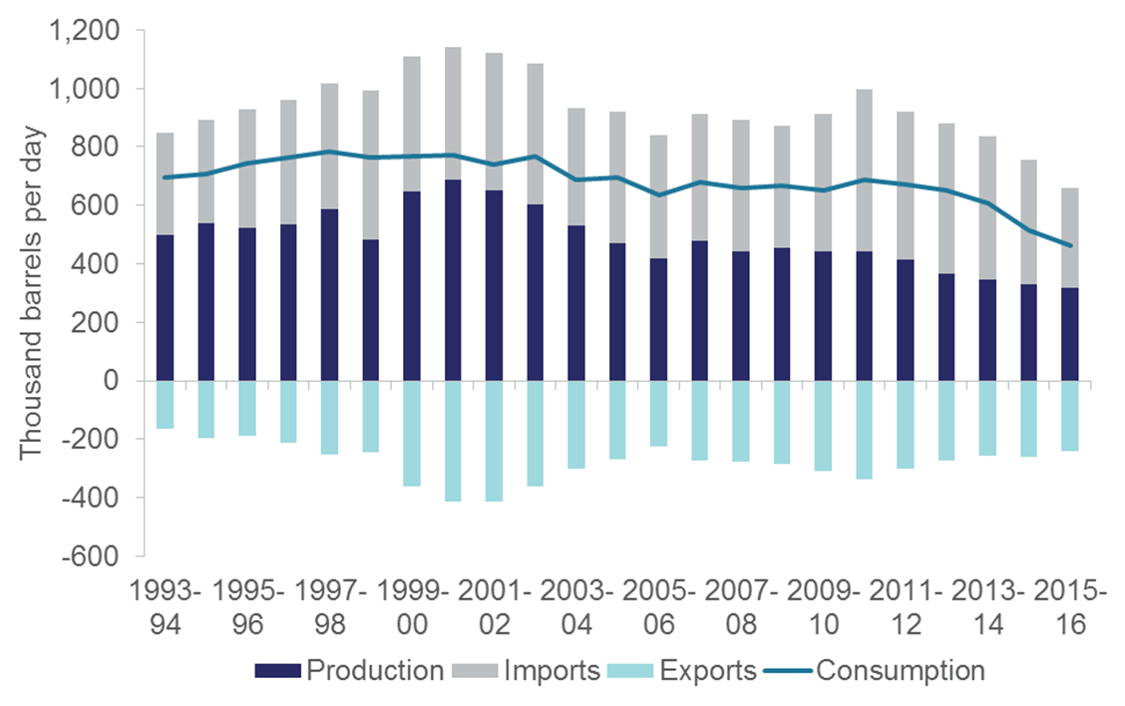
Australia
Oil and Gas Supply and Demand Situation
Australian Refinery Feedstock Balance
Four refineries in Australia supply approximately 50 per cent of refined products used in Australia
Australia’s refining capacity in 2014 was equal to 1.7% of Asia-Pacific capacity
4th Oil and Gas Security Network Forum, 7-8 March 2018, Tokyo, Japan
Notes:
Slide 3 – Information requested
Historical (2005-2016/2017) refinery capacity and production
Oil products exports and imports
Export destination (percent share by economy)
Import sources (percent share by economy)

Slide 7
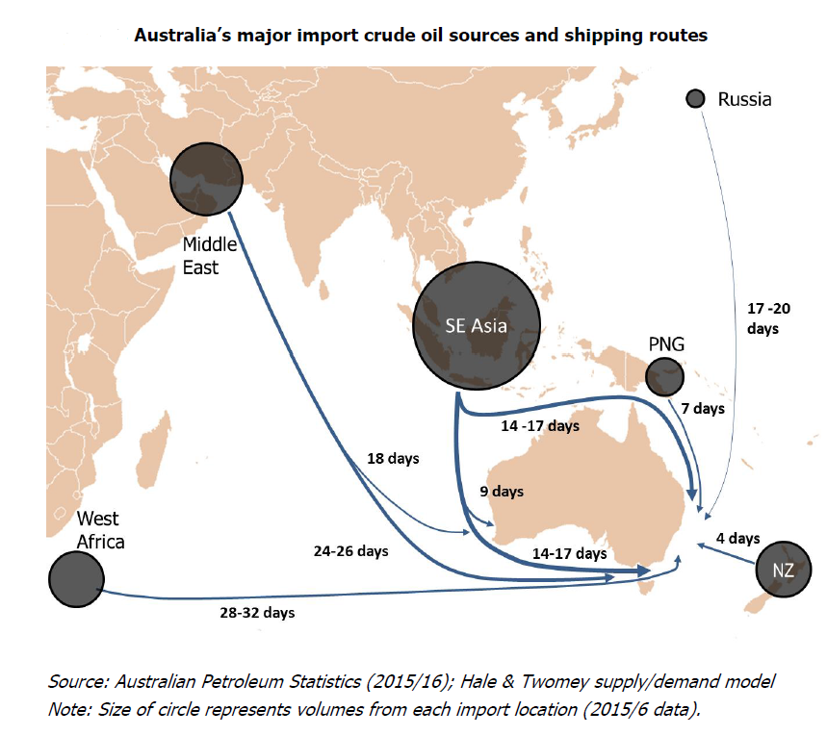
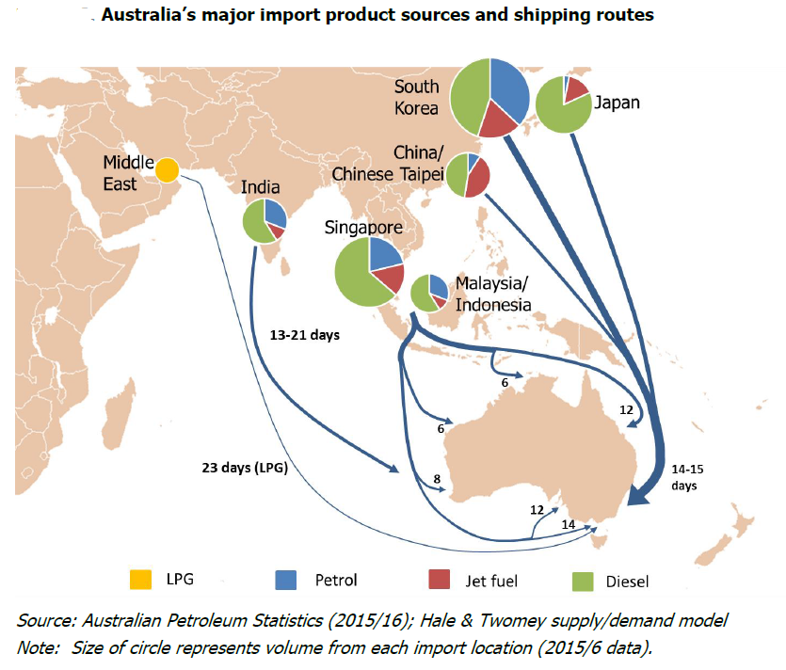
Australia
Oil and Gas Supply and Demand Situation
Product is imported from around 20 countries, with no country providing more than 30% of imports.
At any one time there are 45 oil tankers en route to Australia that collectively carry two weeks of additional supplies.
4th Oil and Gas Security Network Forum, 7-8 March 2018, Tokyo, Japan

Slide 8
Australia
Australia’s fuel mix for electricity generation
Gas demand by sector 2014/15 (latest available)
  38.6% Electricity
  28.2% Industry
  13.7% Mining
  11.3% Households
  8.1% Other
Source: Department of Industry and Innovation, Australian Energy Statistics, 2016
4th Oil and Gas Security Network Forum, 7-8 March 2018, Tokyo, Japan
Notes:
Slide 4 (Information requested)
Historical share (2005-2016/2017) of natural gas in power input fuel mix and power generation mix, and in final energy demand by sector.
Consumption of natural gas for non-power application

Slide 9
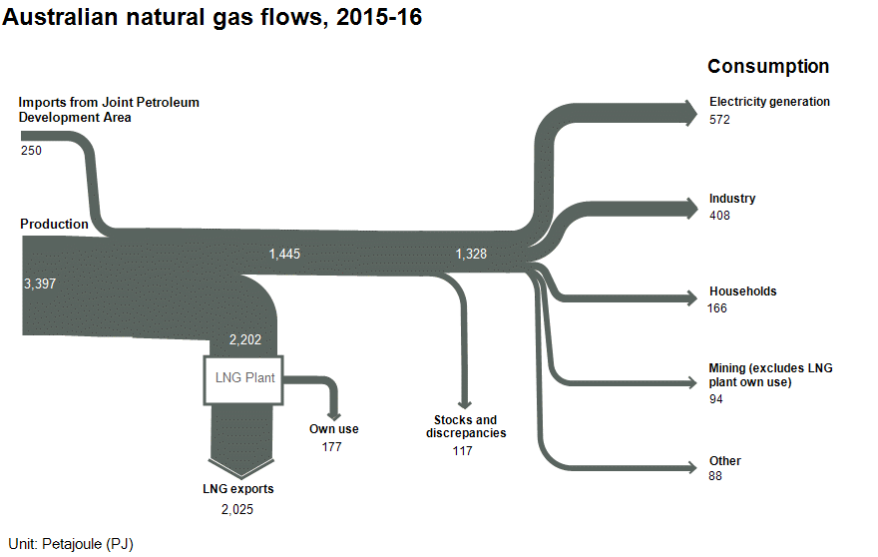
Australia
Oil and Gas Supply and Demand Situation
Natural gas flows, Australia, 2015–16 (Australian Energy Statistics Energy Update, 2017
4th Oil and Gas Security Network Forum, 7-8 March 2018, Tokyo, Japan
Notes:
Slide 5 (Information requested)
Historical (2005-2016/2017) natural gas production, exports and imports (import dependency level) – for gas production, see slide 1
Export destination and import sources (piped gas) (percent share by economy
Existing transnational pipeline (which economy, capacity and length)
Proposed transnational pipeline (which economy, capacity and length, and date of commercial operation)
Export destination and import sources (LNG) (percent share by economy.
Existing and proposed LNG liquefaction facility (capacity and date of commercial operation for the proposed LNG facility)
Existing and proposed regasification facility (capacity and date of commercial operation for the proposed regasification facility)

Slide 10
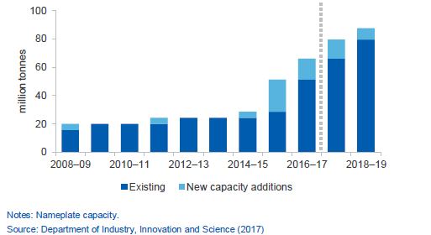
Australia
Australian LNG Exports
LNG Export capacity
LNG export destination, 2016-17
4th Oil and Gas Security Network Forum, 7-8 March 2018, Tokyo, Japan
Notes:
Slide 5 (Information Requested)
Historical (2005-2016/2017) natural gas production, exports and imports (import dependency level)
Export destination and import sources (piped gas) (percent share by economy)
Existing transnational pipeline (which economy, capacity and length)
Proposed transnational pipeline (which economy, capacity and length, and date of commercial operation)
Export destination and import sources (LNG) (percent share by economy)Existing and proposed LNG liquefaction facility (capacity and date of commercial operation for the proposed LNG facility)
Existing and proposed regasification facility (capacity and date of commercial operation for the proposed regasification facility)

Slide 11
Australia
Oil and Gas Security Policy
Australia’s approach to oil and gas security
Market-based approach, backed up by strong regulatory powers.
The Government establishes the market rules, monitors the markets and plans emergency response measures.
Australia does not hold strategic reserves.
Australia is advocating for a greater regional IEA focus (see next slide)
Future energy security means diversified metrics across oil, gas and electricity as all these markets are interdependent.
The Australian Government is developing an energy security assessment across all its energy sectors in response to the recommendations from the Finkel Review (see next slide).
4th Oil and Gas Security Network Forum, 7-8 March 2018, Tokyo, Japan
Notes:
Slide 6 (Information Requested)
Update on Policy Framework on Supply Security
Oil Supply Security Policy
Oil Supply Security Framework
Oil stockpiling for crude oil and petroleum products (absolute amount and for how many days of domestic consumption can be covered). In your own view, at what level of oil stockpiling is appropriate for your economy)
What are the indicators in place to gauge security of supply (if any)?

Slide 12
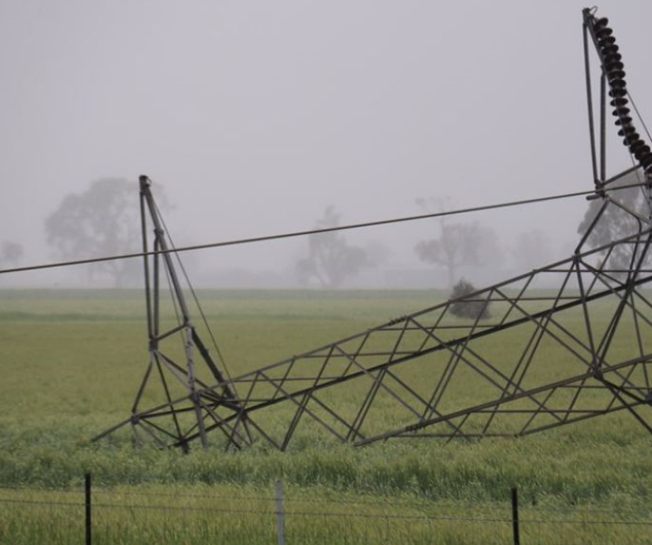

South Australian blackout
Entire state of SA in darkness for 3 hours
AEMO Report: severe weather, infrastructure damage, voltage drop and wind generation disconnected, main interconnector overloaded and closed to prevent damage

Slide 13
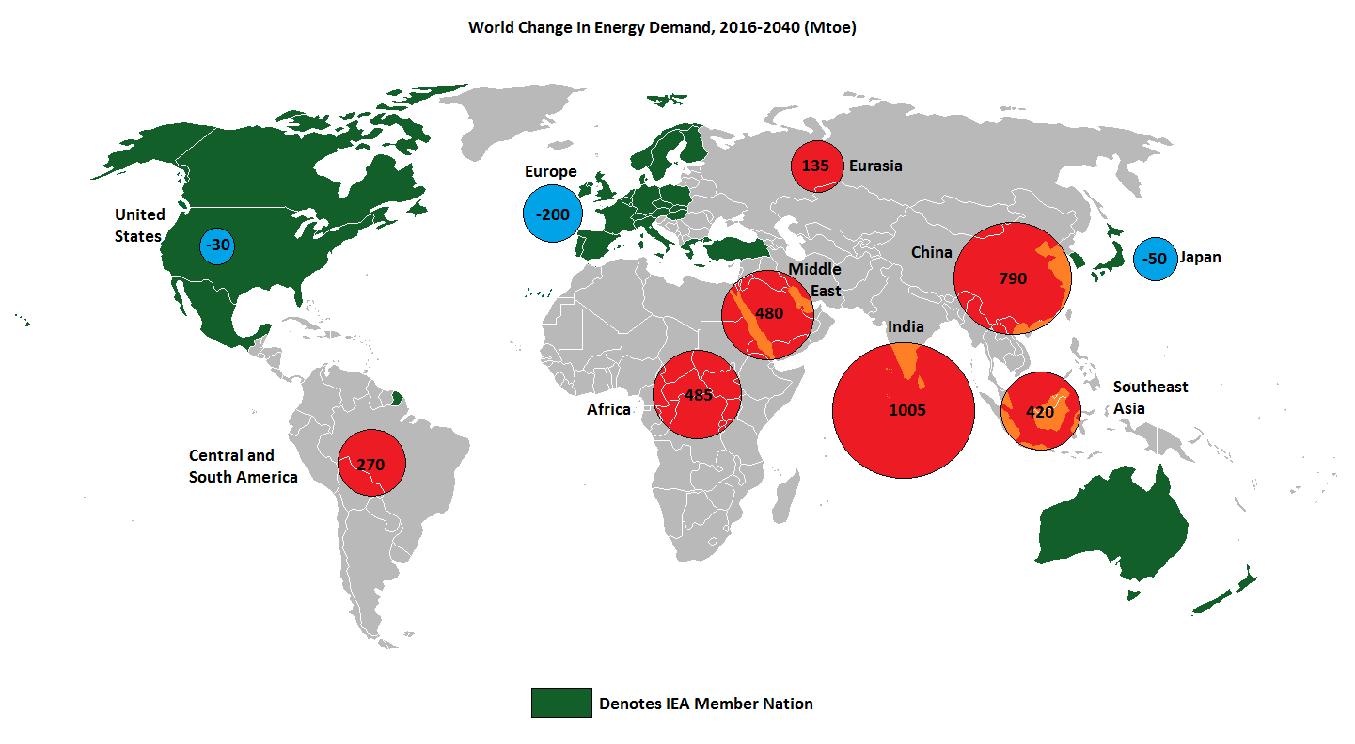
Australia
Oil and Gas Security Policy
Australia is advocating for a greater focus by the IEA in our region
Asia is driving global oil consumption growth, but IEA membership is limited to the two ends of the regional supply chain.
4th Oil and Gas Security Network Forum, 7-8 March 2018, Tokyo, Japan

Slide 14
Australia
Gas Supply Security Policy
  Gas Supply Security Framework
    Australian Domestic Gas Security Mechanism
    COAG Energy Council reforms
  Indicators to gauge security of supply:
    Demand/supply (including peak usage and gas powered generation)
    Market notices
    Infrastructure capacity (pipelines, storage)
    Prices
    AEMO’s Gas Statement of Opportunities
    ACCC Gas Inquiry 2017-2020
4th Oil and Gas Security Network Forum, 7-8 March 2018, Tokyo, Japan
Notes:
Slide 7 (Information Requested)
Gas Supply Security Policy
Gas Supply Security Framework
What are the indicators in place to gauge security of supply (if any)?

Slide 15
Australia
Bilateral/Regional Agreements
  The only existing bilateral or regional agreement relating to oil and gas supply security is the Timor-Leste and Australia Joint Petroleum Development Area.
  Australia and Timor-Leste work together in this area to facilitate the development of shared petroleum resources.
4th Oil and Gas Security Network Forum, 7-8 March 2018, Tokyo, Japan
Notes:
Slide 8 (Information Requested
Existing bilateral/regional agreements related to oil and gas supply security (other than IEA and ASEAN) (if any). Explain the salient provisions of such agreement(s).

Slide 16
Name of the Economy
Oil and Gas Security Policy Gaps
Opportunities exist for regional energy security development, as global energy dynamics are changing:
US becoming the leader in oil and gas production
Shale and LNG add flexibility and versatility to the energy sector
The Future is electrifying – what does this mean for oil and gas?
Affordable and sustainable energy is achievable but the energy transition space will be crucial for countries to navigate successfully.
4th Oil and Gas Security Network Forum, 7-8 March 2018, Tokyo, Japan
Notes:
Slide 9 (Information requested)
For the APEC-wide regional cooperation, what do you think are the policy gaps that need to be addressed or policies that should be formulated and adopted (for consideration by the Energy Ministers) to strengthen regional oil and gas security?

Slide 17
Thank you very much…
Alison.dell@environment.gov.au
+61-2-6275 9595
4th Oil and Gas Security Network Forum, 7-8 March 2018, Tokyo, Japan

