Slide 1

Results of LCTI system in Bitung City
M.J. LOMBAN.
MAYOR OF BITUNG CITY,
North Sulawesi
The 1St LCMT Symposium
Jakarta, 14 September 2017

Slide 2

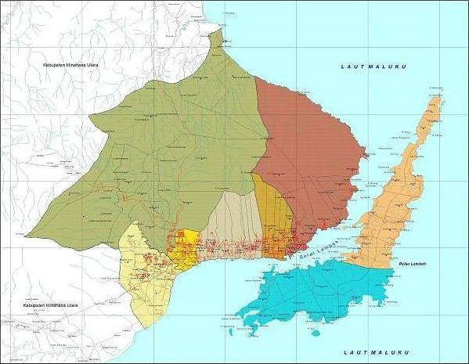
GENERAL DESCRIPTION OF BITUNG CITY
Map of Bitung City
AREA
Located in the most east part of North Sulawesi province
Area 313 Km²
MAIN LAND
Kec. Aertembaga
BORDERS
Kec. Ranowulu
North : Likupang Sub district, Regency of North Minahasa and Moluccas Sea
East : Moluccas Sea
South : Moluccas Sea
West : Kauditan Sub District, North Minahasa Regency
Kec.
Maesa
Kec. Lembeh Utara
Kec. Madidir
Kec. Girian
LEMBEH ISLAND
Kec. Matuari
Kec. Lembeh Selatan

Slide 3
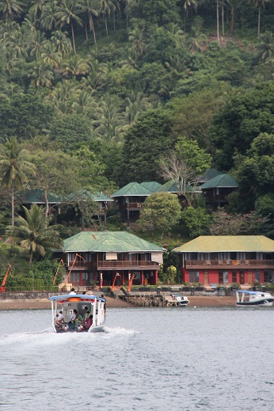
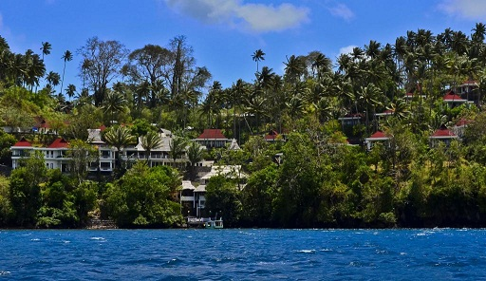
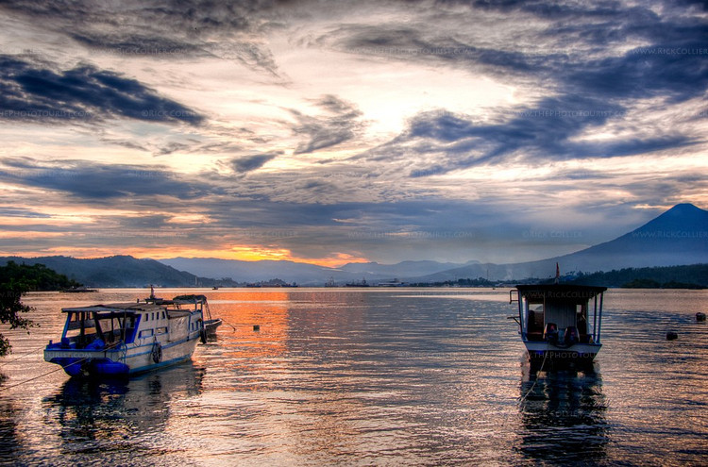
GENERAL DESCRIPTION OF BITUNG CITY
TOPOGRAPHY
Hilly 45,06 %
Mountainous 32,73 %
Flat 4,18 %
Wavy 18,03 %
AREAL DIVISION
Area 31,350.35 ha
Conservation Area 13,378 ha (42.67%)
Consist of : Protected forests, reserves, nature conservation
and natural parks.
17,972 ha (57.33%) Farm.

Slide 4
Geoposition and geostrategic of Bitung
GEOPOSITION
Seebrugge
Rotterdam
Antwerp
Southampton
Seattle
Marseille
North Korea
Oakland(San Fransisco)
New York/New Jersey
Turkey
South Korea
Los Angeles
Japan
China
India
Port of Panama
Thailand
Vietnam
Philippine/General Santos
Malaysia
Brunei
BITUNG
Singapore
Papua Neguine
Darwin
BITUNG is one of the main gates of Indonesia to Asia-Pacific Region.
Sydney
Melbourne
Port of Buenos Aires
(Argentina)
Auckland(New Zealand)

Slide 5
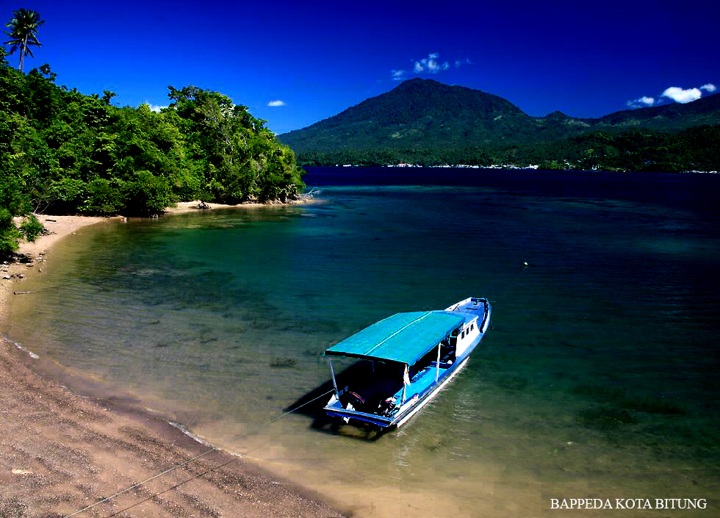
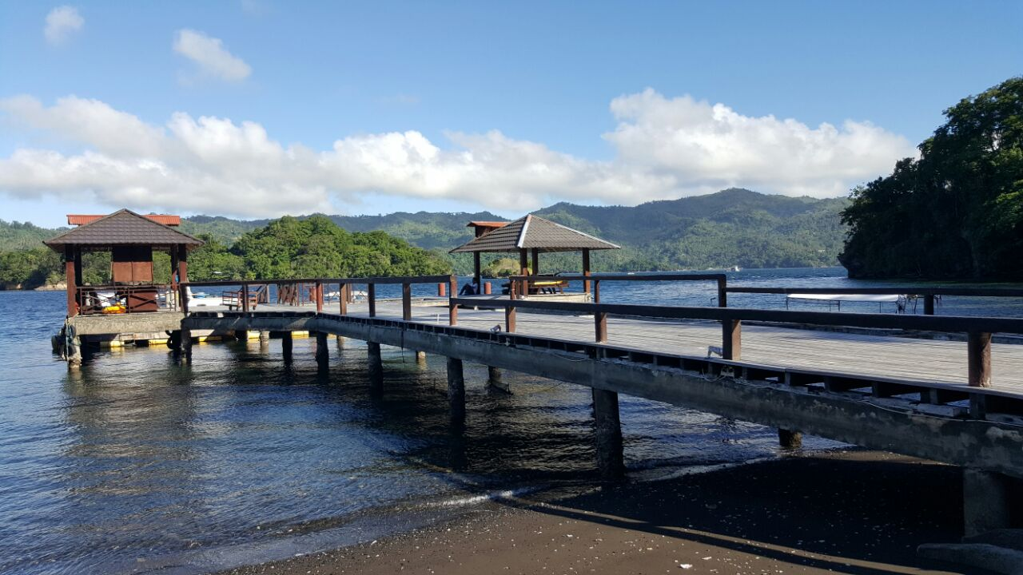
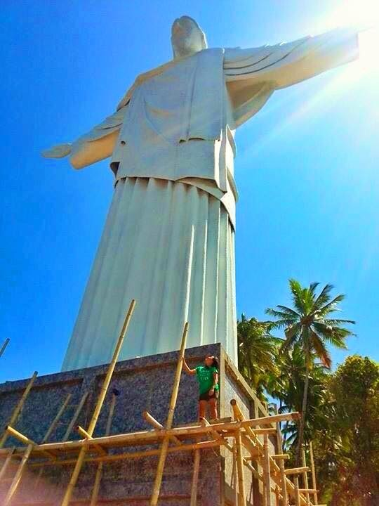
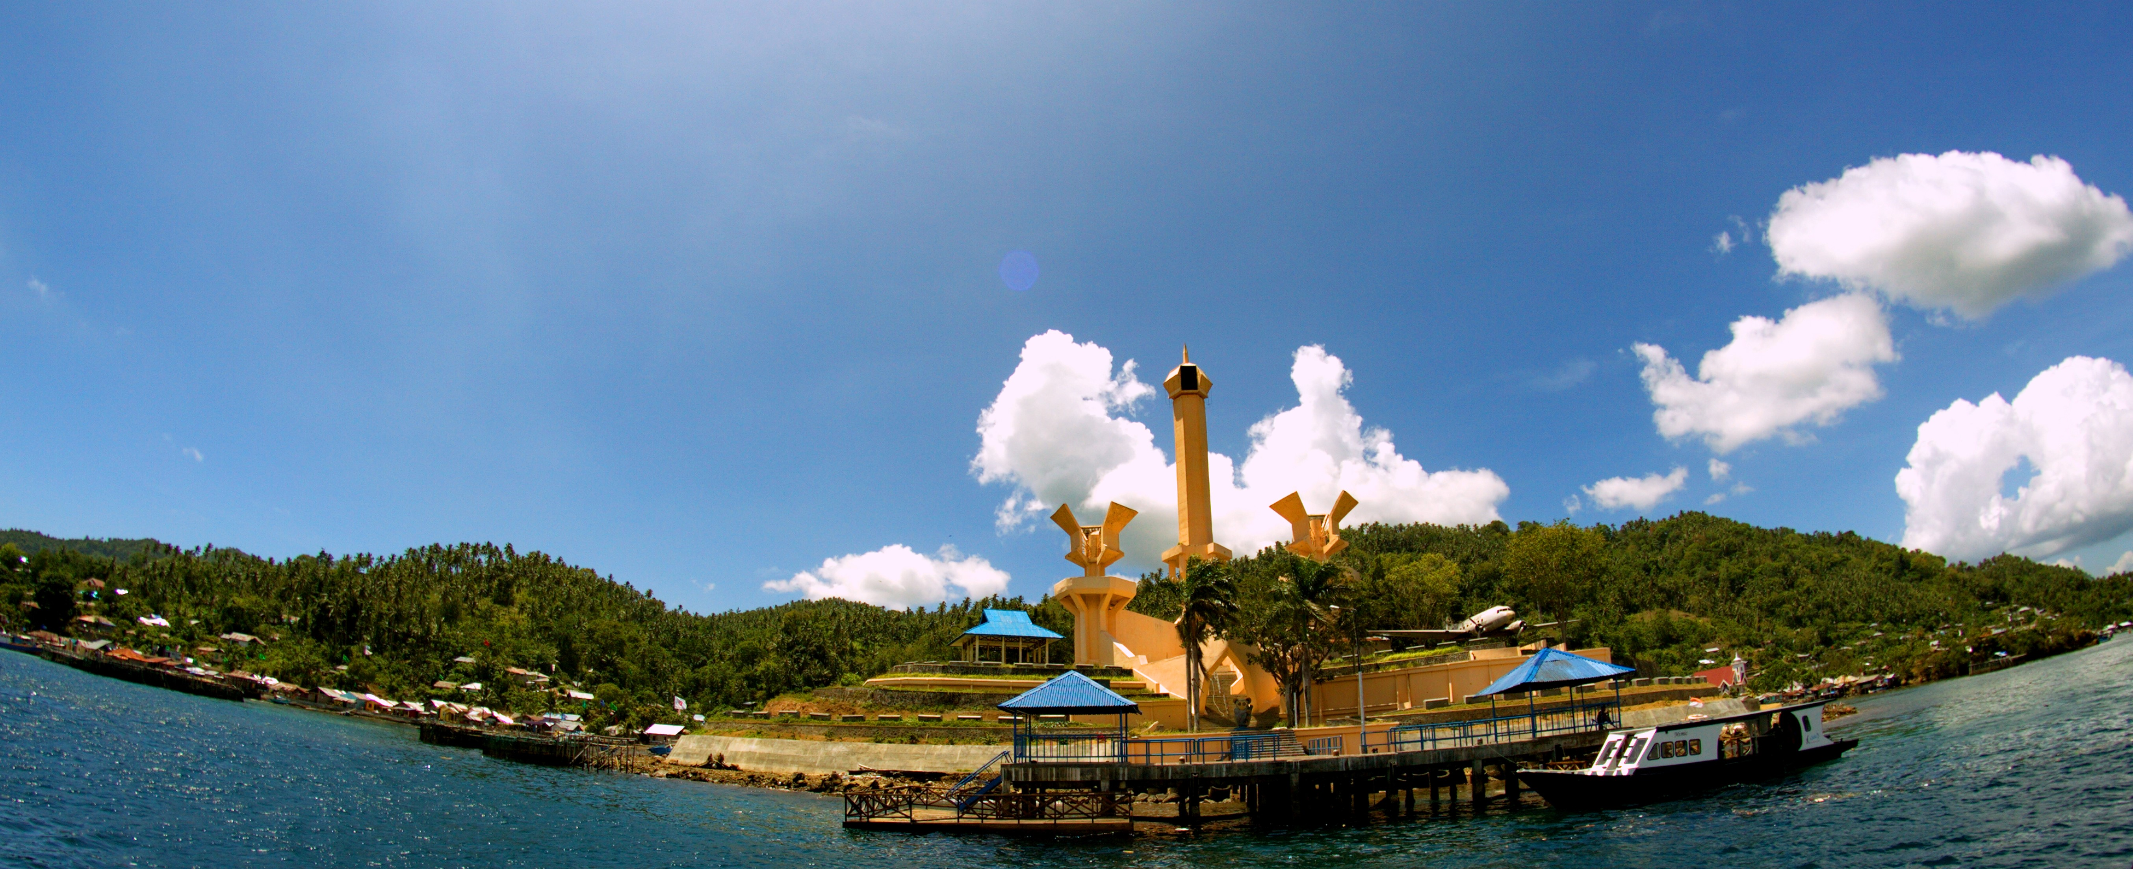
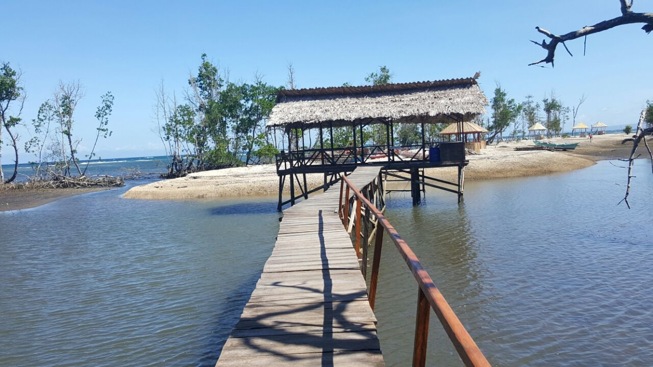
NATURAL POTENTIALS
NATURE CONSERVATION, MOUNTAINS, NATURE PARKS, BAYS, LEMBEH STRAIT, 95 DIVING SPOTS, 17 ISLANDS WHERE LEMBEH ISLAND AS THE BIGGEST ISLAND ACTING AS A PROTECTOR OF THE CITY FROM TSUNAMI ATTACK AND RISK.
GEOTERMAL ENERGY POTENTIAL, MINING POTENTIAL, FISHERIES AND AGRICULTURE, SEA CURENT ENERGY POTENTIAL, SOLAR ENERGY POTENTIAL,

Slide 6
BITUNG AS A LOW CARBON CITY (background)
Enactment of the Phase 5 LCMT –focusing on an industrial area (SEZ) in Bitung city
Special economic Zone (SEZ) designation in Bitung City
Feasibility study implementation by South Pole

Slide 7
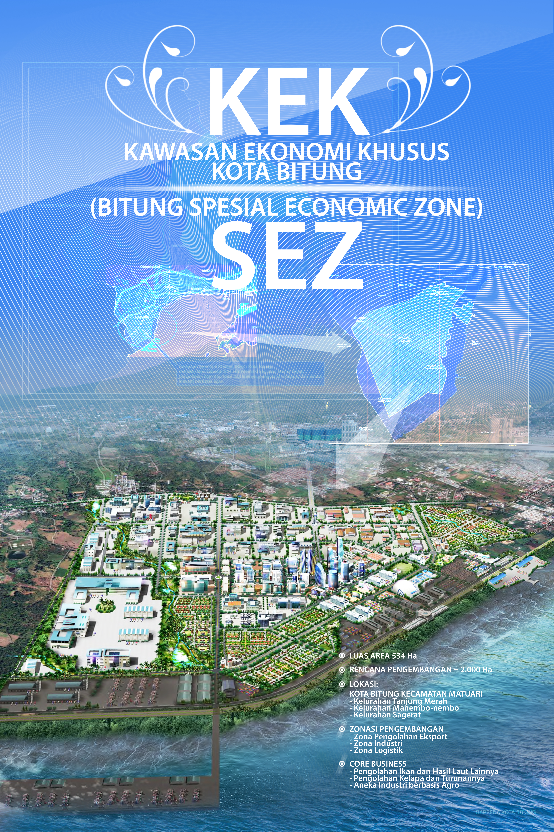
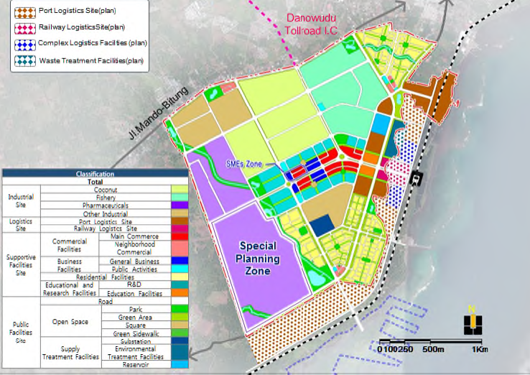
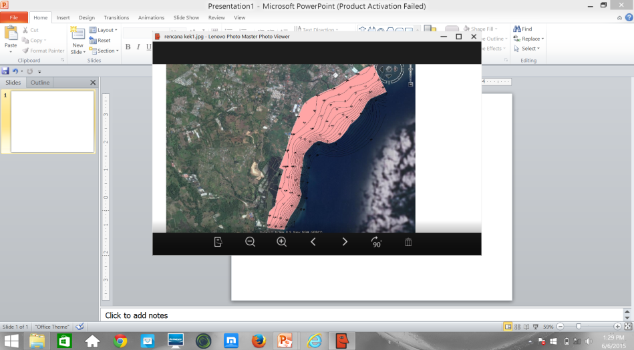
Background
SPECIAL ECONOMIC ZONE

Slide 8
LOW CARBON MEASURES IN BITUNG
Impact | Side | Aspects | Measurement/indicators | Average Score /Stars
Directly related | Demand | Town structure Buildings Transportation | Urban management system of the city Numbers of building with green design Measurement of road length & quality | 60
 | Supply | 4. Area energy system 5. Untapped energy 6. Renewable Energy 7. Multi Energy System | Development of energy system Energy potentials Development of wind energy and solar | 50
 | Demand and supply | 8. Energy management system |  | 50
Indirectly related | Environment and resource | 9. Greenery 10. Water Management 11. Waste Management | CO2 measurement, 12th Adipura award etc Water volume Sewage volume | 80
 | Governance | 12. Policy Framework 13. Education and Management | An increase in budget Public education and go green campaign | 80

Slide 9
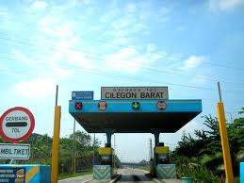
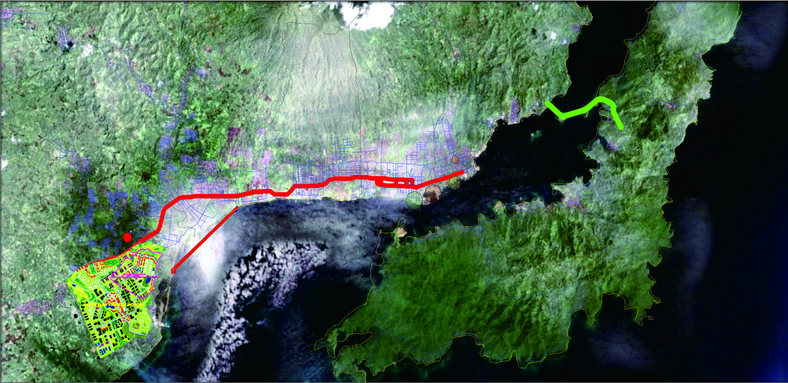
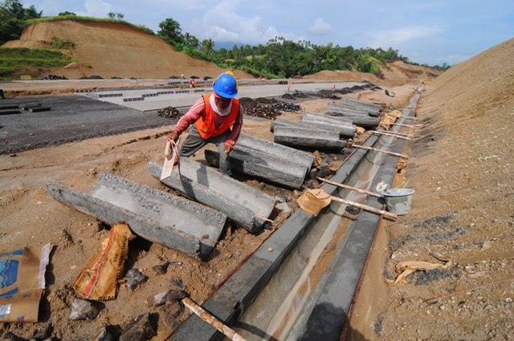

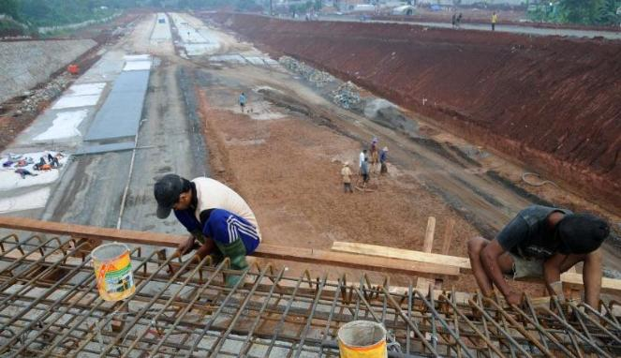
TRANSPORTATION
TOLL ROAD
PINTU TOL PINOKALAN
Alternatif 2 Rencana Jembatan Bitung-Lembeh
Pelabuhan Perikanan PPI
Pelabuhan Kontainer
Rencana Jembatan Bitung-Lembeh
Rencana Pintu Tol
Rencana Jalan Layang
Pelabuhan
Bitung
Jalan Tol
Manado-Bitung
Alur Masuk
Kapal Barang Bobot 5,000 DWT
(± 100 meter)
Jalan Arteri Eksisting
Manado-Bitung
Rencana Reklamasi
Areal Pengembangan KEK
(Luas = 150 Ha)
Rencana Jalur KA
Kawasan Ekonomi Khusus (KEK) = 534 Ha

Slide 10
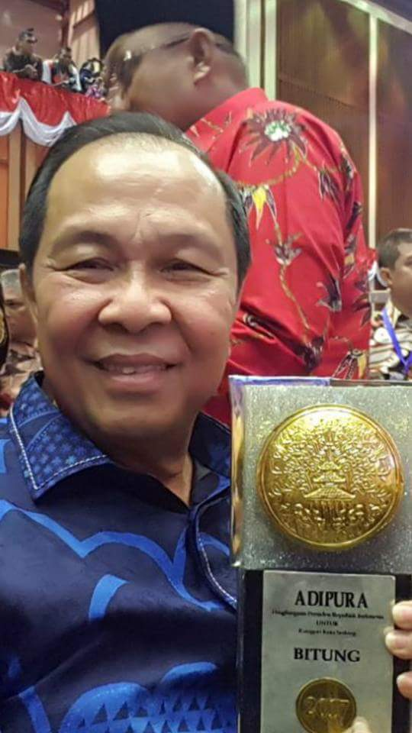
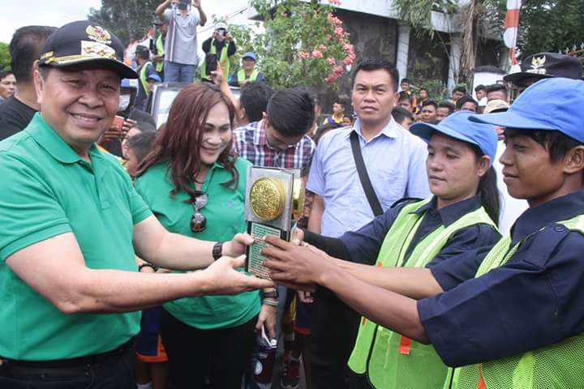
THE ENVIRONMENTAL ASPECT - Greenery
Greenery : 12 times Adipura
Innovation in water management
Waste management : sanitation – public toilet provision, septic tank amnesty

Slide 11
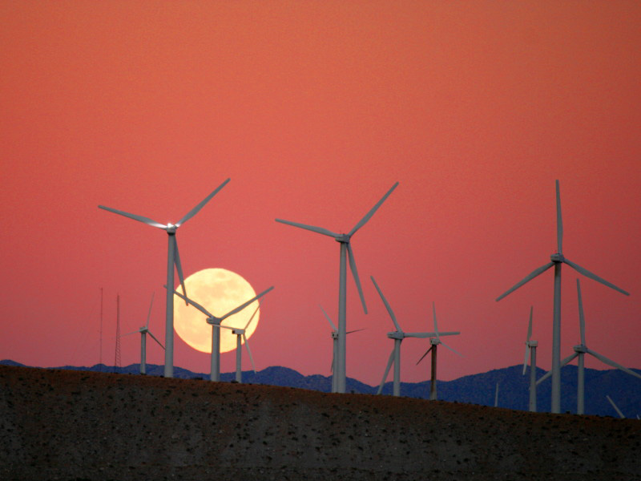
RESOURCES ASPECT . Esp, Renewable energy
Wind, Solar, Geothermal, Sea Current, biogas
Esp. Wind Energy is developed in eight villages in two sub districts at the level of principal permit issued capacity 30W

Slide 12
CO2 MEASUREMENT IN IN SEVERAL LOCATIONS IN THE CITY for 1 hour (source: the Environmental agency
No | Locations | Results
 |  | 2014 | 2015 | 2016
1 | Tangkoko Terminal | <5000 | 2200 | 2100
2 | Girian | <5000 | 320 | 315
3 | Sari Cakalang Field | <5000 | 240 | 235
4 | Mayor Office Complex | <5000 | 560 | 556
5 | CBD | <5000 | 571 | 570
6 | Pateten | <5000 | 112 | 115

Slide 13
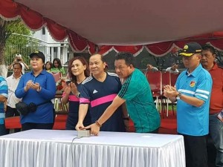
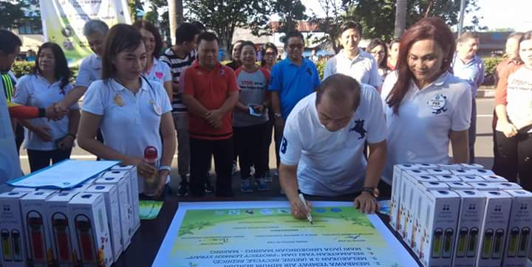
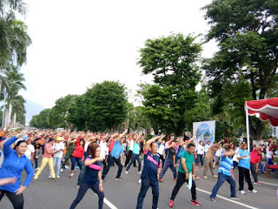
GOVERNANCE
Policy framework: in increase in budgeting of the city related to LCMT : infrastructure and housing quality.
Education and management :
Car Free Day: Go Green Campaign

Slide 14
SELF - EVALUATION RESULT OF BITUNG

Slide 15
FUTURE PLAN

Slide 16
FEEBACK ON LCTi System
Simple but good and flexible self assessment system
Without being judged
Indirectly encouraging to improve the performance of LCMT host.

Slide 17
THANK
YOU

