Slide 1
Chile’s Update
OIL AND GAS SECURITY
María Valenzuela
Engineer of Energy Security and Market Division
Ministry of Energy / Government of Chile
3rd Oil and Gas Security Network Forum, 29-30 June 2017, Irkutsk City, Russia

Slide 2
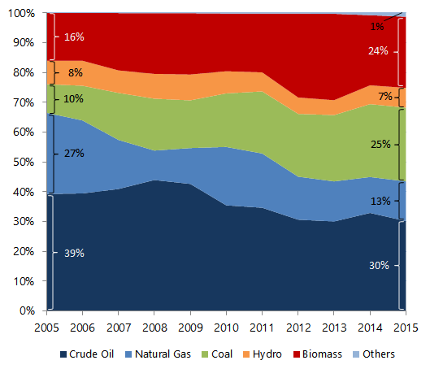
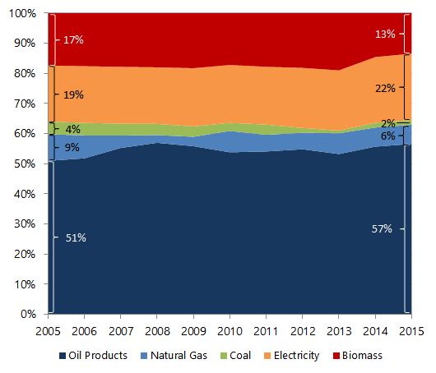
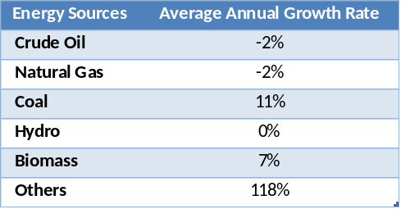
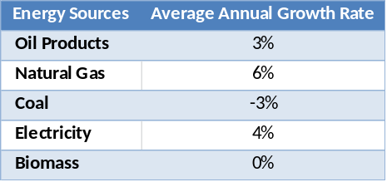
CHILE
Oil and Gas Supply and Demand Situation
Primary Supply, 2005 - 2015
Final Energy Demand, 2005 - 2015
287494 Tcal
305623 Tcal
232033 Tcal
278074 Tcal
Source: Balance Nacional de Energía 2015
Source: Balance Nacional de Energía 2015
Others: Wind Energy, Solar Energy and Biogas.
3rd Oil and Gas Security Network Forum, 29-30 June 2017, Irkutsk City, Russia

Slide 3
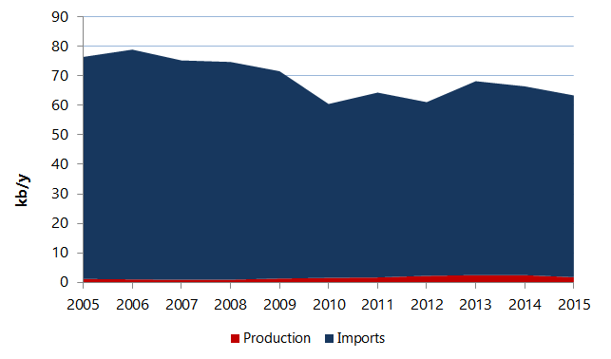
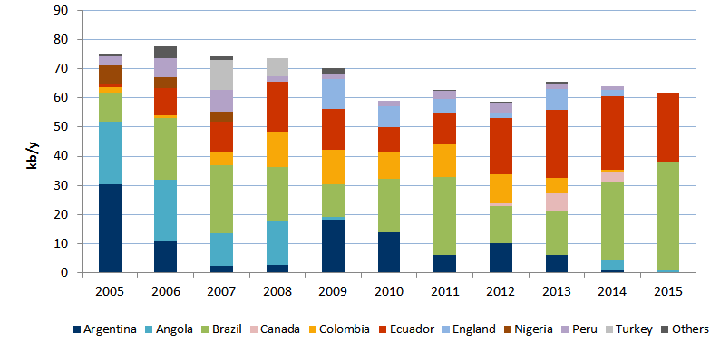
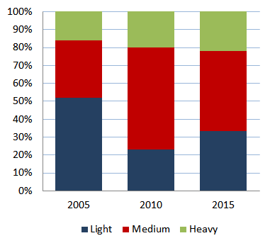
CHILE
Oil and Gas Supply and Demand Situation
Crude Oil Production and Imports, 2005 - 2015
Despite the existence of domestic production, the country is in essence a net importer.
Chile does not export crude oil.
Import levels and origins are governed basically by price.
97%
3%
Source: Balance Nacional de Energía 2015
Crude Oil Imports by Origin
Types of Crude Oil Imported
Source: Cámara de Comercio de Santiago.
Source: Cámara de Comercio de Santiago.
Others: Australia, Bolivia, Malaysia, Thailand and Gabon.
3rd Oil and Gas Security Network Forum, 29-30 June 2017, Irkutsk City, Russia

Slide 4
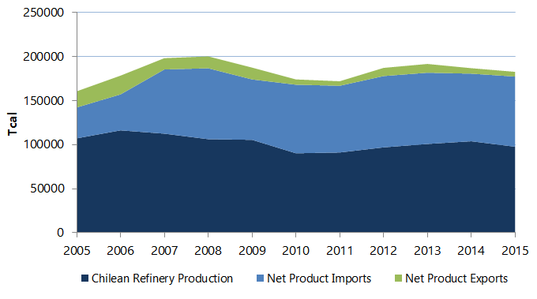


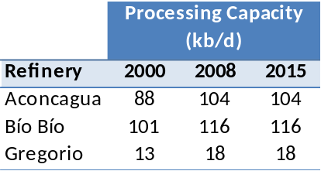

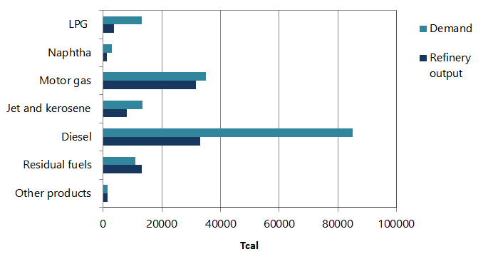
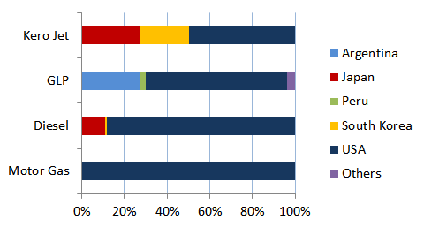
CHILE
Oil and Gas Supply and Demand Situation
Refinery Production, 2005 - 2015
Refinery Capacity
Source: Balance Nacional de Energía 2015
Refining Output vs. Demand, 2015
Oil Products Imports by Origin, 2015
Source: Cámara de Comercio de Santiago.
Source: Balance Nacional de Energía 2015
Others: Trinidad & Tobago, Greece, Italy.
In 2015, Chile only exported fuel oil, which went to Panama
3rd Oil and Gas Security Network Forum, 29-30 June 2017, Irkutsk City, Russia
Notes:
The principal product consumed in Chile is diesel.

Slide 5
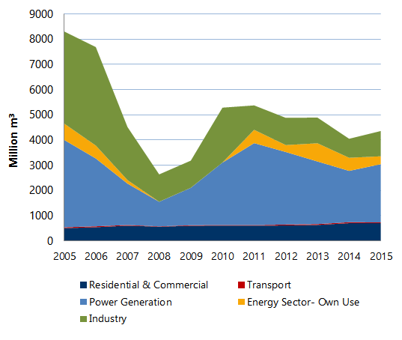
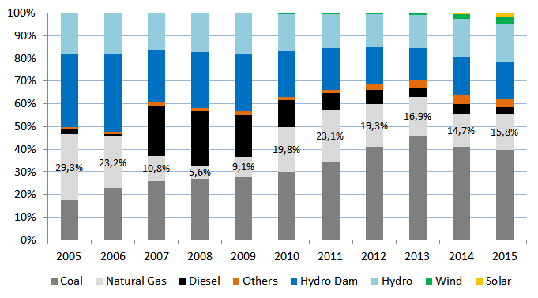
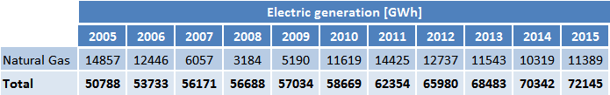
CHILE
Oil and Gas Supply and Demand Situation
Natural Gas Demand by Sector, 2005 - 2015
Share of Natural Gas in Power Generation Mix, 2005 - 2015
Source: Balance Nacional de Energía 2015
Source: Generación Bruta SIC-SING – CNE.
Others: Includes Petcoke, Cogeneration, Biomass
During 2007-2008 Chile experienced extreme drought, and the almost complete interruption of natural gas supply from Argentina (imports continued for residential and commercial sector)
2009: Quintero LNG terminal commissioning.
2010: Mejillones LNG terminal commissioning.
3rd Oil and Gas Security Network Forum, 29-30 June 2017, Irkutsk City, Russia

Slide 6
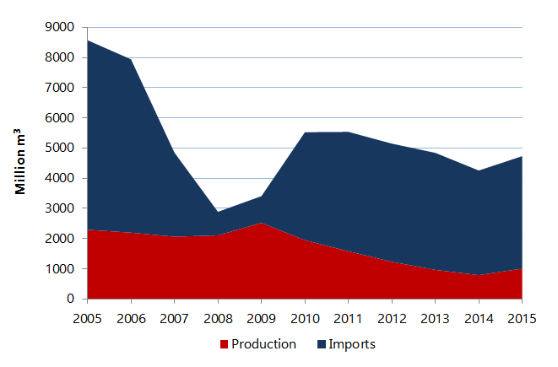
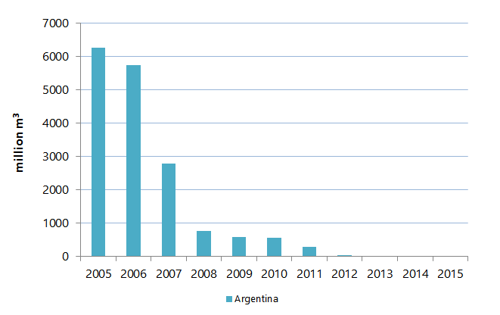
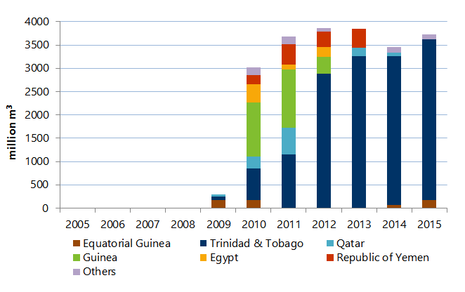
CHILE
Oil and Gas Supply and Demand Situation
Natural Gas Production and Imports, 2005 - 2015
The domestic production of natural gas is only consumed in the Magallanes Region, the southernmost region of Chile.
EXPORTS:
In 2016, 373 million m³ of natural gas (8% of the LNG imported in 2016) were exported to Argentina via gas pipelines. This was the first time that Chile exported natural gas.
An average of 3 million m³ per day is programmed for the period June-August 2017.
Source: Balance Nacional de Energía 2015
Natural Gas Imports by Origin
Piped Gas
LNG
Source: Cámara de Comercio de Santiago.
Source: Cámara de Comercio de Santiago.
3rd Oil and Gas Security Network Forum, 29-30 June 2017, Irkutsk City, Russia
Notes:
Entre el 2011 y 2016 se ha mantenido Trinidad y Tobago como uno de los principales orígenes de las importaciones de GNL, sin embargo durante el 2016, entra EE.UU. como fuente importante de abastecimiento de GNL para Chile.

Slide 7
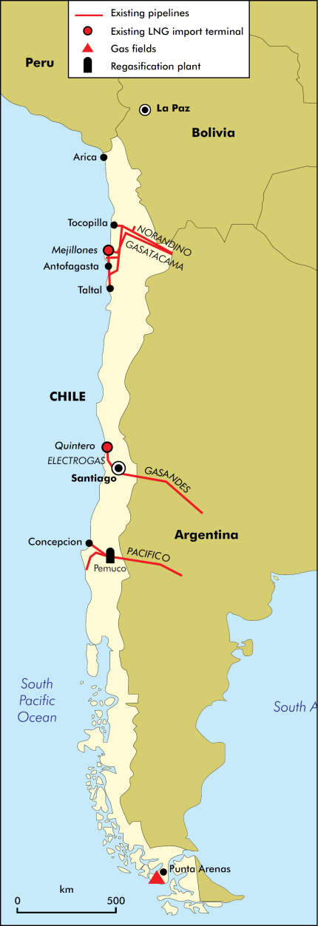
CHILE
Oil and Gas Supply and Demand Situation
Transnational Gas Pipeline | Capacity [million m³/d] | Length [km] | Operation Status for Gas Imports/Exports
Norandino | 7.8 | 1056 | Operational in 2016 solely for exports to Argentina
GasAndes | 10.8 | 541 | Operational as at 2017 exclusively for exports to Argentina
Gas Pacífico | 6 | 674 | Sporadic operation for minimum quantities imported from Argentina
To date there are no transnational pipeline projects.
 | Terminal | Regasification Capacity [million m³/d] | Date of Operation
Existing | Mejillones LNG | 5.5 | July 2009
 | Quintero LNG | 15 | June 2010
Proposed | LNG Floating Maritime Terminal | 10 | 2019
 | Andes LNG | 10 | 2020
 | LNG Penco-Lirquén | 15 | 2019
 | Talcahuano LNG | 8.5 | 2019
Pemuco and the “Virtual Pipeline”
Pemuco is a medium sized regasification plant (0.6 million m³/d of gas) located near Concepción.
LNG supplies are transported by truck from Quintero to Pemuco.
ENAP GAS PIPELINES
3rd Oil and Gas Security Network Forum, 29-30 June 2017, Irkutsk City, Russia

Slide 8
CHILE
Oil and Gas Security Policy
Oil Stockpiling
Indicators to Gauge Supply Security
Product | Storage* [million m³] | Days of Stocks 2015
Crude Oil | 538 | 20
Motor Gas | 184 | 16
Kerosene | 111 | 45
Diesel | 350 | 14
Fuel Oil | 111 | 39
LPG | 196 | 36
Supply/Demand Monitoring by weekly reports on projections:
- Oil Products: Imports, refinery production, stocks and demand.
- Gas Imported: Imports, regasification, stocks and demand.
- Gas Production: Production, demand and line-pack.
Supply Monitoring of Gas & Oil Production by monthly reports.
The stock level is monitored to accomplish the following:
- Oil products: 25 days
- Gas: 10 days
*Average January-December 2015.
Oil industry participants currently have the obligation to hold stocks.
Article 7 of Decree with Force of Law N° 1 of 1978 of the Ministry of Mining states the following:
“Every producer or importer of liquid, petroleum-based fuels is required to maintain an average stock of each product which is equal to 25 days of average sales during the previous six months or average imports for the same period of time, if it is for own consumption.”
Chile’s acknowledges that the current 25-day stockholding obligation needs to be updated.
In the future, under a scenario of low demand for liquid fuels, it may be possible to reduce the stocks requirements that the country needs.
3rd Oil and Gas Security Network Forum, 29-30 June 2017, Irkutsk City, Russia

Slide 9
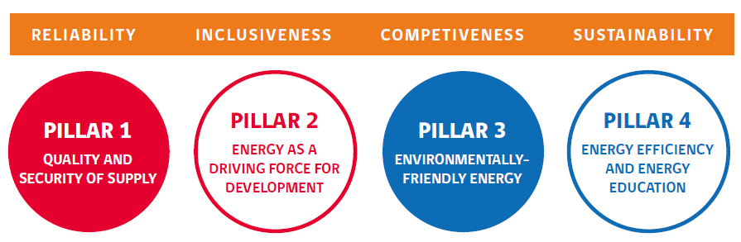
CHILE
Oil and Gas Security Policy
Oil & Gas Supply Security Framework: National Energy Policy for 2050
The National Energy Policy is sustained by four pillars:
Guidelines set forth in the National Energy Policy:
Develop national, regional and municipal plans for managing risks and emergencies affecting the energy sector that are aligned with other sectorial and national plans.
Increase the security of supply, storage, transport and distributions of fuels.
Promote research into and exploration and exploitation of Chiles’s hydrocarbon resources.
3rd Oil and Gas Security Network Forum, 29-30 June 2017, Irkutsk City, Russia

Slide 10
CHILE
Oil and Gas Security Policy Gaps
Strengthen regional oil and gas security
It is in Chile’s interest to maintain regional collaboration with the APEC member economies, with the aim of contributing to keep a bridge of cooperation in technical and emergency response matters. This collaboration will allow economies to provide public value to emergency management in the different phases of the risk cycle, with relevance in the preventive phase. Chile's experience could greatly contribute to strengthening APEC’s regional work in this area, as well as to the exchange of best practices among individual economies.
3rd Oil and Gas Security Network Forum, 29-30 June 2017, Irkutsk City, Russia

Slide 11
Chile’s Update
OIL AND GAS SECURITY
Email Address: mvalenzuela@minenergia.cl
Contact Number: +56 2 22367 75 79
3rd Oil and Gas Security Network Forum, 29-30 June 2017, Irkutsk City, Russia

