Slide 1
IEA Emergency Response Policies
Aad van Bohemen
Head, Energy Policy and Security Division
The 3rd APEC Oil & Gas Security Network Forum
29 & 30 June 2017, Irkutsk, Russia

Slide 2
“Opening the Doors” of the IEA
IEA member countries
Accession countries
Association countries
Key Partner countries
This map is without prejudice to the status of sovereignty over any territory, to the delimitation of international frontiers and boundaries, and to the name of any territory, city or area.

Slide 3
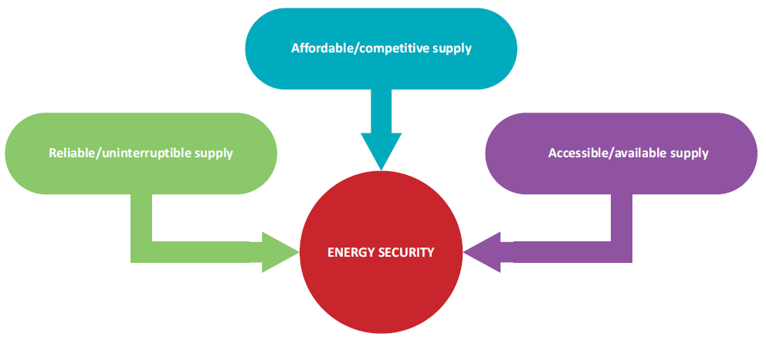
Establishment of IEA
IEA established against backdrop of 1973-1974 oil crisis
  Avoiding competition for limited resources
  Coordinated mechanisms for response
  Safety net
Today, energy security as urgent as ever
  Oil security remains cornerstone
  IEA move to a more comprehensive approach beyond oil
IEA definition of Energy Security
“Uninterrupted availability of energy sources at an affordable price”
Notes:
IEA was established in 1974 as a response to the oil crisis. The objective was to establish a mechanism for coordination in oil supply emergencies.
What brought our Member countries together: belief that cooperation, collective actions could provide something that no country could achieve on its own: enhanced energy security.
Initial role was to co-ordinate measures in times of oil supply emergencies but has developed IEA now a major advisor on many energy subject for our 29 member countries.

Slide 4
Stockholding options
Different stockholding structures in IEA countries
Industry obligation
Government
Agency
Luxembourg
Greece
Norway
Sweden
Turkey
UK
Austria
Denmark
Netherlands
Portugal
Switzerland
Finland
France
Spain
Italy
Estonia
Belgium
Ireland
Germany
Hungary
Slovak Republic
Czech Republic
New Zealand
USA
Japan
Korea
Poland
Commercial & operational stocks
Notes:
Industry stocks
Count towards meeting IEA commitment whether held for commercial purposes or in order to comply with obligation
18 out of 29 IEA members place an obligation on industry
6 are meeting entire 90 days obligation in this way
Government stocks
Government-owned and financed through central budget
Held exclusively for emergency purposes
Only 6 IEA countries
Agency stocks
Varied structures but always defined by legislation
Government-administered or industry-led (owned)

Slide 5
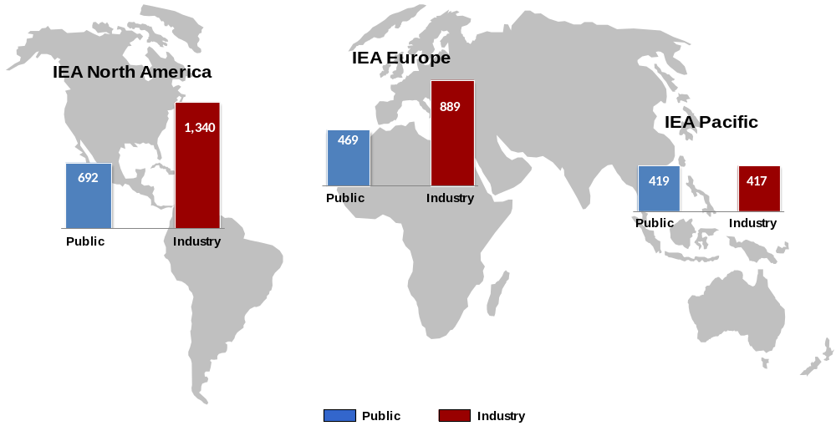
Total IEA stocks
Total IEA: 4.6 billion barrels
Note: data as of end-March 2016; figures in million barrels

Slide 6
Evolution of stockholding
Increase in total stocks
Increase in share of publicly held stocks
Notes:
From 1980s to present
Increase in total stocks
From 3.1 billion barrels in 1980s to 4.1 billion today
Increase in publicly held stocks
From 0.8 billion barrels in 80s to over 1.5 (from 23% to 39%)

Slide 7
Emergency stockholding
Powerful tool to mitigate the impact of an oil supply disruption on the economy
  Tangible, controllable & close to demand
  Release can be implemented quickly & visibly to calm consumers & oil markets
  Release via sales to free market promotes efficient allocation
  Can provide time for orderly demand management & fuel switching in extended disruption

Slide 8
Stock Release Mechanisms
Release of stocks varies by system:
  Industry obligations reduction by % or specified number of days
    Volumes made available through regular market channels
    Possible exceptions: government can allocate to priority customers or set pricing
  For government/agency stocks:
    Tender bidding process
    Sell at market price
    Government sets price
    Loan

Slide 9

Growing importance of non-OECD
* Based on World Energy Outlook 2015 “New Policies” Scenario
Notes:
9
In terms of production: in 2012, OPEC supplied 41% of global oil;
Unconventional techniques: game changers
North America is to become net exporter before 2030
Not everywhere; Korea and Japan almost 100% dependent, Europe’s reliance is set to continue growing

Slide 10



Shifting supply
* Based on World Energy Outlook 2015 “New Policies” Scenario

Slide 11
Emergency Response Exercise
  Emergency Response Exercise (ERE)
    biennial program to train participants in IEA emergency response policies & measures
    open to delegates from IEA and partner countries upon invitation only
    70-80 participants
  Joint ERE in partner countries
    IEA offer such exercises also to partner countries (e.g. China, India), to train a larger number of people of that country
  3 components:
    Exercise in Capitals (EXCAP)
    Main Exercise (EXMAIN)
    SEQ Exercise (EXSEQ)

Slide 12
Conclusions
Energy security as urgent as ever
Oil security remains cornerstone
  Stock-draw proven powerful response mechanism
Continually working to strengthen and adapt response measures
  IEA expanding focus beyond oil
Exercises and co-operation with partners are key to addressing new and emerging challenges

Slide 13

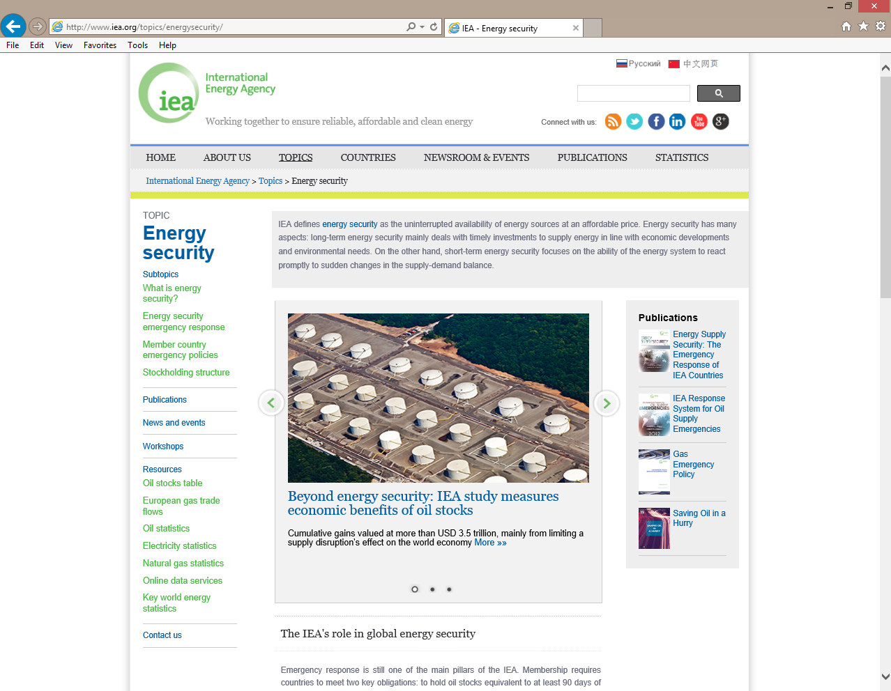
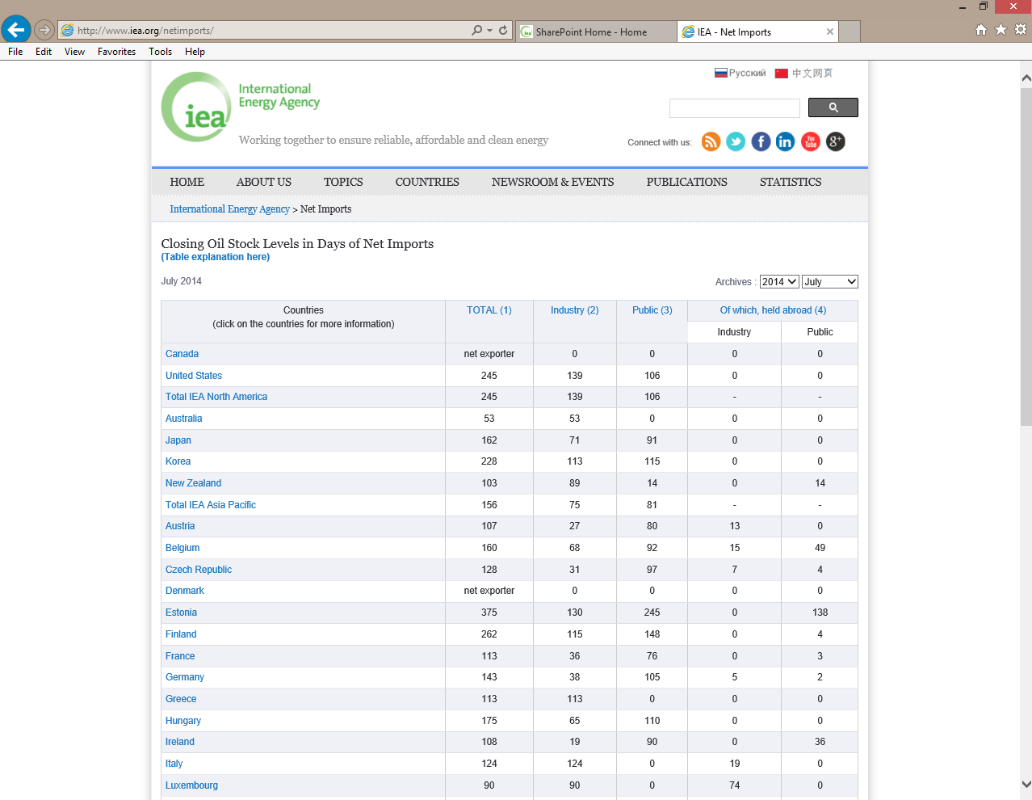
Information on IEA energy security
http://www.iea.org/topics/energysecurity/

Slide 14

Thank you!
Twitter: @IEA
YouTube: IEAEnergy
Facebook: InternationalEnergyAgency
© OECD/IEA 2014

Slide 15
Back up slides

Slide 16
What is the IEA?
  Autonomous agency linked to Organisation for Economic Co-operation & Development (OECD)
  Acts as energy policy advisor with some 250 staff based in Paris
Goals:
  Energy security
  Environmental protection
  Economic growth
  Engagement worldwide
Activities:
  Co-ordinates efforts to ensure energy security
  Conducts policy analysis
  Links research activities & governmental directives
  Compiles energy statistics
  Reviews energy policies and programs
  Convenes, mobilizes science & technology experts
  Promotes co-operation with key non-member countries

Slide 17
Role of the IEA Secretariat
Emergency response to oil supply disruptions is raison d'être for IEA & remains core mission
Strengthening emergency response systems
  Emergency Response Exercises (ERE)
    Training opportunities for delegates
  Emergency Response Reviews (ERR)
    Ensures membership obligations are being met
  Broadening of energy security concept
    Moving beyond simply oil & petroleum products
Global outreach

Slide 18
Emergency Response Exercise
  Components of the Exercise:
  Tests communications & emergency data reporting
  Assessing impacts of disruption scenarios in small break-out groups, discussion in plenary
  Complexity of scenarios depending on experience of participants

Slide 19
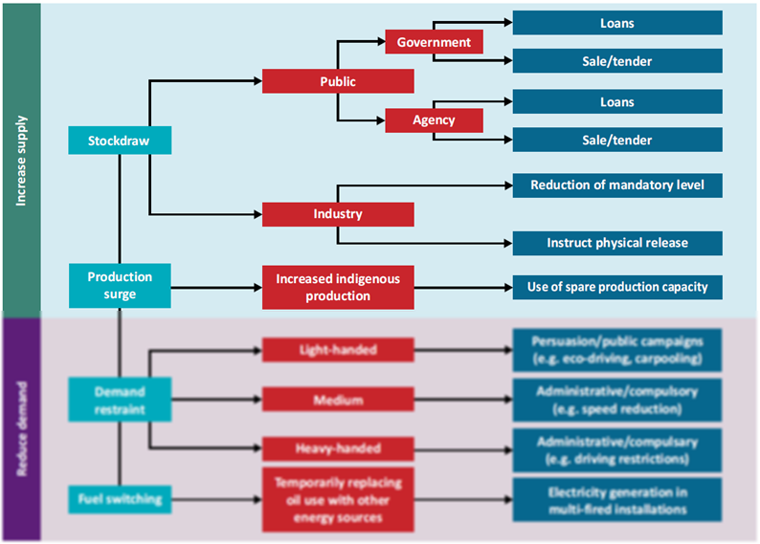
Supply-oriented response measures
Notes:
Focus on stocks; there is another option to increase supply via production surge but that is fairly limited; IEA countries have virtually no spare capacity

Slide 20

Demand-side response measures

Slide 21
Demand-side measures
Demand restraint
  Most policies focus on transportation sector
    Wide range of measures, from light to heavy
    Danger of further strangling economy!
    Short-term can lead to long-term behavioral changes & fuel efficiencies (car-pooling, smart truck logistics etc.)
  Some potential in reduced heating
Fuel switching
  Significant decline since 1970s
  In 2015 only 2% oil in electricity generation (25% in 1973)
  Virtually no potential for short-term switching in transport
Other
  Relaxation of regulation, e.g. on fuel quality specifications
Notes:
Demand restraint measures can range from light measures such as public persuasion campaigns promoting eco driving or carpooling, to more effective like compulsory speed reduction, and most heavy-handed such as driving restrictions or fuel rationing.
It is also important to note that there are significant regional variations that need to be taken into account, reflects variations within transportation sector.
Different travel modes, varying flexibility of travelers to change modes in crisis
Extent of public transit infrastructure
Carpooling less effective where high use of public transit & vice versa
Driving bans less effective in countries with higher car ownership per household
Also, emergency response policies aim to reduce the economic impact of an oil supply disruption. Demand restraint policies by their very nature curtail economic activity so are better deployed in longer disruptions where their role becomes maximising the effectiveness of available resources.

Slide 22
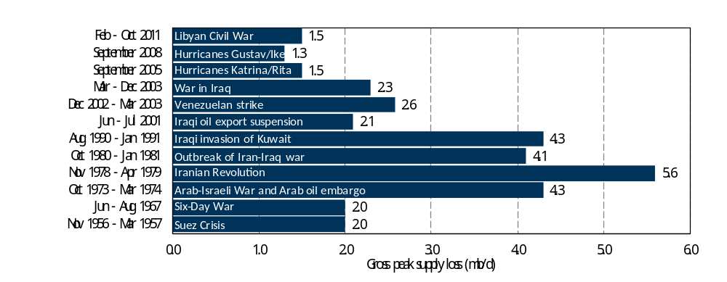
Major oil supply disruptions
Three coordinated stock releases since IEA established
Each disruption must be assessed individually
  Market context critical
  Severity of a disruption not only measured in oil lost
Notes:
Key factors in evaluation:
Level of commercial inventories, likely duration, available spare capacity, quality of lost crude, seasonality, logistics etc.
Only 3 IEA coordinated releases - 1991, 2005 & 2011
But emergency stocks used for individual domestic crises

Slide 23
Oil supply security remains key
Ukraine
Hybrid war
Canada
Pipeline Leaks
Danish Straits
3.3 mb/d
North Sea
Outages
Syria/Iraq
ISIS
Central Asia
Pipelines
US
Hurricanes
Libya
Civil war
Iran
Sanctions
Japan
Tsunami
Venezuela
Political
Unrest
Nigeria
Civil Unrest
Asia
Fuel price protests
Panama Canal
0.85 mb/d
Turkish Straits
2.9 mb/d
Bab El-Mandab
3.8 mb/d
Strait of Hormuz
17 mb/d
Malacca Strait
17 mb/d
Natural disasters
Key oil chokepoints
Technical disruptions
Social disruptions
Notes:
Disruptions still happen all over the globe caused by many different factors
Geopolitical & domestic issues affect both energy producing and consuming countries
Supply disruptions (or demand spikes) might require IEA response

Slide 24
Energy security wider than oil (1)
Share of oil in world energy mix declining but will still remain most important fuel in foreseeable future
  Regional industry changes impacts on energy security?
    E.g. European refining sector restructuring
    Shale gas & oil story in USA – new “market-driven” OPEC for emergencies?
Notes:
While focus on oil security measures today, it is important to note that IEA has done a lot of work on natural gas and electricity security as well. When reviewing the emergency response mechanisms of our members and partners, we now focus on oil, natural gas and electricity security at the same time.
Similar to oil security framework, emergency policies for gas & electricity need to be:
For defined emergencies only
Not for seasonal fluctuations
Designed for specific situations of country / region
Set out in Code of Operations or equivalent
But significant differences:
Regional rather than global markets
Regulation of distribution / public service obligations.
Storage….
IEA working with member countries on emergency response policies for gas & electricity

Slide 25
Energy security wider than oil (2)
Natural gas has increasing role
  Gas markets more integrated; more shipped via long pipelines & LNG -> increasing distances lead to increased potential for vulnerabilities
Electricity: demand is set to grow faster than any other final form of energy
  Increased share of variable renewable generation must be integrated without jeopardizing security
  Natural gas gaining prominence in providing base load flexibility & peak power = gas & electricity market intertwined in security, cost & reliability
Notes:
While focus on oil security measures today, it is important to note that IEA has done a lot of work on natural gas and electricity security as well. When reviewing the emergency response mechanisms of our members and partners, we now focus on oil, natural gas and electricity security at the same time.
Similar to oil security framework, emergency policies for gas & electricity need to be:
For defined emergencies only
Not for seasonal fluctuations
Designed for specific situations of country / region
Set out in Code of Operations or equivalent
But significant differences:
Regional rather than global markets
Regulation of distribution / public service obligations.
Storage….
IEA working with member countries on emergency response policies for gas & electricity

