Slide 1
The 54th Meeting of APEC Energy Working Group (EWG)
Wellington, New Zealand, 22-23 November, 2017
6.a. APERC President’s Report
Takato OJIMI
President, APERC

Slide 2

6.a. (1) APERC Activities Overview
EMM
:1996-
:2012-
Instruction
:2008-
:2014-
Reporting
EWG
:2011-
:2017-
EGEEC
EGNRET
EGCFE
EGEDA
LCMT-TF
EI
RE
(1)
APEC
Energy
Demand &
Supply
Outlook
Overview
EI
LCMT
RE
(2)
Research on
Market Development &
Energy Policies
(4)
Data Network
PRLCE
PREE
PREE &
Follow-up
PREE
Compendium
EE Policy
Workshop
OGSI
OGSE (Exercise)
OGSN (Network)
OGSS (Study)
(3)
Model Training
Oil/Gas/Coal Reports
Annual Conference
Advisory Board Meeting
LNG Producer-Consumer Conference
with METI
(5)Cooperative Projects
Notes:
Here is a diagram of our activities.
As you can see by the key at the upper right, our activities have evolved over time. The Outlook and data collection were some of the earliest activity; security work and the LNG conference are some of the newest.

Slide 3
6.a. (2) APERC Tasks and Activities in 2017
Continue to meet the current acute needs of APEC member economies by choosing appropriate research themes including preparation for the 7th Edition of APEC Demand and Supply (D/S) Outlook <TOR (1)(2)>
Explore win-win collaboration between APEC D/S Outlook exercise and APEC energy data network <TOR(4)>
Accept trainees and dispatch experts through listening to real needs of each economy <TOR(3)>
Directly assist APEC member economies with Cooperative Activities to achieve APEC’s aggregate energy intensity reduction goal of 45% by 2035 and goal of doubling the share of renewables by 2030 <TOR(5)>
Strengthen efforts into oil and gas security and continue to promote dissemination of low-carbon town development <TOR(5)>

Slide 4
6.a. (3) APEC Energy Demand & Supply Outlook
The ‘APEC Energy Demand and Supply Outlook’ project is a priority task for APERC under the APEC Energy Action Programme adopted by leaders in 1995.
The 7th edition is underway and builds on enhanced engagement with energy experts in economies initiated during 6th edition Outlook roadshow.
Economy input: Valuable feedback received during assumptions review helped to improve APERC assumptions. Further feedback on preliminary results and text will be needed this year and next year.
3 Scenarios are planned: Business as Usual (current policies);
APEC Target (combines Intensity Goal with Doubling RE Goal);
Low Carbon Scenario (consistent with 2ºC increase)
Timeline: Nov 2017 Scenario results for economy review; Aug-Oct 2018 EWG and expert review of publication; April 2019 publication release at EWG 57

Slide 5
6.a. (4) APEC Energy Overview
The ‘APEC Energy Overview’ series started in 2000 with the approval of EWG19, in order to help policymakers to share useful information and deepen understanding on energy issues in the APEC region.
The Overview is an annual publication, which contains updated energy demand/supply data as well as descriptions of energy policy and ‘Notable Energy Developments’.
In 2014, “Energy Intensity Analysis” on year-on-year progress for each economy was included as agreed by EGEDA.
The 2016 Edition was published in May 2017 and is available at:
http://aperc.ieej.or.jp/publications/reports/energy_overview.php
In response to the EGNRET request to monitor RE share development, “RE Share Analysis” may also be included in the Overview 2017 edition.
* APERC appreciates the contributions and assistance by EWG and EGEDA members.

Slide 6
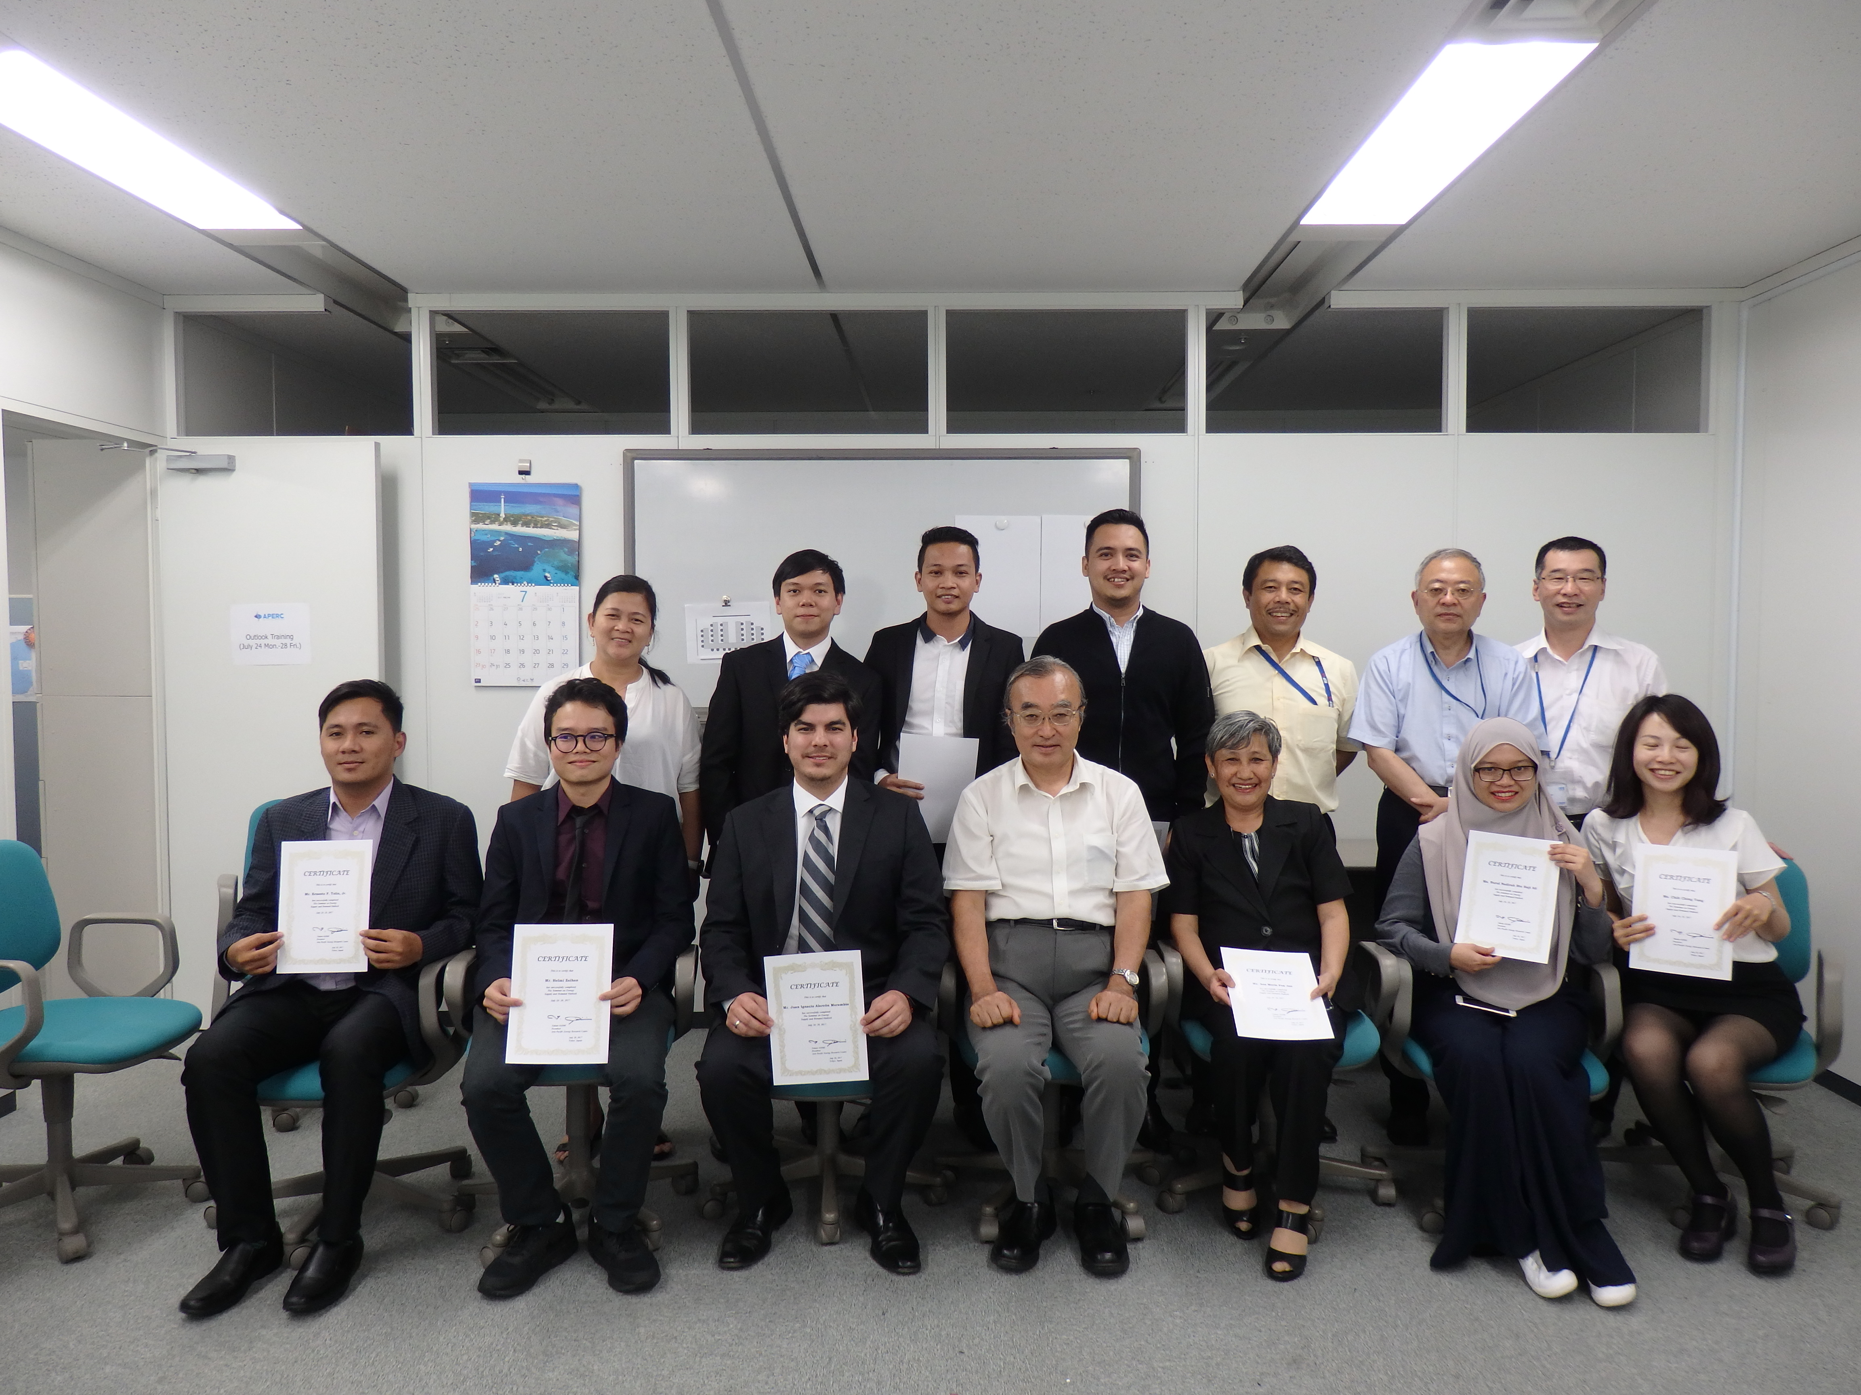
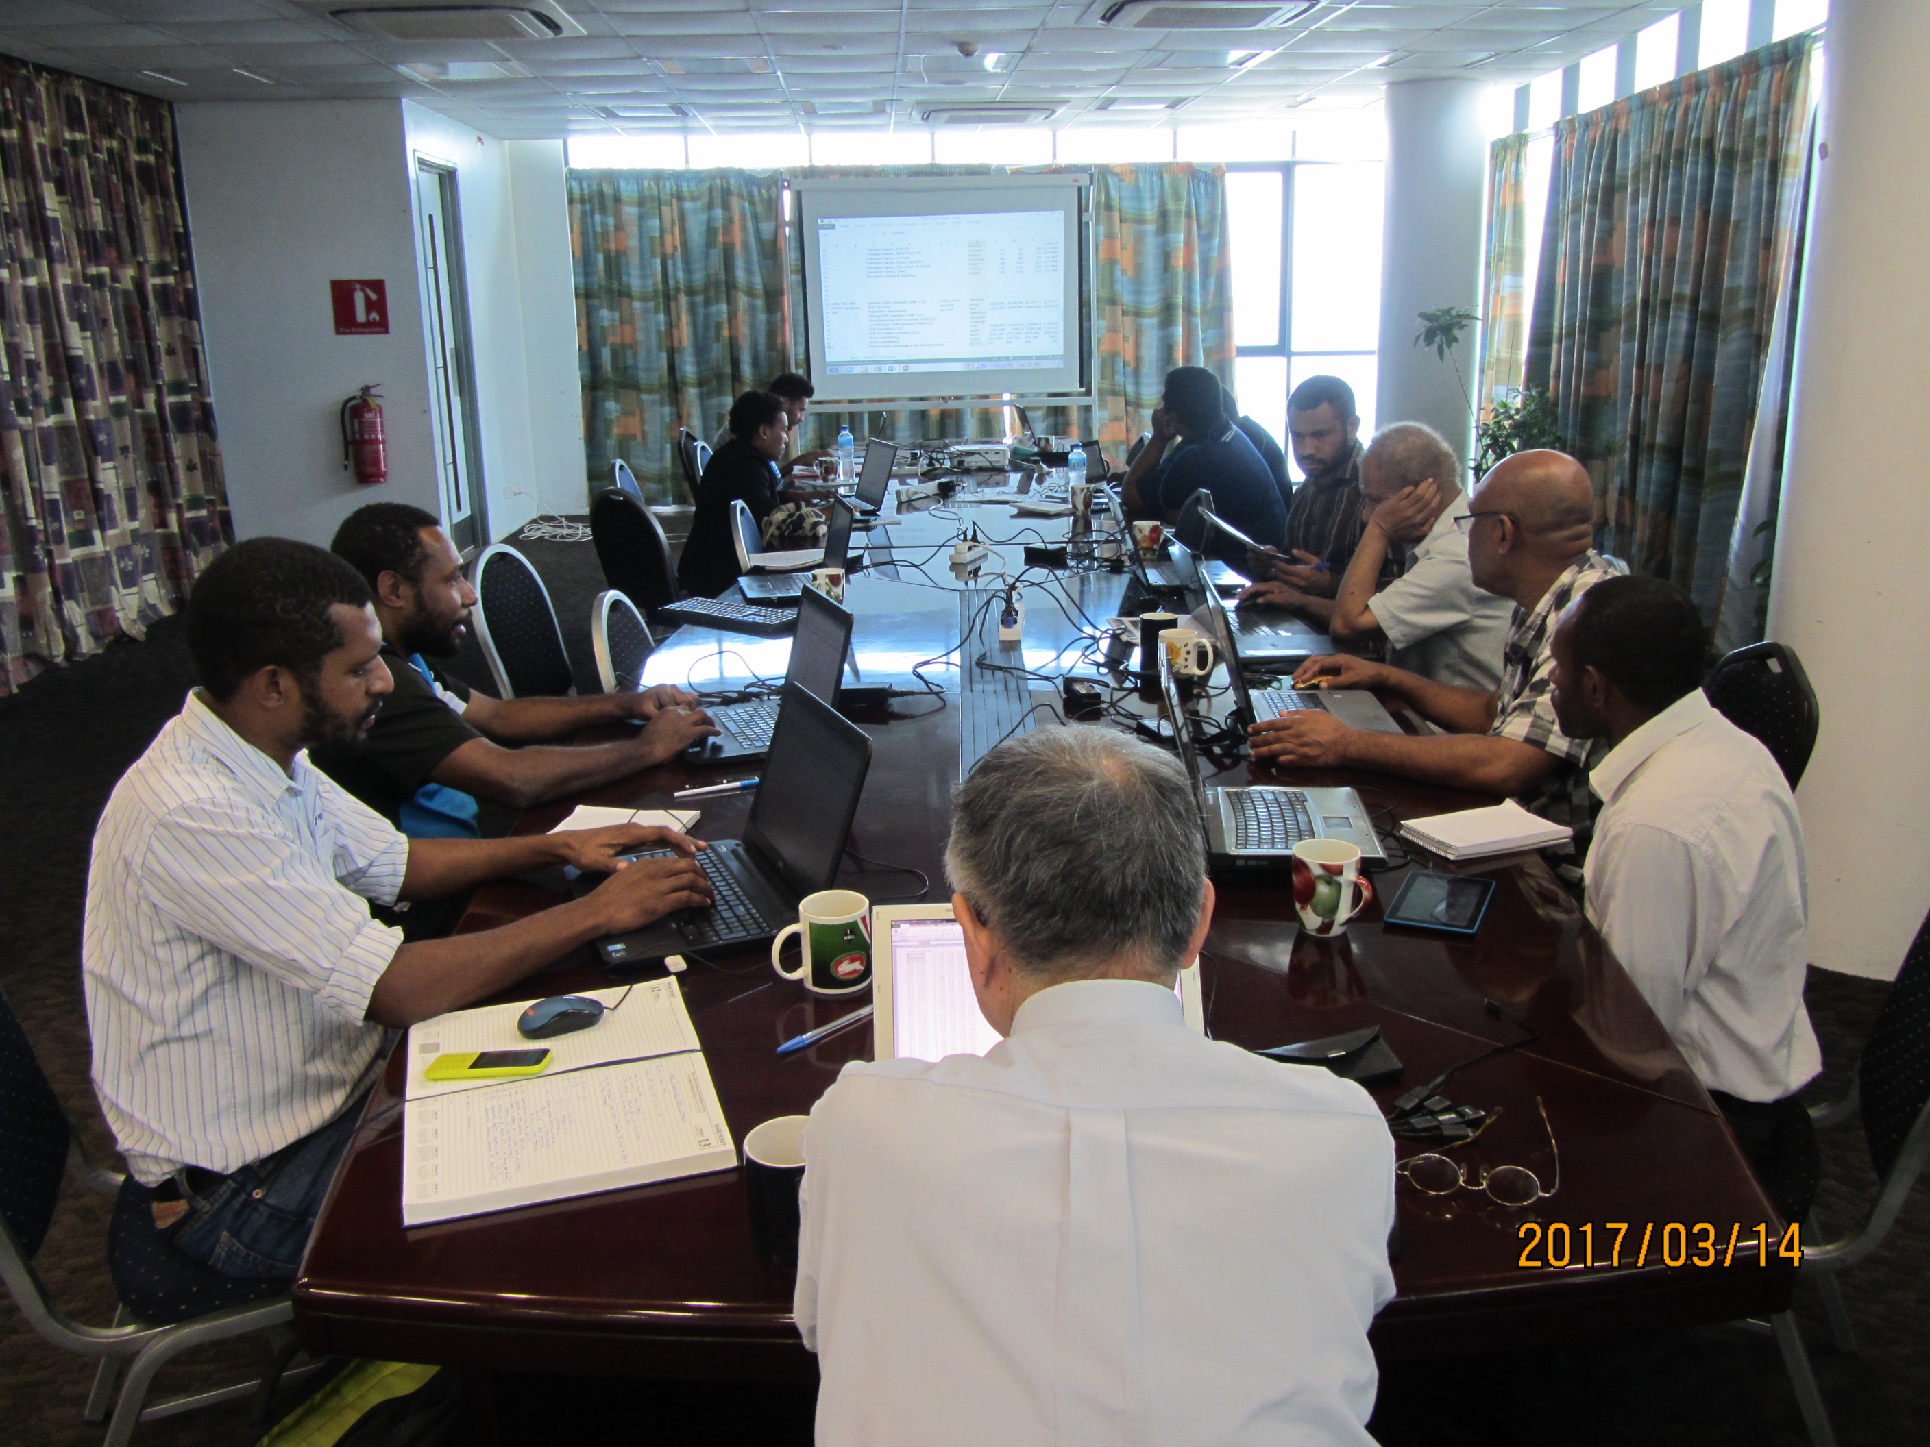
6.a. (5) Trainees and Experts
APERC accepts energy modelling
trainees from developing economies.
  A seminar in Tokyo was held
  on 24-28 July 2017
APERC also dispatches experts to help develop energy data and prepare energy demand and supply outlooks while enhancing ‘energy literacy’ of future leaders in the APEC region.
  4 workshops were held in Mexico, Papua New Guinea, Peru and Indonesia in 2017
  A cooperation course on ‘Energy Issues in the Asia-Pacific Region’ at Waseda University, Japan is now in the second year.

Slide 7
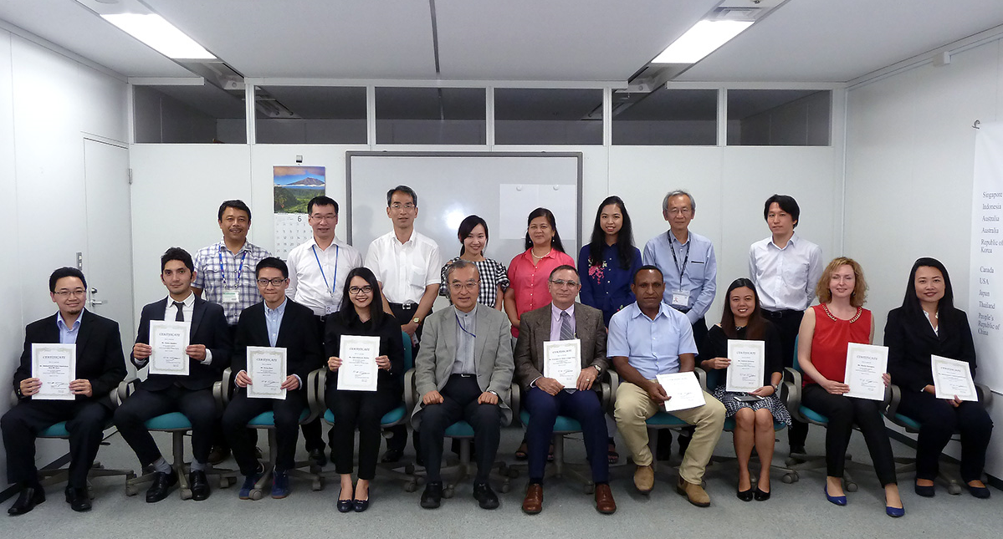
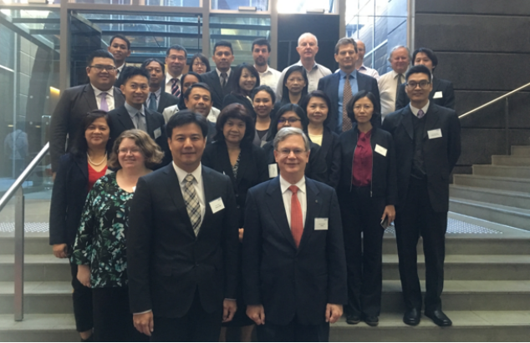

6.a. (6) APEC Energy Data Management Networks [⇒ 10.a.]
・ EGEDA Training Program on Energy Statistics is now
on its fourth year.
  Short-term training was held on
  12-23 June 2017.
  Middle-term training was held from
  4 September to 27 October 2017.
・The 29th EGEDA Meeting
was held in Canberra,
Australia, on 7-9
November 2017.
APEC Energy Statistics 2015 and APEC Energy
Handbook 2015 were published in October 2017.

Slide 8
6.a. (7) Cooperative Activities
2007
2010
2013
2016
2017
2018
2019
PREE
Follow-up PREE
PRLCE
LCMT
LCMT Symposium
OGSE
OGSNF
1. New Zealand
3. Viet Nam
5. Chinese Taipei
8. Indonesia
10. Brunei Darussalam
11. Mexico
2. Chile
4. Thailand
6. Peru
7. Malaysia
9. The Philippines
12. Russia (TBC)
1. Viet Nam
2. Philippines
3. Thailand
4. Malaysia
1. Thailand
3. Indonesia
5. Viet Nam
6. PNG
2. The Philippines
4. Malaysia
1. Yujiapu, China
2. Samui, Thailand
3. Da Nang, Viet Nam
4. San Borja, Peru
5. Bitung, Indonesia
6. Mandaue, The Philippines
7.Krasnoyarsk, Russia
Jakarta,
Indonesia
2. Da Nang, Viet Nam
SE Asia
Indonesia
launched
OGSI
1.The Philippines
3. Peru
2. Australia
1.Kitakyushu,
Japan
2.Kagoshima,
Japan
3.Irkutsk, Russia
4.Tokyo, Japan
EMM8
EMM9
EMM10
EMM11
EMM12
APEC Leaders
Sydney Meeting
APEC EMM
in Fukui
APEC Leaders Honolulu meeting
APEC EMM in
St. Petersburg
APEC EMM
in Beijing
APEC EMM
in Cebu
Energy intensity reduction goal of APEC region by at least 25% by 2030
Introduction of PREE
Launch of
PRLCE & LCMT
Continuation of
PREE & CEEDS
APEC's aggregate energy intensity reduction goal of 45% by 2035
Instruction on improving the response to oil and gas emergency situations (OGSE)
-Approval of OGSI
-Goal of doubling the share of renewables by 2030
-Instruction on enhancing the quality of electric power infrastructure
-Move LCMT to the dissemination stage

Slide 9
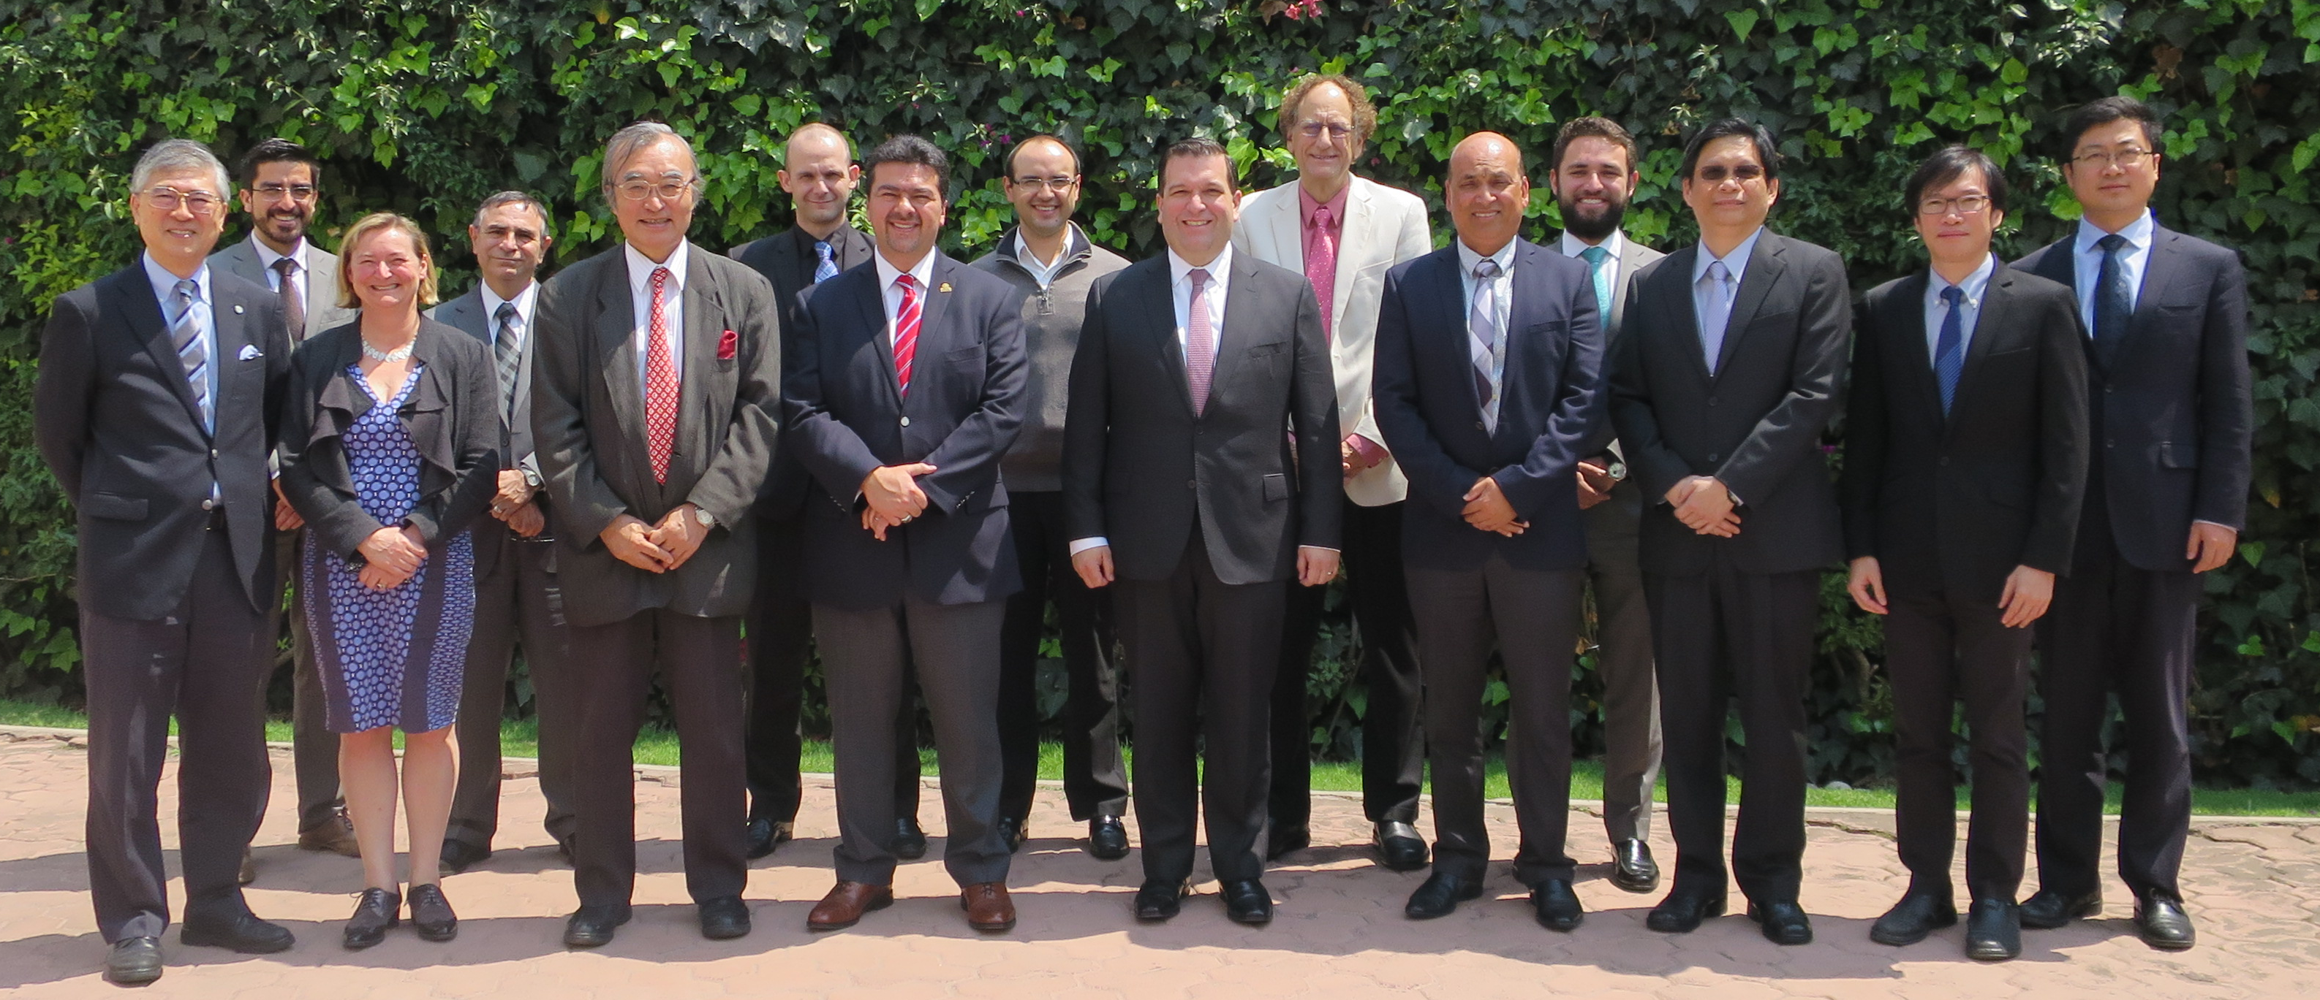
6.a. (7) Cooperative Activities (cont’d)
(1) Peer Review on Energy Efficiency (PREE) [⇒11.b.]
PREE: Phase-6
Economy: Mexico
Venue: Holiday Inn Mexico City
Schedule: 6-10 May 2017
Focus: Energy Efficiency Policies in general
Mexico Participants: 31, Ministry of Energy, CONUE, FIDE, CENACE
Recommendations:46
tt
Experts: 6
-Mr. Borwornpong Sunipasa (THA)
-Dr. Zhang Shicong (China)
-Mr. Pramesh Maharaj (NZ)
-Ms. Elizabeth Yeaman (NZ)
-Mr. Graham Parker (USA)
-Dr. Ming-Shan Jeng (CT)
Secretariat: 4
Mr. Takato Ojimi
Dr. Kazutomo Irie
Ms. Elvira Torres Gelindon
Mr. Diego Rivera Rivota

Slide 10
6.a. (7) Cooperative Activities (cont’d)
Recommendations made in PREE 11 in Mexico in March 2017
Institutional Context | Recommendation 1: SENER and CONUEE should continue keeping communication and coordination among them, not only for the successful implementation by CONUEE of SENER-designed energy efficiency policies, but also for getting feedback from CONUEE’s experience to SENER’s policy designing.
Energy Efficiency Goals, Targets, and Strategy | Recommendation 5: The government should continue to have energy efficiency as a priority in its energy policy and make sure that the committed targets are achieved.
Energy Data Collection and Monitoring | Recommendation 11: Enhance cooperation with relevant actors in conducting household energy consumption surveys.
Policy Measure – Government and Buildings Sectors | Recommendation 17: Consider a stronger energy demand growth in the buildings sector due to a rise on people’s living standards.
Policy Measure –Industrial Sector | Recommendation 22: The government should continue expanding the Learning Network approach for large energy users.
Policy Measure – Transport Sector | Recommendation 29: Push for greater coordination around transport planning and energy efficiency between all levels of government.
Policy Measure – Electricity Sector | Recommendation 34: Establish energy efficiency Public Benefits funds program.
Policy Measure – Appliances and Equipment | Recommendation 40: Benchmark energy efficiency standards with other APEC economies.

Slide 11
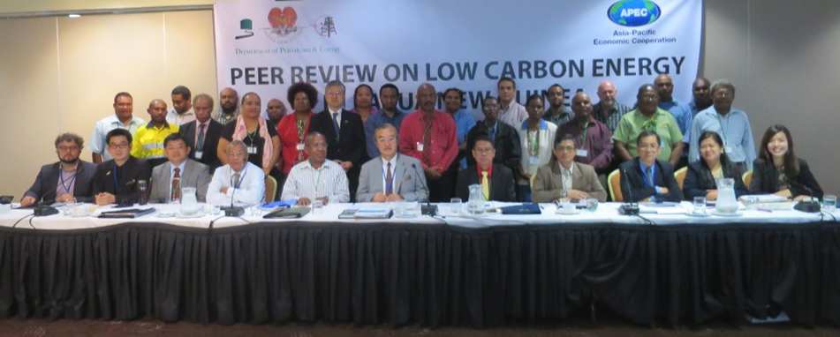
6.a. (7) Cooperative Activities (cont’d)
(2) Peer Review on Low Carbon Energy Policies (PRLCE) [⇒12.b.]
PRLCE: Phase-4
Economy: Papua New Guinea
Venue: Crowne Plaza Port Moresby
Schedule: 1-4 August 2017
Focus: Hydro Power Resources
PNG Participants: 23, Dept. of petroleum and Energy, Climate Change Dev. Authority, PNG Power Ltd. etc.
Recommendations:44
Experts: 7
Dr. Dennis Y.C. Leung (HKC)
Mr. Faisal Rahadian (INA)
Mr. David Rohan (NZ)
Mr. Andresito Ulgado (RP)
Dr. Fu-Ming Lin (CT)
Dr. Nuwong Chollacoop(THA)
Mr. Stephen C. Walls (US)
Secretariat(APERC): 4
Mr. Takato Ojimi
Dr. Kazutomo Irie
Ms. Elvira Torres Gelindon
Ms. Lay Hui Teo

Slide 12
6.a. (7) Cooperative Activities (cont’d)
Recommendations made in PRLCE for Papua New Guinea
Overarching Findings | Recommendation 1: Conduct survey.
Institutional Context | Recommendation 8: Ensure sufficient human resources to drive energy policies.
Renewable Energy Goals, Targets and Strategy | Recommendation 14: PNG should focus attention and resources on a near-term action plan to develop the lowest cost renewable resource available near load centres.
Regulation and Infrastructure | Recommendation 17: PNG should rely on internationally-recognised standards when establishing new regulations covering the performance of technology.
Bioenergy - Biofuels, Biomass | Recommendation 21: Take best practices from other APEC economies regarding biofuel implementation.
Hydropower and Ocean Energy | Recommendation 22: Enact a law that provides policy direction and incentives on developing hydropower and ocean resources.
Solar PV | Recommendation 23: Establish solar energy demonstration projects at school campuses.
Geothermal Energy | Recommendation 25: Enact a law that provides policy direction and incentives on developing geothermal energy resources.
Wind Energy | Recommendation 26: Early planning of wind turbines installation
Power Supply System, Smart Grid, Private Participation | Recommendation 32: The investment focus should move from individual ‘least-cost generation projects’ to a ‘least-cost generation portfolio’ approach.
Greenhouse Gas Management | Recommendation 37: Expedite the implementation of National Climate Change Policy, and formulation of National Energy Policy (NEP).

Slide 13
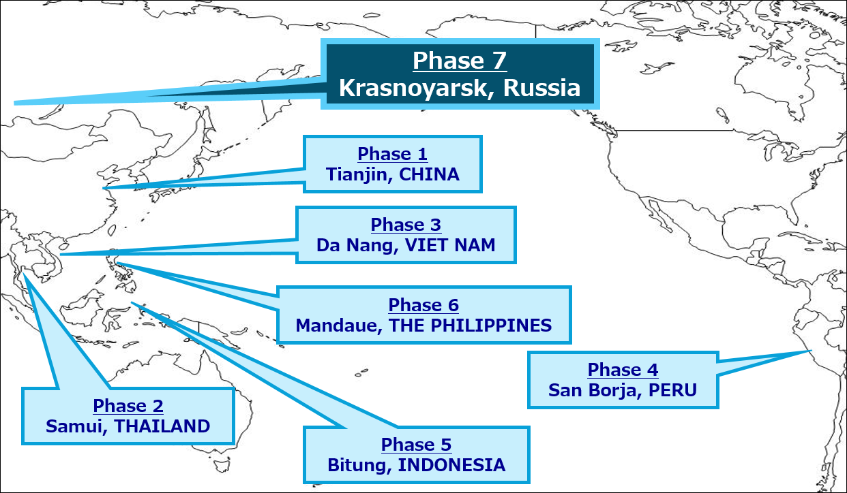
6.a. (7) Cooperative Activities (cont’d)
Low-Carbon Model Town (LCMT) [⇒7.b.]
Phase 7:
LCMT 7 in Krasnoyarsk, Russia in 2017
-Feasibility Study for Krasnoyarsk is underway
-Policy Review for Krasnoyarsk will be conducted on 5-7 December 2017.
The 1st LCMT Symposium was held on
14-15 September in Jakarta, Indonesia
Dissemination Phase 1
-The 2nd LCMT Symposium is planned
to be held in September 2018 in Da Nang,
Viet Nam (case town of the LCMT Phase 3)
Dissemination Phase 2 (Concept Note was submitted to Session 1, 2018)

Slide 14
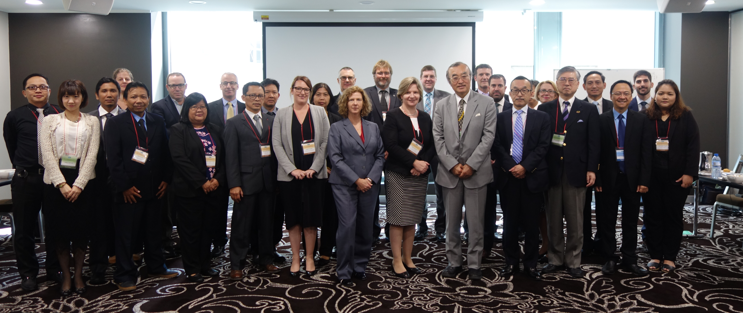
4.a. (8) Oil and Gas Security Initiative [⇒ 13.c.]
Oil and Gas Security Exercise (OGSE)
OGSI:2017
Economy: Australia (Indonesia, the Philippines, Thailand)
Venue: Novotel Melbourne
Schedule: 29-31 March 2017
Focus: A regional Capacity Building
Participants: Australia;8 Dept. of Environment and Eenrgy, etc.
Indonesa;3 National Energy council, Ministry of Energy
and Minerl rsouces
the Philippines;2 Department of Energy
Thailand:2 Ministry of Enrgy, etc.
Recommendations:65
Experts: 7
Ms. Dagmar Graczyk (IEA)
Dr. Phoumin Han (ERIA)
Mr. Christopher Zamora (ACE)
Mr. Jun Okunishi (METI, Japan)
Mr. Doug MacIntyre (DOE, US)
Dr. Ken Koyama (IEEJ)
Ms. Robyn Casey (DOEE, Australia)
Secretariat(APERC): 4
Mr. Takato Ojimi
Dr. Kazutomo Irie
Mr. Michael Sinocruz
Ms. Fang Chia Lee

Slide 15
4.a. (8) Oil and Gas Security Initiative [⇒ 13.c.]
Oil and Gas Security Exercise in Australia
One common oil emergency scenario and three gas emergency scenarios – one each for participating economies based on individual domestic gas situation were provided
The team made some common observations and/or recommendations, such as:
Continue testing existing emergency policies, instruments and institutional setups, and revise them (if necessary) to reflect national, regional and global developments
Consider a policy on floating price mechanism for “business-as-usual” and supply emergency situation to support faster market response and resolution of the supply shortfall
Build capacities of all the agencies involved by sharing and reviewing actual fuel and gas supply-related emergency responses
Undertake studies by Indonesia, the Philippines and Thailand on maritime oil supply routes and shipping arrangements in the event of supply emergency scenario
Develop better-integrated domestic and international gas markets through government policies that support market transparency and supply flexibility
Develop a more accurate modelling on gas infrastructure and surge capability since disruption in gas market has an impact on electricity supply
Ensure adequate infrastructure and the need to finance such to meet future demand. This should be linked to medium- to long-term planning exercises
Assess demand elasticity and the economic and financial cost of an emergency

Slide 16
6.a. (9) APERC Research Staff
APERC has 29 research staff, 6 of whom joined APERC since EWG53
Takato Ojimi (President)
James Michael Kendell (Vice President)*
Kazutomo Irie (General Manager)
Melissa Christenberry Lott
(Assistant Vice President)*
Kaoru Yamaguchi
Edito Barcelona
Cho Yee IP*
Ruengsak Thitiratsakul*
Goichi Komori
Elvira Torres Gelindon
Michael Ochoada Sinocruz*
Choong Jong Oh*
Yusuke Kimura
Martin M. Brown-Santirso*
Takashi Otsuki
Muhamad Izham ABD. Shukor*
Alexey Kabalinskiy*
Atikah Ismail*
Fang-Chia Lee*
Kirsten Nicole Smith*
Yuko Tanaka
Nguyen Linh Dan*
Diego Rivera Rivota*
Thomas Willcock*
Lay Hui Teo*
Gigih Udi Atmo*
Yilin Wang*
Juan Ignacio Alarcon*
Takako Hannon
*19 visiting researchers

Slide 17
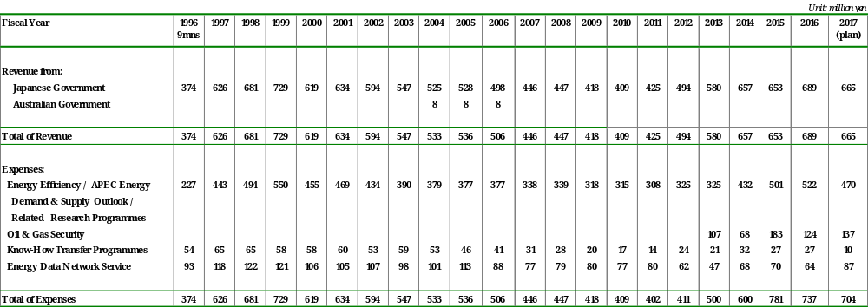
6.a. (10) APERC Budget

Slide 18
Thank you for your kind attention

