Slide 1
RENEwable Energy Developments
Implications of prolonged low energy prices on the energy mix
Rana Adib
Research Coordinator
rana.adib@ren21.net
APERC Annual Conference
25 May 2016

Slide 2

REN21 - a multi stakeholder network
Science & Academia:
IIASA, ISES, SANEDI, TERI, Fundacion Bariloche
      NGOs:
      CURES, GFSE, Greenpeace, ICLEI, ISEP, JREF, RCREEE, WCRE, WFC, WRI, WWF
International Organisations:
ADB, EC, ECREEE, GEF, IEA, IRENA, UNDP, UNEP, UNIDO, World Bank
National Governments:
Brazil, Denmark, Germany, India, Norway, Spain, Uganda, UAE, UK
Industry Associations:
ACORE, ARE, CEC, CREIA, EREF, GWEC, IGA, IHA, IREF, WBA, WWEA

Slide 3
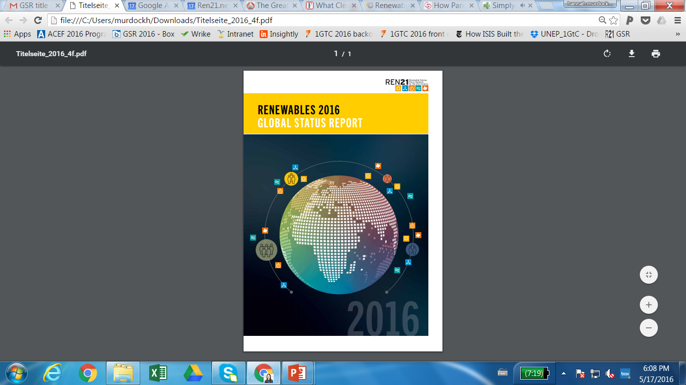
REN21 Renewables 2016 Global Status Report
Launched at Clean Energy Ministerial on 1st June 2016
Network of over 700 contributors, researchers & reviewers worldwide
The report features:
    Global Overview
    Market & Industry Trends
    Distributed Renewable Energy for Energy Access
    Investment Flows
    Policy Landscape
    Energy Efficiency
    Feature: Community Renewable Energy
The report covers:
    All renewable energy technologies
    The power, heating & cooling, and transport sector
    Energy Efficiency
COMING 1 JUNE
www.ren21.net/gsr

Slide 4
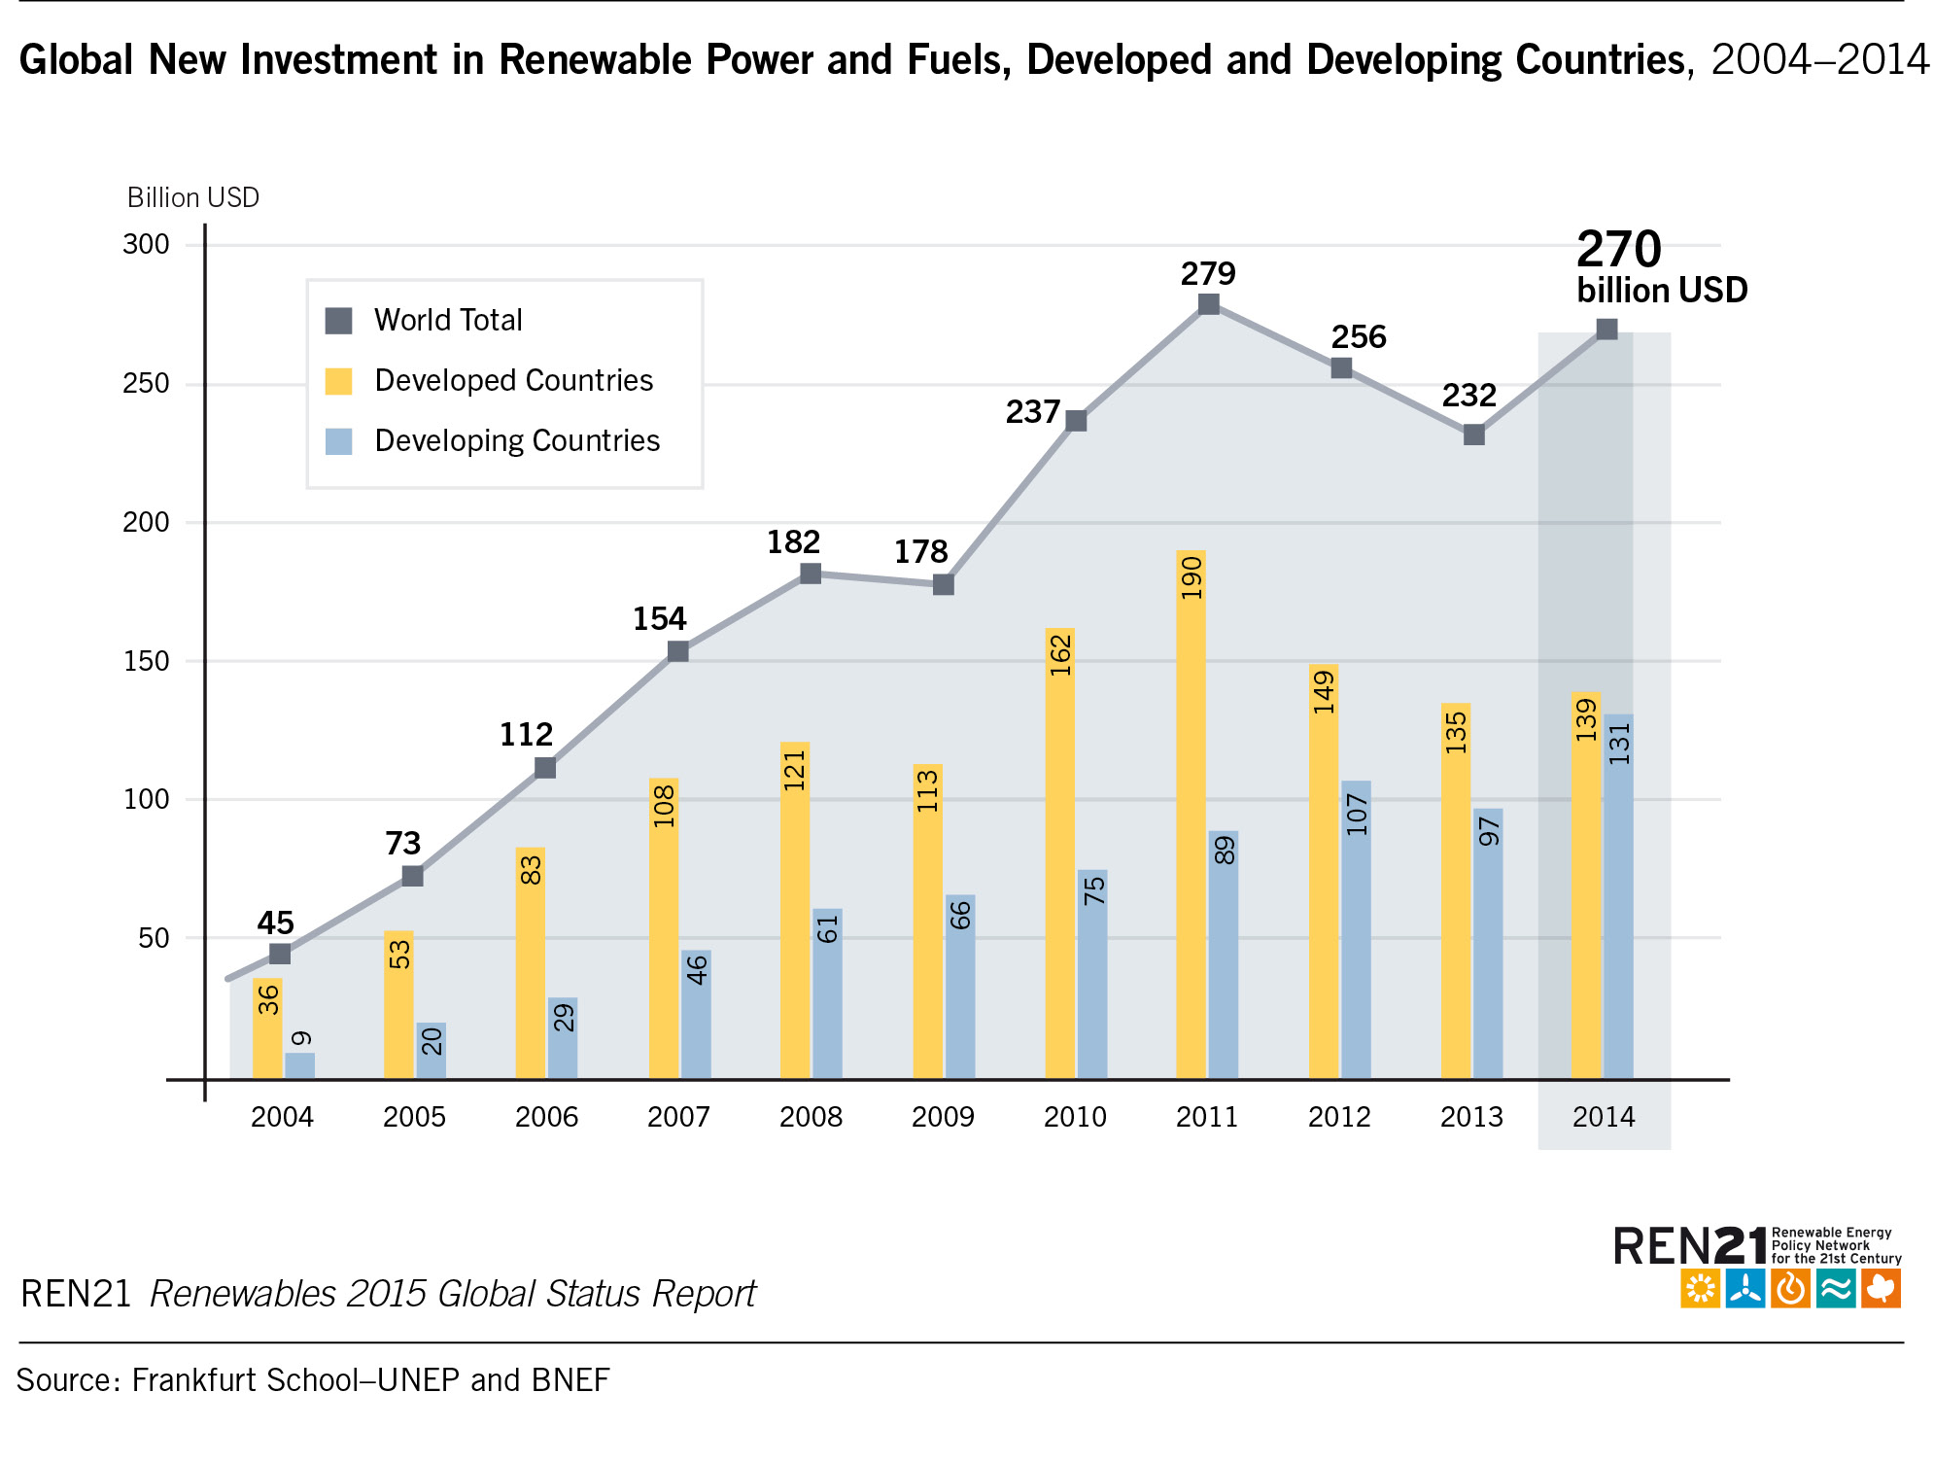
Global Investment in Renewable Energy
  Global new investment estimated 285.9 billion in 2015
  For the first time in history, investment in renewables excluding large hydro in developing countries outweighed that in developed economies
  Developed countries:
  USD 130 billion investment
  ↘ 8% (compared to 2014)
  Developing countries
  USD 156 billion investment
  ↗ 19% (compared to 2014)
Notes:
Small-scale distributed capacity investment, largely rooftop solar PV, was USD 67.4 billion. Falling cost and innovative financing mechanisms are putting small-scale distributed solar within reach of more people, both in developed and emerging economies.
Even more striking is the change that happened in solar. Developed countries dominated with the successive small-scale booms in Germany, Italy and Japan, right up to 2014. In 2015, however, the gap between developed and developing and emerging economies on solar investment was down less than USD 1 billion, as China, India, Chile, South Africa and other nations ramped up PV, and to some extent solar thermal, or concentrated solar power (CSP) deployment. Investment in solar in developed countries in 2015 was USD 80.8 billion, compared to USD 80.2 billion invested in developing and emerging economies.

Slide 5
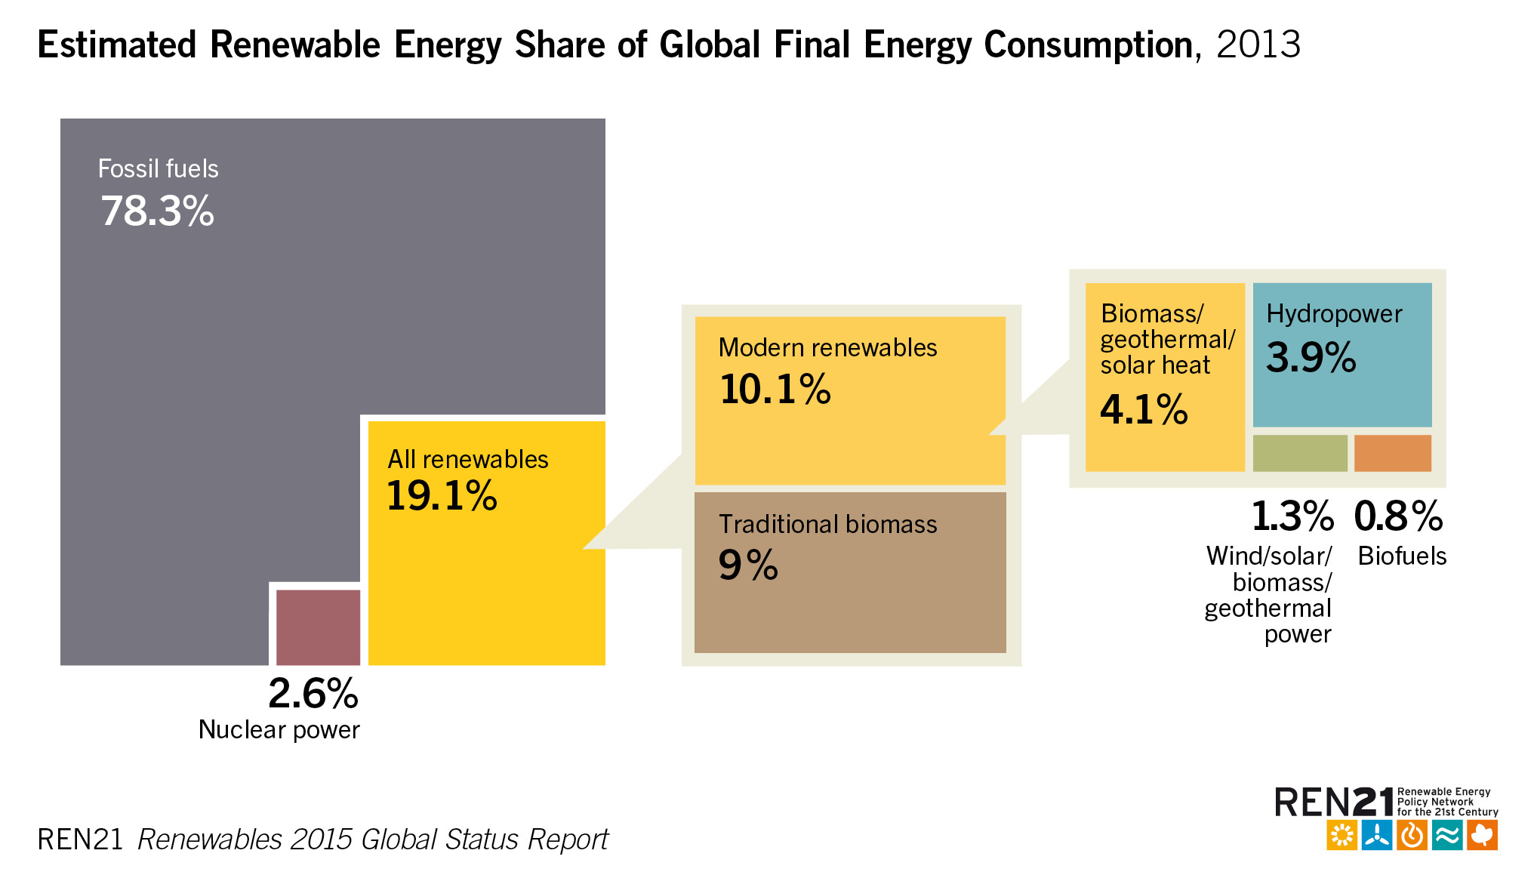
Renewable Energy in the World
Renewable energy provided an estimated 19.2% of global final energy consumption in 2014.
Growth in capacity and generation continued in 2015, but varies in the sectors
Renewables rising rapidly, but the share is not growing as quickly
displacing large stock of existing infrastructure and fuels in developed countries takes time
energy demand in developing countries rises quickly and fossil fuel play a significant part in meeting increased demand
Notes:
Rapid renewables growth in the power sector, mainly driven by
Increased cost competitiveness
Dedicated policy incentives
New markets for centralised and distirbuted renewable energy emerge

Slide 6
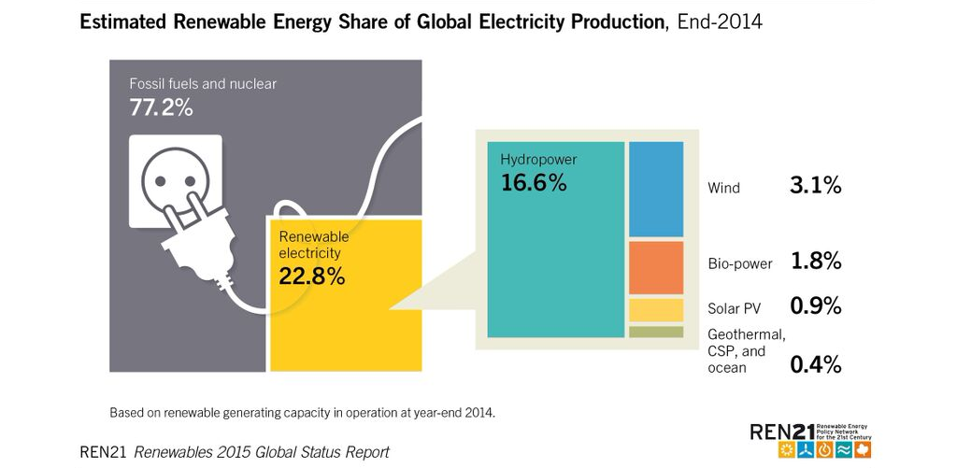
Power Sector
In 2015, renewables covered 23.7% of global electricity demand (up from 22.8%).
Renewables made more than 60% of net additions to global power capacity
Total RE power capacity: 1849 GW, largest increase in capacity ever
Lowest-ever prices for renewable power long-term contracts in the power sector
PV and wind are driving the renewable power market and are cost-competitive with new fossil fuel capacities
Developments in renewable powerbut push the electrification of other sectors
Notes:
Power sector experienced largest annual increase in capacity ever
Wind and solar had record additions, accounting for 77% of new installations, hydropower the remainder
RE power has been broadly competitive with power from fossil fuel
Wind and solar power capacities are also cost-competitive with new fossil fuel capacities
Record-low winning bids in power auctions in 2015 and early 2016 in Latin America, MENA, India indicate expectations of further cost-reductions (X ct/W)
This developùmenton
Added RE power capacity in 2015: 147 GW
For the sixth consecutive year renewables outpaces fossil fuel for net investment in power capacity additions

Slide 7
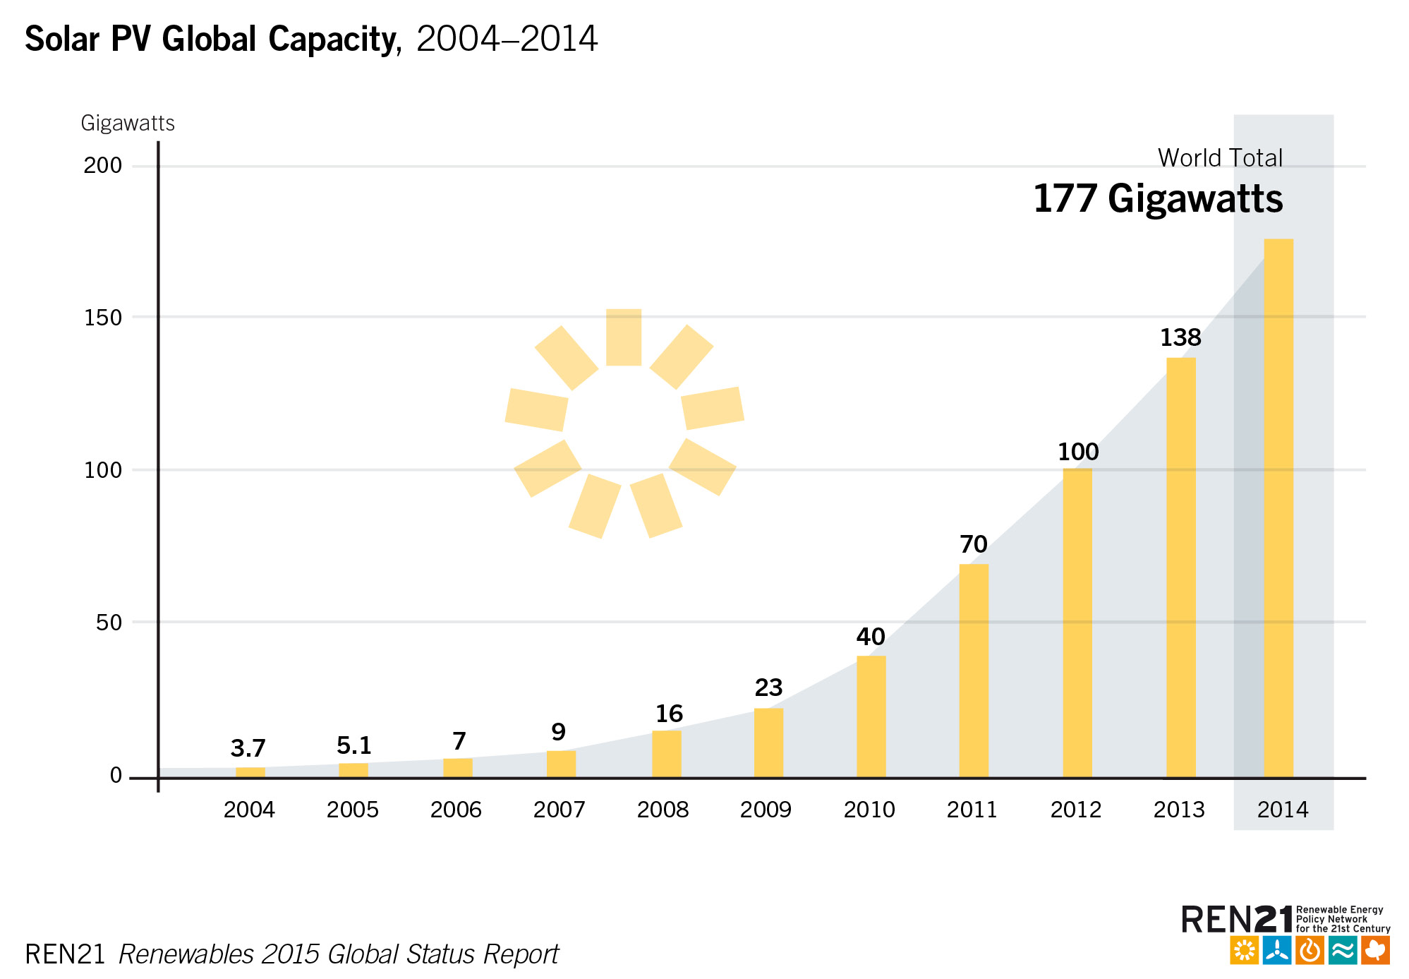
Solar Photovoltaics (PV) – total global capacity
Solar PV:
+50 GW added (10.6 GW in China in 2014; approx. 15 GW in 2015)
Total capacity: 227 GW
More than 60% of all PV capacity in operation worldwide at the end of 2014 was added over the past three years.
Asia accounted for almost 60% of global additions in 2015.
Notes:
2014marked another record year for growth, with about 40 GW of capacity added, for a global total of about 177 GW. The strong market in 2014 came despite the substantial decline in new installations in the European Union, challenges reaching targets (particularly for distributed systems) in China, and slower-than-expected emergence of promising new markets.
More than 60% of all PV capacity in operation worldwide at the end of 2014 was added over the past three years.
Asia eclipsed all other markets, accounting for almost 60% of global additions. China increased its cumulative capacity by 60%, adding a reported 10.6 GW for a total exceeding 28 GW (preliminary figures for 2015: addition of approx. 15 GW for a total exceeding 43 GW).
Over 80% of China’s new capacity was in large-scale power plants, and the remainder was in distributed rooftop systems and other installations for small-scale use.
Average module prices fell during 2014, with multicrystalline silicon module spot prices down about 14% year-over-year to USD 0.6/Watt.

Slide 8
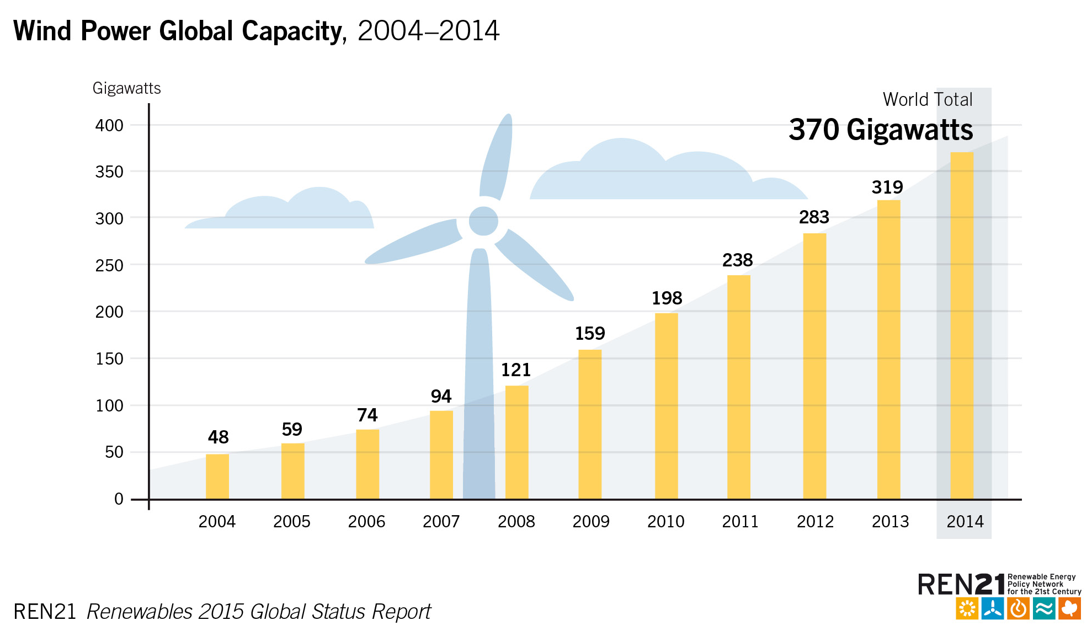
Wind Power – total world capacity
2015: 63 GW of capacity were added (out of which 30.5 GW in China)
Total installed capacity: 433 GW (out of which 145 GW in China)
Offshore: world total exceeding 12.1 GW in 2015 (+ 3.3 GW)
Leading source of new power generating capacities in US and Europe, 2nd largest in China
covering high shares of power demand
(DK: 42%, four states in D: 60%, UY: 15.5%)
Notes:
Powered by an astonishing 30.5 GW of new installations in China, the global wind power industry installed 63 GW in 2015, representing annual market growth of 22%. As a result of its extraordinary annual market, China has edged past the European Union in terms of total installed capacity, with 145.1 GW to the EU’s 141.6 GW. The Chinese government’s drive for clean energy, supported by continuous policy improvement, is motivated by the need to reduce dependence on coal which is the main source of the choking smog strangling China’s major cities, as well as growing concern over climate change.
Total global capacity reached 432,419 MW at the end of 2015, representing cumulative growth of 17%.

Slide 9
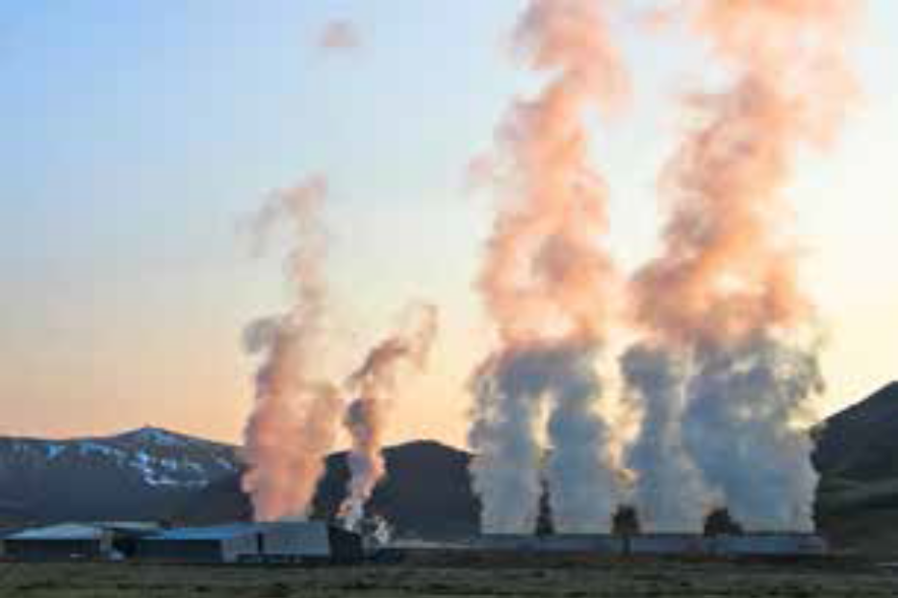
Heating & Cooling
Energy use for heat accounted for about half of total world final energy consumption in 2014. Three-quarters of global energy use for heat is fossil fuel based.
Small but growing modern renewable energy share of final global heat demand: approx. 8%. Mostly biomass, but also solar thermal and geothermal
Policy support for renewable heating & cooling remained far behind other sectors
Low fossil fuel prices challenge already slow developments
Renewable heating & cooling continued to rise, but global growth rates declined
Slowdown in renewable H&C investment
Notes:
In the heating sector, low fossil fuel prices affected growth rates and caused turbulences
Solar thermal heat market has been slowing down
Powered by an astonishing 30.5 GW of new installations in China, the global wind power industry installed 63 GW in 2015, representing annual market growth of 22%. As a result of its extraordinary annual market, China has edged past the European Union in terms of total installed capacity, with 145.1 GW to the EU’s 141.6 GW. The Chinese government’s drive for clean energy, supported by continuous policy improvement, is motivated by the need to reduce dependence on coal which is the main source of the choking smog strangling China’s major cities, as well as growing concern over climate change.
Total global capacity reached 432,419 MW at the end of 2015, representing cumulative growth of 17%.

Slide 10
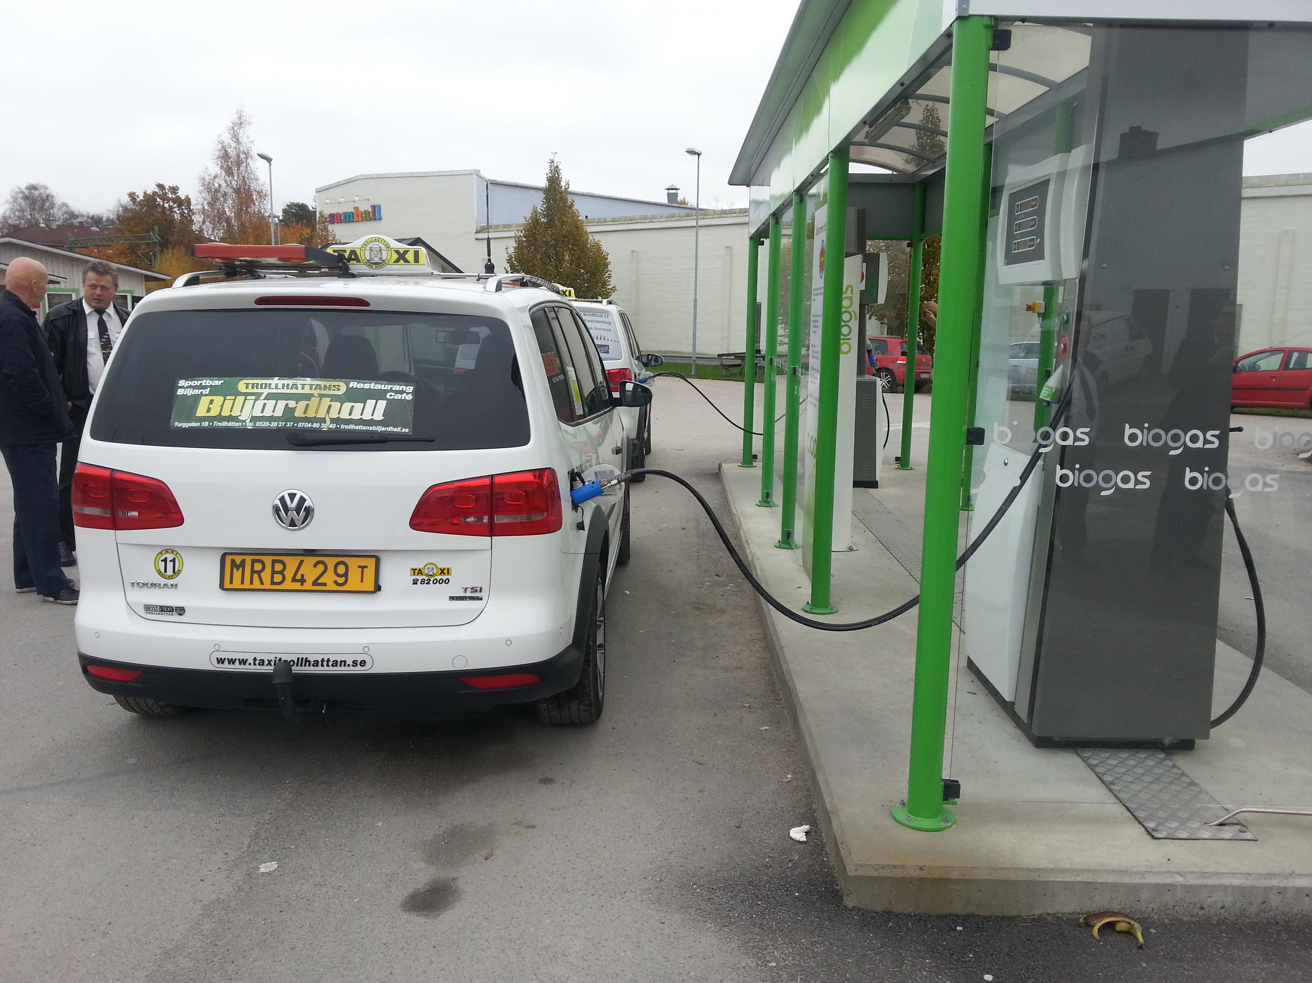
Transport
Renewable energy accounted for an estimated 4% of global fuel for road transport in 2015.
Trends in the development of gaseous fuels and electricity continued to create pathways for the integration of renewables into transportation.
Advances in new markets and applications, like aviation fuels
Large focus on effiency and local air pollution
Low fossil fuel prices affected growth rates and appetite for new investment
biofuels were sheltered in many locations, where blending mandates exist
Notes:
As of early 2015, China was home to 97% of the world’s 235 million electric two wheelers and 79% of the world’s 46,000 electric buses.
In the transport sector, low fossil fuel prices affected growth rates: biofuels were sheltered in many locations, where mandates exist, but the low oil prices affected the appetite for new investment
In particular biodiesem production was affected: with a negative growth rate of -0.9 % compared to +6.5 over the last 5 years
Ethanol production was stil rising with a growth rate of 3.9% comaprd to 3% over the last 5 years
As of early 2015, China was home to 97% of the world’s 235 million electric two wheelers and 79% of the world’s 46,000 electric buses.
In 2014, China mandated that EVs make up at least 30% of all vehicles purchased for government fleets by 2016.

Slide 11
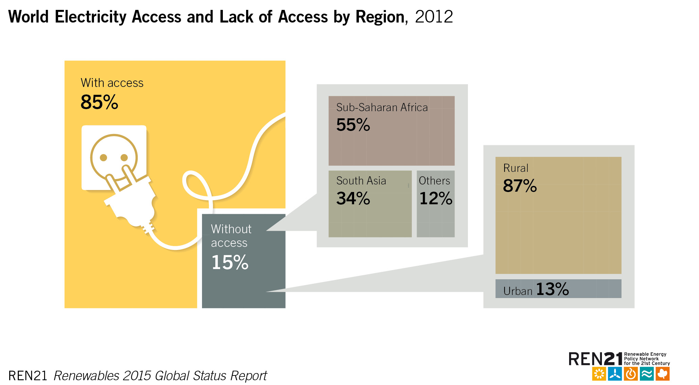
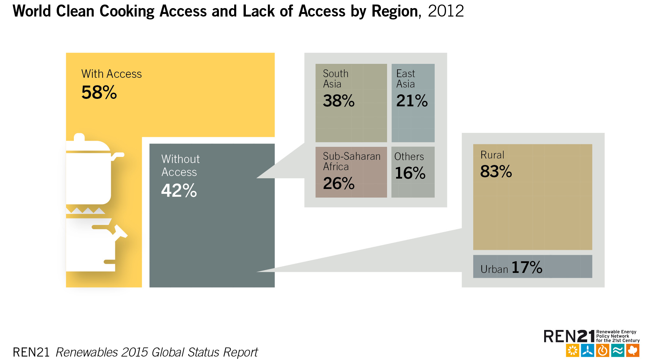
Distributed Renewable Energy for Energy Access
  Distributed renewable energy systems offer opportunity to accelerate the transition to modern energy services in remote areas
  2015 saw positive market trends and increased investment.
  Solar PV markets flourished off-grid solar PV market: USD 300 million per year
  More then 70 countries have off-grid solar PV capacity installed or programmes
  6 million SHS installed beginning of 2015
  276 million US invested in off-grid solar companies
Notes:
15% of the global population still lack any access to an electricity grid, mainly in Asia-Pacific and Sub-saharaan Africa.
2.9 billion people lack access to cleaner forms of cooking
India, China, Nepal: 2 million
Bangladesh: 60000 per month

Slide 12
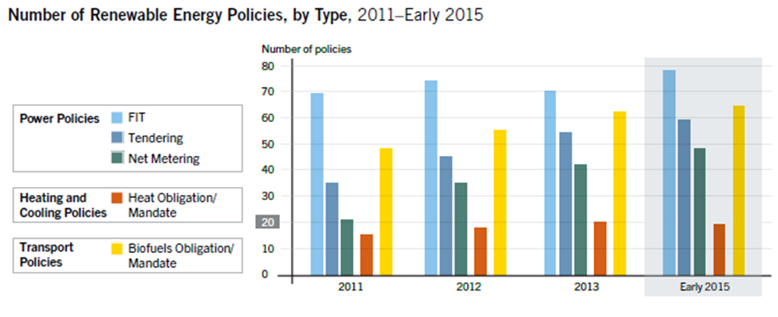
Renewable Energy Policy Landscape
Power sector: the main focus of policies over the last years
FITs were the most popular type of policy
Net metering or net billing policies in force in 48 countries, increase of approx. 220% (2010)
Heating & Cooling in particular needs stronger policy development/suppor
Biofuel blending mandates illustrate the crucial role of policy support
Notes:
Powered by an astonishing 30.5 GW of new installations in China, the global wind power industry installed 63 GW in 2015, representing annual market growth of 22%. As a result of its extraordinary annual market, China has edged past the European Union in terms of total installed capacity, with 145.1 GW to the EU’s 141.6 GW. The Chinese government’s drive for clean energy, supported by continuous policy improvement, is motivated by the need to reduce dependence on coal which is the main source of the choking smog strangling China’s major cities, as well as growing concern over climate change.
Total global capacity reached 432,419 MW at the end of 2015, representing cumulative growth of 17%.

Slide 13
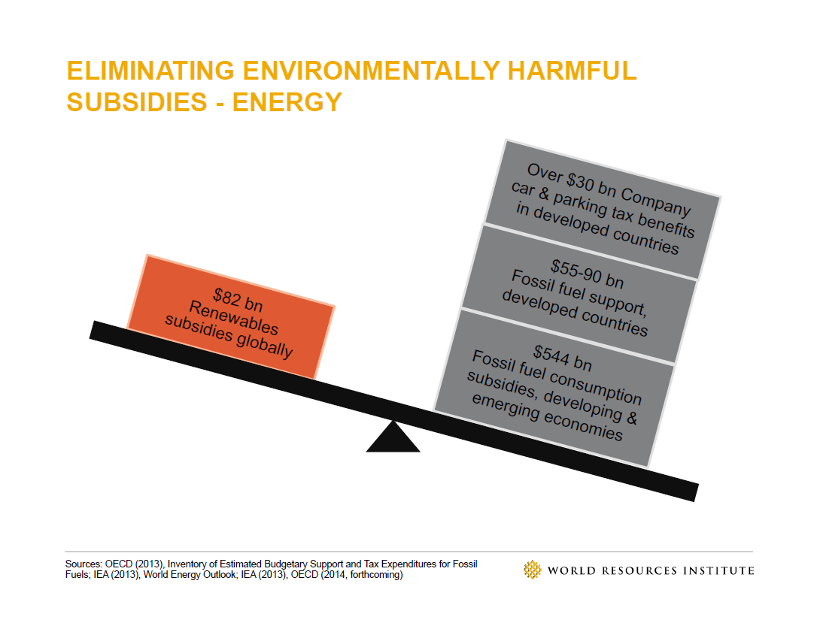
Why do we have to support renewables?
Notes:
In this context, it is extremely important to keep in mind that
Some countries commited to reforming their subsidies for fossil fuel

Slide 14
Renewable Energy in Asia
  Asia installed the most renewable energy power generating capacities
  China: leader in additions in hydropower capacities, bio-power, records in wind and solar PV additions; leader in renewable investement
  India : among the top countries for solar PV, hydro and wind power capacity additions
  Japan: second in total PV additions
  Malaysia, Pakistan, the Philippines, the Republic of Korea, Thailand and Vietnam – have emerged as important markets for more than one renewable power technology.
  Bangladesh, China, India, and Nepal witnessing rapid expansion of small-scale renewable systems, including renewables-based mini-grids.
  Renewable energy heat
  Modern biomass for residential heat markets has grown, especially in Japan and the Republic of Korea (strict efficiency requirements)
  China leading in terms of installed capacities in solar thermal, geothermal, biogas heat
In the transport sector, ethanol continued to grow, biodiesel prioduction fell sharply
Notes:
Powered by an astonishing 30.5 GW of new installations in China, the global wind power industry installed 63 GW in 2015, representing annual market growth of 22%. As a result of its extraordinary annual market, China has edged past the European Union in terms of total installed capacity, with 145.1 GW to the EU’s 141.6 GW. The Chinese government’s drive for clean energy, supported by continuous policy improvement, is motivated by the need to reduce dependence on coal which is the main source of the choking smog strangling China’s major cities, as well as growing concern over climate change.
Power: Asia installed the most renewable power generating capacity during 2015. China again led the world in additions of hydropower capacity, was a leader in bio-power capacity and set new world records for wind and solar power installations. India also ranked among the top countries for solar PV, hydro and wind power capacity additions, and Japan was second only to China for new solar PV installations. Turkey ranked first globally for new geothermal power capacity, third for new hydro and tenth for wind power capacity additions. Other countries in the region – including Malaysia, Pakistan, the Philippines, the Republic of Korea, Thailand and Vietnam – have emerged as important markets for more than one renewable power technology.
Heating and cooling: China continued to lead the world in installed capacity of solar thermal, geothermal and biogas-fuelled heating systems in 2015. The country saw declining investment in solar thermal collectors for the second consecutive year, although demand increased in some market segments (e.g. multifamily residences). Elsewhere in Asia, modern biomass for residential heat markets has grown, especially in Japan and the Republic of Korea, where strict efficiency requirements have influenced the development of globally competitive biomass boilers. Some Asian countries, such as India, continued to use substantial shares of bioenergy for heat production in industry. Renewable energy use in clean cook stoves – dominated by biogas – also has been on the rise, in particular in China and India and to a lesser extent in Bangladesh and Cambodia.
Transport: As fuel ethanol continued to grow in Asia, led by increases in China and Thailand, biodiesel production fell sharply. Indonesia, previously one of the top biodiesel producers worldwide, saw production decrease by roughly 60%. China’s biodiesel production increased, almost overtaking Indonesia’s 2015 levels.
Total global capacity reached 432,419 MW at the end of 2015, representing cumulative growth of 17%.
Chaine

Slide 15
Final conclusions
Impact of low oil prices, and also natural gas and coal prices
Negative impact on some renewable energy markets, in particular heating & cooling as well as transport
No/little impact on renewable power markets
Underline the improved cost competitiveness of solar and wind power
Opportunities for renewables as rising concerns about volatility of fossil fuel prices
Actions
Low fossil fuel prices is an opportunity to phase out fossil fuel subsidies
Address policy support in the heating & cooling sector
Energy planning and policy design need to integrated long-term perspectives in heating & cooling and transport

Slide 16
Renewables RISING
GSR2016 Thunderclap campaign
http://thndr.me/uFywvV
Join and help us spread the word!
COMING 1 JUNE
Help us spread the word & join the Campaign

Slide 17
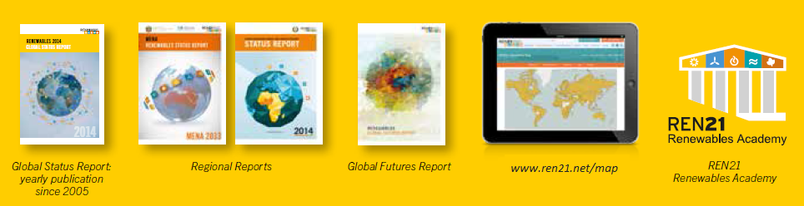

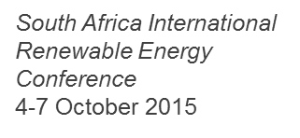
RENEWABLE ENERGY POLICY NETWORK
FOR THE 21st CENTURY
^{www.ren21.net/gsr}
^{Subscribe to our newsletter}
^{www.ren21.net}

