Slide 1

ENERGY AND INDUSTRY DEPARTMENT
PRIME MINISTER’S OFFICE
BRUNEI DARUSSALAM
LNG Producer-Consumer Conference 2016
By
Minister of Energy and Industry at the Prime Minister’s Office
Pehin Datu Singamanteri Colonel (Rtd.) Dato Seri Setia
(Dr.) Awang Haji Mohammad Yasmin Bin Haji Umar
Tokyo, 24 November 2016
Notes:
OPENING SLIDE (SLIDE 0)
LNG Producer-Consumer Conference 2016
Key Note Speech for Session 3: Emerging LNG Markets in Asia
24th November 2016, Tokyo, Japan
Session 3: Asian countries, including Southeast Asia, are expected to be the major driver of developing LNG market. Asian Ministers and representatives are invited to discuss the roles to be played by LNG in their energy policies, and their outlook of LNG demand and the challenges in bringing in LNG.
[YB Pehin’s time: 7 mins]

Slide 2
Session 3
Emerging LNG Markets in Asia
Notes:
SLIDE 1
Thank you Chair,
Colleague Ministers, Distinguished Delegates, Ladies and Gentlemen, I wish to first of all thank His Excellency Mr Hiroshige Seko, the Minister of Economy, Trade and Industry, Japan, the government and people of Japan for the warm and generous hospitality accorded to us here, and congratulations on the successful hosting of this Conference.

Slide 3
Energy Demand Outlook
Global energy consumption 2012 - 2040 expected to increase by 48%.
In 2040:-
  78% of total energy consumed by fossil fuels.
  73% of increasing global gas consumption driven by industrial & electricity generation.
Source: International Energy Outlook 2016, the U.S EIA
In the medium-term 2015-2021, liquefaction capacity additions will be mainly from USA & Australia.
Demand mainly from Asia (China, India, other developing countries) & EU.
Notes:
SLIDE 2
Ladies and Gentlemen,
{Supply - Demand Outlook}
The International Energy Outlook 2016 (IEO2016) reference case by U.S. Energy Information Administration (EIA), shows a worldwide energy consumption increase of 48% from 2012 to 2040 mostly from non-OECD countries including China and India. In terms of fuel types, though renewables and nuclear shows the fastest growth, fossil fuels will still continue to account for 78% energy use. In terms of natural gas consumption, 73% of total world energy gas consumption increase will be from two sectors i.e. from industrial use with an increase by average of 1.7% per year and from electric power generation of 2.2% per year.
According to the Medium-Term Market Report 2016 by International Energy Agency (IEA), from 2015-2021 the liquefaction capacity additions will be mainly from USA and Australia while on the LNG import side, the main regions will be from China, India, other developing Asia and EU.

Slide 4

Gas Policy and Paris Agreement
Gas utilisation:- Low carbon economy & address climate change issue
Paris Agreement entered into force on 4th November 2016.
Natural gas will continue to be in demand:- emits lowest CO₂ & produces lowest NOx, SO. Plays vital role in reducing emissions.
Complements drive in renewables & energy efficiency initiatives.
Notes:
SLIDE 3
{Gas in policy & Paris Agreement}
The forecast shows that gas utilisation coupled with plans for LNG expansion will still continue to play a part in the world energy scenario. This move is supported by countries policies to deliver a low carbon economy and address climate change. The Paris Agreement that was recently entered into force on 4 November 2016 reinforces this message and brings it to back into the main international agenda. This agreement, which Brunei Darussalam has ratified on 21 September 2016 will provide transparency and accountability thus sending the right message across all, be it policy makers or business entity, that any decisions made must account the climate change agenda.
With this in mind, natural gas will still continue to be in demand. As the lowest carbon dioxide emitter among the fossil fuels i.e. over 30% less carbon dioxide than diesel and 37% less than heavy fuel oil, it will continue to play an important role in the energy mix as an enabler for countries to fulfill their environmental commitments to reduce emissions. Apart from this, natural gas is also able to address air pollution as it produces the lowest nitrogen oxides, sulfur dioxide and fine particulate matter among the fossil fuel. From the presentation by IEA during the National Energy Administration of China (NEA)-IGU G20 Natural Gas Day held last June 2016, air pollution is the 4th largest human health risk. In the longer term, carbon capture and storage technology and having it retrofitted to natural gas power plants after 2030 will also be an enabler to allow near zero emissions. Being well established and readily available now, this will compliment the drive in renewables and energy efficiencies initiatives.

Slide 5
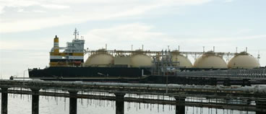
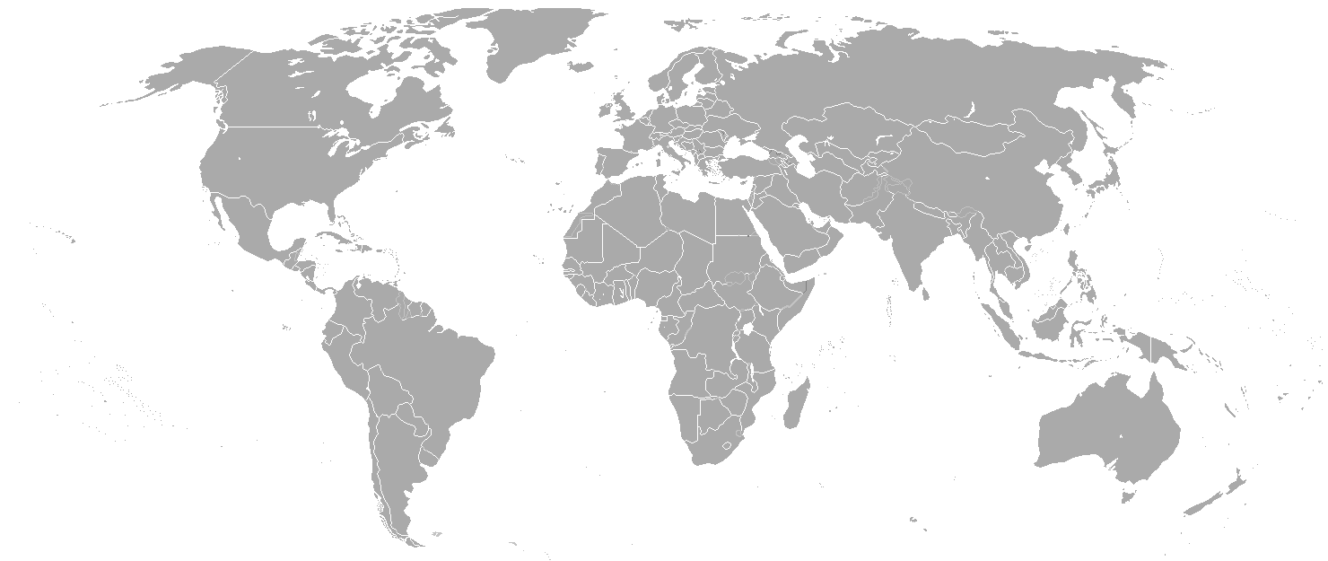
Emerging LNG Market
Asia as main driver for LNG demand;
By 2025, more than 60 additional countries will start importing LNG:
  Volume up to 37 mtpa;
  Support from advance technologies FSRUs and FSUs.
Notes:
SLIDE 4
{Emerging market}
As stated earlier, LNG demand will mainly be coming from this region. The amount from established importers will still continue to rise from 238 million metric tonne per annum (mmtpa) to 384 mmtpa in 2025. In terms of where the other potential future of LNG market will come from, Wood Mackenzie report has indicated that more than 60 additional countries from the 36 countries in 2015 could potentially start importing LNG by 2025 with volumes up to 37 mmtpa. This is made possible through utilising floating storage and regasification units (FSRUs) or floating storage units (FSUs) which is a lower cost option and provides better flexibility. We have seen how in 2015, FSRU have allowed Jorden, Egypt, Pakistan and Dubai to take in LNG for the first time. Such technology advances have opened up new players and shows that there are solutions available to reach new LNG entrants. This plays an important role in itself to support climate change agenda.

Slide 6
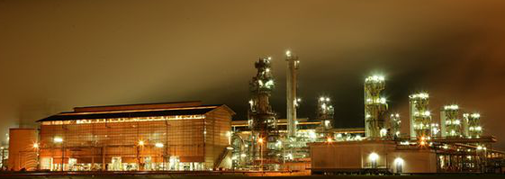
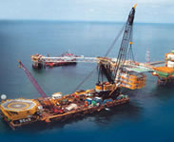
Brunei as LNG Producing Country
LNG producer for more than 40 years.
Plant rejuvenation (2004) has enabled Brunei LNG to produce for the next 60 years.
Recent developments in the LNG industry is welcomed.
Brunei continuously seeks potential opportunities.
Notes:
SLIDE 5
{Brunei Darussalam context}
For Brunei Darussalam, we are no stranger to the LNG industry. The Brunei LNG plant is the first to be built in the Western Pacific in 1972 and to date has been able to meet its contractual cargoes to its buyers. In order to ensure there is continued and reliable LNG supply, Brunei LNG has undertaken rejuvenation works since 2004 and this has resulted in the plant being able to produce LNG for the next sixty years. Brunei Darussalam welcomes the recent developments in the LNG industry and support Japan’s efforts towards realising a sustainable Asian LNG hub. As an LNG producer, Brunei is constantly looking at potential opportunities.
This LNG Producer-Consumer Conference allows both parties to have a better understanding of each other challenges that will come along with any negotiations. I believe all of you share this and I hope we can make full use of the opportunities that this conference presents. With that, I conclude my speech. Thank you.

Slide 7
Thank you

