Slide 1
LNG Producer-Consumer Conference 2016:
Natural Gas Market Development in ASEAN
Hidetoshi Nishimura
Tokyo, Japan
24-Nov-2016
Notes:
Excellences, distinguished guests, and ladies and gentlemen, I am Hidetoshi Nishimura, president of the Economic Research Institute for ASEAN and East Asia (ERIA). ERIA is a regional think tank dedicated to serving economic and energy policy makers in the East Asia region, especially ASEAN. I am honored to be here today, sharing with you ERIA’s studies and thoughts on the topic of LNG in the region.

Slide 2
Energy Mix in the ASEAN Region
Source: ERIA (2016)
Notes:
The ASEAN region is conventionally a heavy user of natural gas in its primary energy mix. The share of natural gas stands as 20% of its total primary energy consumption in 2012 – the base year of current ERIA energy outlook. This share of natural gas will stay stable until 2035.

Slide 3
Natural Gas Demand Outlook in EAS and ASEAN
The Gap between Projected Demand vs. Supply from within the Region will Reach 546 bcm per year by 2035
Source: ERIA (2016)
Notes:
When it comes to the absolute volume of demand for natural gas in both East Asia and ASEAN, even in the APS scenario, the demand will double from 2012 level. After considering the scenarios of indigenous production, the East Asia region needs to source 546 bcm of natural gas from outside the region in 2035 in the form of LNG. In the near term, this growing gap could be met by increased supply from the new projects that are already planned. However, in the long term, mechanism to secure sufficient infrastructure both in the upstream and downstream should be established for this region.

Slide 4
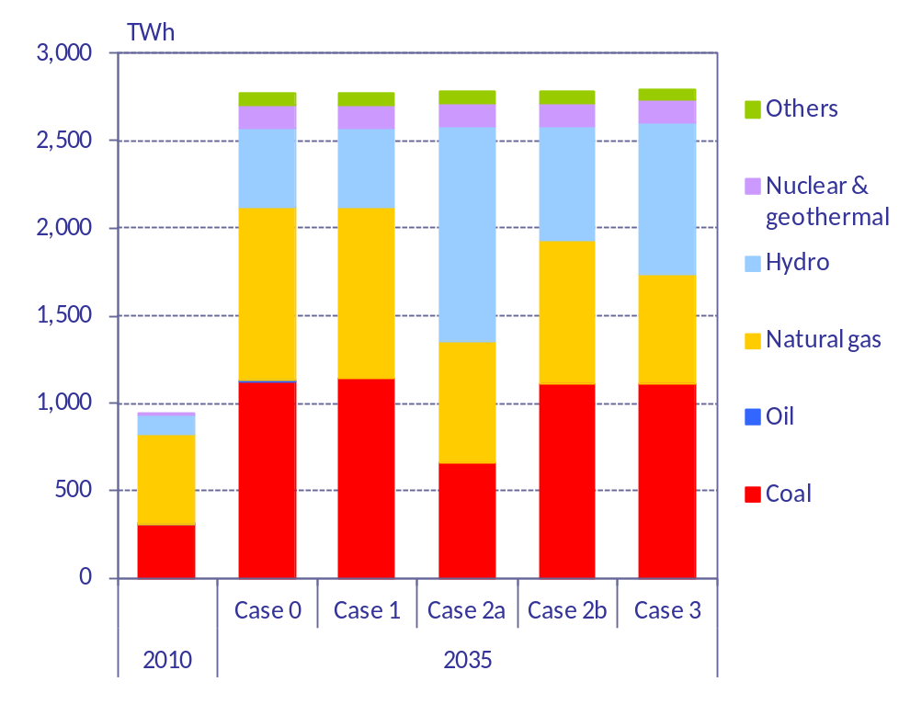
ASEAN Power Grid and the Future Fuel Mix for Power Generation
 | Resource availability | Stability electricity output | Generating cost | Environmental friendliness | Necessary action
Coal | good | good | good | bad | Improve efficiency
Natural gas | good | good | medium | medium | Reduce price
Hydro | medium | good | good | good | Develop potential capacity
Biomass Geothermal | medium | good | medium | good | Financial support
Wind Solar | good | bad | bad | good | R&D for smart grid Financial support
Case 0: Reference case (no grid connection)
Case 1: Grid connection, no additional hydro-potential
Case 2a: Grid connection, additional hydro-potential
Case 2b: Grid connection, additional hydro-potential (only utilized for export)
Case 3: Same as Case 2b, with no upper limit for the grid connection capacity
Source: ERIA (2016)
Notes:
The demand for natural gas is also driven by the dynamics within the energy industry. As the figure on the left shows, the development of hydropower by 2035 could be strongly boosted by the completion of ASEAN power grid (APG) – a main pillar of ASEAN energy policy, while the share from natural gas and coal will be squeezed. Such implies that natural gas needs to improve its competitiveness against alternative sources of energy.
As the figure on the right shows, natural gas has the advantage of being available, flexible, and relatively low greenhouse gas emissions. However, it needs to somehow improve its competitiveness by cutting the cost. Such is especially true in East Asia region which imports LNG at the highest prices in the world.

Slide 5
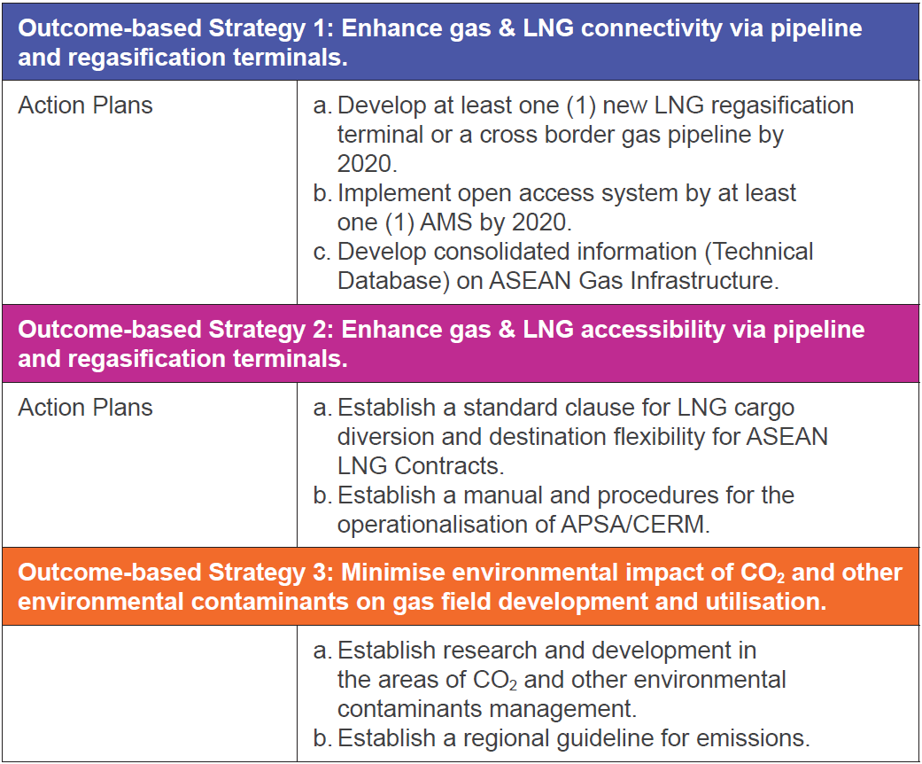
ASEAN Policies on Regional Natural Gas Market
1. Considering the challenges in global gas developments, including in the East Natuna Gas Field, the strategic focus of TAGP will expand from piped gas to LNG as the option for gas supply in the region – the virtual pipeline in ASEAN.
2. Securing supply through infrastructure development and the carbon emissions reduction due to use of natural gas have been emphasized in the latest policies in ASEAN.
Source: APAEC 2016-2025
Notes:
As the ASEAN Plan of Action for Energy Cooperation (APAEC) 2016-2025 was recently released, ASEAN strategy for natural gas is to gradually move towards integrated natural gas market, through the implementation of so called Trans-ASEAN Gas Pipeline, TAGP. Importantly, LNG is now considered as the future virtual pipeline. Investment in LNG terminals especially regasification facilities in the region is emphasized.
At the same time, ASEAN policies will encourage the development of institutions such as open access to infrastructure, information and data sharing, operationalization of ASEAN Petroleum Security Agreement (APSA) and Coordinated Emergency Response Measures (CERM), as well as establishment of standard clause for LNG destination flexibility in ASEAN.
Concerning the long term sustainability of natural gas market development in this region, APAEC also clearly discusses the importance of carbon emissions reduction related to the production and consumption of natural gas. Should there be further development of an ASEAN-wide agreement on constraining the carbon emissions from other sources of energy, especially oil and coal, natural gas as a cleaner fuel could be further promoted in this region.

Slide 6
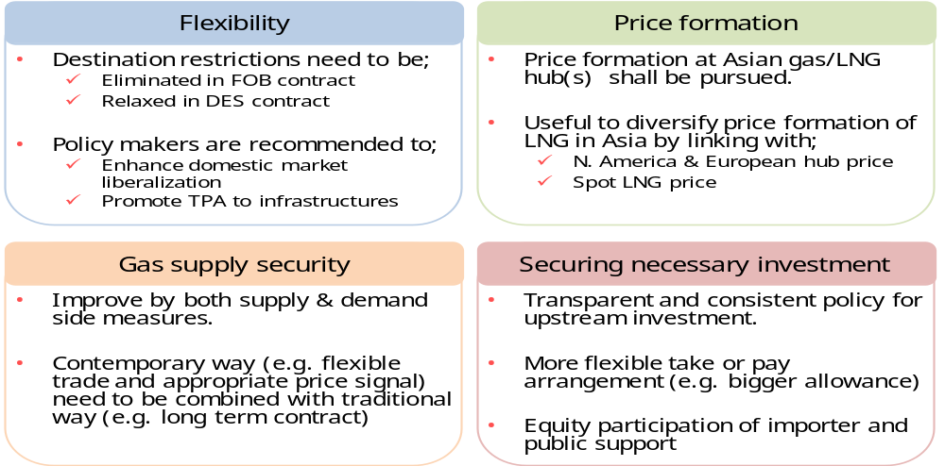
Multilateral Joint Study for LNG Market
To develop a sustainable LNG market in East Asia, LNG market players and policy makers are recommended to enhance the flexibility and transparency of this market.
In the meantime, proper development of LNG infrastructure is equally important regarding security
Notes:
Ladies and gentlemen, natural gas market in ASEAN, as well as in East Asia, is in transition. Specially, gas and power market are being liberalized in importing countries while the creation of trading hubs is under way, which will lead to a well-functioning market and provide benchmark prices of natural gas for this region.
ERIA study has achieved consensus among producers and consumers in this region regarding the following issues:
1. The relaxation or abolishment of destination restrictions, especially in the Free-On-Board contracts, is one key condition to creating hubs.
2. The liberalization of domestic markets is also key to increasing the number of traders and the amount of transactions.
3. The development of infrastructure for natural gas is equally important.
4. It is through achieving the above three points that the security of supply for the future of this region can be realized

Slide 7
Conclusions
ASEAN will gradually shift from net exporter of natural gas and LNG toward net importer
  This does not automatically imply a bigger role/share for natural gas in the region’s future energy mix
Thus, ASEAN countries need to:
  Actively developing adequate infrastructure including pipeline network and LNG terminals
  Collaborating in building regional institutions, such as destination flexibility to ensure security of supply in the future
A key question which links up all the above issues, as ERIA studies imply, is:
  What “price discovery mechanism” could deliver proper price signals to incentivize investment while also ensure affordable supply to this region?
Notes:
For conclusion, I would like to highlight the following points:
ASEAN will gradually shift from net exporter of natural gas toward net importer
This does not automatically imply a bigger role/share for natural gas in the region’s future energy mix
Thus, ASEAN countries need to:
Actively developing adequate infrastructure including pipeline network and LNG receiving terminals
Collaborating in regional institutions, such as destination flexibility to ensure security of supply in the future
A key question which links up all the above issues, as ERIA studies imply, is:
What “price discovery mechanism” could deliver proper price signals to incentivize investment while also ensure affordable supply to this region? Specifically, pricing for LNG in this region until now is dominated by long-term contract pegged to crude oil prices. This situation in East Asia looks increasingly unsuitable, comparing to other regions, such as North America and Europe where the prices are formed based on competitive spot market. More suitable “price discovery mechanism” which could truly and timely reflect the balance between demand and supply in this region is thus called for.
I hope that my speech so far has been informative and can invite future discussions especially regarding this question. I also welcome any comments or questions for further clarification on the points I made. Thank you very much!

