Slide 1

Emerging LNG Markets in Asia
Secretary Alfonso G. Cusi
Philippine Department of Energy
LNG Producer-Consumer Conference 2016
Room “Hiten”, Grand Prince Hotel
New Takanawa, Tokyo
24 November 2016

Slide 2
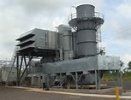
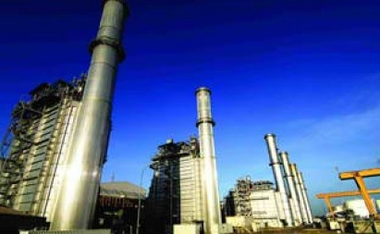

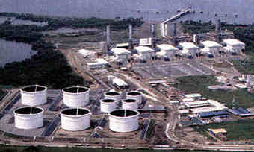


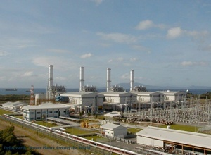
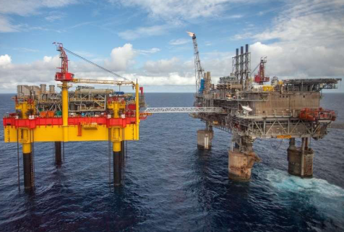
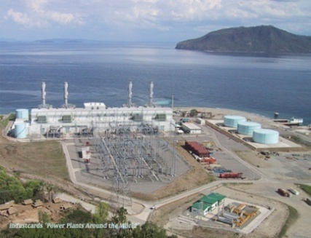


Malampaya Gas: Supply/Demand
100 MW Avion
First Gen/ IPP
414 MW San Gabriel First Gen/ IPP
560 MW San Lorenzo First Gen/ IPP
Shell Refinery
1,000 MW Sta. Rita
First Gen/ IPP
Malampaya Gas Field
2.7 TCF (2001)
1,200 MW Ilijan Power Plant
NPC IPP(KEPCO)
Notes:
2

Slide 3
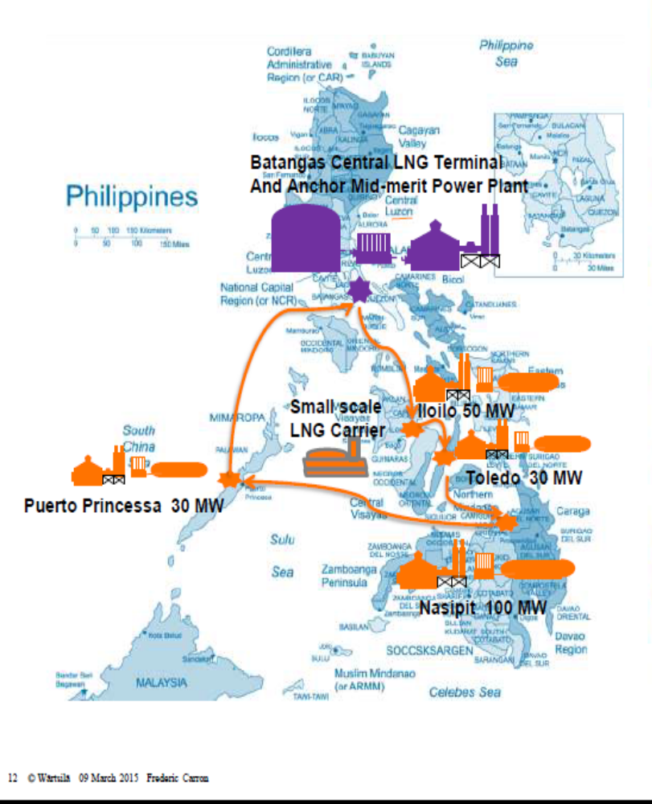
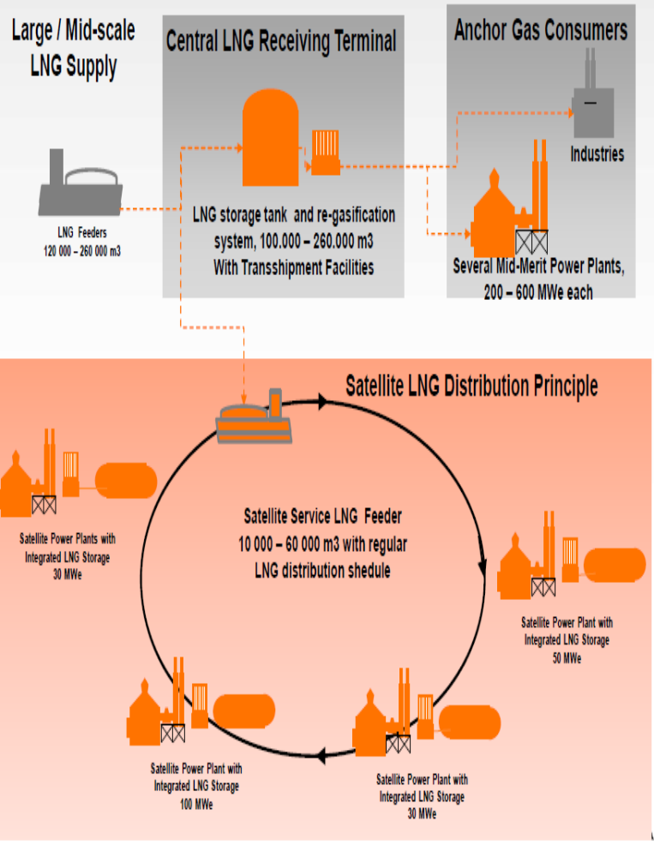
Satellite Power Plant
Mindoro Cluster
Diesel Plant:
71 MW Installed
49.6 MW Dependable

Slide 4


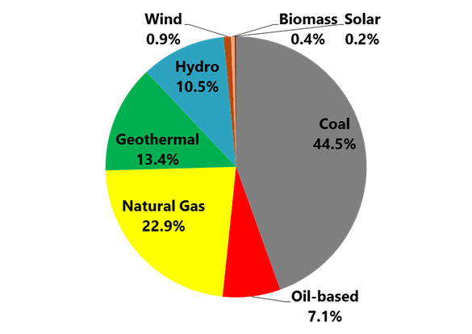
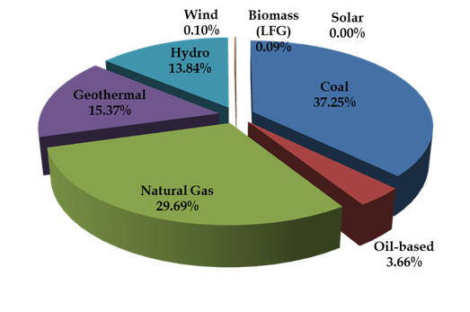

2015
Total Generation : 68,279 GWH
RE: 29.4%
RE+NG: 59.3%
Total Generation: 68,279 GWh
RE: 25.4%
RE + NG: 48.3%

Slide 5
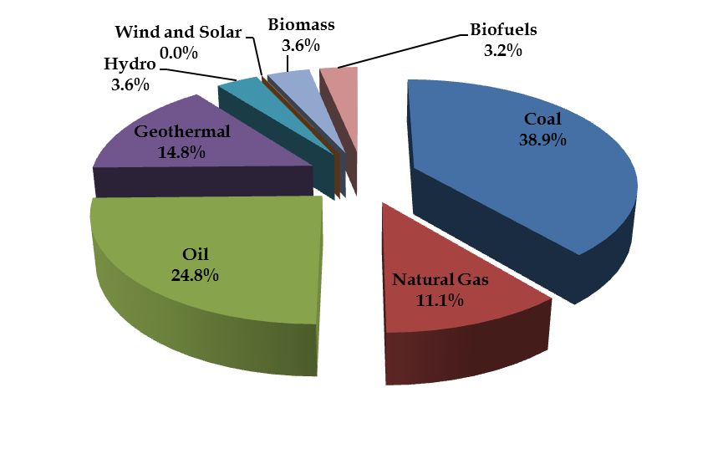
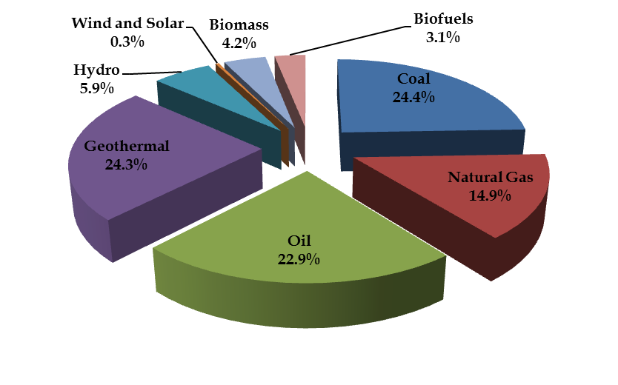
Transition to Clean Energy
2030 Primary Energy Mix
Low Carbon Scenario (LCS)
2030 Total Energy = 77.52 MTOE
Business As Usual (BAU)
2030 Total Energy = 73.86 MTOE

