Slide 1
Pathways to Develop a Flexible and Liquid LNG Market
Peter Coleman, CEO and Managing Director | 24 November 2016

Slide 2
Disclaimer and important notice
This presentation contains forward looking statements that are subject to risk factors associated with oil and gas businesses. It is believed that the expectations reflected in these statements are reasonable but they may be affected by a variety of variables and changes in underlying assumptions which could cause actual results or trends to differ materially, including but not limited to: price fluctuations, actual demand, currency fluctuations, drilling and production results, reserve estimates, loss of market, industry competition, environmental risks, physical risks, legislative, fiscal and regulatory developments, economic and financial market conditions in various countries and regions, political risks, project delay or advancement, approvals and cost estimates.
All references to dollars, cents or $ in this presentation are to US currency, unless otherwise stated.
References to “Woodside” may be references to Woodside Petroleum Ltd. or its applicable subsidiaries.

Slide 3
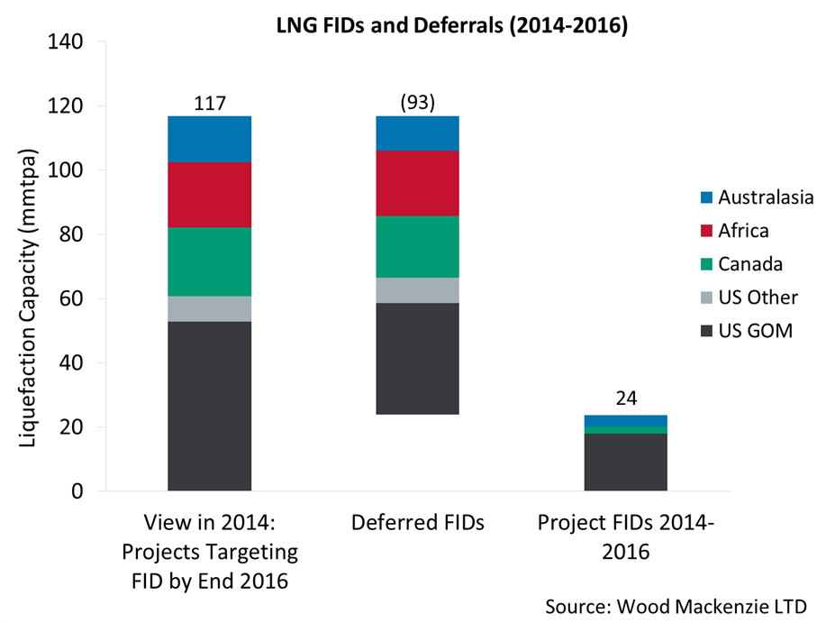
Deferred FIDs between 2014 and 2016 have reduced associated capacity growth by 80%

Slide 4
Key Messages
Buyers have asked for and suppliers have delivered contract flexibility
Increased capacity from FIDs up to 2014 is delivering flexibility
New supply is likely to come from lowest cost producers, but continued supply growth is currently challenged
A balance between supplier and buyer interests is needed for sustainable long term development of market flexibility
Woodside has proven capability and has the balance sheet strength to offer contract flexibility

