Slide 1
JERA’s Initiatives to Foster Evolution in the Asian Market
November 24th, 2016
Yuji Kakimi
President, JERA Co., Inc.

Slide 2
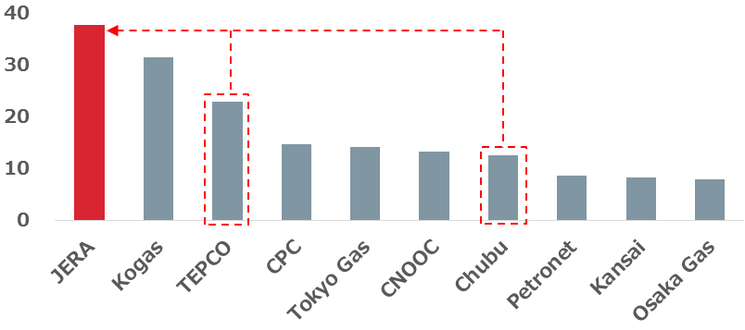
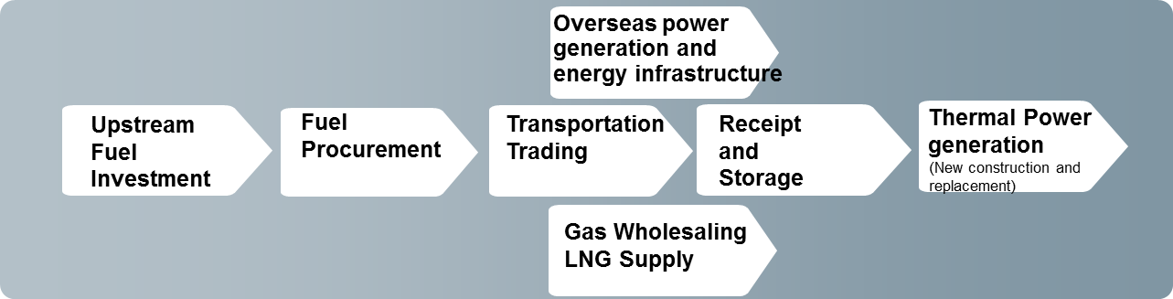
JERA’s Evolution
1.
JERA has succeeded to TEPCO Fuel & Power and Chubu’s existing fuel business and the overseas power generation business, and aims to become one of the world’s leading energy firms.
Roadmap of Comprehensive Alliance
Scale of LNG Procurement
April
2015
Establishment of JERA
(mil tons)
+
New fuel and IPP business development
October
2015
+
Fuel trading and shipping
+
Existing fuel business (upstream/procurement)
July 2016
Existing overseas IPP
Decision of integration of existing domestic thermal power generation business to JERA
Spring 2017
JERA’s Business Domains

Slide 3
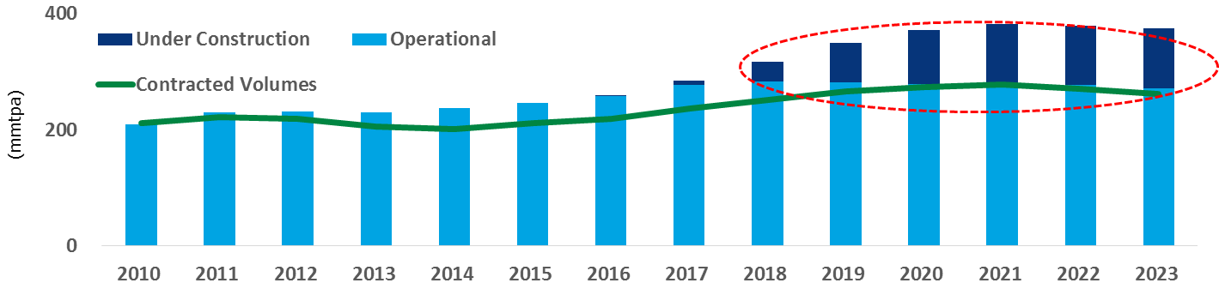
Changes in the Global LNG Market
Potential Supply-Demand Imbalance and Innovations
2.
The expected over supply of LNG from 2018 will have an enormous impact on the market and open the way to significant innovation.
Effective Liquefaction Capacity vs Contracted Volumes
Innovations
(Source: Wood Mackenzie)
Production
Markets
Demand
New business models
New technology
More spot transactions
More varied pricing
New offtakers using FSRUs
LNG bunkering
Cost reduction
Deeper traded markets
Demand growth
Diversification of suppliers
Diversification of market actors
Diversification of buyers
Increased Transparency and Liquidity

Slide 4
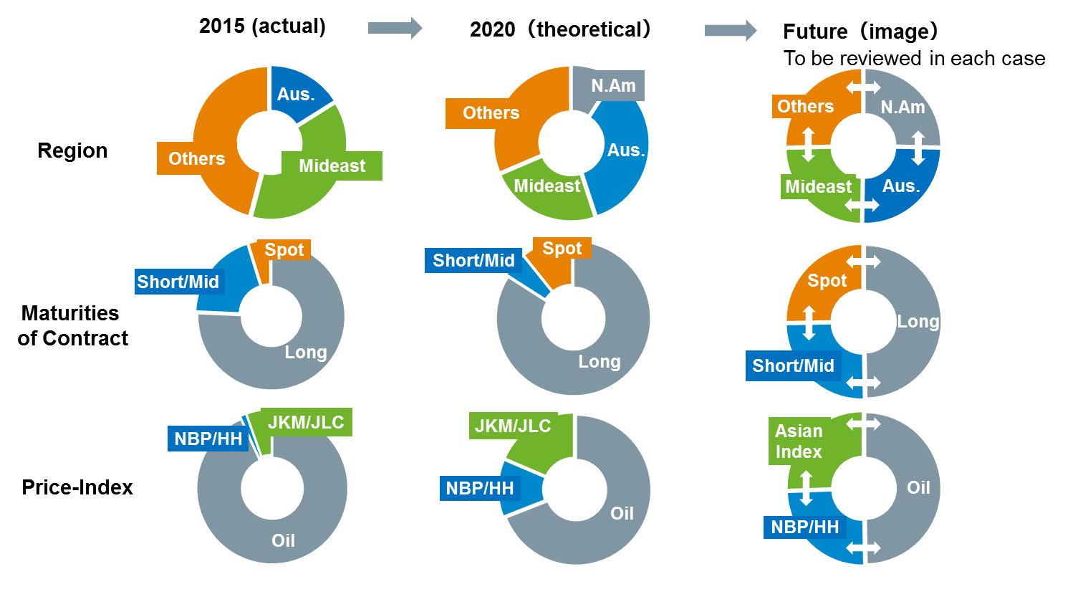
JERA’s LNG Procurement Strategy
3.
JERA will maintain world top-class LNG procurement volume to provide economical, flexible and stable LNG supply to customers and expand LNG business.

Slide 5
JERA’s Initiatives
4.
JERA strategically supports;
Innovation in LNG projects
Innovation in LNG markets
  JERA supports...
  JERA supports...
  Using innovative technology in production and transportation area
  New business models for LNG project development
  Innovative flexibility and price terms
  Innovation in sale of LNG from fully depreciated existing projects
  Expansion of traded LNG volume
  LNG price indices appropriate for Asian market
  By way of...
  Enhanced trading platform
  Innovative use of price indices
  Use of new price indices in longer term SPAs
  Use of LNG tanker fleet to increase market liquidity
  By way of...
  Robust offtake ability
  LNG project participation
  New offtaker consortium leadership

