Slide 1

Pathways to Develop Flexible and Liquid LNG Market
5th LNG Producer-Consumer Conference
Derek Chen
Chairman of CPC Corporation, Taiwan
Tokyo, Japan
24th November 2016
Notes:
Distinguished guests, industry colleagues and friends, ladies and gentlemen: good morning!
I am honored to be here with you today to discuss what we are encountering in the global LNG market and how we can develop pathways to making it more flexible and liquid.

Slide 2
Taiwan’s primary energy mix
KLOE
        In 2015:
          98% of total energy needs was imported.
          Fossil fuels’ share was 90.8%: coal (29.3%), oil (48.2%) and gas (13.3%).
          Renewable energy accounted for 1.9%.
1.9 % Renewable
1.5 %
7.3 % Nuclear
8.7 %
13.3 %, Gas
7.4 %
52.7 %
48.2 % Oil
Compared with the last decade:
          Primary energy supply: increased by 8.5%
          Natural gas supply: increased by 96%
Coal
29.7 %
29.3 %,,
Source: Bureau of Energy, Ministry of Economic Affairs, ROC.
Notes:
In 2015, around 98% of Taiwan’s total energy supply was imported.
Fossil fuels took up 90.8% of that, with coal accounting for 29.3%, oil for 48.2% and natural gas for 13.3%.
Over the last decade, the natural gas component in the primary energy supply has grown by 96%.

Slide 3
  Taiwan’s energy consumption mix
Electricity made up 49% of total energy consumption in 2015.
Principal fuels for power generation : coal (34%), natural gas (28%) and nuclear (16%).
Energy consumption structure in 2015
Electricity Mix
Source: Bureau of Energy, Ministry of Economic Affairs, ROC.
Notes:
The pie chart shows the basic structure of Taiwan’s energy consumption in 2015, with electricity taking the majority share at 49%.
Natural gas was the fuel for 30.4% of total electricity generated and we expect 2016 to show a significant increase to 35%.

Slide 4
Demand for LNG is growing
  The gradual year-on-year increase in Taiwan’s LNG imports is a result of increasing demand for its use in power generation.
(unit : 10 thousand tons)
1,421
Towards a nuclear-free homeland in 2025
1,460
Increase 66%
1,330
Nuclear Free
1,254
1,250
Chinshan #1
Chinshan #2
Kuosheng #1
Kuosheng #2
Maanshan #1
1,198
2025
1,092
2024
2023
882
Maanshan#2
2021
2019
2018
2010
2014
2011
2012
2009
2013
2015
2016(P)
Source: Taipower’s 10505 long-term power generation plan
Source: GIIGNL Annual Report 2016
Notes:
I would like to share with you a few factors affecting Taiwan’s demand for LNG.
Firstly, Taiwan’s government has declared the goal of achieving a ‘Nuclear-free Homeland’ by 2025. In order to make this happen, the six existing nuclear power plants will each be decommissioned after reaching the end of its 40-year operating life.
Secondly and aside from the announcement of the ‘Nuclear-free Homeland’, something deserving of extra attention is the passing of the Greenhouse Gas Reduction and Management Act by our Legislative Yuan (parliament) in 2015. This embodies the clear objective of reducing Taiwan’s annual carbon dioxide emission levels by 2050 to one-half those of 2005; and it precede adoption of the provisions of the COP 21 agreement in Paris.
Last but not least, public concerns also play a crucial role. For example, government-mandated controls to restrict air pollution will become stricter and consequently we can expect demand for natural gas in Taiwan to show a marked increase.

Slide 5


Diversifying our sources
CPC has signed long-term LNG contracts with diverse suppliers.
CPC imported LNG from 12 out of 17 exporters in 2015.
Source diversification is an ongoing aim for CPC.
Portfolio
Canada
Qatar
USA
Africa
USA(Cameron)
Malaysia
Indonesia
Papua New Guinea
Global Portfolio
Australia
Existing
Potential
Under development
Notes:
We at CPC have put a lot of effort into diversifying our sources of natural gas to ensure that Taiwan has a stable supply.
As you can see from the map, our existing sources under long-term contracts include Indonesia, Malaysia, Qatar and Papua New Guinea. In years to come, they will be augmented by the addition of Australia, the USA and global portfolio suppliers.
In 2015, CPC imported LNG from 12 out of the 17 globally-available sources. Further diversifying our sources is both a continuous and a consistent aim.

Slide 6
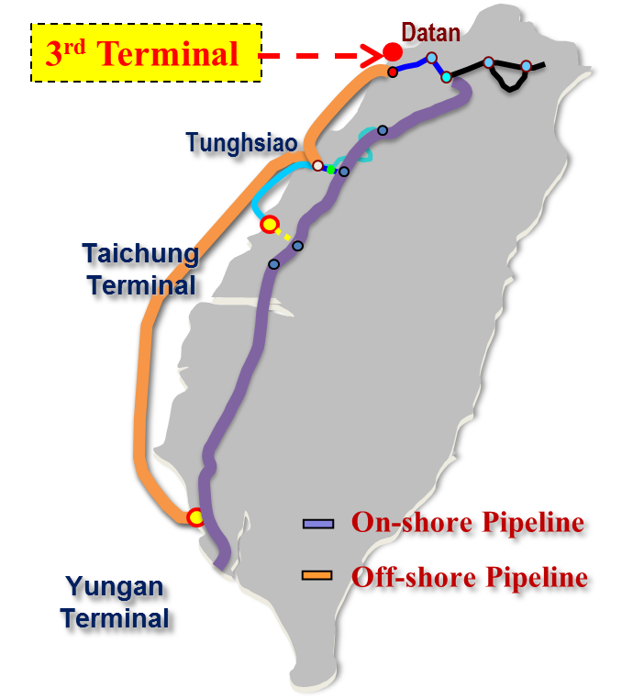
    CPC’s natural gas supply network
    Planned 3rd LNG Terminal: capacity - up to 6.0 MTPA
4.5
4.5
4.5
9.0
9.0
9.0
Existing LNG Terminals:
    Taichung
    Operating capacity: 4.5 MTA; tank capacity：480k m3
    Yung-An
    Operating Capacity: 9.0 MTA；tank capacity：690k m3
Notes:
Pictured in the bar chart are the projections of growth in our LNG handling capacity from 2015 to 2030.
In order to meet the gradual year-on-year increase in Taiwan’s demand, CPC has launched a storage expansion project at its Taichung Receiving Terminal. With completion planned for 2019, this will boost its annual operating capacity to 5 million tons. In addition, CPC has initiated planning for the construction of Taiwan’s third LNG receiving terminal. It will have a handling capacity of up to 3 million tons a year by 2023 and will be sited in northern Taiwan.
With this decision, CPC is putting into effect the planned expansion of its LNG receiving capacity - up to the target figure of 20 million tons a year by 2030 - to meet future demand.

Slide 7
The challenges we face
1
2
3
4
Completing Taiwan’s LNG storage expansion projects on schedule
Flexibility in transactions
Transparency and liquidity in pricing
The risks arising from delay in new FIDs
Notes:
It is very important for Taiwan that there is a robust global natural gas market – one that makes it possible to both diversify our sources and fulfill future demand at the tremendous rate of 20 million tons per year.
However, there are present and future challenges in this scenario: delayed FIDs could pose a risk to fulfilling global demand; whether or not natural gas pricing will involve both transparency and liquidity; the need for more flexibility in natural gas transactions, enabling buyers to adjust inventory in differing demand situations; and whether or not Taiwan’s LNG storage expansion projects can be completed on schedule.

Slide 8
Getting to a flexible and liquid market for LNG
Affordable and reasonable price
Secure supply
Consolidated cooperation
Flexible and Liquid
LNG Market
Reliability
Credibility
Affordable cost
Return on investment
Consumers
Producers
Notes:
As a state-owned company and Taiwan’s sole importer of LNG, we are committed to helping establish a more robust, flexible and liquid LNG market in the future. That is our ultimate goal and to reach it we need to bear in mind these core values:
Affordable and reasonable price
LNG importers are looking for an economic cost while LNG exporters need a reasonable margin, one that justifies their investment.
Secure supply
Energy is essential the world over.
Credibility and reliability are key criteria for both the LNG consumer and the producer in making each transaction go smoothly - and hence also in ensuring the security of natural gas supplies.
Consolidated cooperation
We industry players, both LNG consumers and producers, have worked well together thus far. If we can further consolidate our cooperation on the road ahead, I believe we will own the future and all enjoy the benefits flowing from that.

Slide 9



Thank you for your time and attention
Notes:
This is the end of my presentation. Thank you very much for your time and attention.

