Slide 1

LNG Producer Consumer Conference
Tokyo, Japan • November 24, 2016
Presentation by Governor Bill Walker

Slide 2
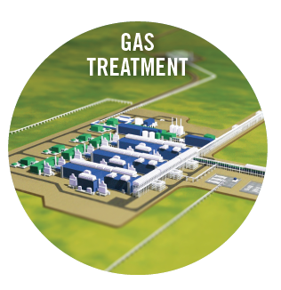
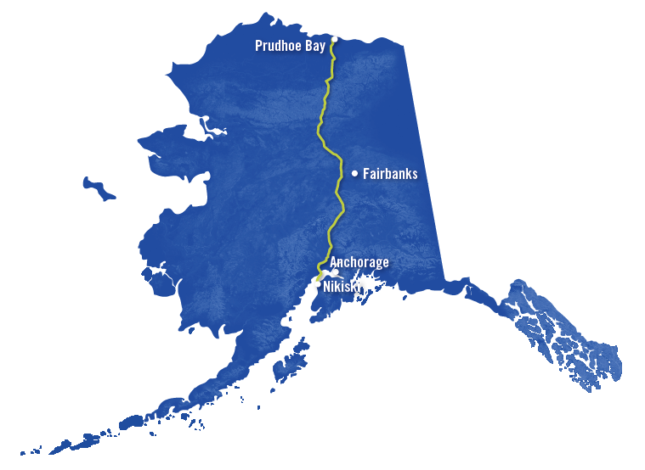
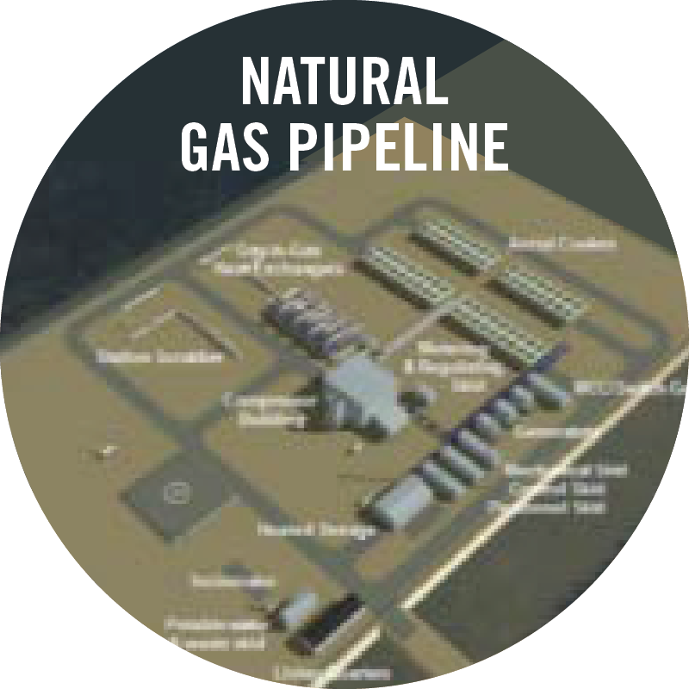
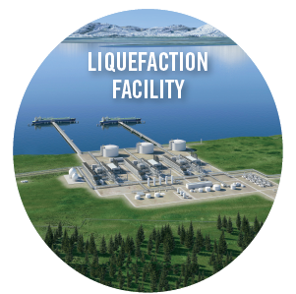
Alaska Moving Forward
Alaska is taking the lead to move a major gas infrastructure project forward.
Alaska is motivated as a sovereign:
  Seeks to monetize its resources; over 8 Bcf per day is reinjected on the North Slope.
  Focused on developing a project for the long-term benefit of its people, not simply on quarterly earnings/profit margins.
  Able to provide tax advantages e.g. potential federal tax exemption.
  Can provide a streamlined regulatory process and leverage its strong relationship with the federal government.
Bcf/d = Billion cubic feet per day

Slide 3
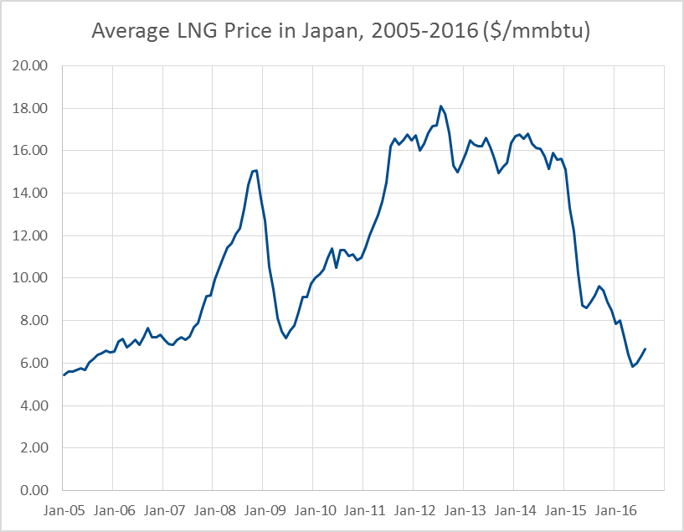
Price Volatility Creates Challenges
Under historical pricing, utilities and ratepayers absorb world price fluctuations.
Volatility causes economic, budgetary, and investment uncertainties for both consuming and producing sovereigns.
A direct relationship between sovereigns to develop energy supply infrastructure can provide stability and predictability.
Future Price Uncertainty
Price doubling in two years.
Source: World Gas Intelligence

Slide 4
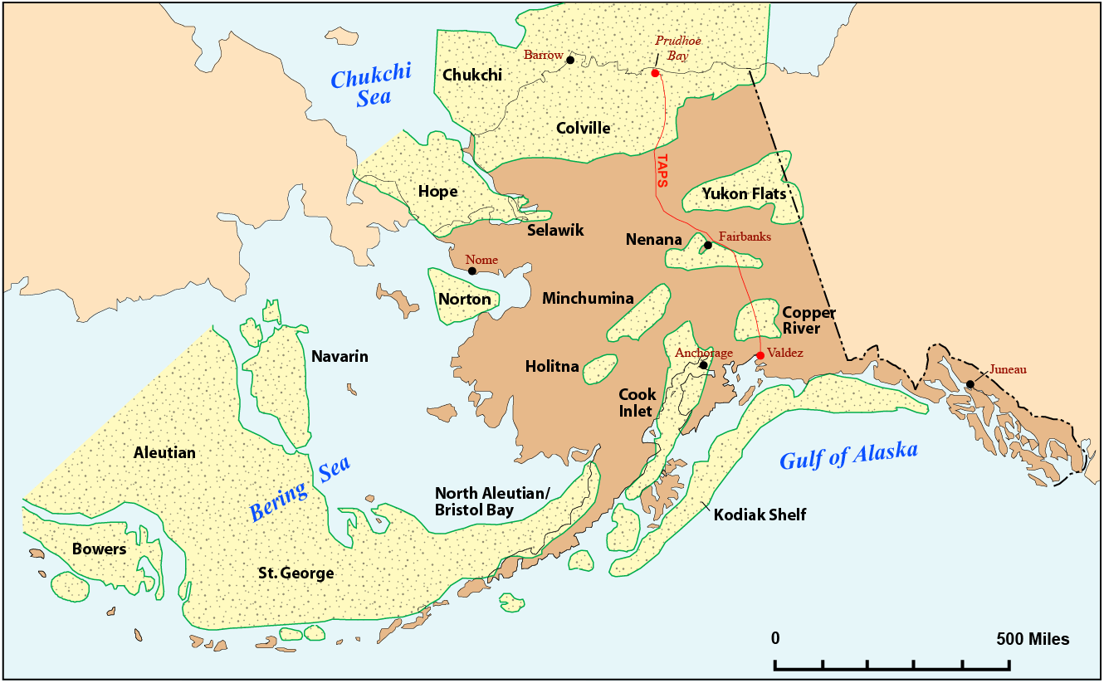
Alaska – A Stable Investment Partner
Proactive and innovative regulatory process in regards to land availability and right-of-way.
Pursuit of third party infrastructure financing.
Continuous promotion of upstream development of oil and gas resources:
  Annual oil and gas lease sales to facilitate new field exploration investment,
  Provide technical reports and geologic maps on oil and gas resources on state land to the public,
  Previously set aside lease tracts for methane hydrate field production tests (in collaboration with U.S. DOE and JOGMEC),
  Additional opportunities for partnership in current and future oil and gas development projects.
Alaska’s Sedimentary Basins
Source: Alaska Department of Natural Resources

Slide 5
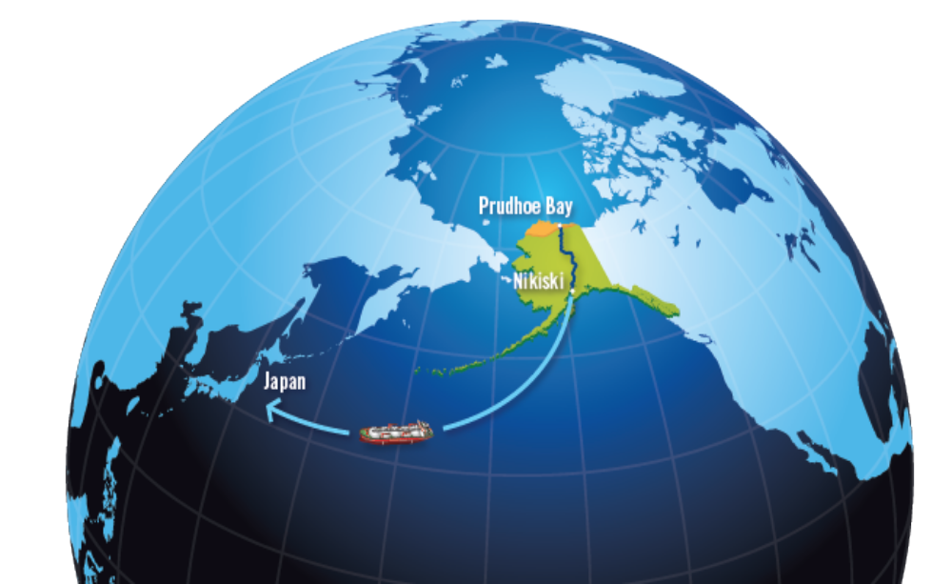
Alaska – A Stable Regional Supplier
Alaska is a stable supply source in the region with a direct route to major Asian markets.
Alaska has the ability and flexibility to offer innovative pricing contracts.
Stability plus index to local hub if desired.
Low cost, proven conventional reserves.
Value chain integration and investment opportunity.
Complete destination flexibility.
Alaska Moving Forward

