Slide 1
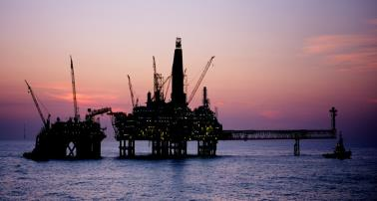
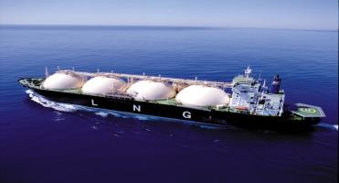
LNG supply outlook and actions by producers - An Australian perspective
LNG Producer Consumer Conference 2015 - Japan
Demus King
General Manager
Offshore Resources Branch
Australian Government Department of Industry and Science

Slide 2
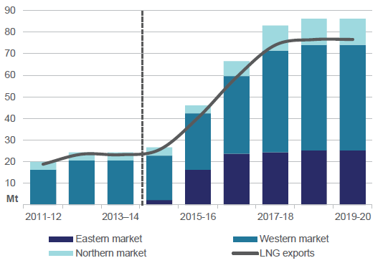
Australian LNG capacity and exports
Source: Office of the Chief Economist

Slide 3
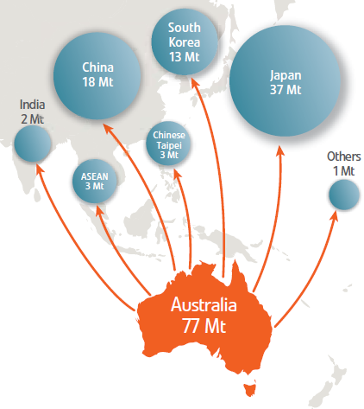
Australian LNG supply to Asia
Australia’s projected LNG exports 2020
Australia is well placed to meet growing Asian LNG demand, given:
large gas reserves;
proximity to Asia;
reputation as a reliable supplier
Increasing productivity; and
reputation as a stable investment environment
Australia will have 86 Mt capacity by 2020.
Where will supply to meet post- 2020 demand come from?
Source: Office of the Chief Economist
* Based on Wood Mackenzie supply demand outlook, 5-6 yr construction time

Slide 4
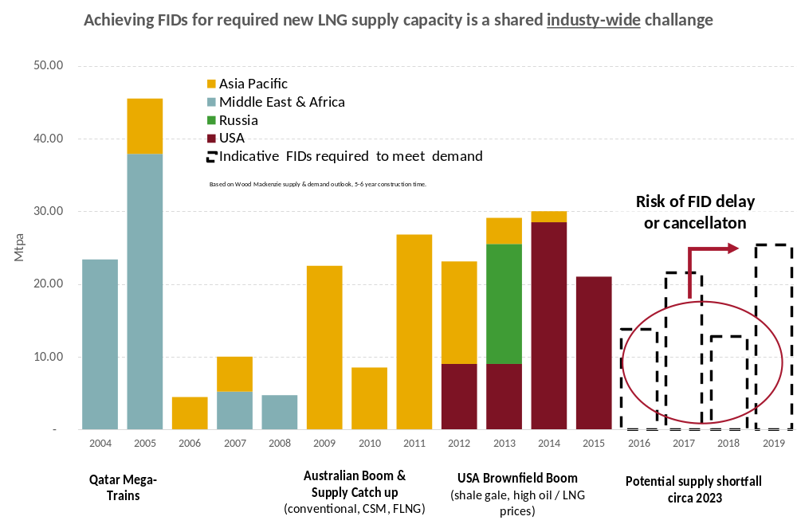
Australia’s competitiveness
Global LNG FID cycle
* Based on Wood Mackenzie supply demand outlook, 5-6 yr construction time
  THANK YOU!

