Slide 1
Sustainable Natural Gas Market for Growing Demand of Clean Energy in East Asia
Hidetoshi Nishimura
President
Economic Research Institute for ASEAN and East Asia
LNG Producer-Consumer Conference 2015, Tokyo
16 Sept 2015
www.eria.org

Slide 2
Outline
Outlook of clean energy and the role of natural gas in the EAS region
Security and Affordability of Natural Gas Supply Calls for Flexibility in the EAS Market
Issues and challenges of establishing a sustainable regional natural gas market
Conclusions and policy implications

Slide 3
Outlook of clean energy and the role of natural gas in the EAS region (I)
The ERIA “Energy Outlook and Analysis of Energy Saving Potential in East Asia” is a “policy-driven” outlook for the EAS region.
  Future scenarios are built on assumptions about different energy and environment policies.
  It thus presents a feasible maximum potential for policies to deliver cleaner energy consumption.
Natural gas is projected to play an important but limited role in supplying clean energy to the region, despite fast growth in absolute volume of consumption
  Prices of natural gas is projected based on exogenously specified oil price assumptions, reflecting the features of the natural gas market in the region
  No major policy initiatives to enhance the role of natural gas

Slide 4
Outlook of clean energy and the role of natural gas in the EAS region (II)
Source: ERIA

Slide 5
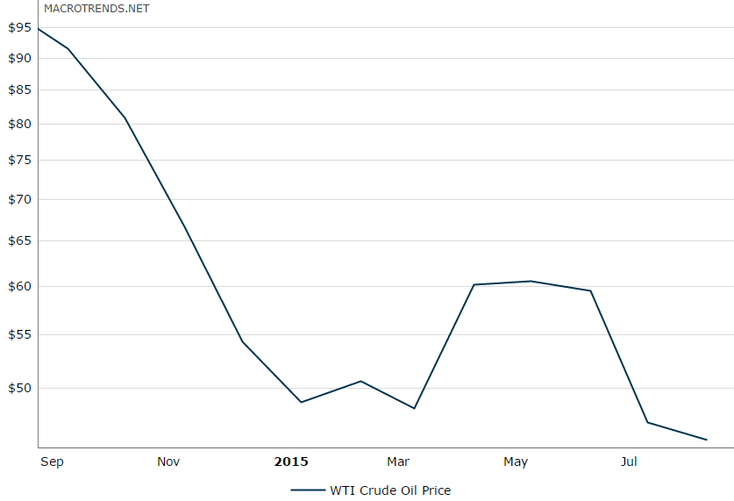
Security and Affordability of Natural Gas Supply Calls for Flexibility in the EAS Market
The Gap between Projected Demand vs. Supply from within the Region
The EAS region needs to source 546 bcm of natural gas from outside the region in 2035.
A majority of the imports from the outside of EAS will be in the form of LNG.
How to secure the supply through sufficient infrastructure investment?
What “price discovery mechanism” could deliver proper price signals to incentivize investment and ensure affordable supply to this region?
Source: ERIA
546 bcm

Slide 6
Issues and challenges of establishing a sustainable regional natural gas market
A more flexible regional market will be the key to achieve both secured and affordable supply, leading to a sustainable market in the region
The following issues should be emphasized and addressed
  The quasi-vertical integration of the supply chain
  The dominance of long-term contracts in trading
  The oil indexation in the pricing formula
  The destination clause

Slide 7
Conclusions and policy implications
A sustainable regional natural gas market is featured by secured and affordable supply, enabled by enhanced flexibility
  It leads to a win-win situation for both producers and consumers
The following policy recommendations are drawn:
  Towards abolition of investment barriers
  Towards domestic market liberalization
  Towards intra-regional agreement on natural gas trade, especially regarding flexibility and pricing mechanism
  Towards intra-regional agreement on market monitoring

Slide 8
Thank you for your kind attention!
Q & A
Hidetoshi Nishimura
Email: hidetoshi.nishimura@eria.org

