Slide 1
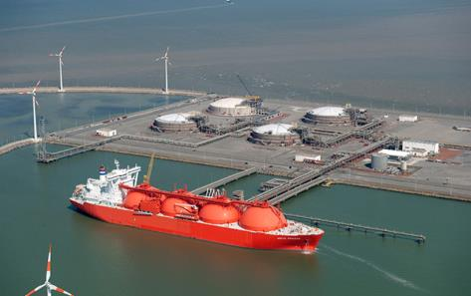
An EU strategy for liquified natural gas
Christopher Jones,
Deputy Director-General
European Comission
DG Energy
LNG Producer – Consumer Conference
Tokyo, 16 September 2015

Slide 2
Energy
Union
Energy for Europe – serving society, supporting the economy, protecting the environment

Slide 3
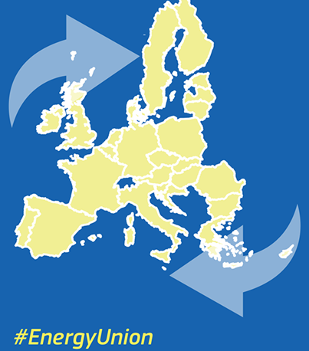
ENERGY UNION : 5 Dimensions
Energy security, solidarity and trust
A fully integrated internal EU-wide energy market
Energy efficiency as an energy source in its own right
Transition to a low-carbon society
Research, innovation and competiveness

Slide 4
Gas demand has reached a 14-year low in 2013 with a total gas consumption of 449 bcm/a
Annual gas consumption – EU-28
Lack of competitiveness of gas versus coal
Large-scale deployment of RES
Mild winters
Financial and economic crisis
Increase in energy efficiency
-1.3% CAGR

Slide 5
Projected EU28 gas demand
Notes: the PRIMES EE27 scenario is based on the 2013 reference scenario, using 2010 Eurostat data, and for the year 2030 involves 40% reduction in GHG relative to 1990, 27.8% renewable energy as a share of final energy consumption and 27.4% energy savings relative to a 2007 baseline. Domestic production based on ENTSOG projections.

Slide 6
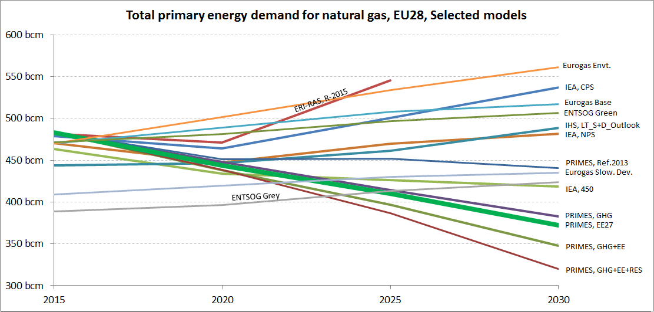
EU demand trajectories to 2030 range between 320 and 563bcm/a depending on the assumptions
TPED trajectories for gas, EU-28, selected Models
Do not comply with EU environmental objectives
Comply with EU environmental objectives
All scenarios meeting EU targets see significant, steady decline in demand from now to 2030
6
TPED=Total Primary Energy Demand Primes EE27 scenario is considered best agreed 2030 strategy proxy

Slide 7
Single supplier dependency in Baltics, Finland, Central and South-East Europe
Share of gas from one single supplier in total gas consumption in 2013
0 – 20% of total gas consumption
20 – 40% of total gas consumption
40 – 60% of total gas consumption
60 – 80% of total gas consumption
>80% of total gas consumption
Source: IHS

Slide 8
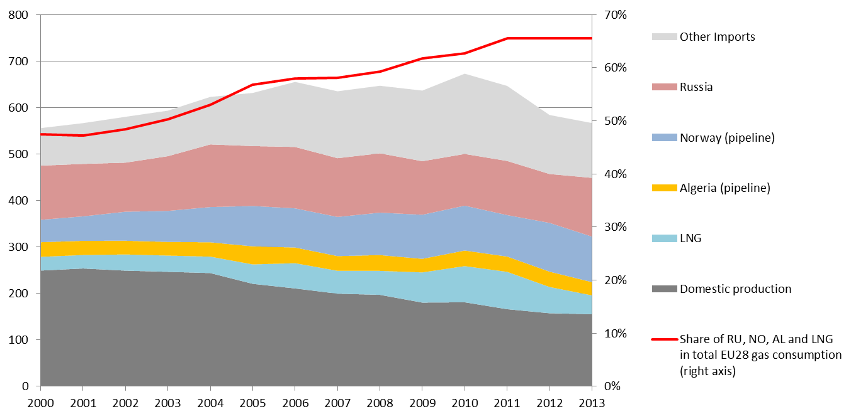
LNG represents 15% of total EU gas imports
(bcm)
Domestic production and imports left axis / share of key exporters to EU on right axis
Source: IHS

Slide 11
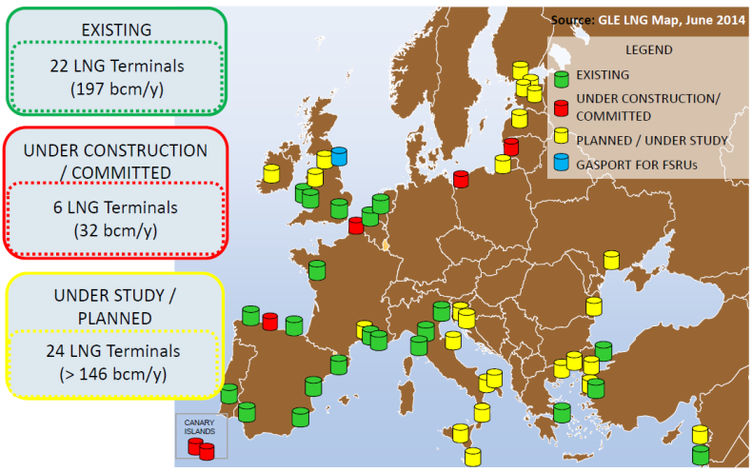
LNG terminals in Europe (large scale)

Slide 12
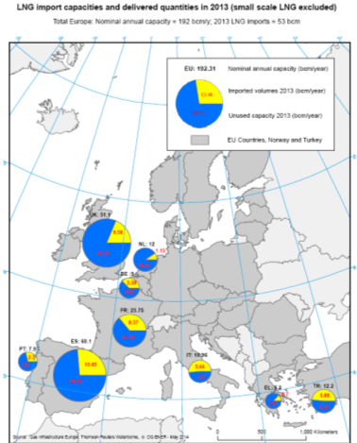
LNG : around 75% of the EU import capacity is in Spain, Portugal, France and the UK
Bottlenecks

Slide 13
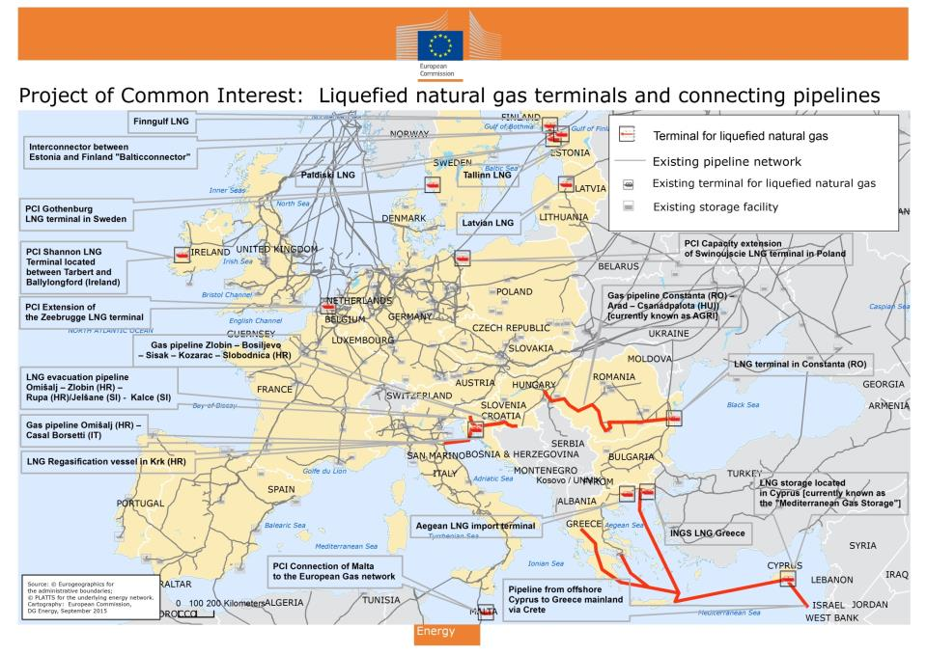
Placeholder for map with LNG related priority infrastructure projects

Slide 14
EU LNG and Gas Storage Strategy
(Dec 2015 – Jan 2016) 1/2
LNG markets becoming more global, liquid and more competitive : exploiting opportunities for reliable, diverse and competitive gas supplies to the EU.
  increasing role of LNG as a price setter in the EU's gas market
  increasing role of LNG for gas security
  promoting transparency in the global gas and LNG market
  decreasing importance of destination clauses for LNG deliveries

Slide 15
LNG and Gas Storage Strategy
(Dec 2015 – Jan 2016) 2/2
LNG markets becoming more global, liquid and more competitive : exploiting opportunities for reliable, diverse and competitive gas supplies to the EU.
  using all EU LNG terminals efficiently
  completing missing links to enable all EU member states to benefit from access to LNG market (…bn EUR in Connecting Europe Facility, …bn EUR in European Fund for Strategic Investment)
  completing the EU's internal gas market

Slide 16
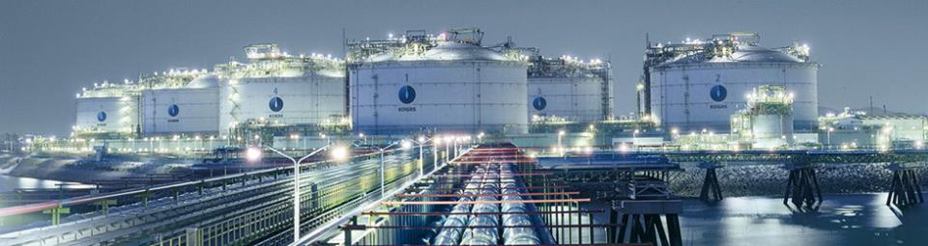
THANK YOU FOR YOUR ATTENTION
http://ec.europa.eu/energy/en/news/lng-and-gas-storage-eu-share-your-views

Slide 17
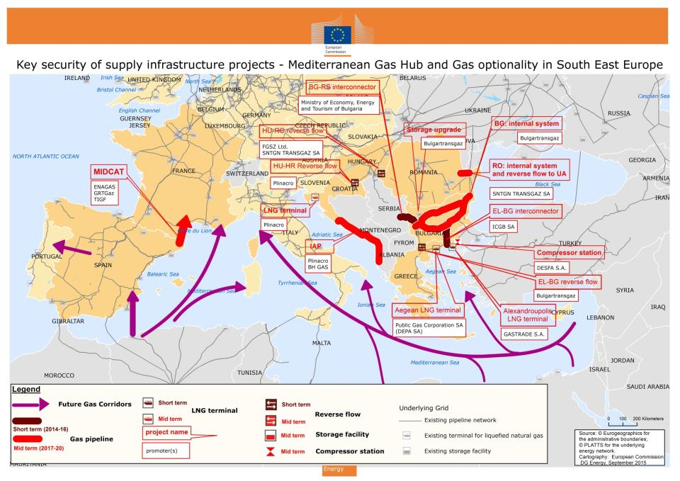

Slide 18
