Slide 1

2015 APEC Energy Ministerial Meeting (EMM 12)
in Cebu, the Philippines
Asia Pacific Energy Research Centre (APERC) Speech
Takato OJIMI
President, Asia Pacific Energy Research Centre (APERC)
13 October 2015

Slide 2


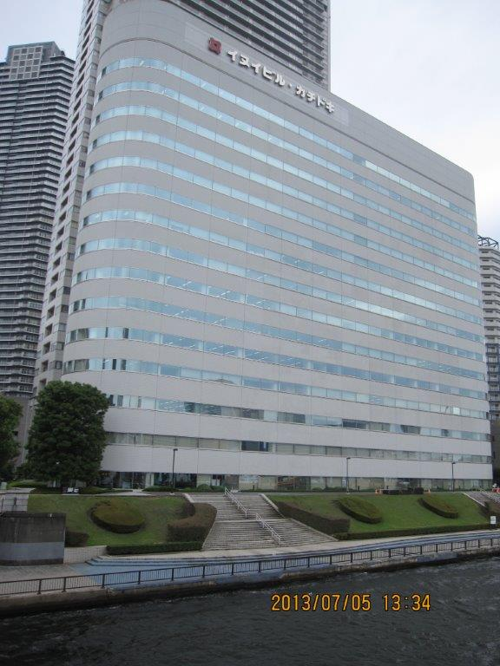
Asia Pacific Energy Research Centre (APERC)
Established in 1996, and will celebrate the 20th anniversary next year.
Funded by the Japanese government.
17 visiting researchers sent from APEC economies.
Supports the energy related activities of APEC with:
  APEC Energy Demand and Supply Outlook
  Policy cooperative projects for energy efficiency
  and low-carbon energy policies
  Oil and Gas Security Initiative (OGSI)
  APEC energy data network (EGEDA Coordinating Agency)
  Training on energy statistics and modelling
APERC in Tokyo

Slide 3
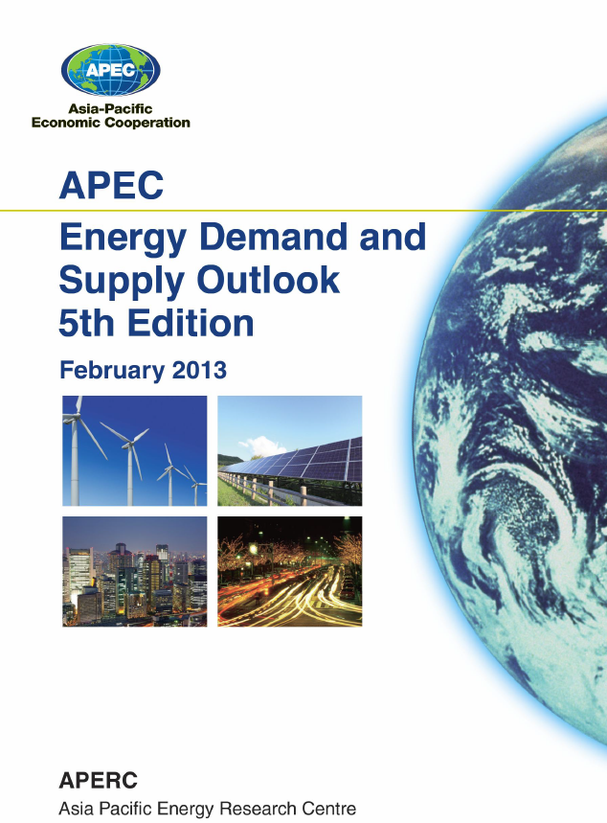
APEC Energy Demand & Supply Outlook
The “APEC Energy Demand and Supply Outlook” is a priority task of APERC under the APEC Energy Action Programme adopted by leaders in 1995.
We try to help facilitate APEC cooperation by providing:
  Useful reference work on energy in the APEC region.
  Useful suggestions and case studies to policymakers.
APERC is now working on the 6th edition of the ”Outlook” to be published in spring 2016.
(Previous editions are available on APERC website http://aperc.ieej.or.jp/)

Slide 4
Fossil Fuels Continue to Dominate APEC Energy Supply
Preliminary Results
Energy Supply 30%
Gas
Gas
Oil
Fuel Shares
 | 1990 | 2013 | 2040
Coal | 27.9% | 37.6% | 31.4%
Oil | 35.7% | 27.7% | 25.5%
Gas | 20.2% | 20.5% | 24.9%
Hydro | 1.9% | 2.2% | 2.7%
Other Renewables | 8.6% | 7.4% | 10.2%
Nuclear | 5.8% | 4.6% | 5.2%
Oil
Coal
Coal
86%
82%
The Share of Fossil Fuel
Source: APERC Analysis

Slide 5
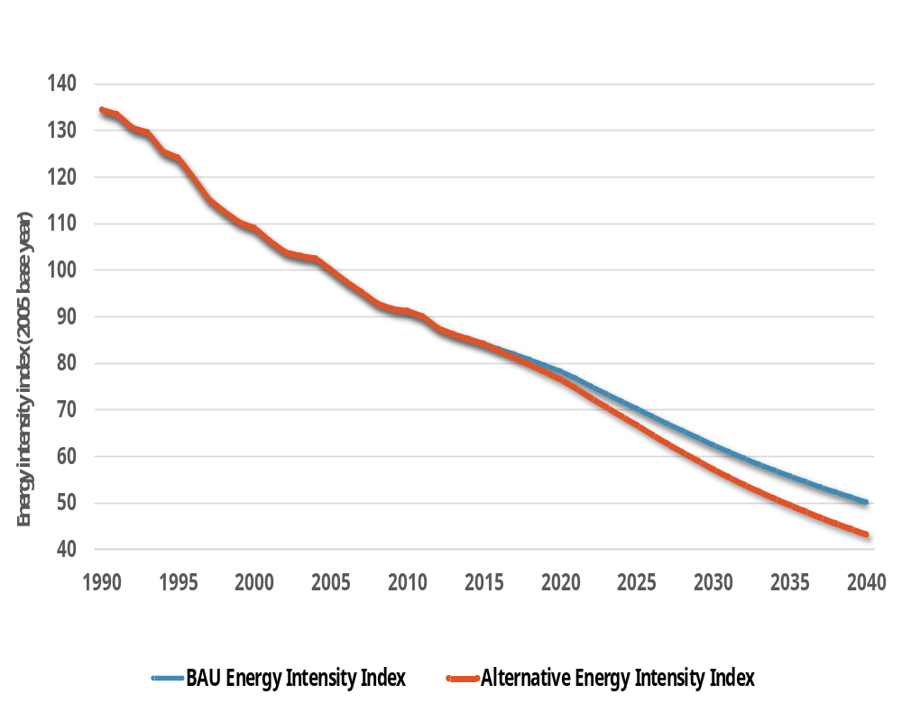
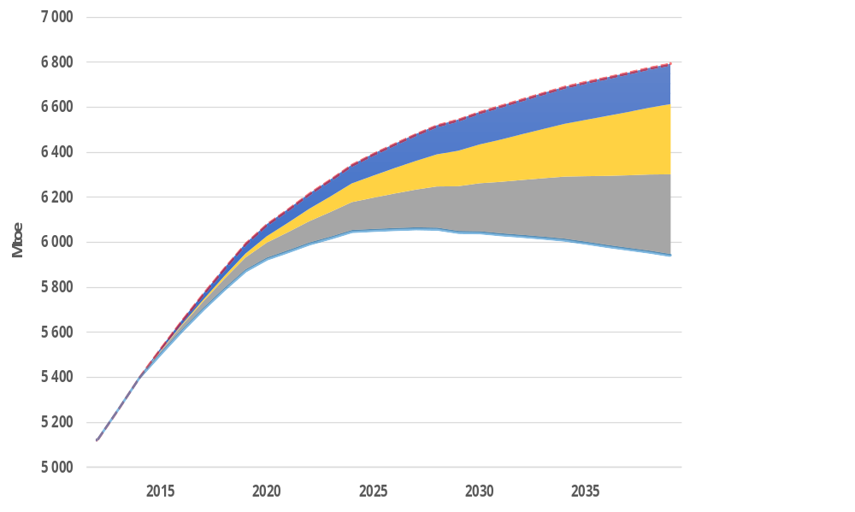
APEC Energy Intensity :BAU vs Improved Efficiency Scenario
BAU Scenario
16%
850 Mtoe
2032
2036
Buildings Savings
Transport Savings
Industry Savings
Improved Efficiency
Scenario
45% reduction target
APEC’s target in 2035 can be met earlier under the alternative scenario
Preliminary Results
Source: APERC Analysis

Slide 6
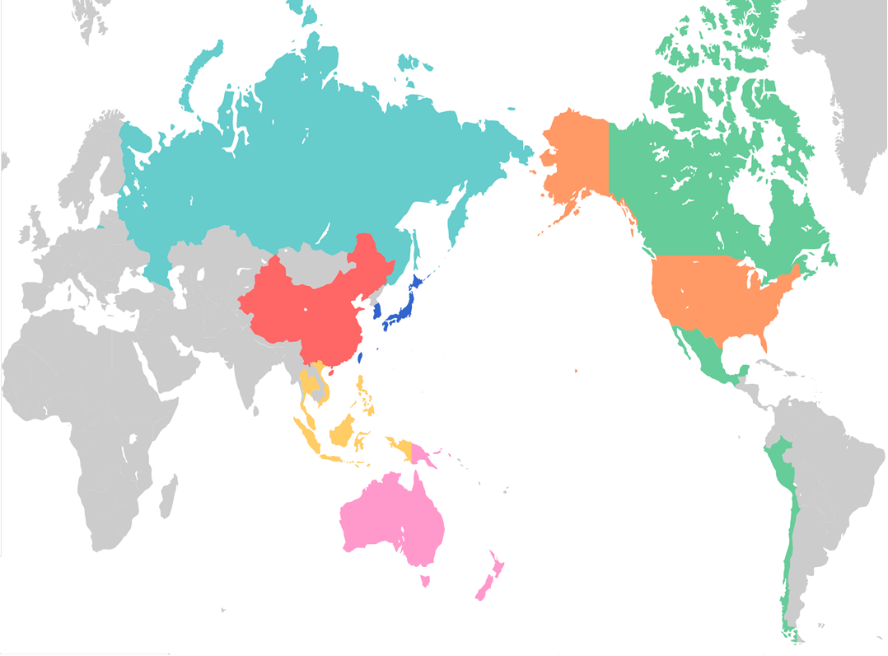
High Renewables Scenario
Installed Capacity
Russia
Other North East Asia
United States
Much of the increases in renewable capacity will come from solar and wind.
Other sub-regions also see significant contribution of hydro.
China
South East Asia
Other Americas
Oceania
2012 BAU: 761 GW
2030 High Renewables (HR): 2 525 GW
2040 High Renewables (HR): 3 112 GW
Preliminary Results
Note: This map is for illustrative purposes and is without prejudice to the status of or sovereignty over any territory covered by this map.
Source: APERC Analysis

Slide 7
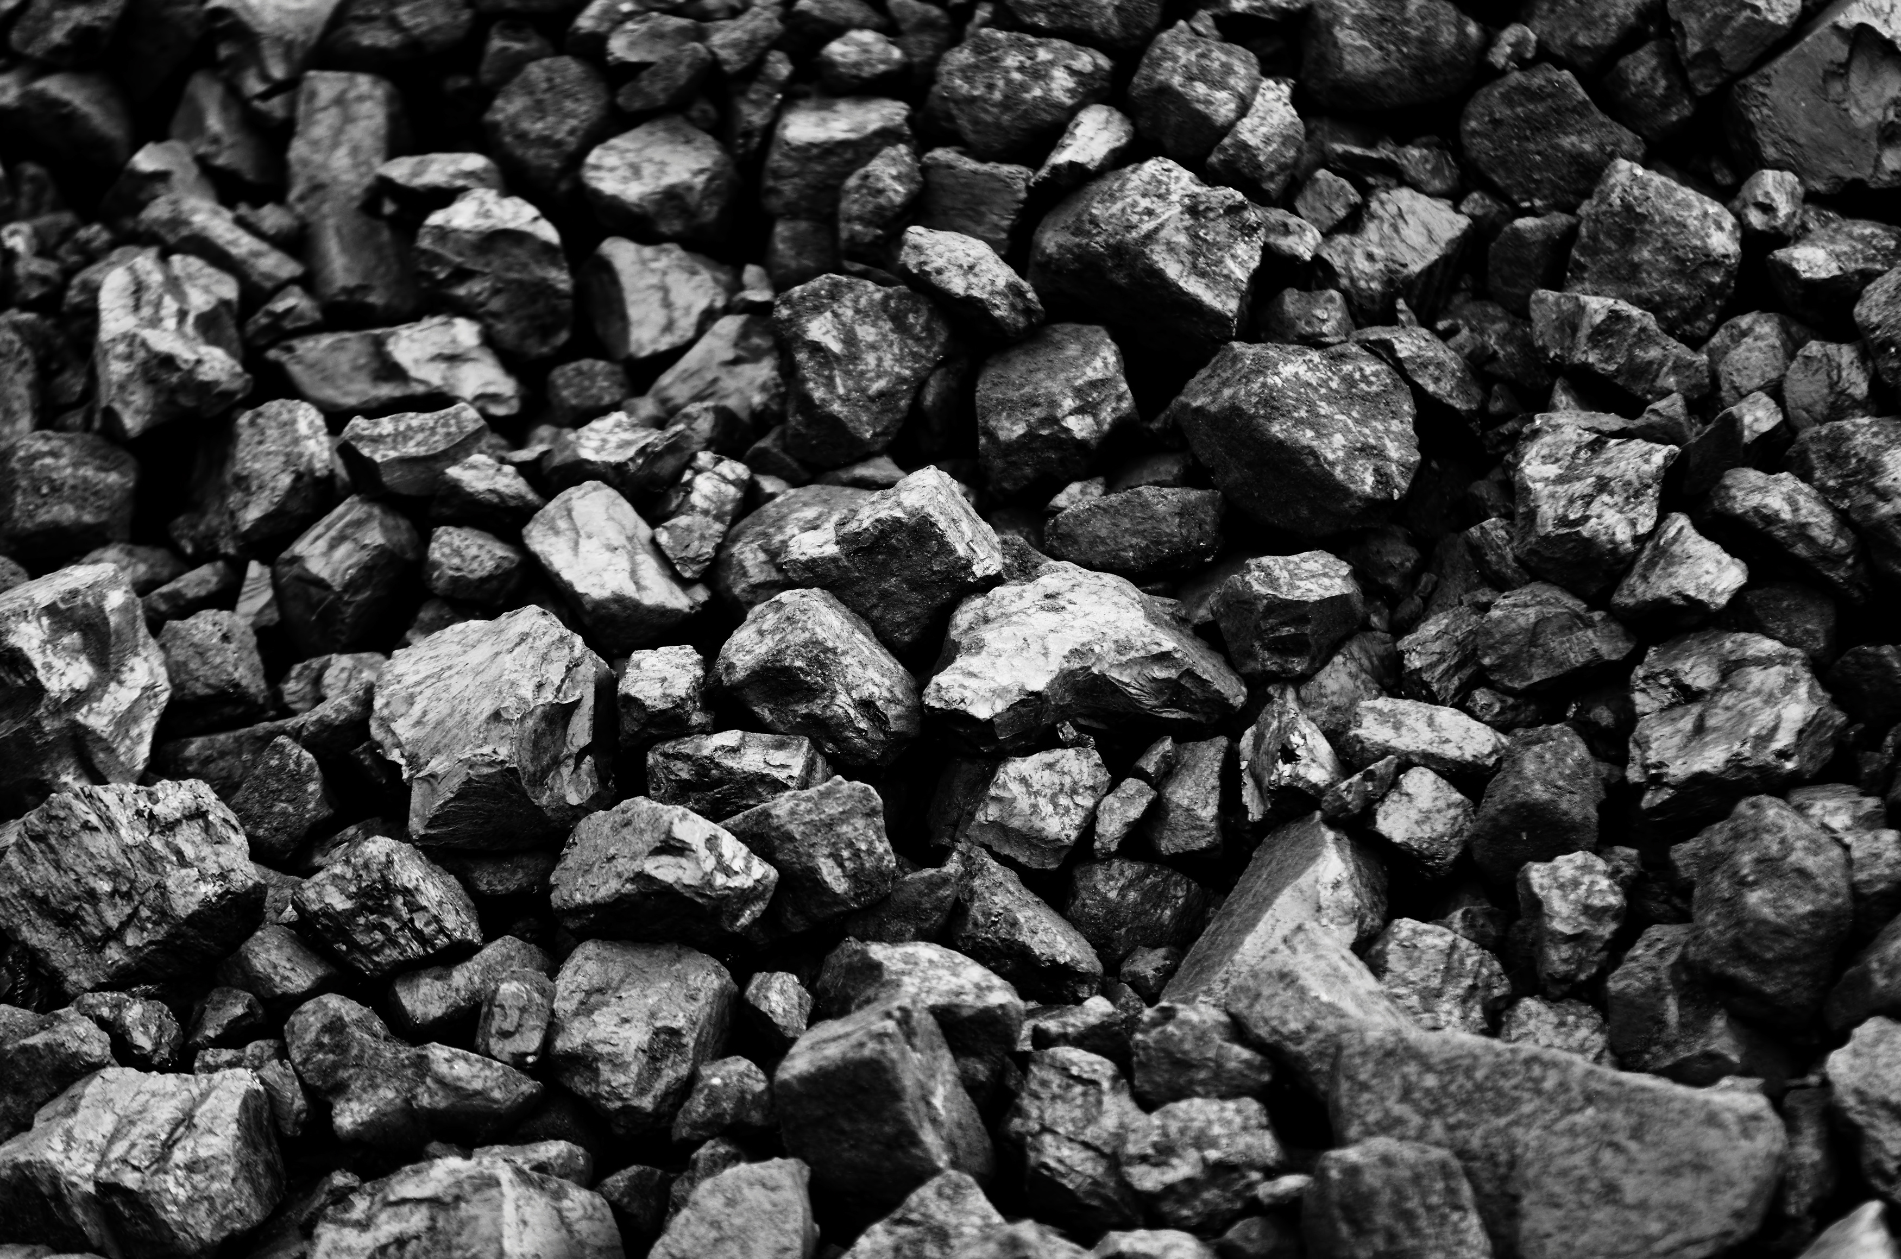

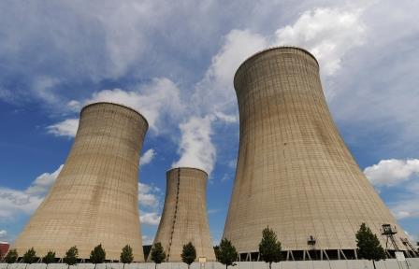
Alternative Power Mix Scenario
Trade off between cleaner coal, gas and nuclear
High Nuclear and High Gas leads to the lowest CO2 emissions level.
Preliminary Results
Source: APERC Analysis

Slide 8
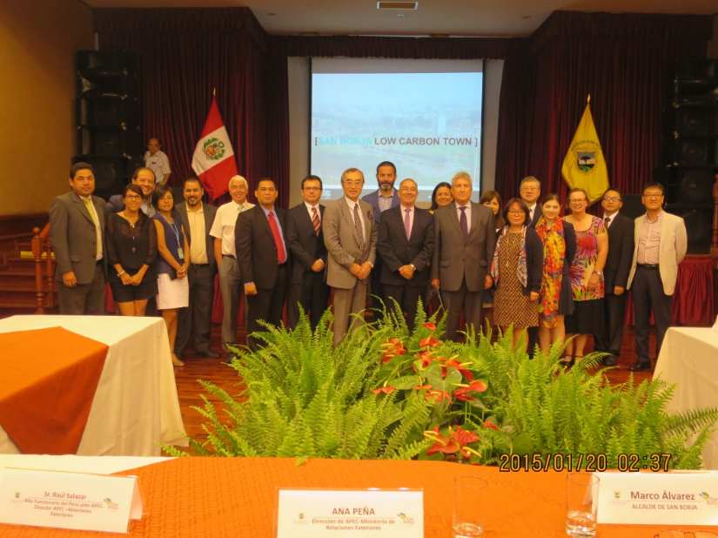
APEC Policy Cooperative Projects
The following APEC Policy Cooperative Projects were undertaken:
PREE (Peer Review on Energy Efficiency)
10 Peer Reviews and 3 Follow-up Peer Reviews have been completed.
Latest: 3rd Follow-up PREE, August 2015 – Thailand.
PRLCE (Peer review on Low Carbon Energy Policies)
4 Peer Reviews have been completed.
Next: 5th PRLCE, January 2016 – Viet Nam.
LCMT (Low Carbon Model Town Project)
4 cases have been studied.
Ongoing: Phase 5, 2015 - Bitung, Indonesia.
Appreciate the economies for volunteering to host Cooperative Projects.

Slide 9
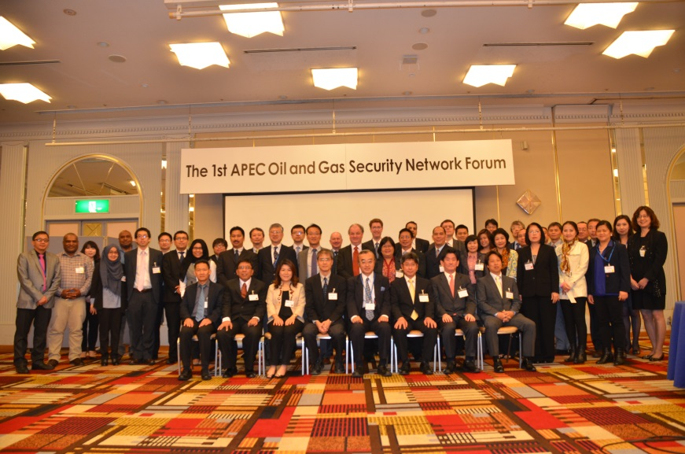
APEC Oil and Gas Initiative
The APEC Oil and Gas Security Initiative (OGSI) was launched in response to “The APEC Energy Ministerial Meeting Declaration” adopted in Beijing, China (7-8 November 2014).
OGSI consists of three overarching activities:
  Oil and Gas Security Exercise (OGSE)
  Next in the Philippines in December 2015
  Oil and Gas Security Network (OGSN)
  Bimonthly Newsletters and Annual Forums
  Oil and Gas Security Studies (OGSS)
  6 research topics in the 1st year
  Further guidance is sought from the Ministers.

Slide 10
APERC would like to discharge tasks mandated by Energy Ministers as much as possible.
Thank you for your kind attention.
http://aperc.ieej.or.jp

