Slide 1

2014 APEC Energy Ministerial Meeting (EMM 11)
in Beijing, People’s Republic of China
Asia Pacific Energy Research Centre (APERC) Speech
Takato OJIMI
President, Asia Pacific Energy Research Centre (APERC)
2 September 2014

Slide 2


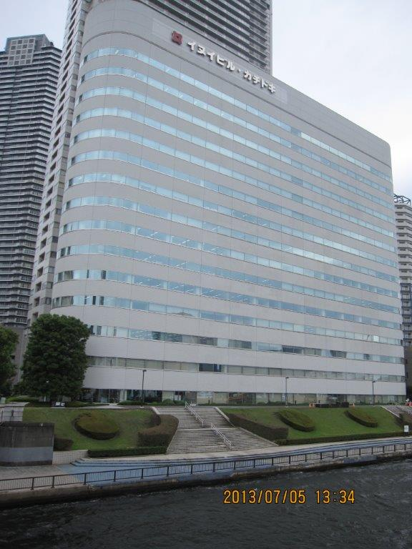
Asia Pacific Energy Research Centre (APERC)
Asia Pacific Energy Research Centre (APERC)
Supports the energy activities of APEC with:
  Research, especially analysis of energy supply and demand in the APEC Region;
  Cooperative programs to promote energy efficiency, low-carbon energy supply and emergency preparedness for energy security.
Established in 1996 and funded by the Japanese government, based in Tokyo.
Currently has 20 staff members, including 10 visiting researchers from major APEC economies.

Slide 3
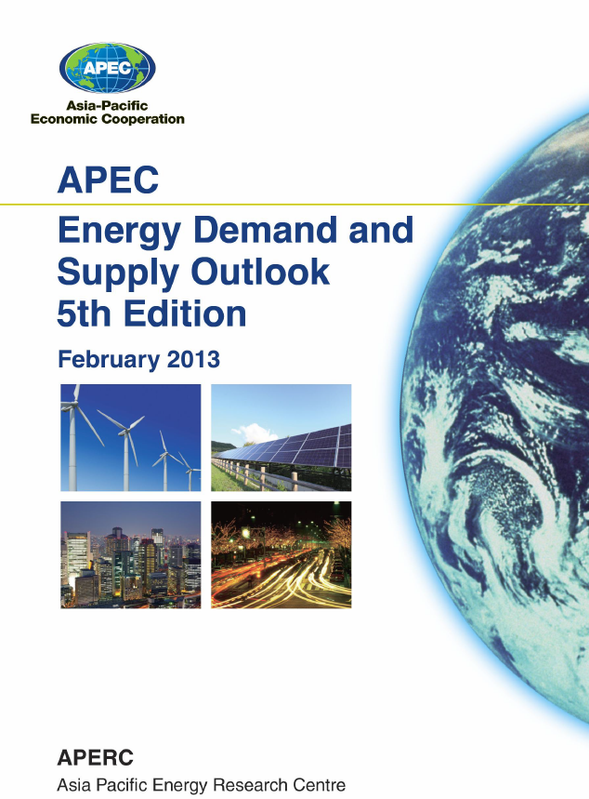
APEC Energy Demand & Supply Outlook
The “APERC Energy Demand and Supply Outlook” is a priority task of APERC under the APEC Energy Action Programme adopted by leaders in 1995.
We try to help facilitate APEC cooperation by providing:
  Useful reference work on energy in the APEC region.
  Useful suggestions and case studies to policymakers.
The 5th edition of the ”APEC Energy Demand and Supply Outlook” was published in February 2013.
(It is available on APERC website http://aperc.ieej.or.jp/)

Slide 4
…And APEC Energy Intensity Is Likely to Fall
APEC Energy Demand & Supply Outlook
Some key points to take from the Outlook analysis are:
On the demand side, APEC will be using about 45% less primary energy per dollar of GDP by 2035 than it did in 2005.
  However, there are two very serious energy challenges in this period.
  First, APEC’s oil imports from outside the region will rise by 114%.
  Second, CO₂ emissions will rise by 72%.
Primary Energy Intensity Down 45%
2005-2035

Slide 5
But Energy Security Will Be an Even Greater Concern…
APEC Energy Demand & Supply Outlook
APEC Oil Imports Up 114%
2005-2035
APEC Emissions Up 72%
2005-2035

Slide 6

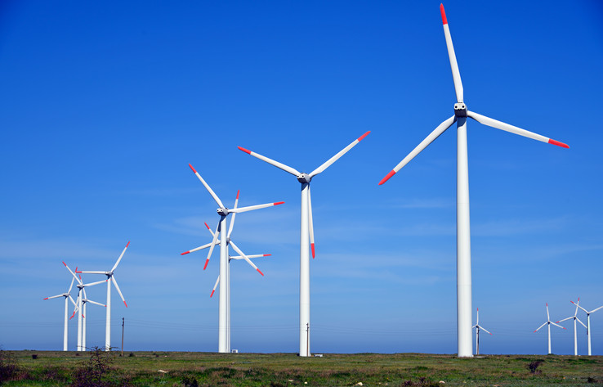

APEC Energy Demand & Supply Outlook
Drawing from the Outlook analysis, some policy suggestions were made:
    Maximize energy efficiency improvement.
    Develop regional capacity for the reform of inefficient fossil fuel subsidies.
    Initiate work to remove constraints on natural gas production, trade and investment.
    Promote the development of renewable energy sources.
    Promote CCS and make coal-fired power plants more efficient.

Slide 7
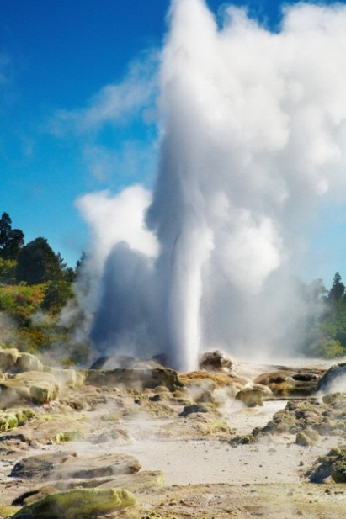
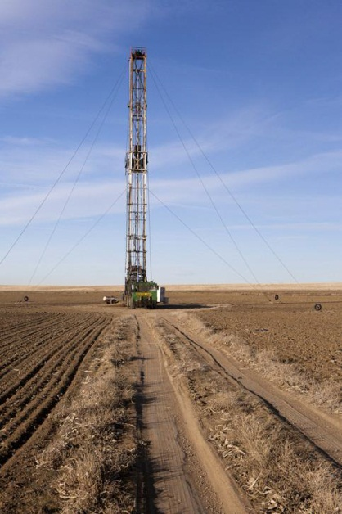
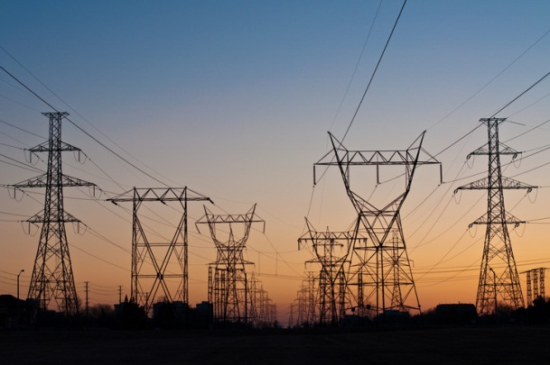
APEC Energy Demand & Supply Outlook
APERC has started preparatory research activities for the 6th edition of the Outlook to be published in 2015.
In addition to the model enhancements, we are investigating special topics such as:
  Shale Gas Development.
  Geothermal Electricity Development.
  Grid Interconnection in Northeast Asia.

Slide 8

APEC Cooperative Projects
Since the last EMM 10, the following APEC Cooperative Projects were undertaken:
PREE (Peer Review on Energy Efficiency)
10th PREE, June 2013- Brunei Darussalam.
2nd Follow-up PREE, September 2014 – the Philippines (in preparation).
PRLCE (Peer review on Low Carbon Energy Policies)
2nd PRLCE, November 2012- the Philippines.
3rd PRLCE, May 2013 – Indonesia.
4th PRLCE, December - Malaysia .
LCMT (Low Carbon Model Town Project)
Phase 2, 2012 - Samui Island, Thailand.
Phase 3, 2013 - Da Nang, Viet Nam.
Phase 4, 2014 - San Borja, Peru (ongoing).

Slide 9
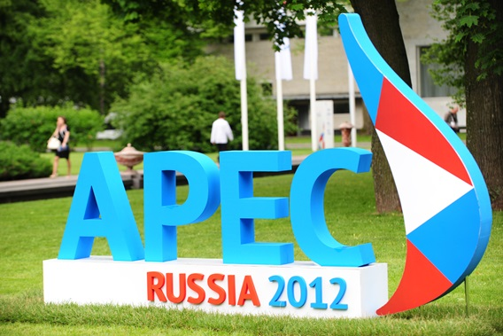
APEC Oil and Gas Security
The APEC Oil and Gas Security Exercises (OGSE) was launched in response to “The APEC Energy Ministerial Meeting Declaration” adopted in St. Petersburg, Russia (24-25 June 2012).
St Petersburg Declaration:
“We encourage EWG and APERC to work in collaboration with the International Energy Agency (IEA) and the Association of Southeast Asian Nations (ASEAN) on activities to improve the response to oil and gas emergency situation in the APEC region, including emergency response workshops and exercises”.

Slide 10
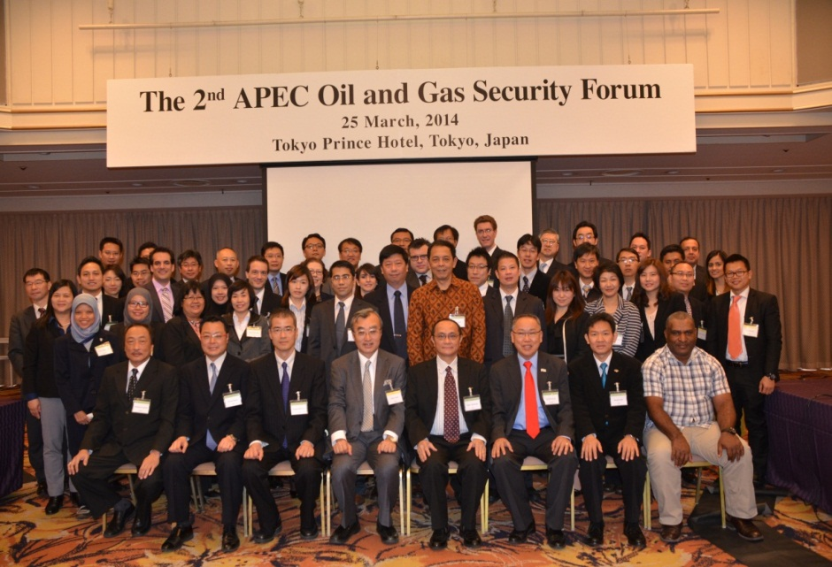
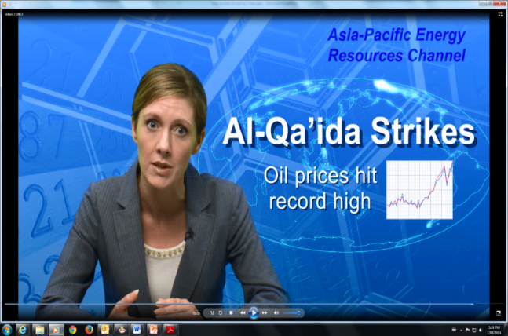
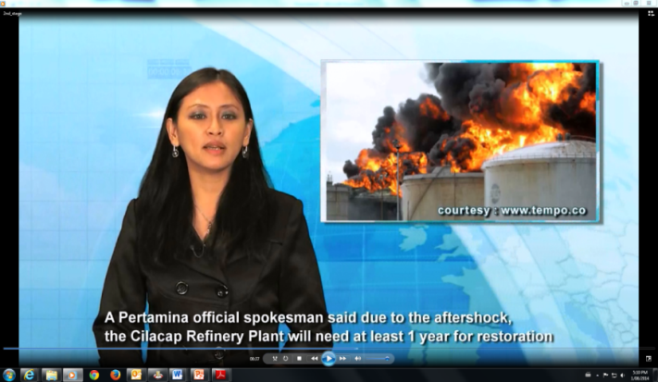
Oil and Gas Security Forums and Exercises
Two Forums were held in Tokyo by inviting delegates from APEC economies, IEA and ASEAN (ACE, ASCOPE, HAPUA, ERIA)”
  Kick-off Forum, 18-19 April 2013; and
  Wrap-up Forum, 25 March 2014.
Two Exercises were undertaken:
  The Joint Southeast Asian Exercise, September 2013, Bangkok Thailand; and
  Indonesian Exercise, October 2014, Jakarta

Slide 11

APEC Oil and Gas Security – Future Activities
Based on the lessons learnt from the forums and exercises, APERC is now proposing Oil and Gas Security Initiative (OGSI). This future activity will pursue energy security in the APEC region.
OGSI consists of three overarching activities:
  Oil and Gas Security Exercise (OGSE)
    Exercises on a voluntary basis.
    Exercise Model Procedure (EMP).
  Oil and Gas Security Network (OGSN)
    Newsletter & Forums.
  Oil and Gas Security Studies (OGSS) ;
    Oil and gas security analysis.

Slide 12
Thank you for your kind attention.
http://aperc.ieej.or.jp

