Slide 1
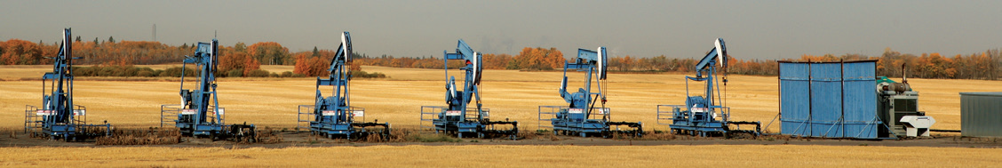
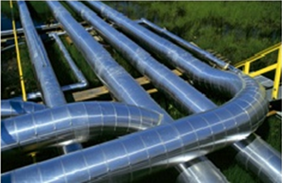
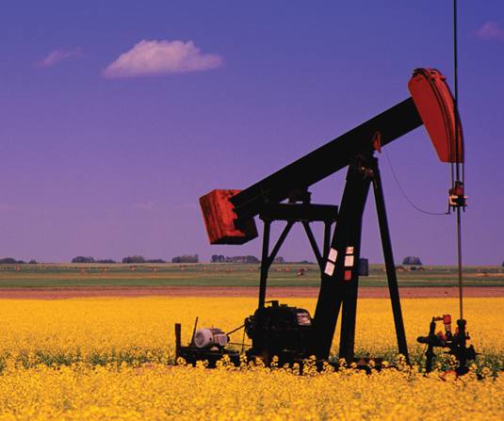
Alberta’s Energy Resource Potential
Alberta Department of Energy
Government of Alberta
September 2013

Slide 2
Alberta’s Crude Oil
Alberta Produced 2.5 Million Barrels per day in 2012
Rank | Country | Production 2012 (MMbbl/d) |  | Rank | Country | Production 2012 (MMbbl/d)
1 | Saudi Arabia | 11.53 |  | 6 | Iran | 3.68
2 | Russia | 10.6 |  | 7 | UAE | 3.68
3 | USA | 8.9 |  | 8 | Kuwait | 3.22
4 | China | 4.16 |  | 9 | Iraq | 3.12
5 | Canada | 3.74 |  | 10 | Mexico | 2.91
actual
forecast

Slide 3
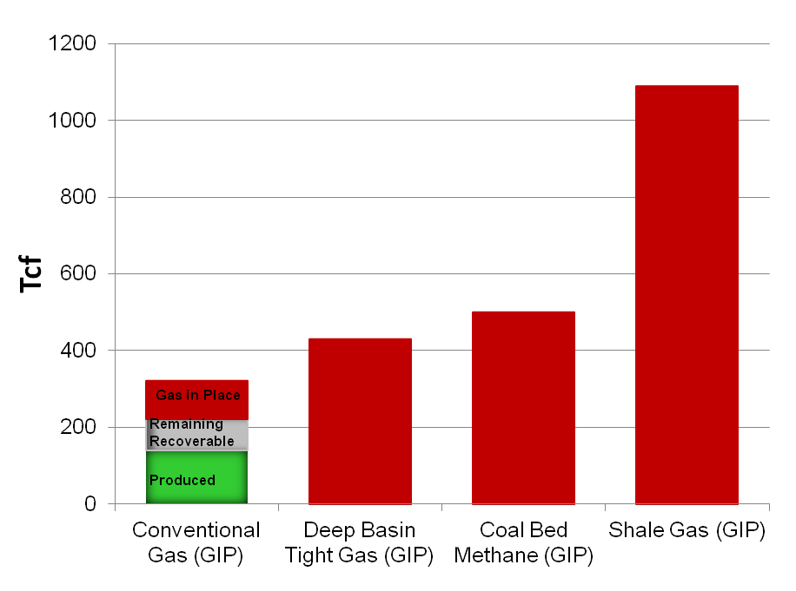
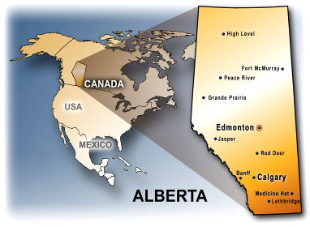
Alberta’s Natural Gas
Alberta Produced 9.8 Bcf/d in 2012
3600
3400
≈
≈ 11
Source: Energy Resource Conservation Board, Petrel Robertson
GIP: Gas in Place is the total gas volume believed to be contained in the reservoir.
Rank | Country | Production 2012 (Bcf/d) |  | Rank | Country | Production 2012 (Bcf/d)
1 | USA | 65.7 |  | 6 | Norway | 11.1
2 | Russia | 57.1 |  | 7 | China | 10.3
3 | Iran | 15.5 |  | 8 | Saudi Arabia | 9.9
4 | Qatar | 15.2 |  | 9 | Algeria | 7.9
5 | Canada | 15.1 |  | 10 | Indonesia | 6.9

Slide 4
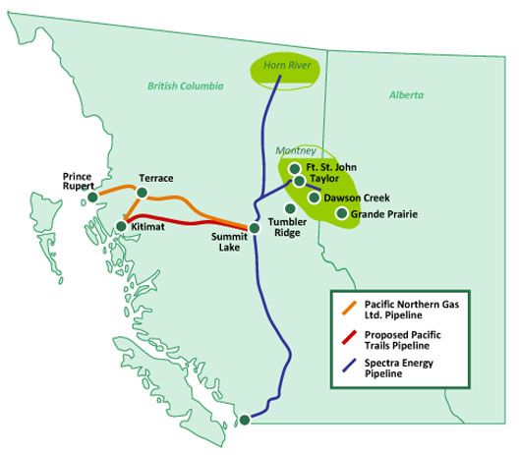
Natural Gas Movement to the West
Proposed: Pacific Trails (to Kitimat LNG) Capacity = 1 bcf per day
LNG export projects:
4. Pacific NW LNG (Petronas/Progress)(2 to 3.6 Bcf/d)
5. BG (BG/Spectra)(4.0) Bcf/d
Prince Rupert Gas Transmission: capacity=n/a (Petronas, TransCanada)
0.25 bcf per day of natural gas moves from AB into BC
NGTL System
Duvernay
Proposed: $4 billion Coastal Gaslink (TransCanada)
Capacity = 1.7Bcf/day
LNG export projects:
1. Kitimat LNG (Apache/Chevron) (0.7 to 1.4 Bcf/d)
2. LNG Canada (Shell/Mistubishi, KOGAS/CNPC) (1.8 to 3.6 Bcf/d)
3. Douglas Channel LNG (LNG Partners,) (0.125 Bcf/d)

Slide 5
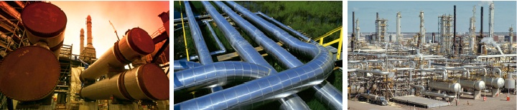
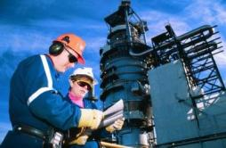
Thank You

