Slide 1
Towards an efficient LNG market in the Asia - Pacific
Maria van der Hoeven
Executive Director
10 September, 2013

Slide 2
For gas the Asian century is just starting
Primary energy consumption
Mtoe

Slide 3
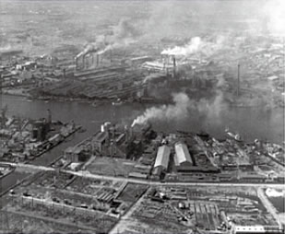
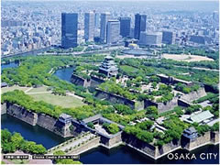
Natural gas is the key to improving air quality in Asia
Osaka 1965
Osaka 2013

Slide 4
Economic growth and energy policies will raise the importance of Asia in global gas
Share of the Asia-Pacific in global gas demand
WEO 2012
Due to geology and geography, LNG will have to play a dominant role in supplying Asia

Slide 5
The old business model is an increasing competitiveness burden
20
$2012/MBtu
18
16
Japan (LNG import)
14
12
Europe
(German import)
10
8
6
4
US (Henry Hub)
2
0
1991
1994
1997
2000
2003
2006
2009
2012

Slide 6
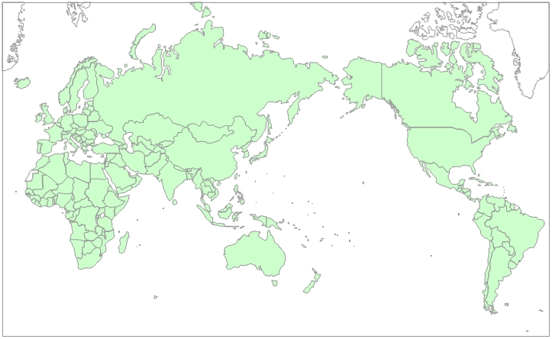




Security issues, depletion and domestic demand growth lead to tight LNG supply
  surging domestic demand
  LNG liquefaction plants
  declining gas output
  security issues
Supply shortfalls double the market impact of Japanese demand increase

Slide 7
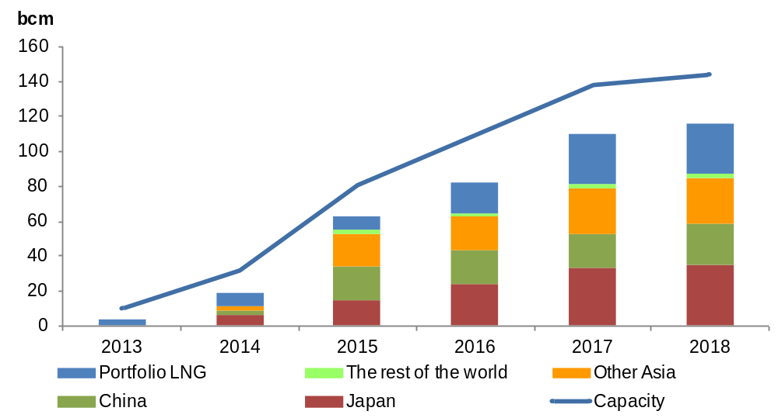
New LNG supply is predominantly backed by long-term contracts
Portfolio LNG and secondary re-exports both play an increasing role

Slide 8
Are oil and gas still substitute products?
Oil and gas fired power generation in the Asia Pacific
Twh
WEO 2012
Notes:
.

Slide 9
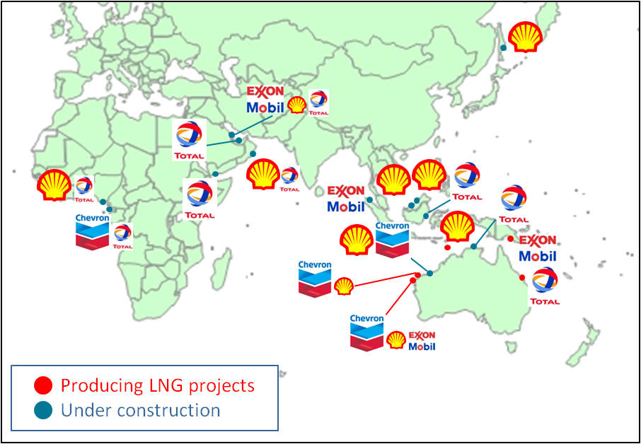
Is a destination clause still essential for project financing?

Slide 10
With non-conventional technology and new discoveries, resources will compete for markets
The proportion of proven reserves projected to be consumed till 2030
In 5 years discoveries and reserve additions exceeded production by 175 years worth of Japanese demand
Notes:
.

Slide 11
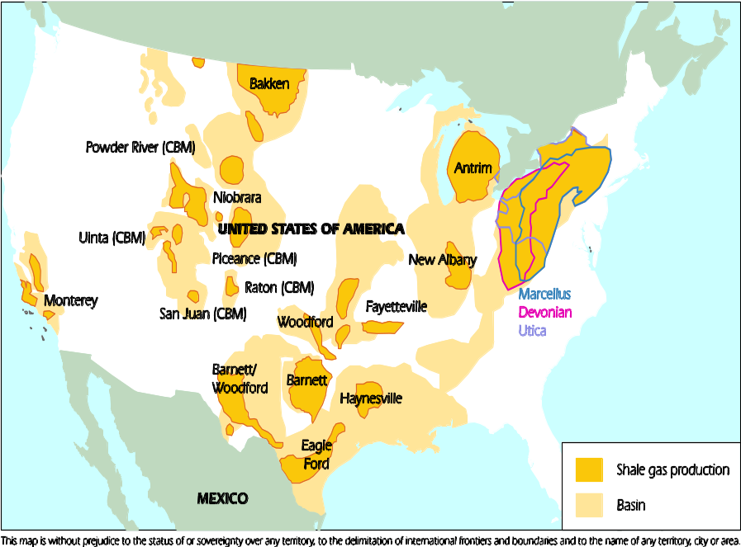
The United States continues to lead non-conventional development
Technological improvements in seismic, drilling and fracking
“Mass manufacturing” methods in oil field services
Strong financial boost from liquids
With US markets saturated, Canadian production growth depends on LNG exports

Slide 12
North America is emerging as a major exporter
BCM
Contract signed
Algeria
Can Henry Hub+ emerge as a price signal for Asia?

Slide 13
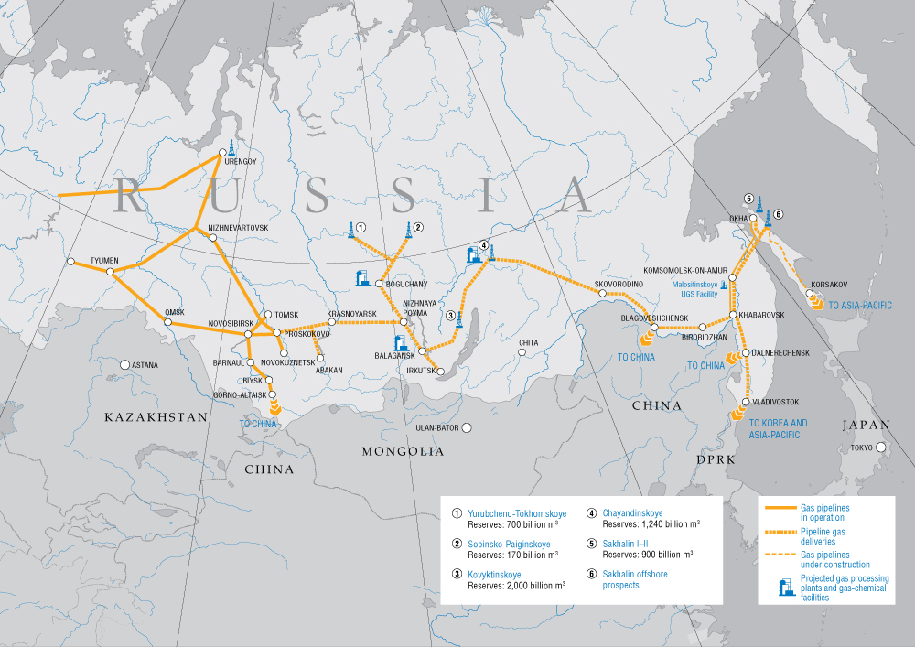
Russian gas: the East is the manifest destiny?
Source: Gazprom. Note that political boundaries are not endorsed by the IEA
Production constrained by EU and domestic demand
Surging independent production backed by NGLs
Asian exports depend on capital-intensive infrastructure

Slide 14
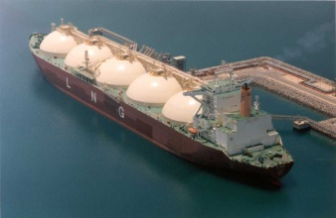
Facilitating market development
3rd party access and unbundling in gas AND electricity
Wholesale price liberalization
Flexible infrastructure
Encouraging entry of new supply
Diversifying the primary energy mix (nuclear, renewables)
Investment security and producer confidence needs to be maintained

Slide 15
Towards an efficient LNG market in the Asia - Pacific
Maria van der Hoeven
Executive Director
10 September, 2013

