Slide 1
European natural gas market and
GDF SUEZ LNG activities
Session 4 “New procurement behaviors by consumers”
Philip Olivier
President of GDF SUEZ LNG
2nd LNG Producer -Consumer Conference
Tokyo, JAPAN
10 September 2013

Slide 2
European Natural Gas Supply and Demand Balance Outlook

Slide 3
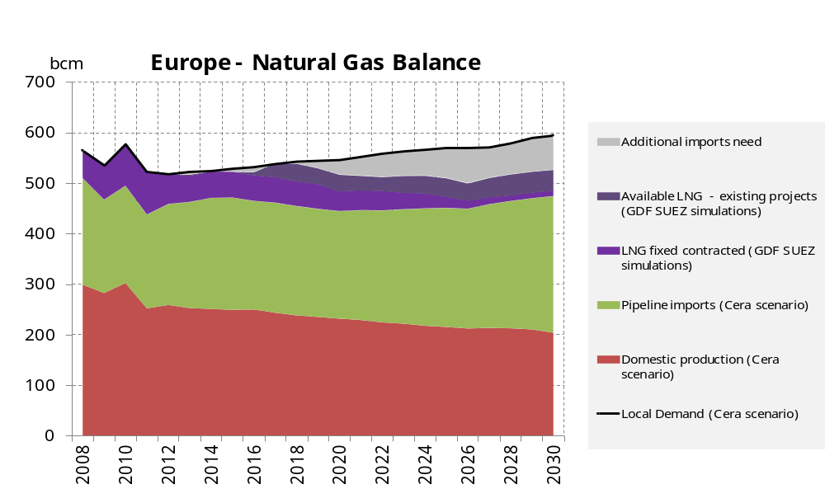
Europe Long Term Natural Gas Supply
Gas demand: Slow European gas demand growth
Gas supply: Continuous domestic production decline, increasing pipeline imports…
LNG imports: the return of flexible LNG?
CERA, Global Redesign, 2012, GDF SUEZ simulations *Historical data include spot LNG

Slide 4
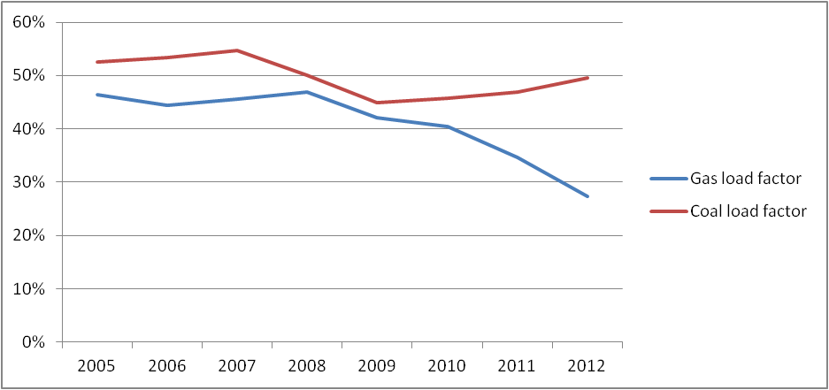
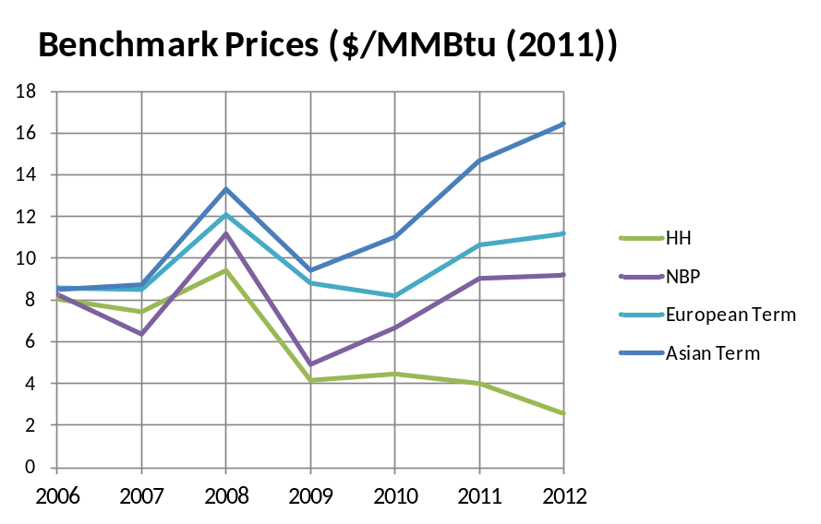
Lessons Learnt from European Gas Markets
NG price competitiveness: Numerous LT contracts prices reviews
Failed carbon market, Increasing coal and renewables in power production
Visibility on long term investment: European regulatory environment.
Load factor of natural gas and coal plants for power production in Europe
Benchmark prices
$/MMBtu
Source: CERA August 2013
Source: CERA and DOE EIA, 2013

Slide 5
Strategy of GDF SUEZ in LNG

Slide 6


GDF SUEZ’s response to challenging gas markets
A diversified supply and sales portfolio
Diversified Gas Supply Portfolio
Diversified LNG sales portfolio
Breakdownn of gas supply by source countries (including natural gas and LNG)
Breakdown of LNG sales by type
of contracts
Other * 9%
14%
17%
24%
24%
26% Norway
17%
Russia
686 TWh
10%
Unspecified
origin
11% Algeria
5% Trinidad and Tobago
Netherlands 10%
Yemen 4%
4% Egypt
LNG supply
A large and diversified 16 mmtpa LNG supply portfolio: 3rd largest in the world
  In 2012, LNG supply accounted for 30% GDF SUEZ long-term gas supply portfolio
Large and diversified sales portfolio
  Internal and external sales to optimize portfolio management
  Medium term and short term sales to third parties

Slide 7
GDF SUEZ Ambitions in LNG
  Develop our own liquefaction / production projects to increase our presence
  along the LNG value chain
  Increase portfolio to 20 mtpa by 2020 with new supply sources and equity LNG
  x2 external LNG sales (from 2 to 4 mtpa) mainly in emerging markets by 2020
  Develop / manage regas. assets in new markets (Asia, Latin America)
  Develop the retail LNG market
Ambitious portfolio development
20 mtpa
mtpa
External markets
16
x2
4
20-30%
2
10
0.5
14
Up to 16
Internal markets
9.5
70-80%
2000
2010
2020

Slide 8
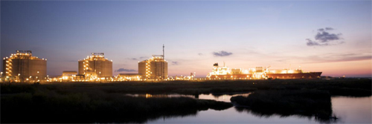

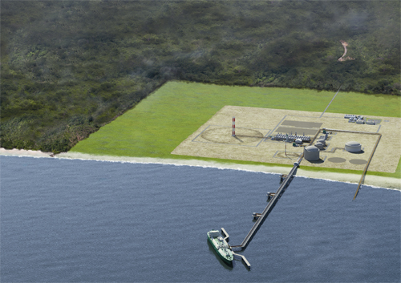

Diversification of GDF SUEZ LNG supply portfolio
GDF SUEZ liquefaction projects
LNG Liquefier/Tolling
Integrated Projects
Aggregator
US EXPORTS - Cameron LNG
BONAPARTE LNG
CAMEROON LNG
Access to liquefaction capacity
Access to flexible LNG
Opportunity to sell to Asia Pacific with a variety of indexation exposure (HH, Brent)
FID in 2014, early start up of supply 2017
Upstream and floating liquefaction offshore Australia
Commercialization of the LNG
in Asia Pacific markets
FID in 2015, first gas in 2019
Aggregation of the feedgas
Onshore liquefaction plant development
Commercialization of the LNG and offtake LNG volumes
Opportunity for geographical optimization
FID in 2016, first gas in 2020
  GDF SUEZ aims to collaborate with Asian counterparts to develop its projects
  Opportunities for Japanese buyers to access oil / hub indexed volumes

Slide 9

THANK YOU !
  THANK YOU!
Notes:
THANK YOU!
ありがとう ! ➔ A Li Ga do

