Slide 1
LNG in BC
Steve Carr – Deputy Minister
Ministry of Natural Gas Development – British Columbia
September 10, 2013
2nd LNG Producer-Consumer Conference
Tokyo, Japan

Slide 2
B.C.’s Competitive Advantages
Transportation Advantage
Ambient Temperature
Vast Resources
Stable Jurisdiction
Workforce Strategy – Industry collaboration
Strong Regulatory Regime
First Nations engagement
Competitive Fiscal Regime

Slide 3
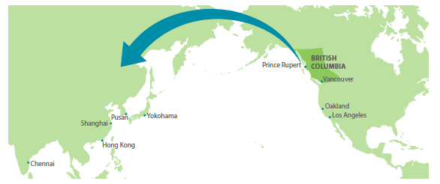
Transportation Advantage
Closest Gateway to Asia
Vessel Transit Times, in Days, from Major North American Ports to Major Asian Cities
 | Hong Kong | Shanghai | Yokohama | Pusan | Chennai
Prince Rupert | 11.1 | 9.9 | 7.92 | 9.5 | 17.1
Vancouver | 12 | 10.6 | 8.92 | 9.7 | 18
Los Angeles | 13.2 | 11.9 | 10.08 | 11 | 19.3
Louisiana | 22.1 | 20.8 | 19.1 | 19.9 | 24.0
*Estimated based on vessel speed of 20 knots
Source: B.C., Canada Prospects in Mining and Natural Gas
3

Slide 4
“
Operating Cost Advantage
B.C. Gas has a cooler ambient temperature than most competitors.
As ambient temperature decreases by 1 degree centigrade; energy efficiency for power consumption increases by 1.7%
Located in northern B.C., Prince Rupert and Kitimat average temperature is 7 degrees Celsius which provides a competitive advantage over other jurisdictions:
  Australia: 27c = approx 34% BC energy efficiency advantage
  Qatar: 26c* = approx 32.3% BC advantage
  Mozambique: 23c* = approx 27.2% BC advantage
  Louisiana: 22c* = approx 25.5% BC advantage
  *degrees from National Oceanic and Atmospheric Administration (NOAA)
All data is subject to engineering design, calculations may vary

Slide 5
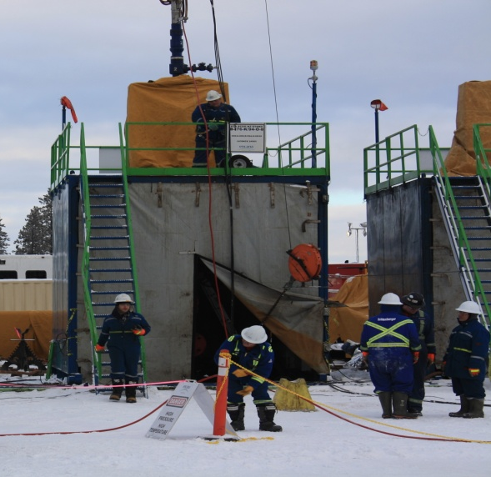
Vast Resources
  Currently1,400 Tcf of shale gas resource in place
  1/3 of B.C.’s shale gas or 400 Tcf could support LNG exports for 84 years
  Infrastructure in place to extract and process gas (roads, pipe and plants)
  Proven ability to get gas out of the ground without environmental impacts
5

Slide 6

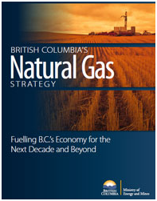
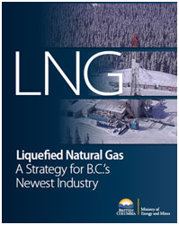
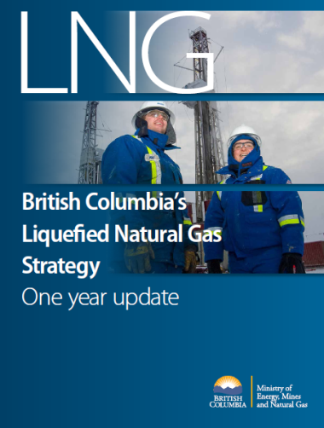
Stable Jurisdication
  Direct line of sight from senior elected officials to all regulatory agencies.
    Strategies and plans in place to ensure B.C. is a competitive and reliable exporter of LNG.
        B.C. has clear government commitments to maximize the LNG development opportunity.
            B.C. is open for business, establishing a one stop Task Force focusing on the LNG sector.

Slide 7
B.C. Natural Gas Workforce Strategy
B.C. embraces the employment opportunities that the LNG industry will bring to communities
We are ready to deliver a skilled workforce to respond to industry needs through the Natural Gas Workforce Strategy
B.C. has an advantage over other jurisdictions with access to a large labour pool across Canada and the United States.
We have a plan in place for specific trades training and will work with employers to sequence workforce requirement and actively recruit workers
B.C. will be taking early and decisive action to address workforce needs

Slide 8


Strong Regulatory Regime
  Modernized Oil and Gas Activities Act
  Effective single window regulator: B.C. Oil and Gas Commission
  Canada and B.C. regulatory alignment and common priority in the development of the LNG sector
  Alignment across government on environmental assessment process
  Commitment to streamlined and efficient processes with defined timelines.

Slide 9
First Nations
  Strong support for LNG development from First Nations
  Many partnerships already in place
    First Nations Limited Partnership – 15 First Nations on pipeline route supporting Chevron/Apache project
    Haisla First Nation in Kitimat are partnering on several LNG projects including the LNG Canada project
    Economic benefit agreements signed and others advancing
    Industrial Benefits Agreements are being negotiated by industry with First Nations
  B.C. is committed to working with First Nations on training opportunities, jobs and economic benefits

Slide 10
Competitive Fiscal Regime
B.C. Is committed to providing certainty on tax
  We have conducted research across jurisdictions
  We will be the most competitive jurisdiction on tax
Competitive Upstream Royalty Regime
Support for Upstream Infrastructure development:
    $120 M in provincial royalty credits for 2013
    Facilitates new road and pipeline projects and increases natural gas production.

Slide 11
BC’s Competitive Advantage Summary
LNG is the highest priority of B.C. government
B.C. has a competitive and secure fiscal regime
We have a vast energy resource which will bring great benefits to global markets
B.C. can offer lower operating costs for transportation and liquefaction
B.C. has access to a large, skilled labour force

