Slide 1

U.S. Gulf Coast LNG to Asia:
Low-Cost Diversification of Supply
Michael Smith
Chairman, CEO and Founder
Freeport LNG Development, L.P.

Slide 2
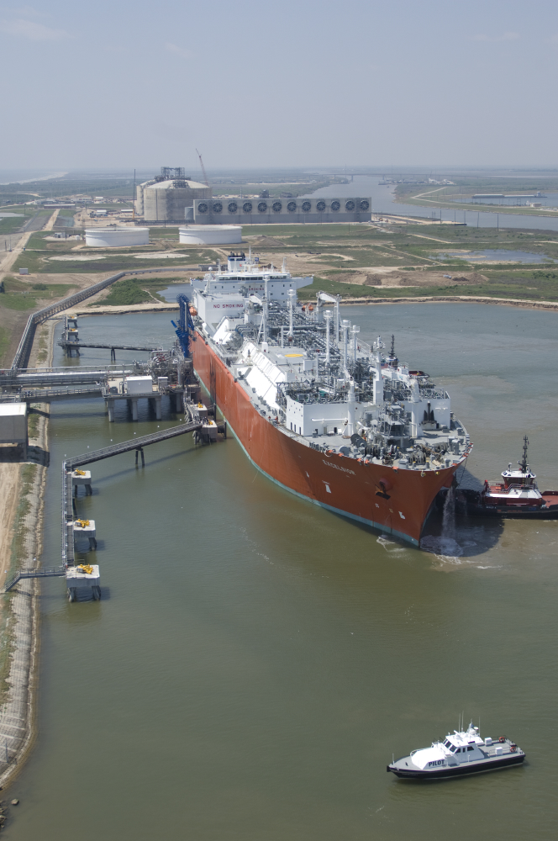
The Freeport LNG Perspective
Founded in 2002
2 Bcf/d LNG regasification facility located on Quintana Island near Freeport, Texas
Three long-term, take-or-pay tolling TUAs with COP, Dow and Mitsubishi
Over $1.6 billion of existing assets
Very strong financially, with investment-grade debt rating of BBB-
125+ employees

Slide 3
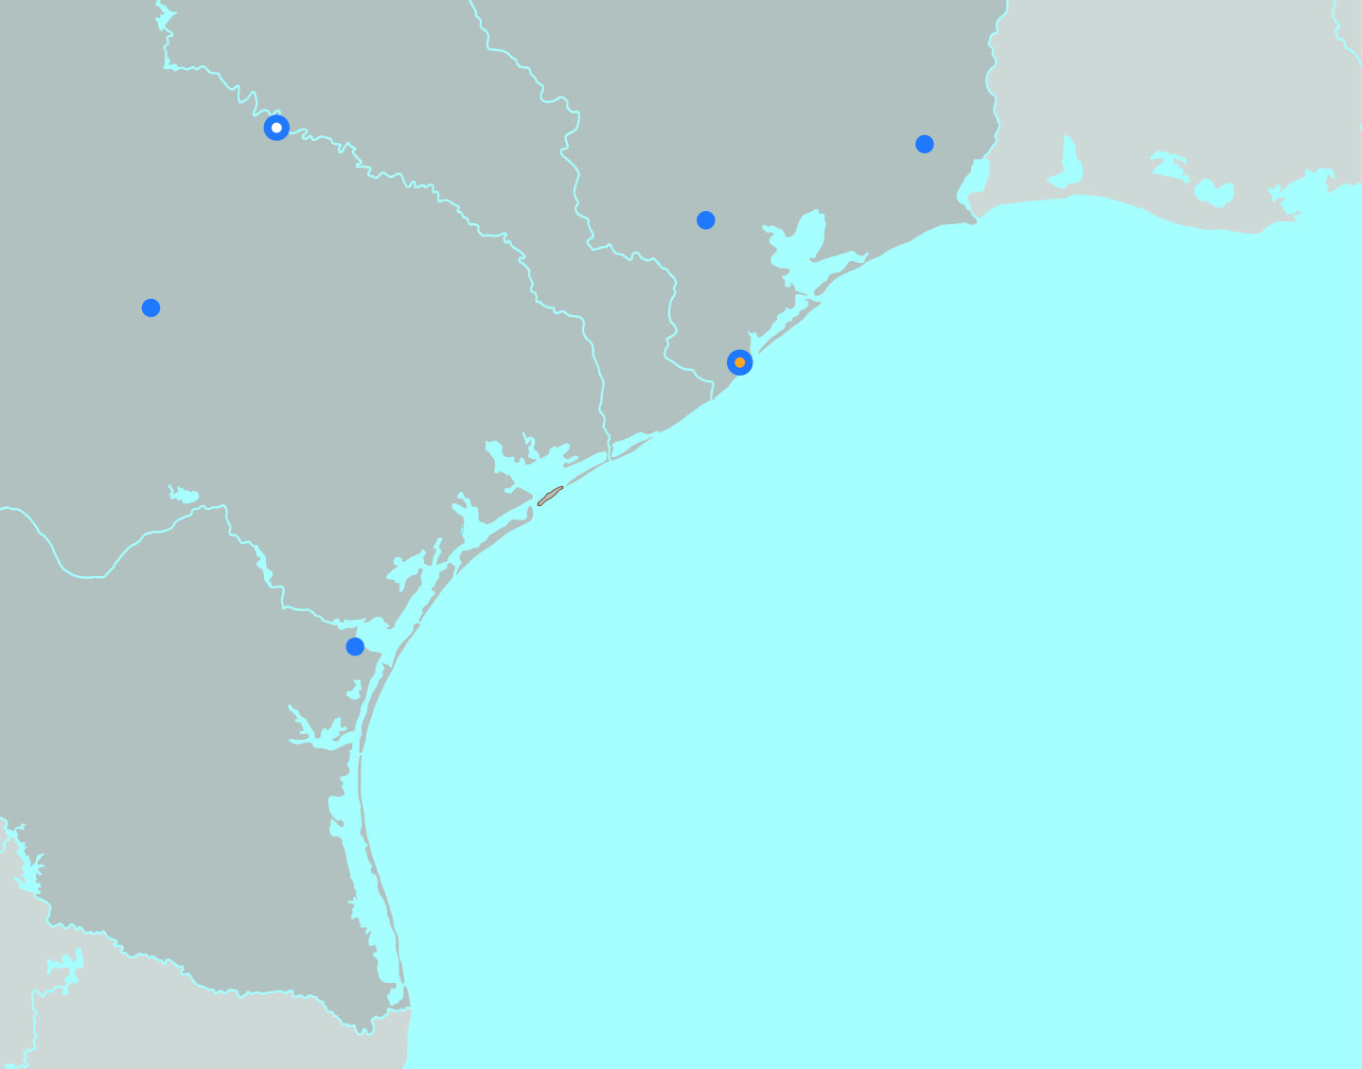

Freeport LNG’s Liquefaction Project
Freeport LNG is converting its existing import terminal into a bidirectional liquefaction and export facility.
Three liquefaction trains (APCI) and associated natural gas pretreatment of up to 5 million tons per annum each.
TEXAS
Austin
LOUISIANA
Beaumont
Houston
San Antonio
Corpus Christi
GULF OF
MEXICO
MEXICO
The capacity of three trains have been sold under long-term liquefaction tolling agreements.
    Train 1: Osaka Gas, Japan’s second largest gas utility, and Chubu Electric, Japan’s third largest electric utility
    Train 2: BP, fourth largest oil company in the world with over 30 years of LNG experience
    Train 3: Toshiba Corporation and SK E&S LNG.
EPC costs expected to exceed $2.5 billion per train.
Production start-up (commissioning): 2017
3

Slide 4
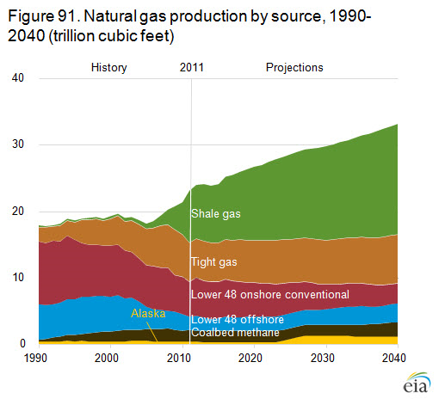
U.S. Natural Gas Production 2007-2040
Tcf
Source:
EIA and Bureau of Labor Statistics
Between 2007 and 2011, shale gas production more than quadrupled.
Shale gas share of total gas production jumped from 8.1 % in 2007 to 29.9 % in 2011.
Gas production had been increasing even without drilling in prolific dry gas areas.
When gas prices rise to around $5.00/MMBtu, unlimited amount of dry gas will be produced in the U.S.
This will cap gas prices between $5.00 an $6.00 in the foreseeable future.

Slide 5
U.S. Gulf Coast LNG to Asia
Lower Cost Supply
  At current U.S. gas prices around $3.50, LNG delivered into Asia from the U.S. Gulf Coast would be very competitive with current oil-linked LNG prices.
  Even if current gas prices were to increase significantly, the landed cost would still compare very favorably to DES prices in Japan.
  Increases in oil prices would make U.S. Gulf Coast prices even more competitive.
Supply Diversification
  Development of a new supply source—the mainland U.S.
  Introduction of a new price index into Asia (linked to U.S. gas prices indices)
Innovative Project Structures
  Projects allow LNG customers direct access to natural gas reserves.
  No dependence on upstream development, reducing project risks and potential cost overruns.
  Flexible feed gas pricing mechanisms and destination provisions.

Slide 6
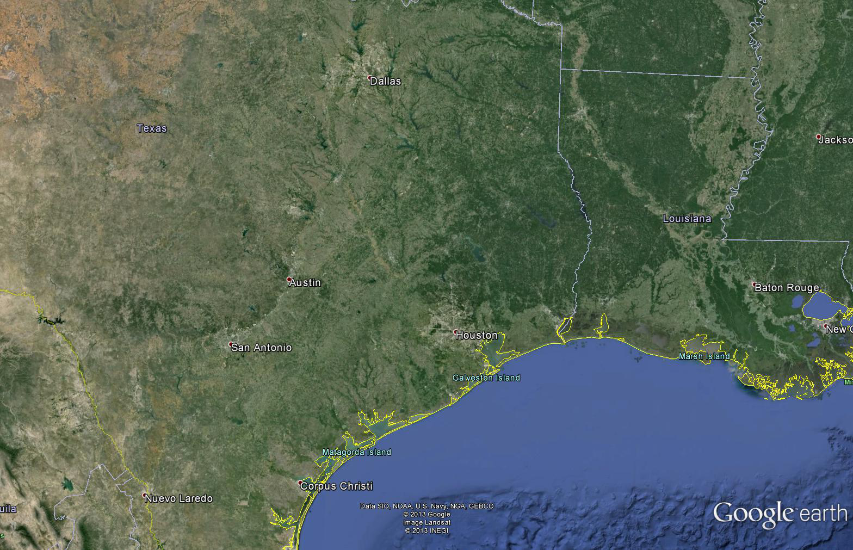

The Freeport Advantage
Barnett
Haynesville
Eagle Ford
Sabine Pass
Lake Charles
Golden Pass
Cameron
~9 Bcf/d
2 Bcf/d
The existing regas assets reduce cost and risk.
Shortest marine approach of any U.S. LNG facility.
Access to cheap Eagle Ford gas.
Located in Texas, the largest natural gas-producing state in the U.S.

Slide 7
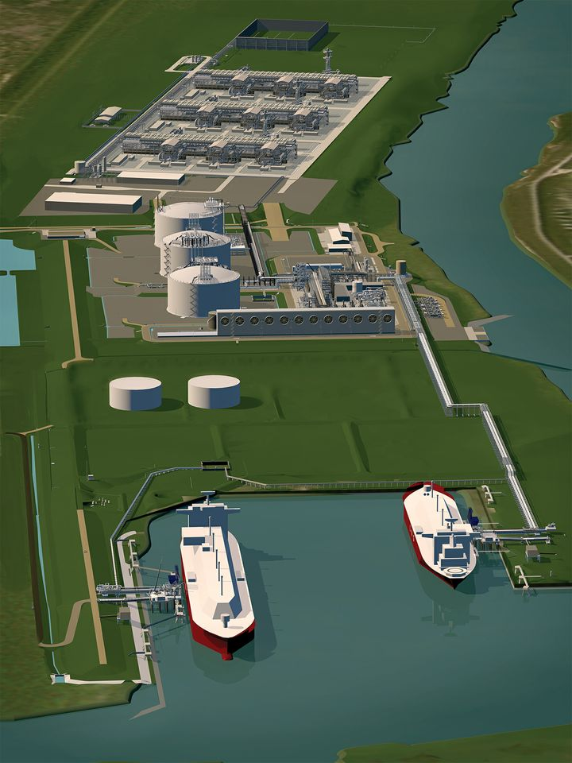
Thank You

