Slide 1
Indonesia Upstream Natural Gas Policy & LNG Outlook
Widhyawan Prawiraatmadja
Deputy Chairman for Commercial Management
2nd LNG Producer – Consumer Conference
Tokyo, 9 September 2013

Slide 2
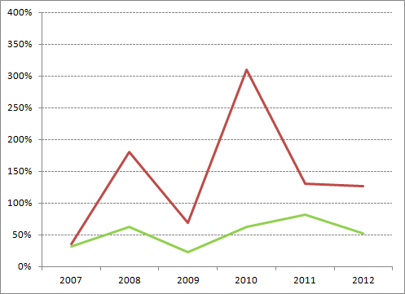
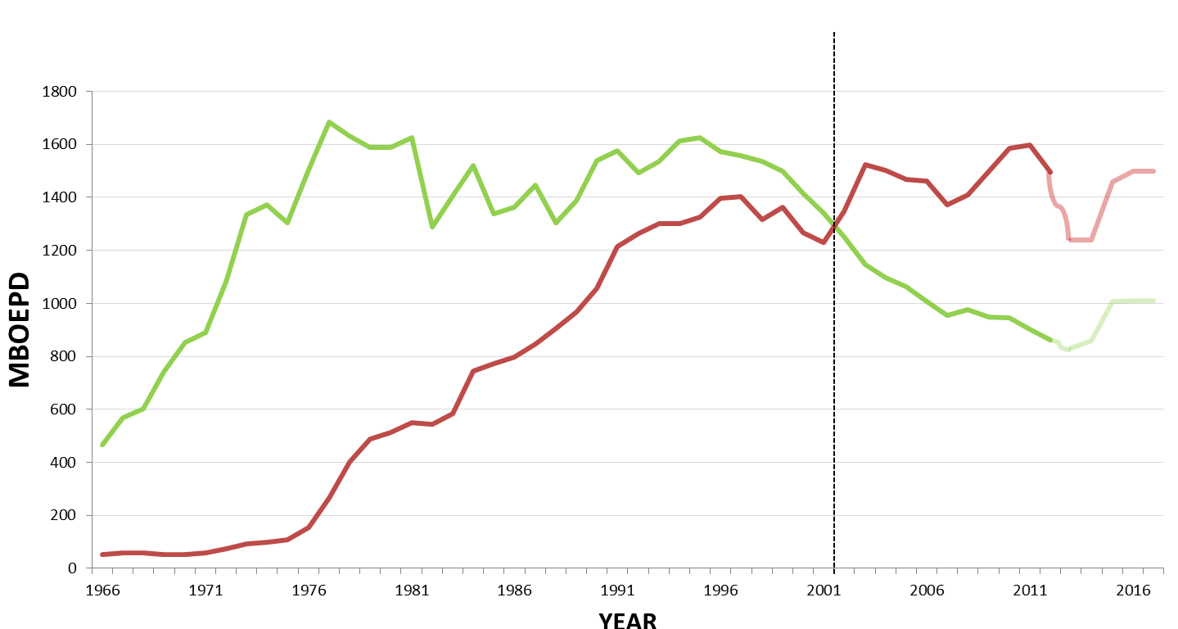
Future upstream oil and gas in Indonesia will be dominated with natural gas production, as exploration results tend to be more of “gas prone”
Starting 2002, Upstream energy in Indonesia is dominated by gas and this trend will continue in the future
The major reason of gas dominance is due to the Oil Reserve Replacement Ratio (RRR) is lower than 100%
Dominated
By OIL
Dominated
By GAS
Peak 1977
Peak 1995
GAS
OIL
Notes:
The History :
Indonesia mengalami kejayaan produksi minyak dimana mencapai 1.6 juta bopd pada tahun 1977 dengan berproduksinya lapangan-lapangan Giant seperti Minas, Duri dll.
Pada tahun 1995 dicapai juga puncak produksi ke dua melalui keberhasilan kegiatan EOR dari lapangan Duri.
Sejak tahun 2002 peningkatan produksi gas terus meningkat sehingga saat ini puncak produksi gas sebesar 1.6 juta boepd tercapai.
Dalam 6 tahun terakhir Reserves Replacement Ration (RRR) Laju penemuan minyak dengan laju pengurasan minyak menunjukkan bahwa RRR untuk gas menunjukkan di atas 100% menenunjukkan bahwa terdapat cadangan yang lebih banyak untuk diproduksikan daripada pengurasan gas per tahunnya.
Sementara untuk minyak angka RRR menunjukkan dibawah 100%

Slide 3

While exports are being maintained, most of additional gas supply now goes the domestic market; as this trends continue, new gas projects will also need to cater domestic consumers as well as exports
Notes:
*) Outlook based on realization per April 2013
*

Slide 4
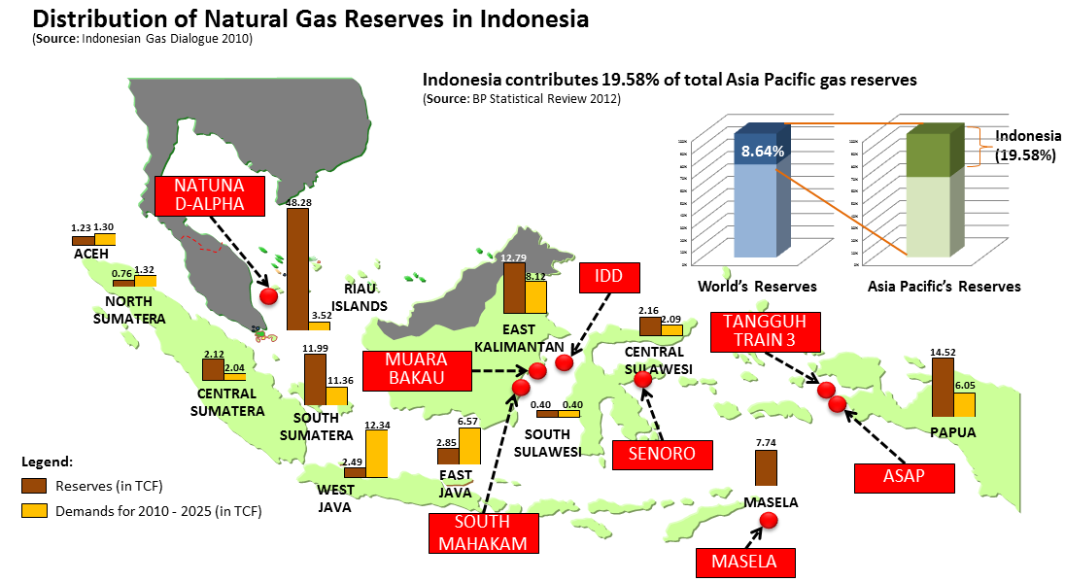
The gap between gas supply in the Eastern part of Indonesia and gas demand in the Western part of Indonesia drives the need of gas infrastructure development – hence domestic use of LNG
2.30
0.59
Central Java
Current Projects,
2013
TIUNG BIRU JAMBARAN CENDANA

Slide 5
In the near future, upstream oil and gas new projects will be dominated by gas – the large ones are in the form of LNG
Major ongoing upstream project
Banyu Urip | Blok A | IDD-Bangka | IDD-Gendalo | IDD Gehem | Tangguh Train 3
Handil Ph 4 | YY | MDA-MBH | Jam-TBR | Abadi
Peciko-7C | South MHK | Jangkrik
UL | Bukit Tua | Jangkrik NE
Kepodang | Ande-Ande Lumut
Area MTD
Senoro
Musi Timur
GG
Legend:
Gas
Oil

Slide 6
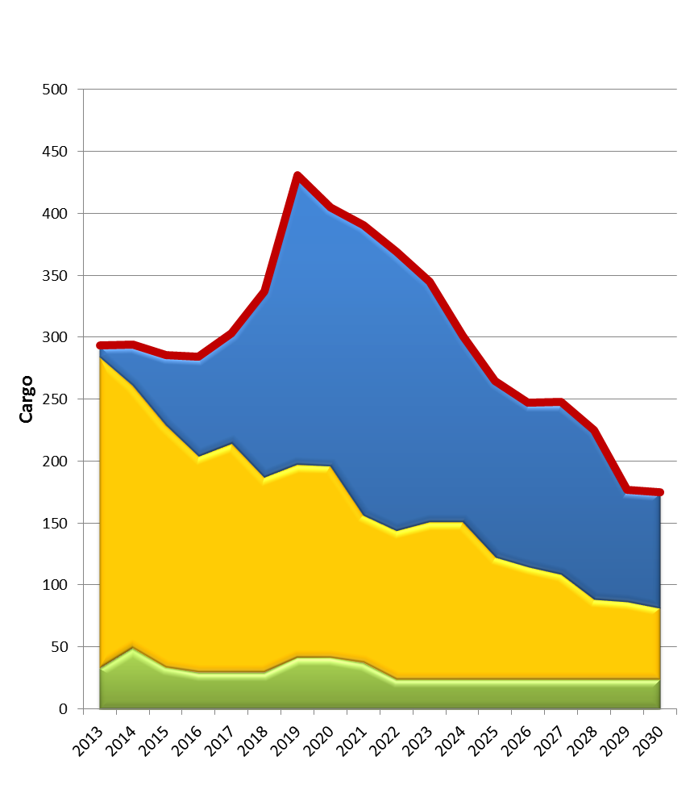
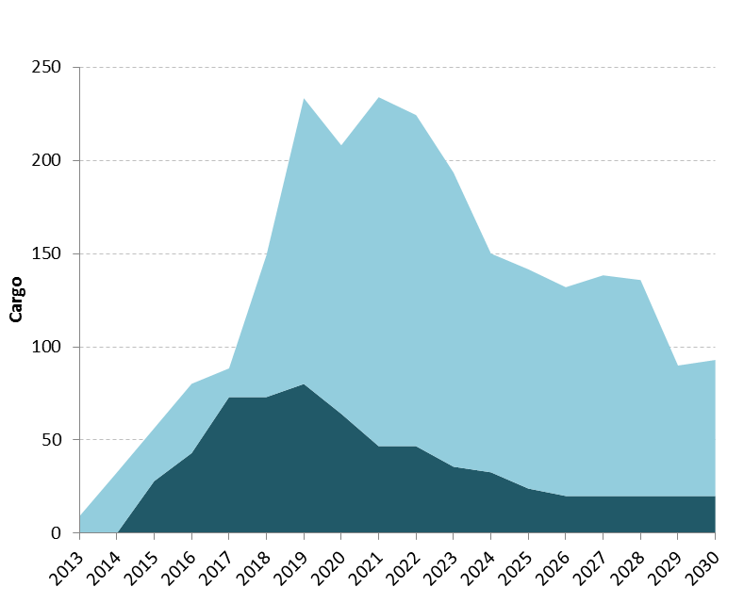
Indonesia LNG Outlook
Allocation of Indonesia LNG
Uncommitted LNG Supply is prioritized to fulfill the unallocated demand for domestic purposes as some domestic FSU/FSRUs has not had allocated LNG yet
Indonesia LNG Supply
Estimate allocation for uncommitted LNG supply
Uncommitted Supply
Existing Commitment
Free uncommitted supply
Domestic Commitment
Prioritized for domestic

Slide 7
End Remarks (1)
Indonesia’s economic growth is expected to continue albeit at lower rates than projected – amidst the concern of the widening current account deficit that the country is now facing. Even at the slower rates, the growth will have to be fueled by energy resources, including natural gas.
Even though there will be more natural gas projects, it is apparent that domestic consumption has to be prioritized at the expense of less exports. For this, the country will have to develop more natural gas infrastructure, including LNG receiving facilities. Nonetheless, Indonesia will continue its commitments to its traditional LNG buyers, and new projects economics are still supported by some export volumes
SKK Migas will have to make sure that the oil and gas activities – from exploration to oil and gas monetization – are giving the utmost benefit to the country while giving fair returns to the investors

Slide 8
End Remarks (2)
In doing its job, SKK Migas will continuously improve its governance and treats integrity as the values that we have to seriously uphold. We treat the oil and gas business activities not as an extractive industry per se but to generate multiplier effect to the national economy: i.e., intended for “Pro Growth,” “Pro Job,” and “Pro Environment” while enhancing the local content in all project development, as well as in empowering PERTAMINA as the national oil company
Last but not least, as strategic commodities, oil and gas continue to be intertwined with socio-political issues; the upcoming general and presidential election in 2014 is no exception. It is important that the government addresses the challenges in maintaining the investment climate.

