Slide 1


The New Role of JOGMEC
in the LNG Business
10th September, 2013
Hirobumi Kawano
JOGMEC

Slide 2
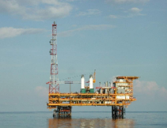
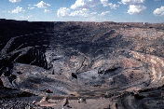
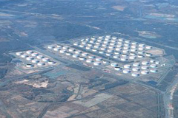
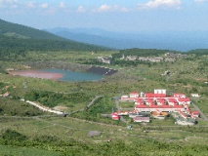
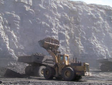
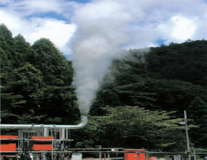
JOGMEC’s Activities
Japan Oil, Gas and Metals National Corporation (JOGMEC)
Established: February 29, 2004 [succeeded the functions of Japan National Oil Corporation(JNOC)]
President: Hirobumi Kawano
Capital: 502 Billion Yen (As of March, 2013) = around 5.02Billion US$ (100US$/Yen)
Mission
Securing Stable Supply of Oil, Natural Gas and Mineral Resources for Japanese Industries and Citizens
Activities
Oil & Gas Upstream
Investment and
Research & Development
Metals Strategy &
Exploration, and
Technology
Development
Stockpiling
Mine Pollution
Control
Coal Strategy &
Exploration,
and
Technology
Development
Geothermal
Resources
Development
(limited in Japan)

Slide 3
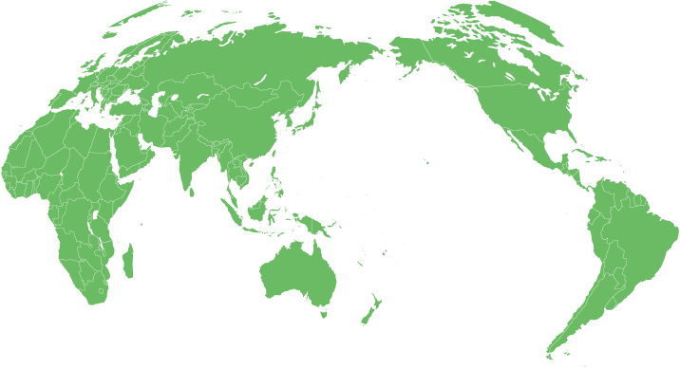
JOGMEC’s E&P Projects
Horn River, Cordova, Liard Shale Gas Project
North Montney Shale Gas Project
Cordova Shale Gas Project
Cutbank Dawson Shale Gas Project
Tangguh LNG Project
Rovuma Offshore Area 1 Project
PNG LNG Project
Abadi LNG Project
Ichthys LNG Project
Equity Capital (41)
Wheatstone LNG Project
Liability Guarantee (13)
Gas Projects
(As of August 31, 2013)
Notes:
2
2

Slide 4
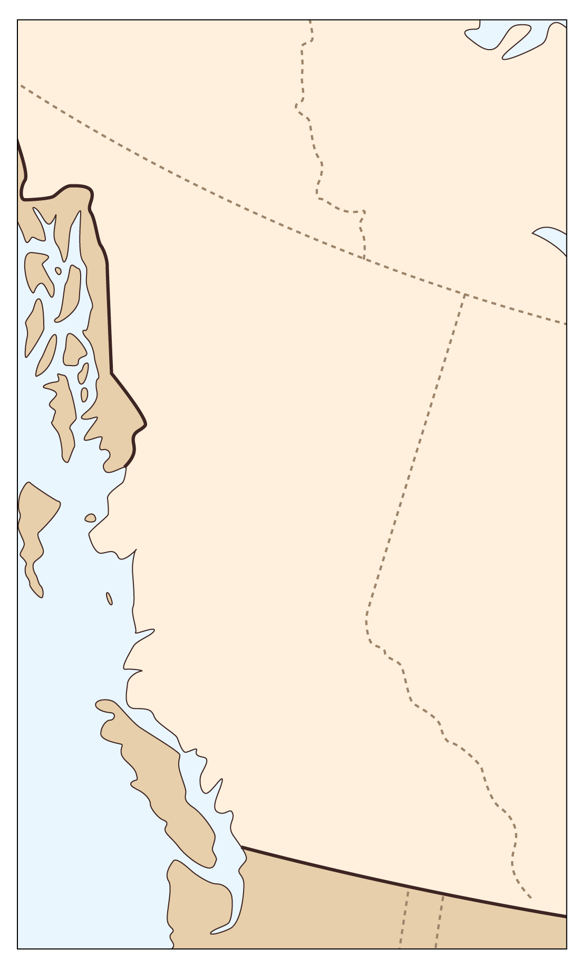
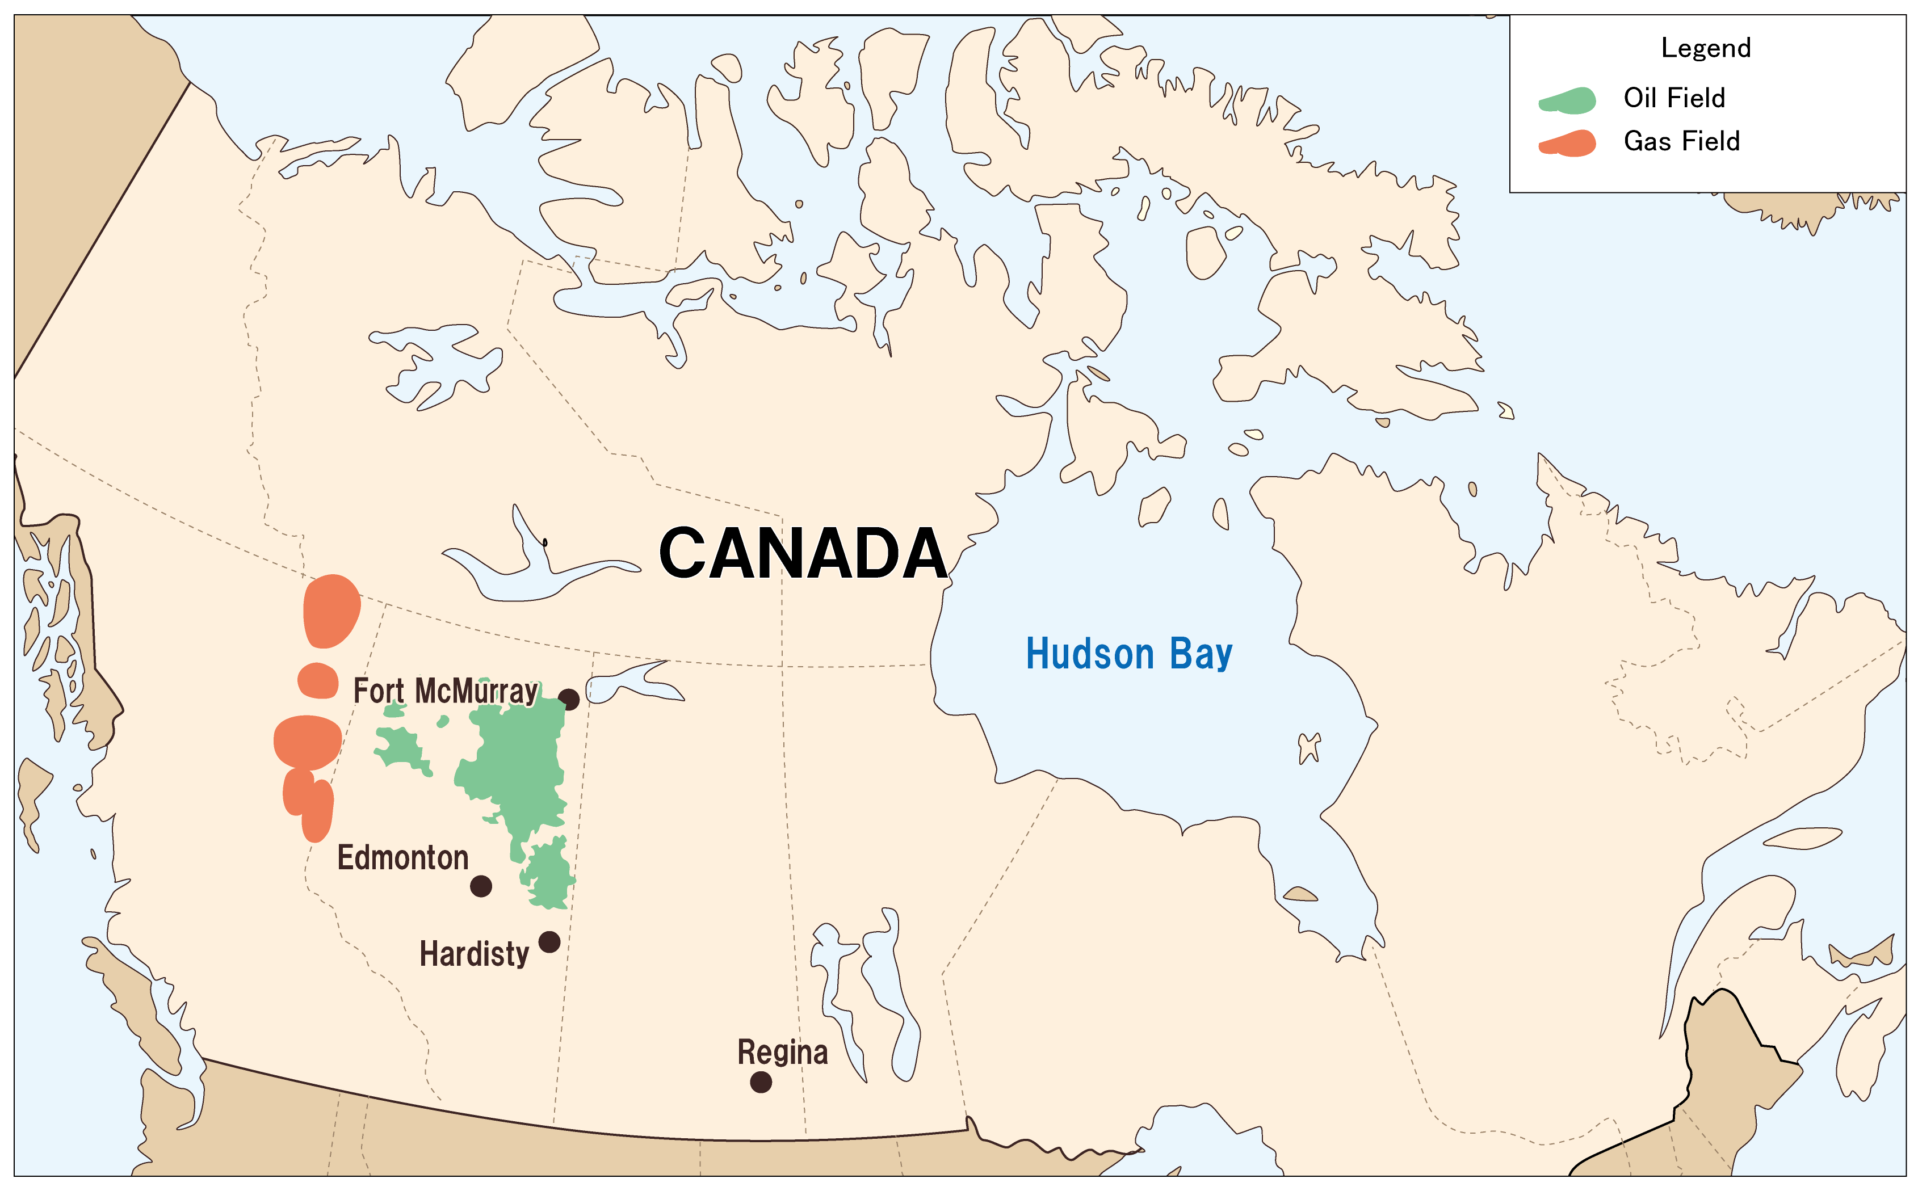
JOGMEC’s Activities in Canada
Financial Support
Technological Support
4 projects in the west of Canada
Joint study with Mitsubishi and Encana
Core Analysis
Geomechanics
Seismic
INPEX
Horn River, Cordova, Liard
JAPEX
North Montney
Land
Mitsubishi Corp.
Cordova Basin
Increase of the asset value of the project
Cost reduction
Production increase
Mitsubishi Corp.
Cutbank Dawson Land

Slide 5
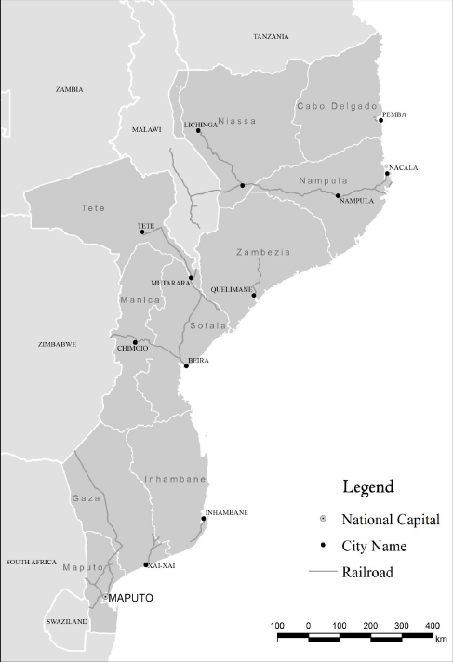
JOGMEC’s Activities in Mozambique
Financial Support
Technological Support
2 projects offshore Mozambique
Human resources development
(38 Mozambican people
as of August 31, 2013)
P50:35-65Tcf
Rovuma Offshore Area1
Workshops for the Steering Committee (Mozambican Gov’t)
  Lectures on LNG business
Training courses in Japan
  Drilling management
  Reservoir engineering
  LNG engineering
Rovuma Offshore Area2 & 5

Slide 6
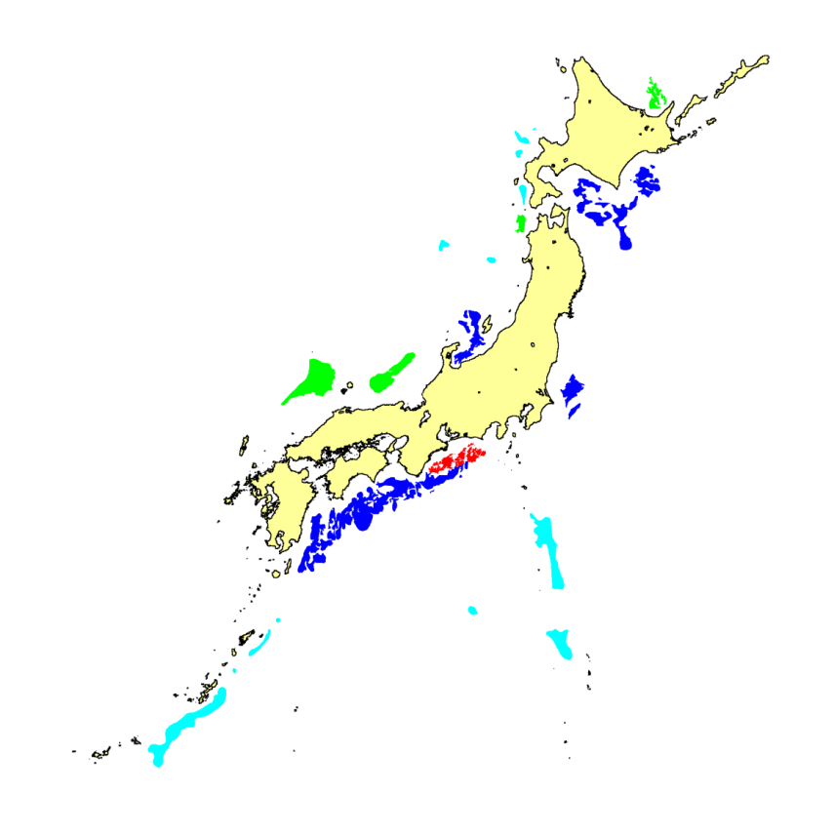
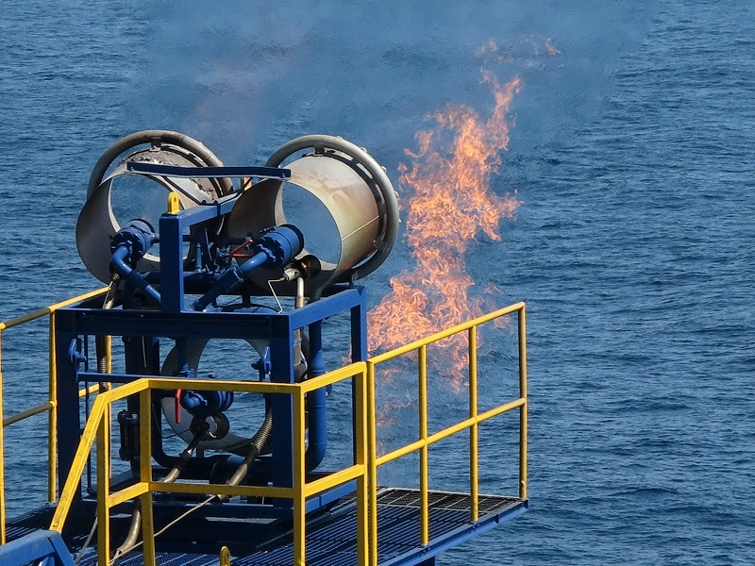
Methane Hydrate Offshore Production Test
The first methane hydrate offshore production test in March, 2013
Test site
BSR (MH concentrated zones are confirmed partially by detailed surveys)
BSR (Characteristics of MH concentration are suggested in some areas)
BSR (Characteristics of MH concentration are not recognized)
BSR (Surveys are insufficient for the evaluation of MH)

Slide 7
Thank you for your attention.

